Slide 1
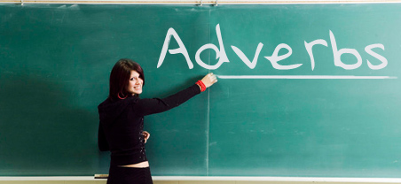
Friday 5th February
L.O. To use adverbs to describe how something is happening.

Slide 2
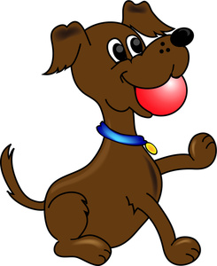
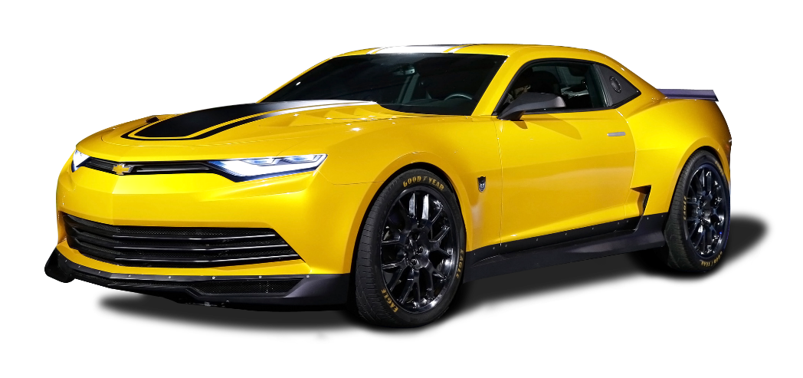
Can we remember:
Which word is the verb in these sentences?
The dog ran after the ball.
I drove to the shop.

Slide 3
The dog ran after the ball.
I drove to the shop.
The verb is the doing or action word in a sentence.

Slide 4
Adverbs
These are words that tell us how something is happening.
They describe the verb in a sentence.
Let’s put adverbs into our sentences.

Slide 5
The dog ran after the ball.
The dog ran quickly after the ball.
I drove to the shop.
I drove carefully to the shop.
Using adverbs makes our sentences more interesting and adds more information.

Slide 6
Many adverbs have the ending (or suffix) ly.
Here are some examples.
slowly | quickly | softly
loudly | quietly | silently
happily | angrily | suddenly
gently | helpfully | brilliantly
Many adverbs do not end in –ly e.g. He tried hard.
‘hard’ is an adverb.

Slide 7
We can turn a word (an adjective) into an adverb by adding ly.
Look at the spelling pattern
adjective | adverb | Spelling pattern
quick | quickly | add ly to the word
happy | happily | Change y to i and add ly

Slide 8
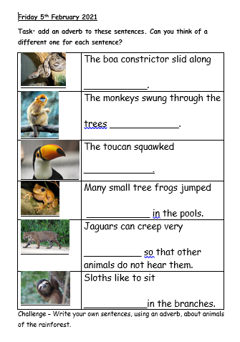
Your task
To choose an adverb to add to the sentences about the animals.
Options on completing the task
Print off the sheet and write in the adverb.
Type the adverb into the word doc.
Record on your own sheet.
Word bank for support
The –ly words on the next slide (‘How?’ adverbs) gives some adverbs you could use.

Slide 9


