Slide 1
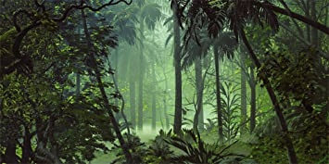
Thursday 4th February 2021
Geography:
Layers of the Rainforest

Slide 2
Watch this YouTube video which explores
the layers of the rainforest.
https://www.youtube.com/watch?v=blh3Kq9xf_o

Slide 3
The rainforest is made up of 4 different layers:
The emergent layer- this is the top layer, where macaws and bird eating tarantulas live.
The canopy layer-this is under the emergent layer and is where sloths, toucans and Red-eyed tree frogs live.
The understory layer- is beneath the canopy layer. This is where Boa Constrictors, bats and geckos live.
The forest floor layer- this is the bottom layer and is home to jaguars, anteaters and scorpions.

Slide 4

The animals of the rainforest do not usually stay in only one layer. Some animals can be found in several different rainforest layers.
Some animals may live in one layer and hunt in another layer of the rainforest e.g. snakes

Slide 5
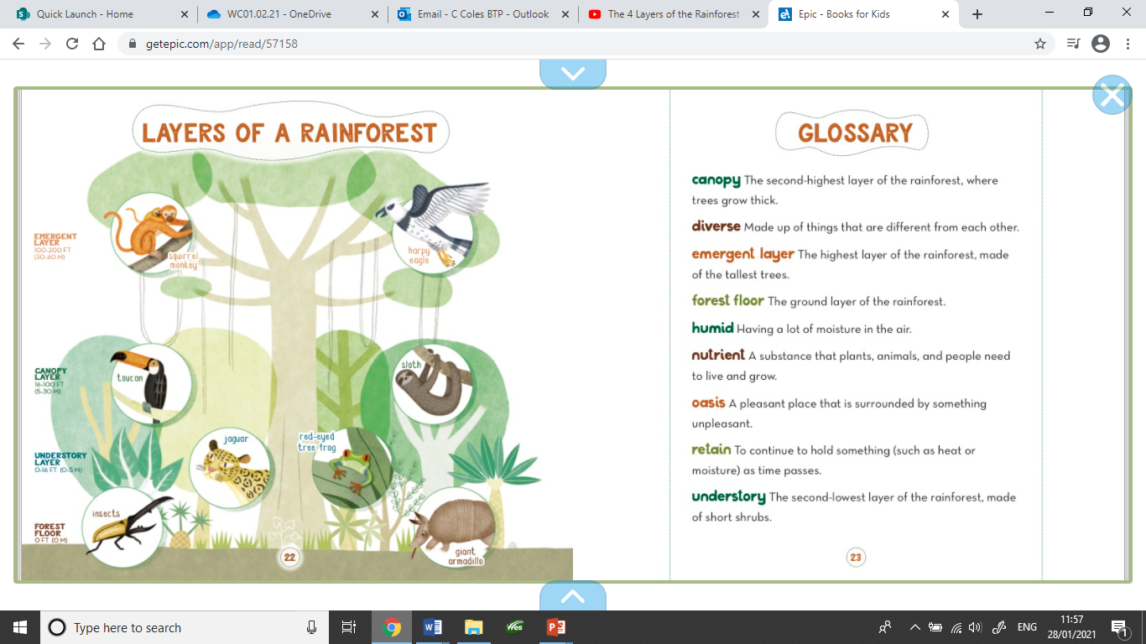
Your task:
Create a poster/display to show the
different layers of the rainforest
and the animals who live there.
You may need to research some
animals that may not have been mentioned
to find out what layer they live in.
Some examples are on the following slide
to give you some ideas.

Slide 6


