Slide 1

Reading Comprehension
Thursday 4th February 2021
LO: To show an understanding of the rainforest text by responding to comprehension questions.

Slide 2
Inferences
This means that you need to look through the text because there are clues to help you answer the question.
These clues might help you to work out how someone is feeling, why somebody did something or why something is happening.
The two types of question that inferences are used for are;
‘why?’ and ‘how do you know?’
You then look back through the text to help you to find out how you know.

Slide 3
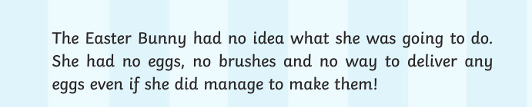
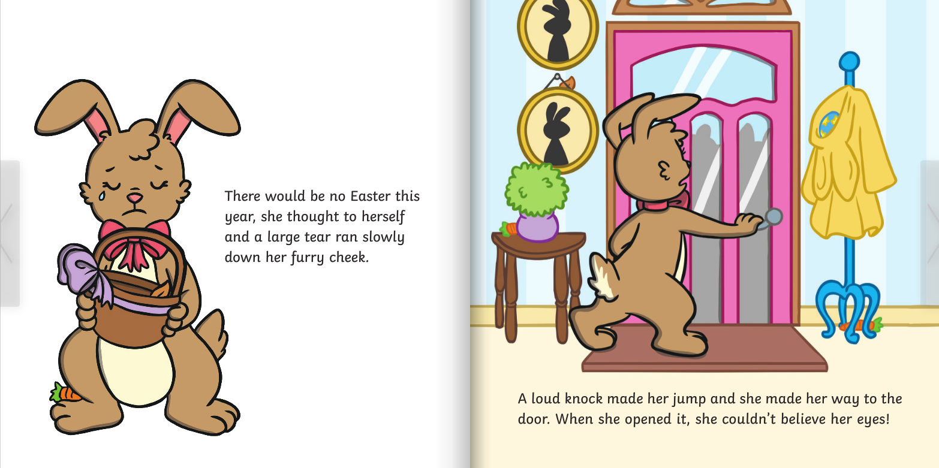
Let’s work out an inference question together.
How can you tell that The Easter Bunny was upset? What words help you with your answer?

Slide 4
Prediction
When we are asked to predict, we need to think about what we have already read and then guess which might happen later in the book.
You can use both the pictures and the text to support you when working out what might happen.
An example of a prediction question is…
How do you think the story will end?

Slide 5
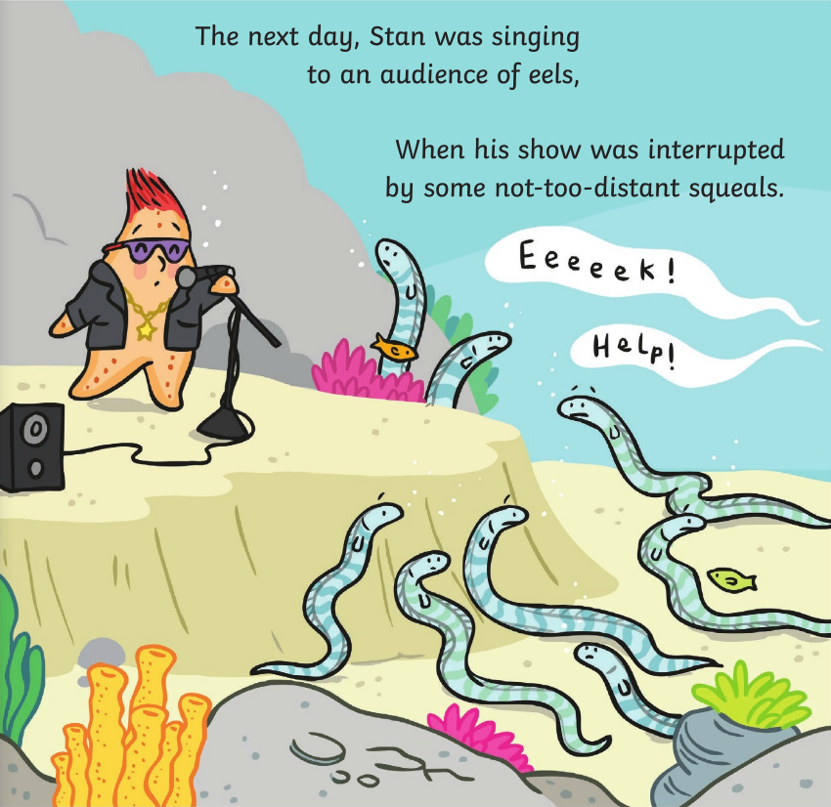
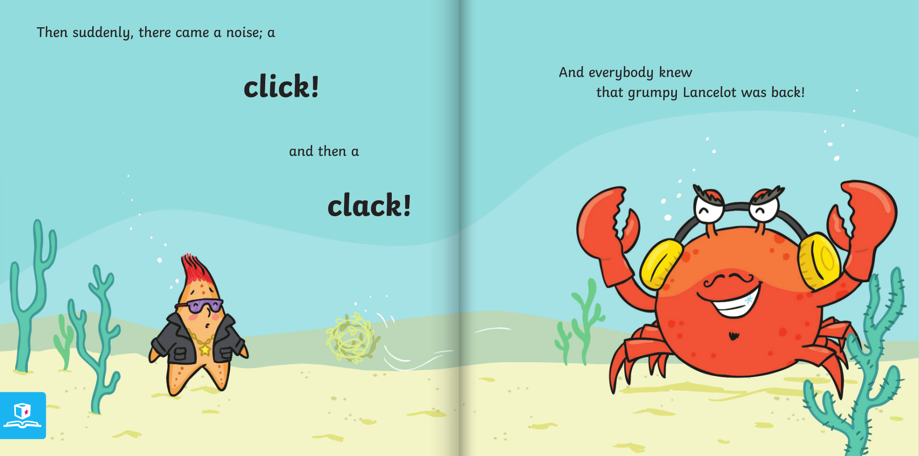
Let’s work out an prediction question together.
What do you think Lancelot is going to say?

Slide 6
Today’s task
To read through the text about Rainforests and answer the attached questions.
Remember to use part of the question in your answer.
E.g. How much rain do Rainforests get?
Rainforests get at least 200cm of rain every year.

Slide 7
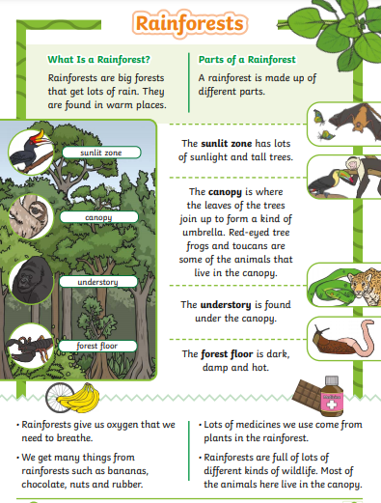
Todays task comes in 3 difficulties.
Green- Easiest
Amber- Middle
Red- Hardest
You are free to choose which one you complete.
Each comes with a matching text and questions.

