Slide 1
Wednesday 3rd February 2021
LO: To write to persuade.

Slide 2
Today we are going to use the arguments (reasons) the animals gave for protecting the great Kapok tree to create a persuasive poster to try to make other people understand why it is important to protect the Amazon Rainforest.
The word persuasive or to persuade means to make somebody have the same opinion as you.
Let’s revisit the book.
What did the animals say to the man to persuade him to protect the tree?

Slide 3
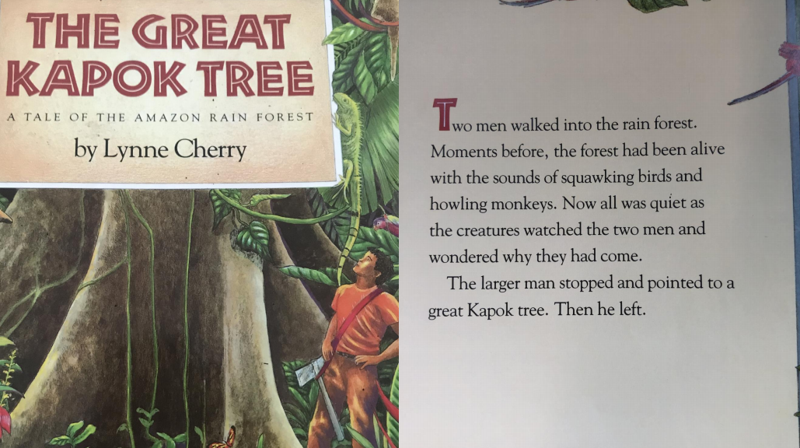

Slide 4
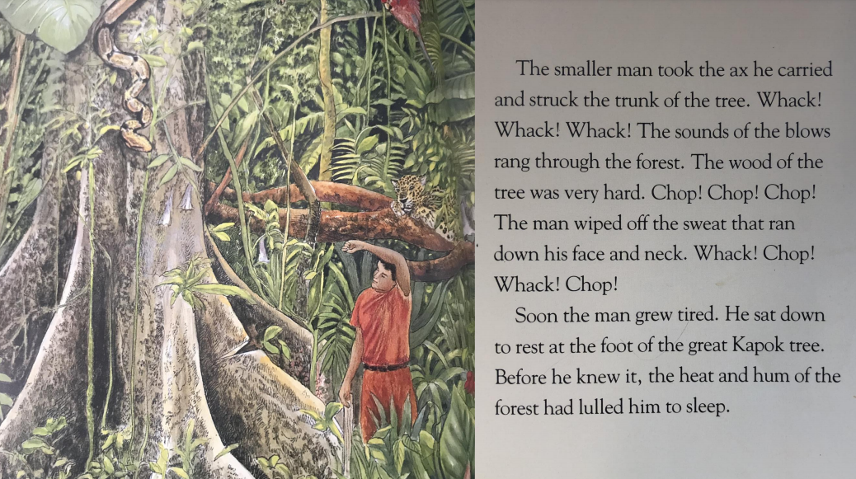

Slide 5
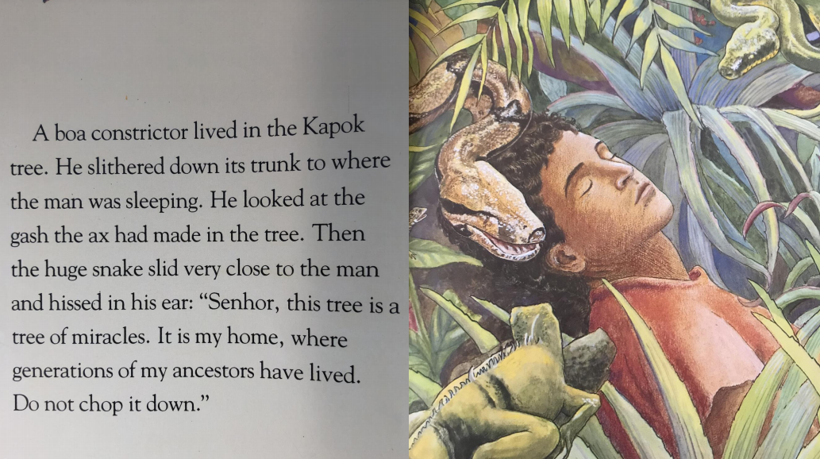
Boa Constrictor - It is my home. Generations of my ancestors have lived here.

Slide 6
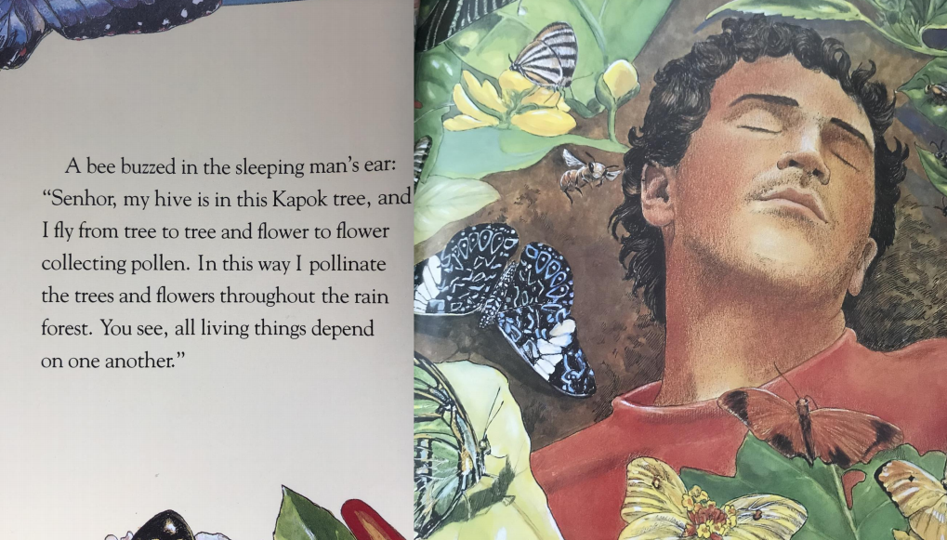
Bee – My hive is in the tree. I pollinate the trees and flowers. All living things depend on each other.

Slide 7
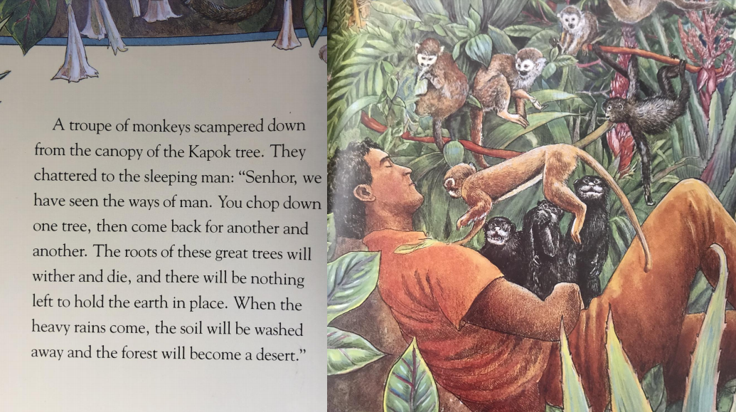
Monkey – The roots of this tree will die. The rain will wash the soil away and the forest will become a desert.

Slide 8
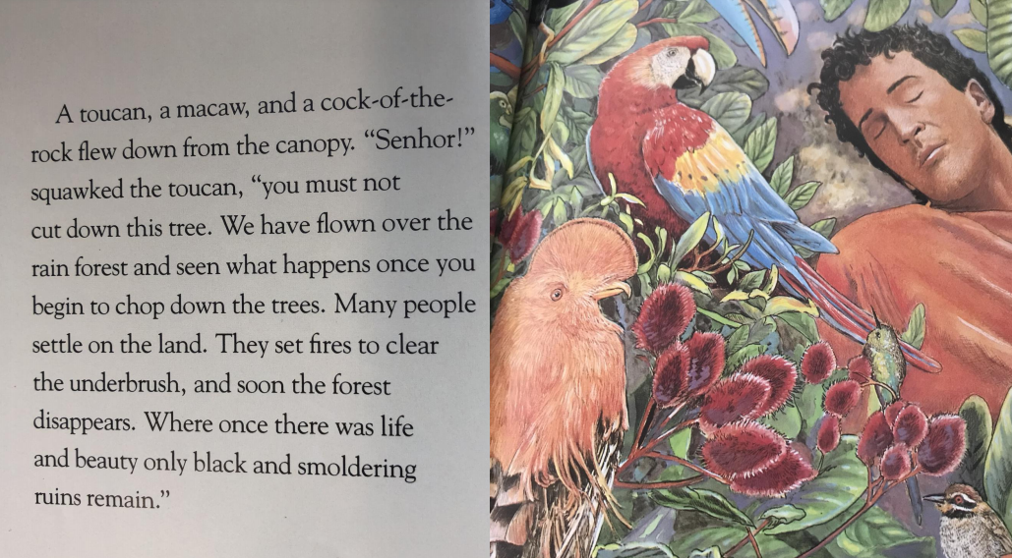
Birds – If you cut down the trees, humans will build houses on the land. They will light fires and soon the forest will disappear.

Slide 9
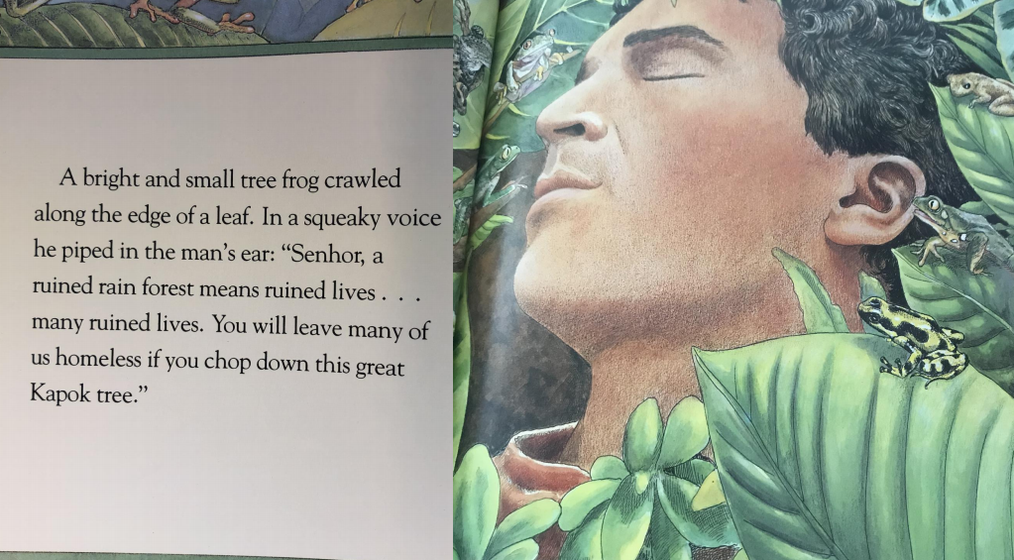
Frog – You will make many animals homeless.

Slide 10
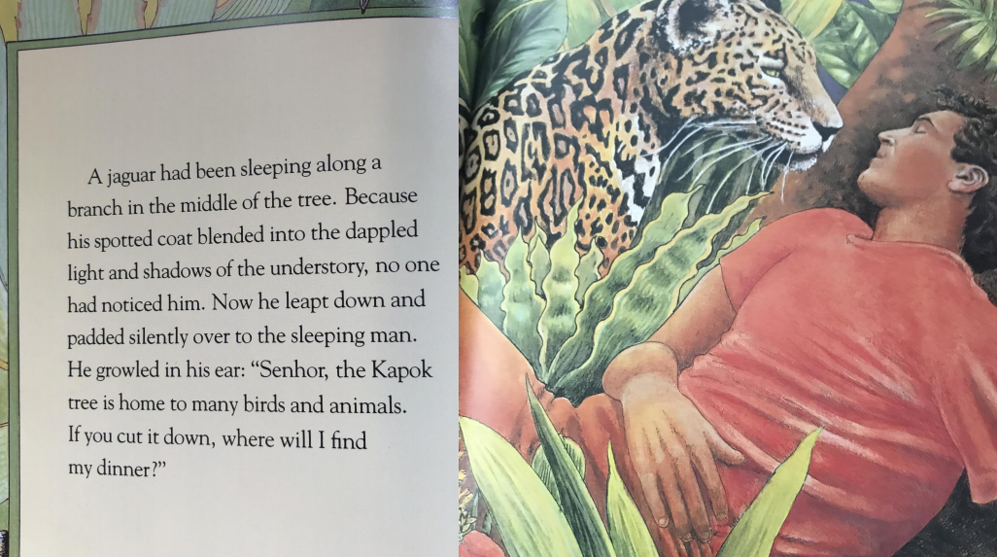
Jaguar – If you make the small animals homeless, I will have nothing to eat.

Slide 11
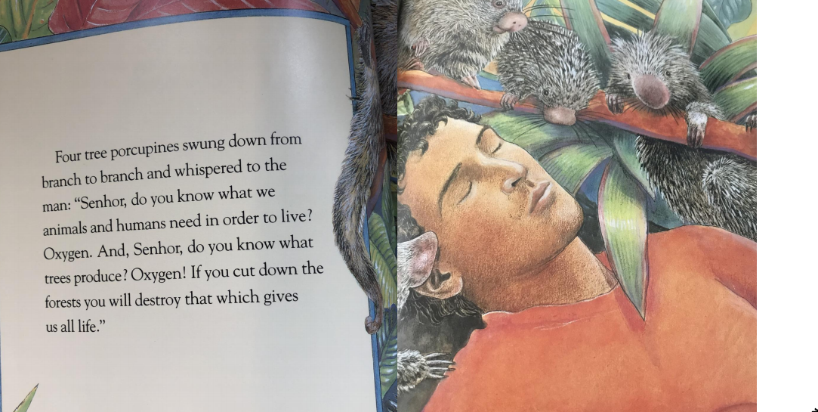
Porcupine – If you cut down too many trees, we will not have enough oxygen to survive.

Slide 12
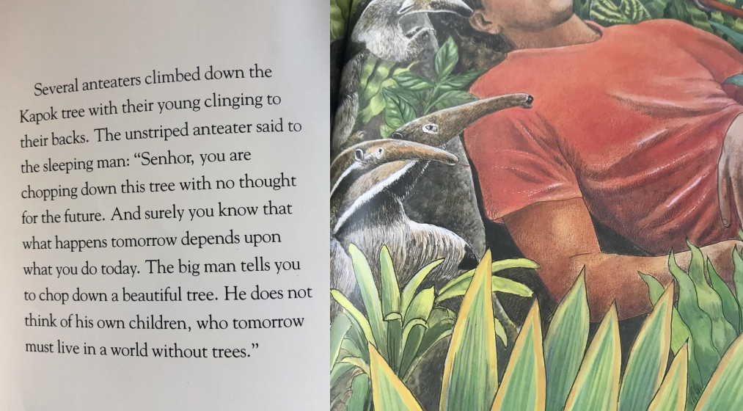
Anteater – Don’t just think about yourself. Think about the children of the future.

Slide 13
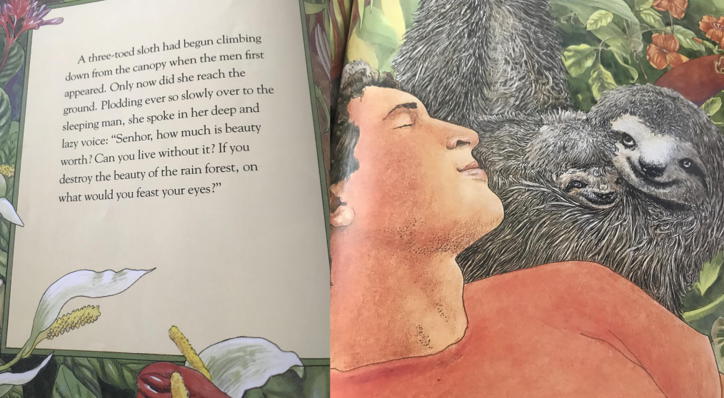
Sloth – You will destroy the beauty found in the rain forest.

Slide 14
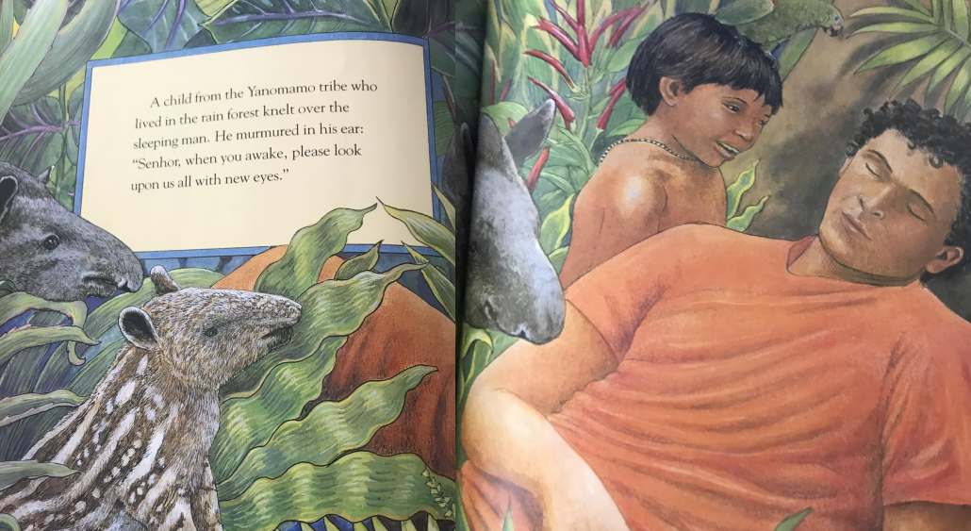

Slide 15
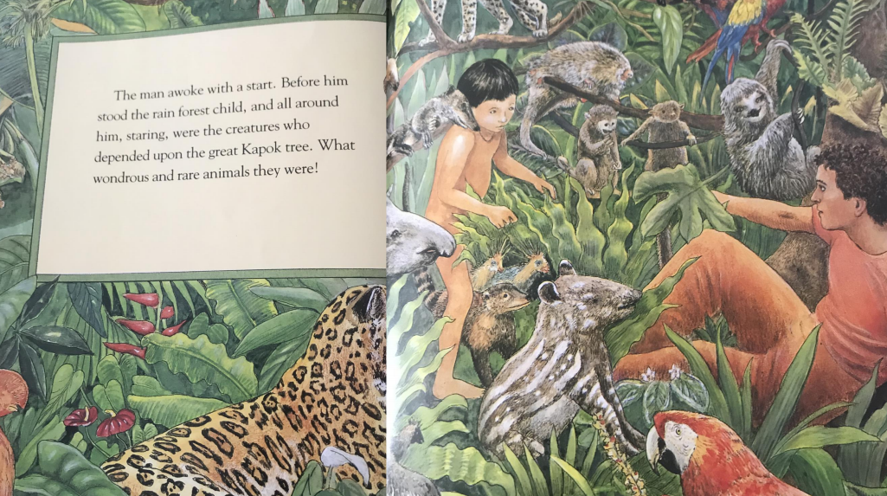

Slide 16
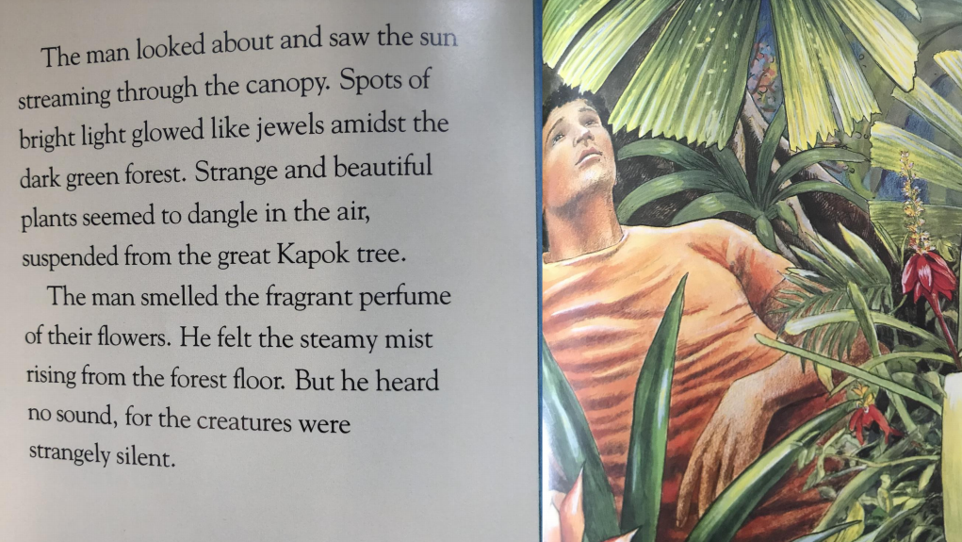

Slide 17
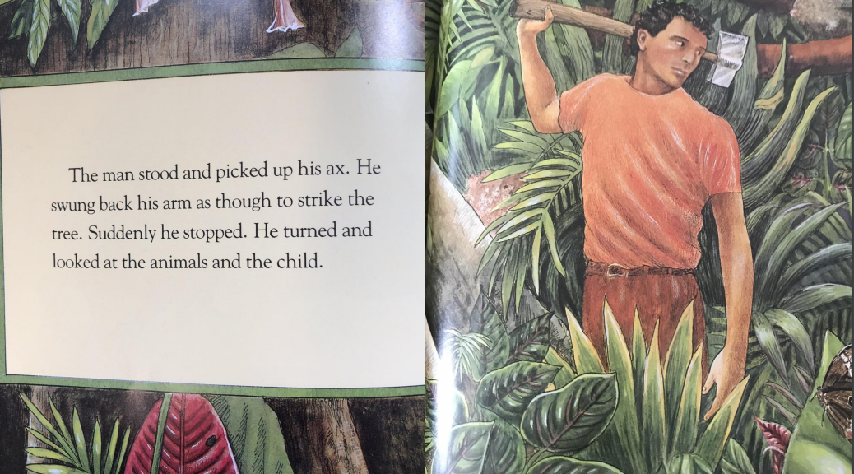

Slide 18
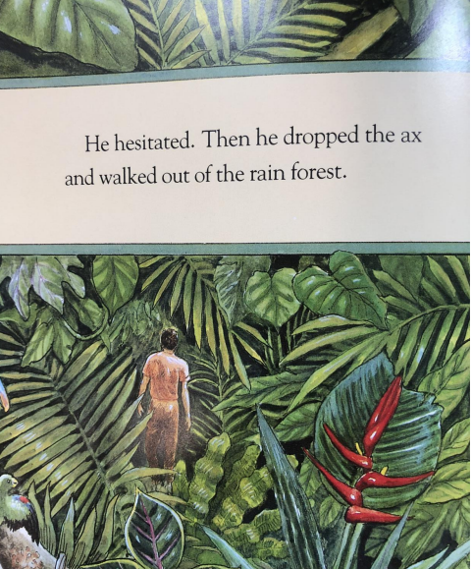
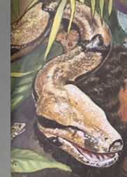
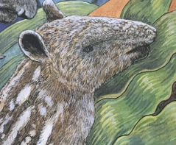

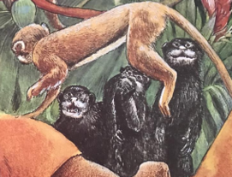
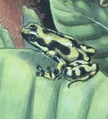
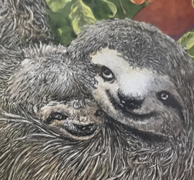
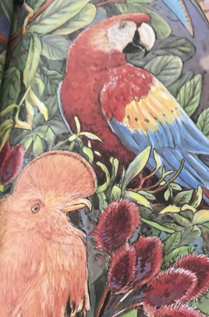
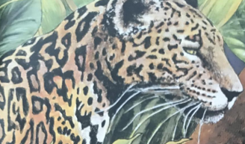
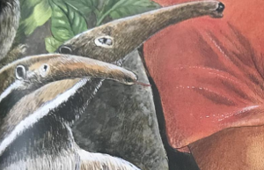
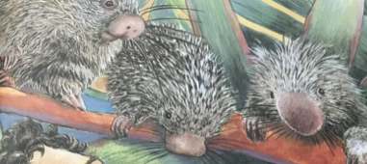
Can you remember what the animals told the man?

Slide 19
Your Task
To use the arguments the animals in the story gave the man to make a poster to try to persuade people to protect the rainforest.
Option 1 – Write speech bubbles next to the animals on the template poster explaining their reasons for saving the rainforest. You can either print out and write on the poster or type instead.
Or
Option 2 – Present the persuasive poster in an original way.

Slide 20
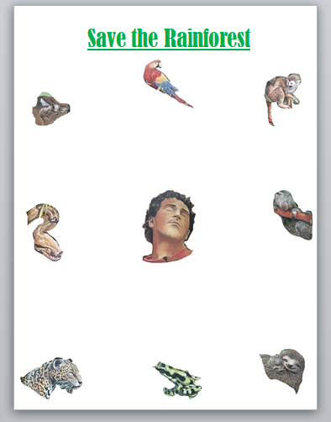
Option 1-Use speech bubbles to complete the poster template.

Slide 21
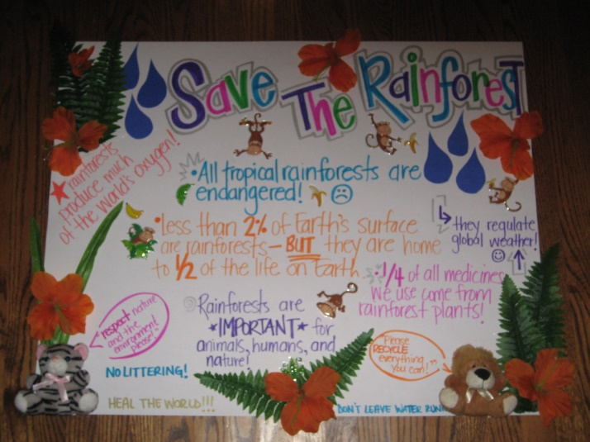
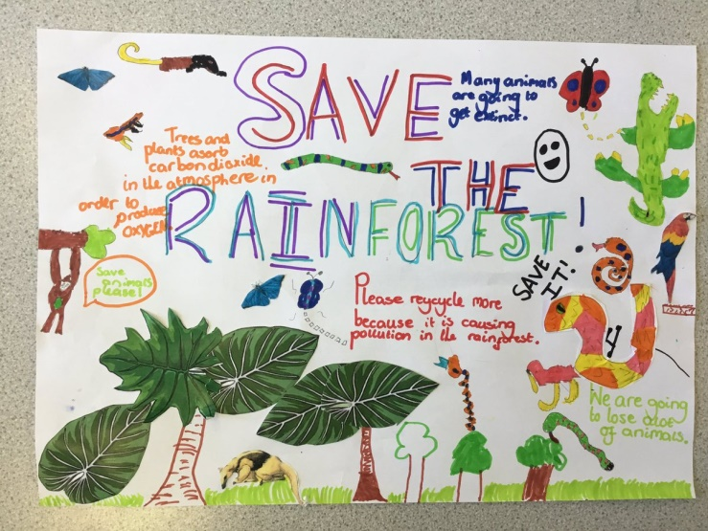
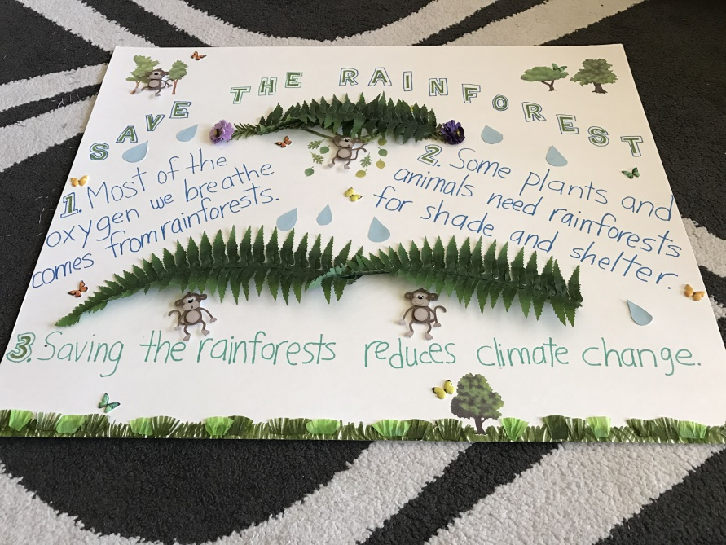
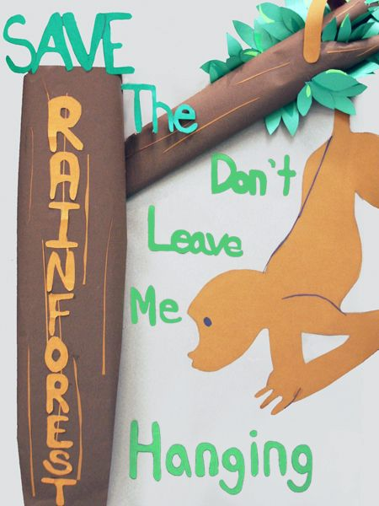
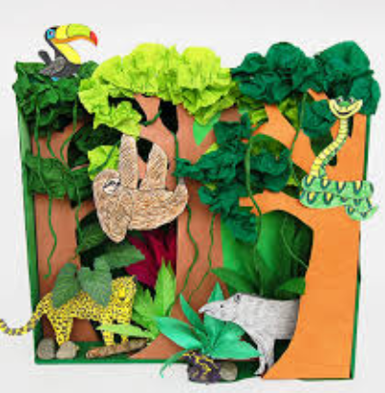
Option 2 – Create an original poster. Here are some ideas.

Slide 22
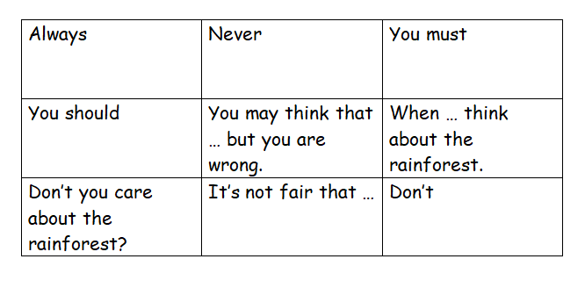
Word Bank
Here are some useful words and phrases to include in your posters when trying to persuade.

