Slide 1
Monday 1ST fEBRUARY 2021
LO: To MATCH A DESCRIPTION TO AN ANIMAL.

Slide 2
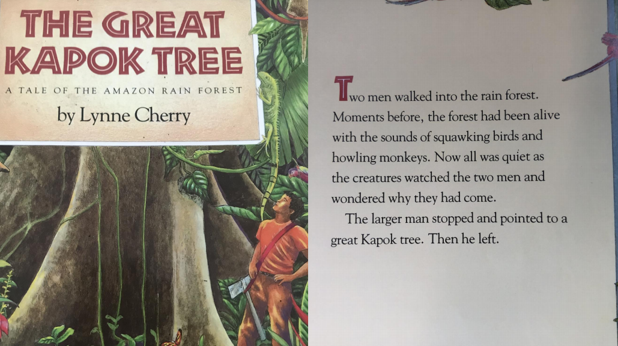

Slide 3
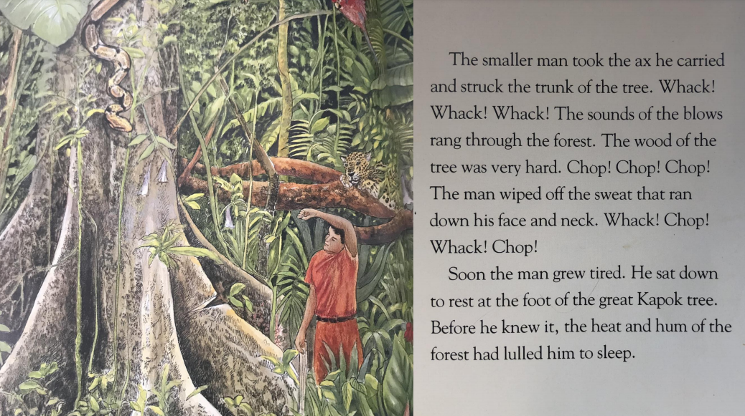

Slide 4
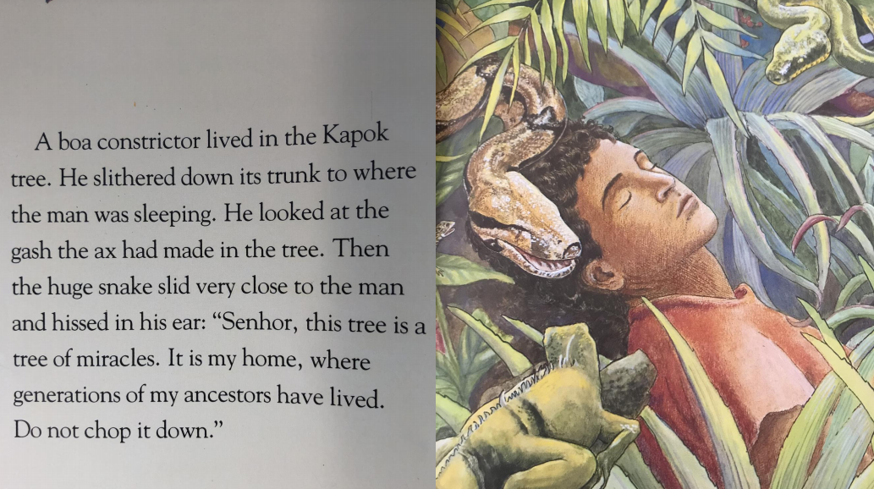

Slide 5
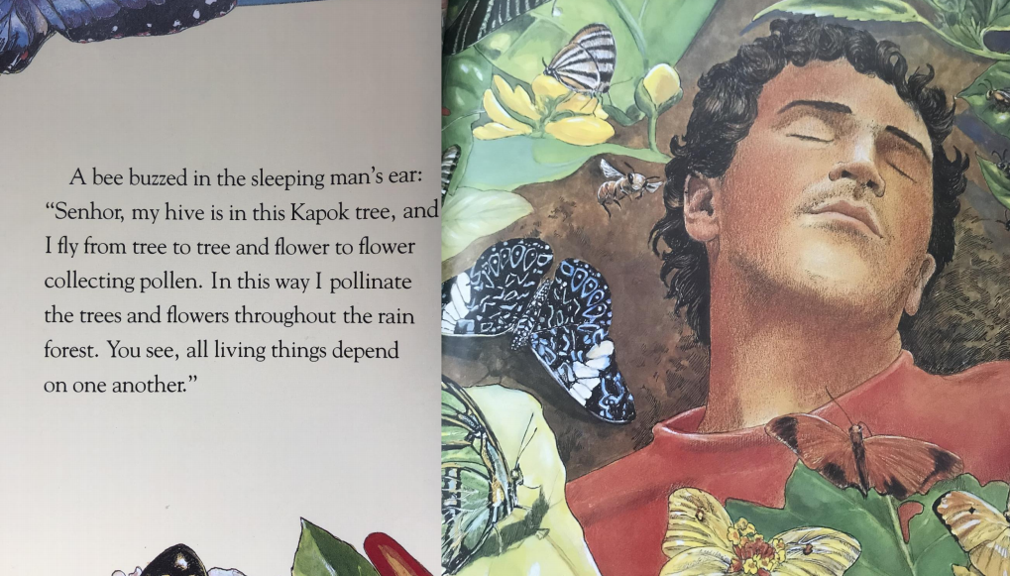

Slide 6
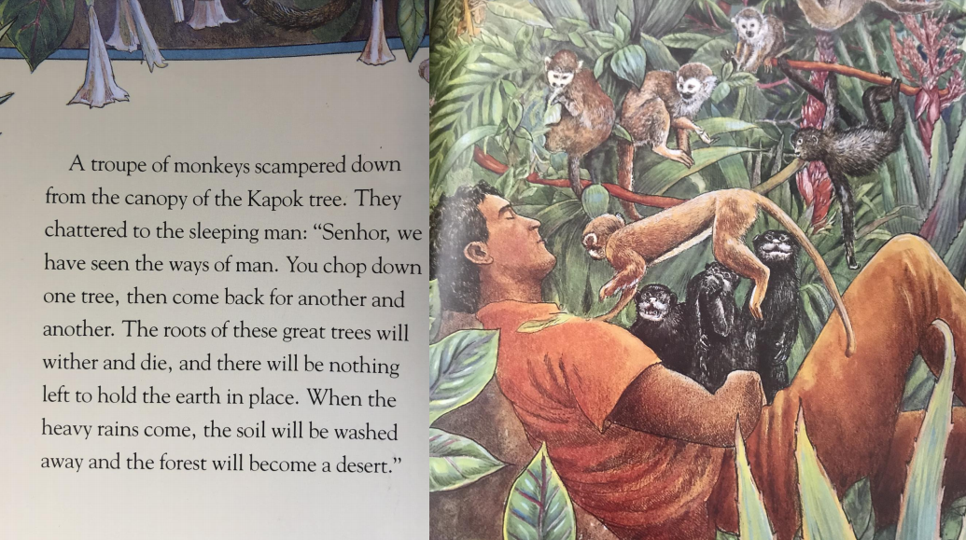

Slide 7
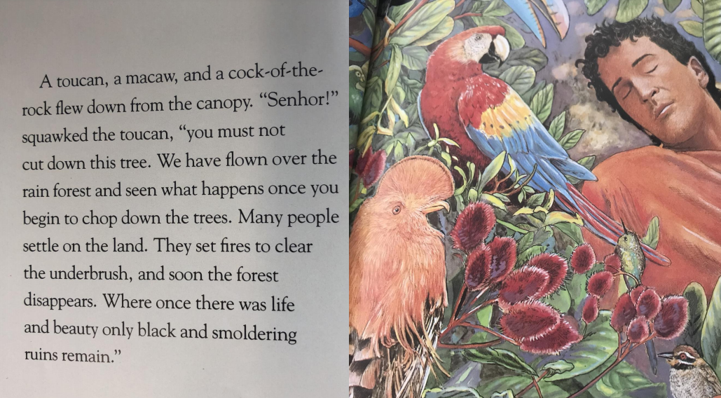

Slide 8
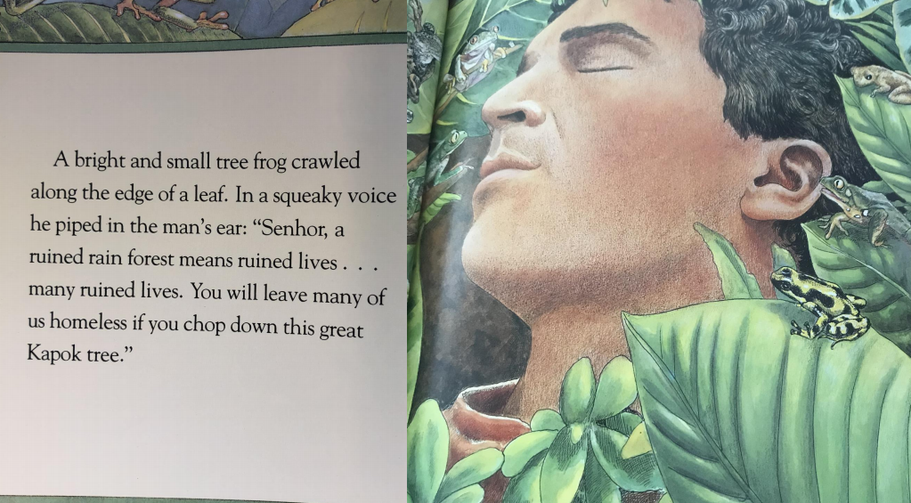

Slide 9
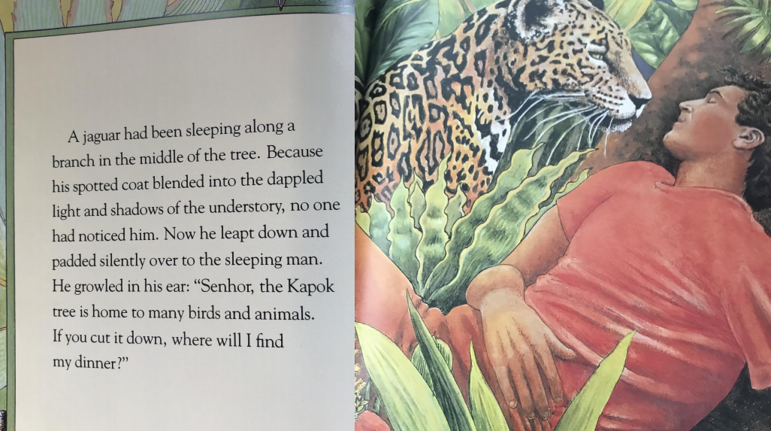

Slide 10
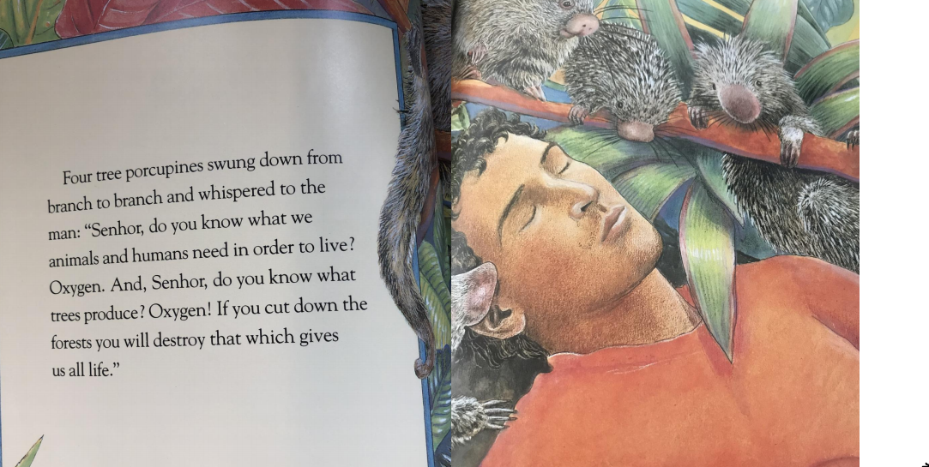

Slide 11
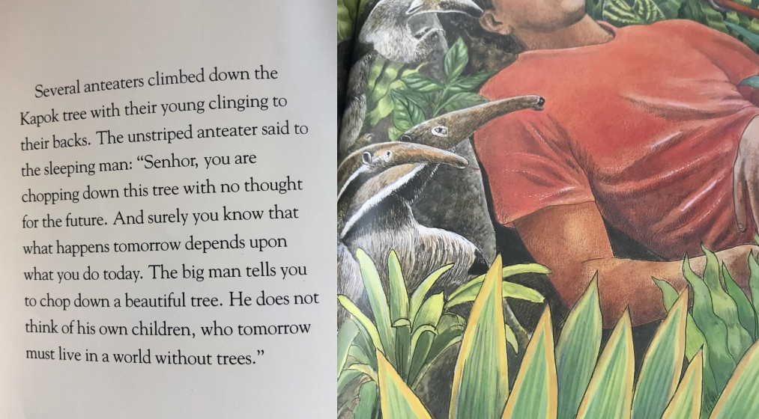

Slide 12
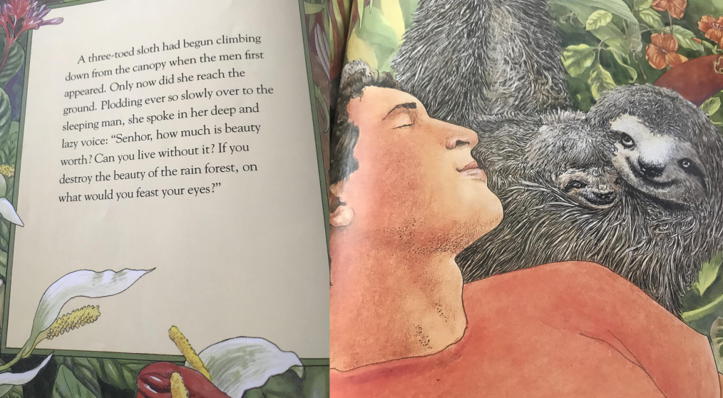

Slide 13
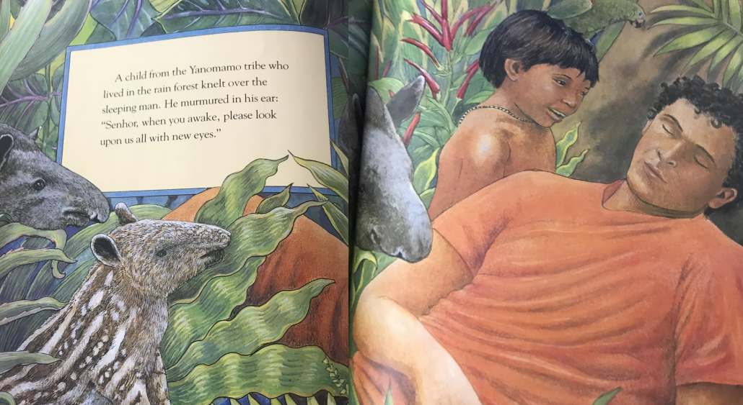

Slide 14
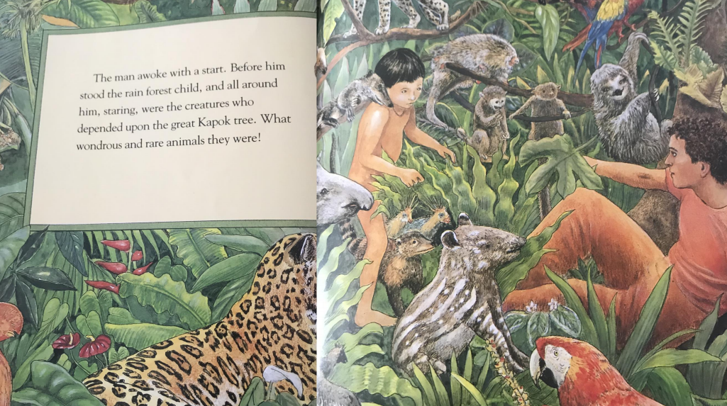

Slide 15
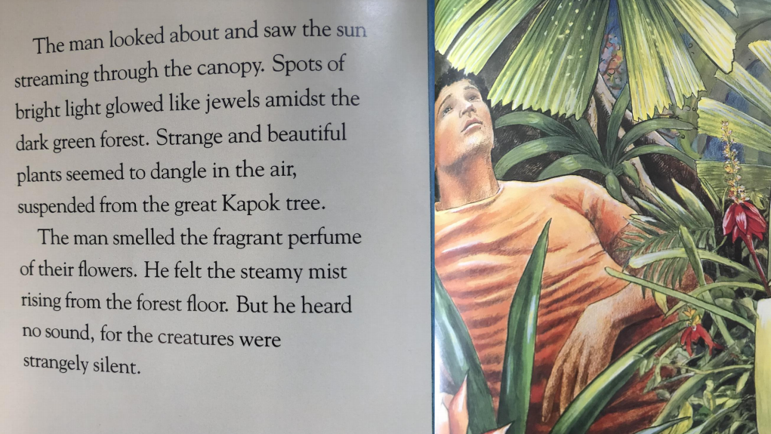

Slide 16
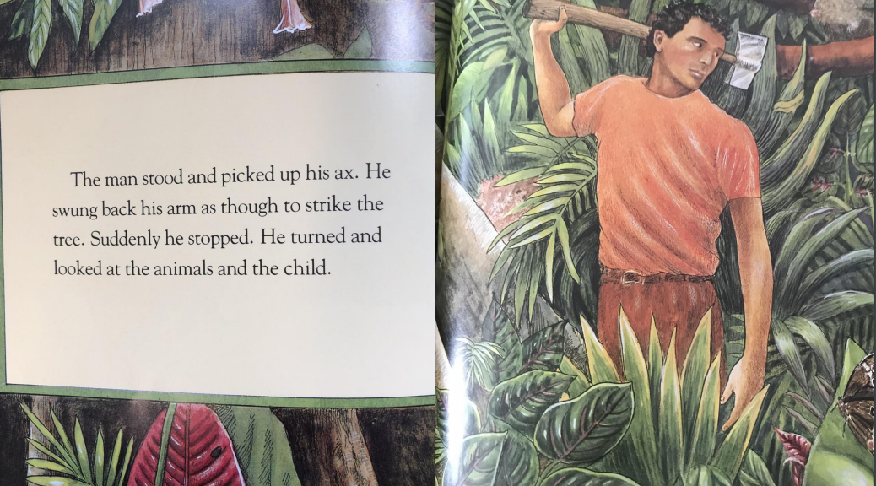

Slide 17
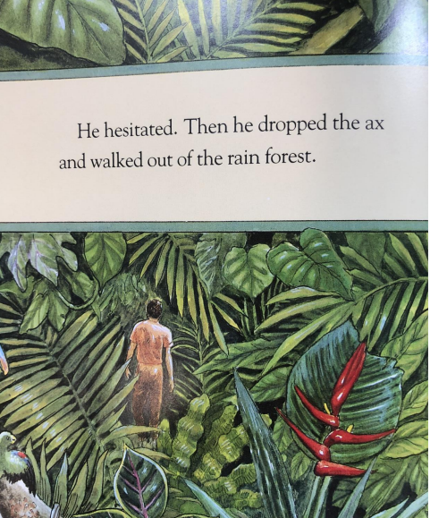
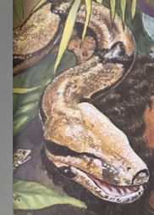
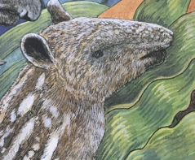

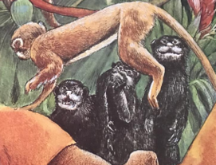
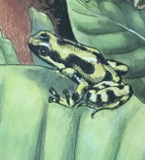
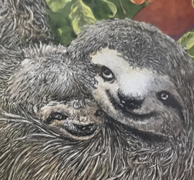
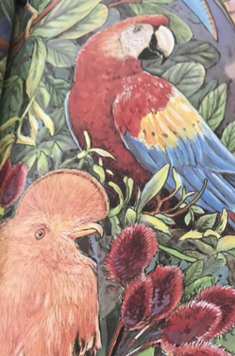
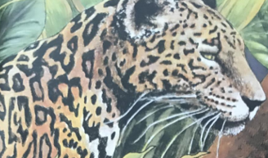
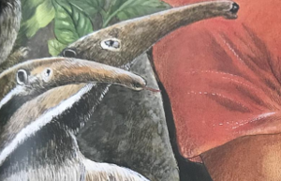
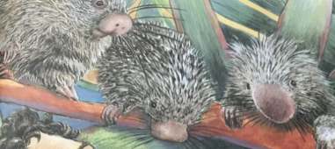
Which animals can you remember from the story?

Slide 18
Your Task
Read the descriptions written and match them to the creatures of the rainforest. You can match the pictures and descriptions on this powerpoint.
Choose your own mystery animal from the selection given and write a description for it. Do you think someone could guess which creature it might be from the 3 pictures?

Slide 19
Task 1: Match the animals to the descriptions. Draw in lines on a print out or move the descriptions next to the picture.
Who am I?
I have a long nose and tongue perfect for eating insects. I have brown fur and white stripes down my body. I have no teeth and a long bushy tail.
Who am I?
I have a round face and sad looking eyes. I have stubby ears and greyish fur. I move very slowly and have claws on my feet to help me climb.
Who am I?
I have a small green body with black spots. I have no tail and big eyes to see predators. I have damp skin and love to swim.
Who am I?
I have a long, smooth, scaly body. My skin is brown with black stripes and I have sharp teeth in my mouth.

Slide 20
Task 2: Write your own description for a mystery animal.
Write your description here:
Who am I?
I have

