Slide 1
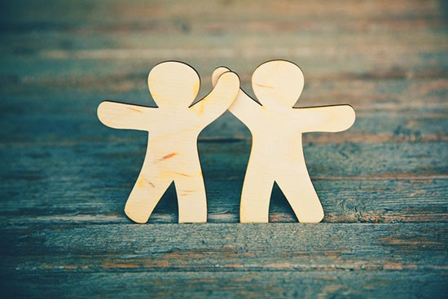
Friday 5th March 2021
PSHE: Friendship

Slide 2
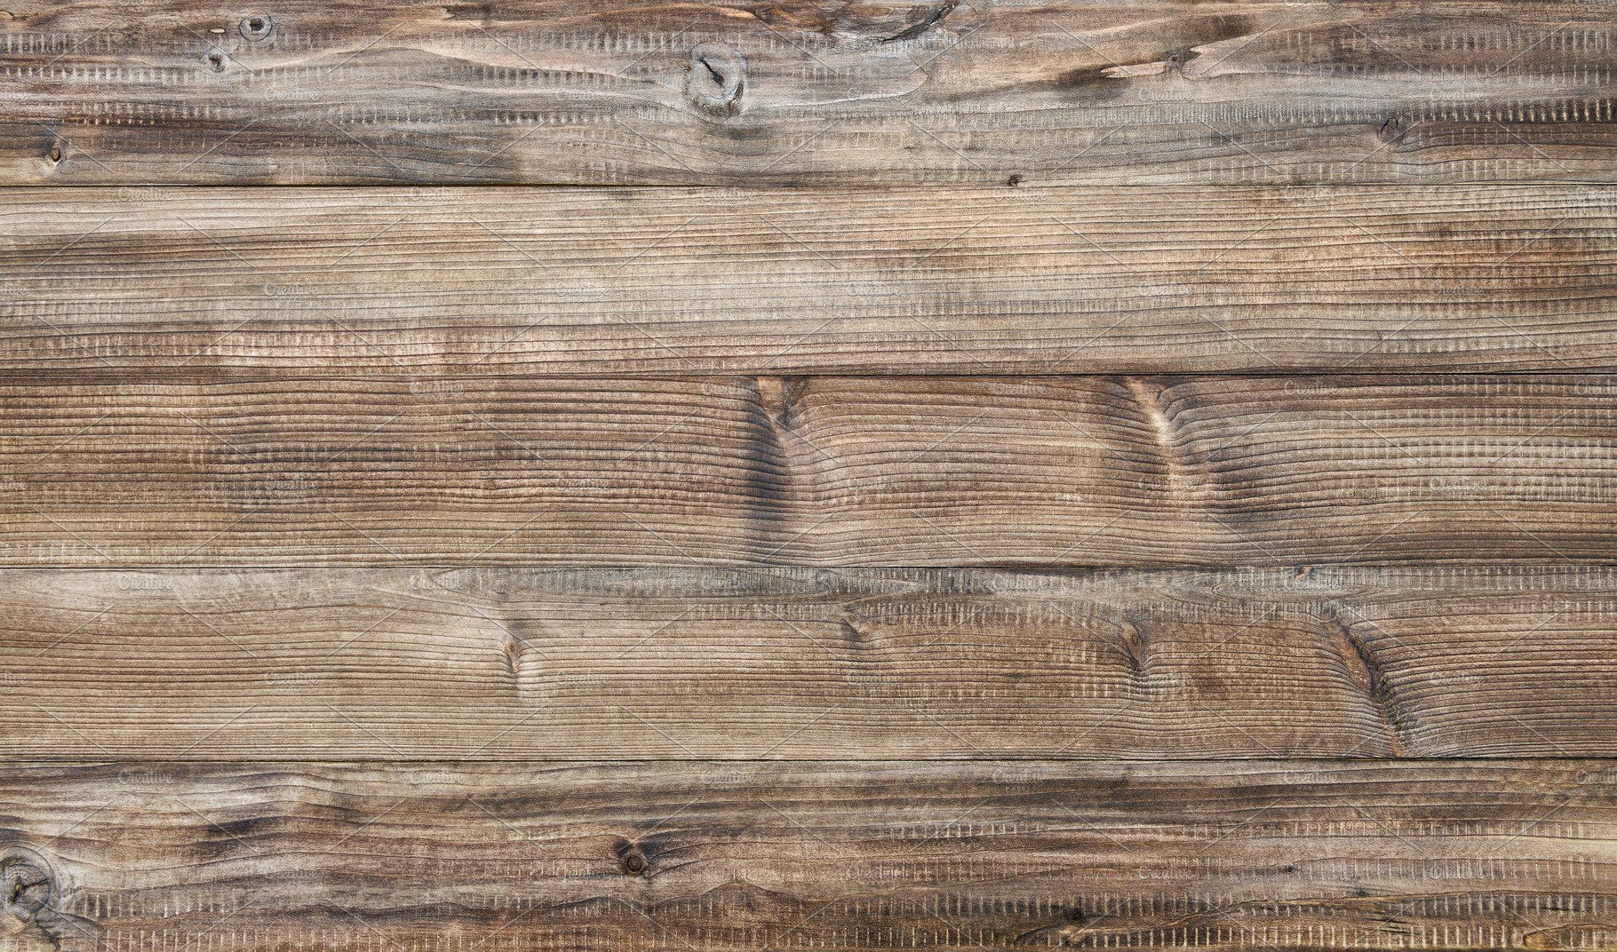
What does friendship mean to you?
To me friendship is a strong bond with someone where I can trust them and share my thoughts and feelings. Friends are there for each other and help each other if they are sad.

Slide 3
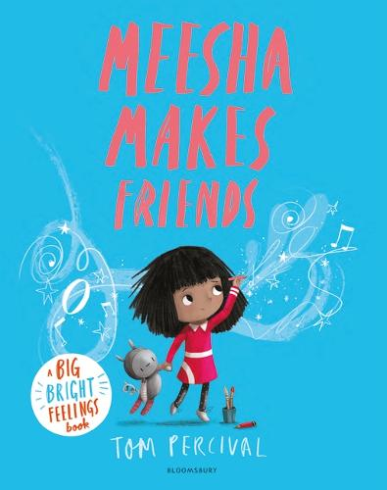
Watch and listen to the story Meesha makes friends
https://www.youtube.com/watch?v=KZbW_okynM0

Slide 4
In the story Meesha struggles to make friends so she decides to make her own friends. This ends up helping Meesha to make friends with other children and gives her confidence to talk to new people.
Your task: Make your own friends using and media you could like. Some ideas are on the following slide but you can choose to come up with your own idea. Think about what you think makes a good friend.

Slide 5


