Slide 1


Slide 3








1) Are the groups equal or unequal?
2) Ron and Amir share these strawberries equally.
How many will they each get?
3) Can you divide the strawberries equally between 4 people?

Slide 4
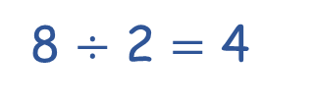
1) Are the groups equal or unequal?
2) Ron and Amir share these strawberries equally.
How many will they each get?
3) Can you divide the strawberries equally between 4 people?
equal
8 $÷$ 2 $=$ 4
Yes, they will each get 2 strawberries

Slide 6



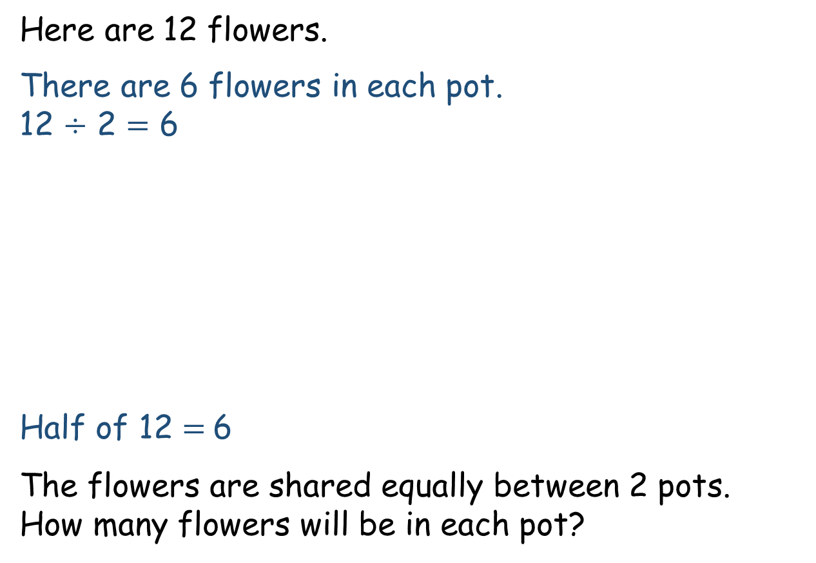
Here are 12 flowers.
There are 6 flowers in each pot.
12 $÷$ 2 $=$ 6
Half of 12 $=$6
The flowers are shared equally between 2 pots.
How many flowers will be in each pot?

Slide 7

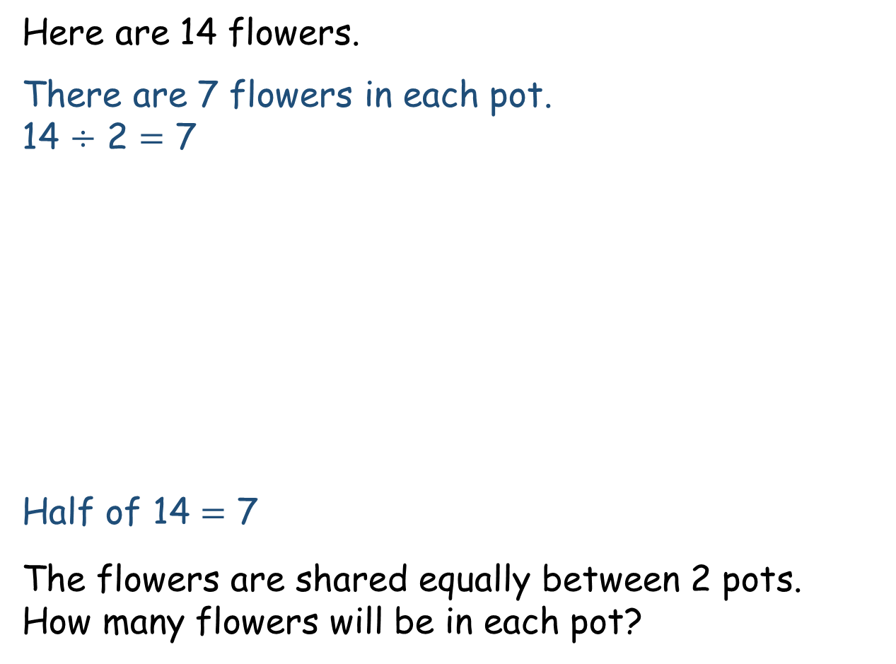
Here are 14 flowers.
There are 7 flowers in each pot.
14 $÷$ 2 $=$ 7
Half of 14 $=$ 7
The flowers are shared equally between 2 pots.
How many flowers will be in each pot?
Have a think

Slide 8



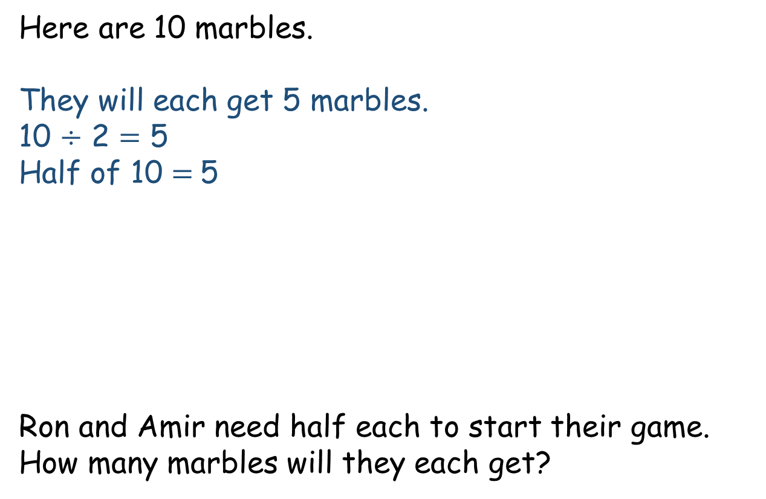
Here are 10 marbles.
They will each get 5 marbles.
10 $÷$ 2 $=$ 5
Half of 10 $=$5
Ron and Amir need half each to start their game.
How many marbles will they each get?

Slide 9
They have lost a marble. Now there are 9
Can Ron and Amir halve 9 marbles?

Slide 10
Have a go at questions
1 – 3 on the worksheet

Slide 11

Jack is using this array to help him find $\frac{\text{1}}{\text{2}}$ of 12

Slide 12



Ron bought some sweets.
He has eaten half of them.
Here are the sweets he has left.
How many sweets did Ron have to begin with?
8
?
$\frac{\text{1}}{\text{2}}$ of $=$ 4
8
Have a think

Slide 13
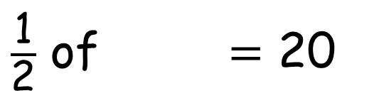
$\frac{\text{1}}{\text{2}}$ of $=$ 20
40
Have a think
40
?
20
20

Slide 14
Have a go at the rest of the questions on the worksheet

