Slide 1


Slide 3

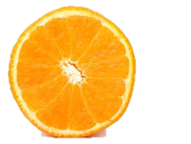
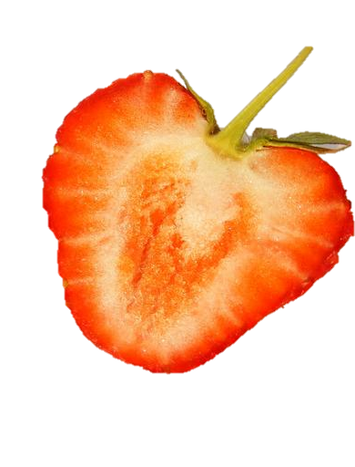
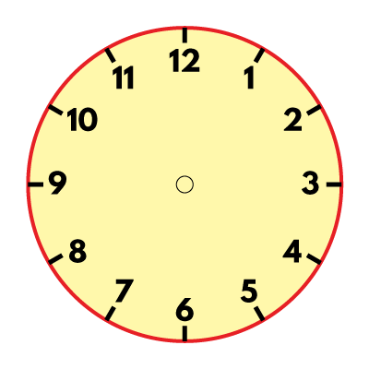

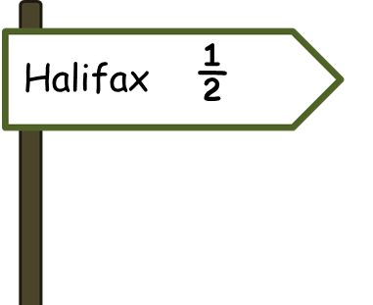
What do you notice?
Have a think

Slide 5



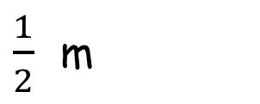

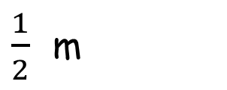

Here are some more halves.
$$\frac{1}{2}$$
$$\frac{\text{1}}{\text{2}}$$
$$\frac{1}{2}$$
$$\frac{1}{2}$$
$\frac{1}{2}$ m
$\frac{1}{2}$ m
One half means one part out of 2 equal parts.
Two halves are equal to one whole.

Slide 6



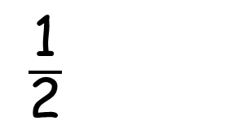
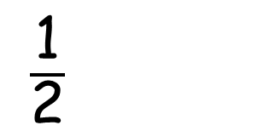
Ron and Amir are going to share the pizza.
They cut it into 2 equal parts.
They each have one half of the whole pizza.
Here is a pizza.
$\frac{\text{1}}{\text{2}}$
$\frac{\text{1}}{\text{2}}$

Slide 7

Which of these shapes have one half shaded?
v
v

Slide 8

Eva wants to colour half of each set of shapes.
a)
b)
c)
How many should she colour each time?
Have a think

Slide 9
Have a go at questions
1 – 5 on the worksheet

Slide 10

Here is half a shape.
Can you draw the whole shape?
Is there more than one way to do this?
Have a think

Slide 11


Which shapes have exactly one half shaded?
Have a think

Slide 12
Have a go at the rest of the questions on the worksheet

