Slide 1
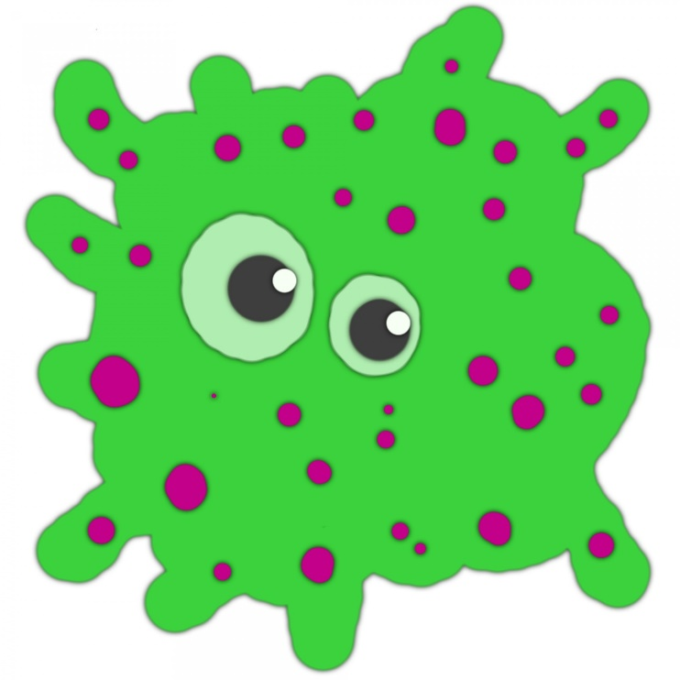

Wednesday 3rd March
Science
How do germs spread?

Slide 2
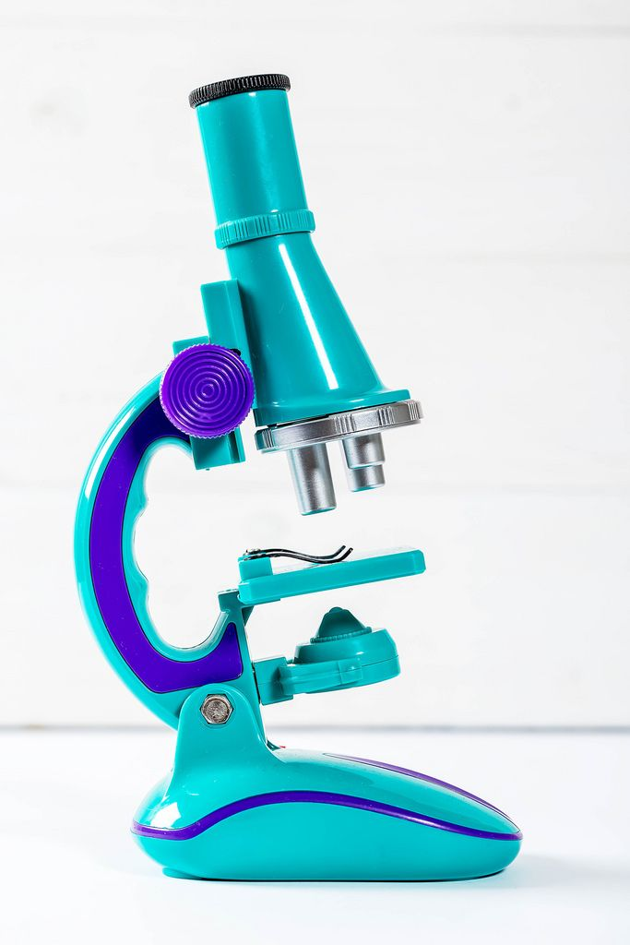
What are Germs?
Germs are tiny living things.
We cannot see them unless we use a microscope.
They can make us poorly.
This might be a ‘tummy bug’ or a cough and cold.
The Coronavirus Covid-19 is a germ.

Slide 3
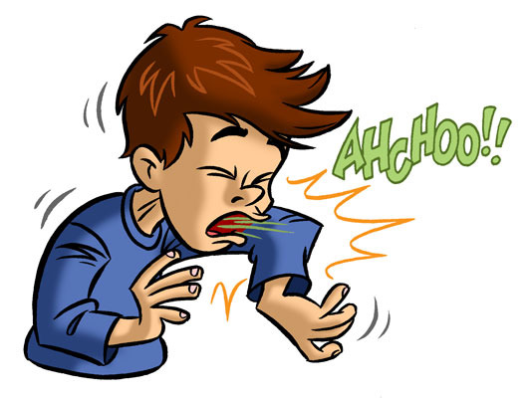
How do germs spread?
Germs are found on the surface of things e.g. toys, tables, ipads, chairs, doors.
When we touch things we pick up the germs on our hands.
Germs can also be passed from someone else. We might pick up a germ by holding hands, hugging or touching someone.
If we then put our hands in our mouth or eyes, the germs can enter our body and might make us poorly.

Slide 4
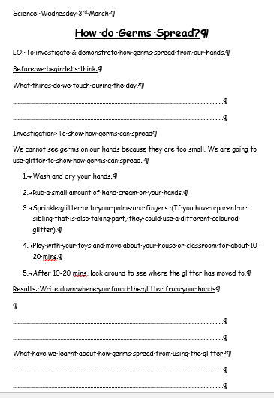
Your Task: To investigate how germs spread
Carry out the investigation below.
Options for recording
Type into the Word doc worksheet.
Print off the worksheet and write onto it.
Record on your own paper.
Let’s Think
What do we touch during the day?
Look closely at your hands and nails. What can you see? Do you think you can see everything on your hands?

Slide 5

Investigation: To show how germs can spread
We cannot see germs on our hands because they are too small.
We are going to use glitter to show how germs can spread.
Wash and dry your hands.
Rub a small amount of hand cream on your hands.
Sprinkle glitter onto your palms and fingers. If you have a parent or sibling that is also taking part, they could use a different coloured glitter.
Play with your toys and move about your house or classroom for about 10-20 mins.
After some playtime and moving about time, look to see where the glitter has moved to.
What have we learnt about the way germs spread from our hands?

Slide 6
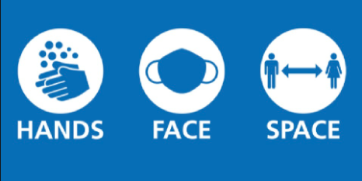
How can we stop germs spreading?
At the moment, everyone around the world is trying to control the spread of the Coronavirus. This is a new germ.
We can wash our hands when we arrive at school and before we eat.
HANDS
Adults can cover their mouth and nose with a covering to stop germs reaching themselves and other people.
FACE
We can keep a distance from other people when this is possible.
SPACE

