Slide 1


Slide 3
1) Draw 1 line to divide the shape into 2 equal parts.
2) Draw 1 line to divide the shape into 2 unequal parts.
3) Which of the triangles have been divided into equal parts?

Slide 4
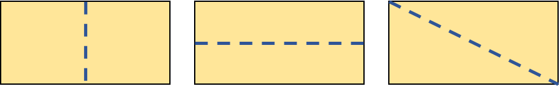
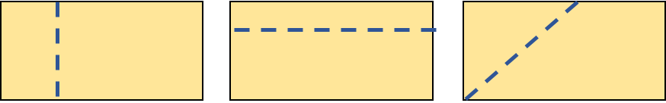
1) Draw 1 line to divide the shape into 2 equal parts.
2) Draw 1 line to divide the shape into 2 unequal parts.
3) Which of the triangles have been divided into equal parts?

Slide 6
What do you notice?
Each shape has 4 equal parts.

Slide 7
How many equal parts does each shape have?
2 equal parts
4 equal parts
8 equal parts
3 equal parts

Slide 8
Which shapes have equal parts?

Slide 9







Are the groups equal or unequal?
a)
b)
equal
unequal

Slide 10
Have a go at questions
1 – 6 on the worksheet

Slide 11



Ron and Amir are making equal groups.
They each have 18 counters.
Can you make any other equal groups with
18 counters?
I have made 6 equal groups.
I have made 3 equal groups.
Have a think

Slide 12
Ron and Amir are making equal groups.
They each have 18 counters.
2 equal groups of 9
9 equal groups of 2
18 equal groups of 1
Can we make 4 equal groups?

Slide 13


Whitney and Dora are finding different ways to colour equal parts of the shape below.
I can colour
2 equal parts.
Let’s colour 3 equal parts.
There’s another way to colour 2 equal parts.
I will find another way
We can colour 6 equal parts

Slide 14
Have a go at the rest of the questions on the worksheet

