Slide 1


Slide 3

1) What do the represent?
2) What do the represent?
3) What do the represent?

Slide 4
1) What do the represent?
2) What do the represent?
3) What do the represent?
Vertices
Edges
Faces

Slide 6

Which objects are repeating?
What comes next?
?
?
?
It helps if I say the pattern out loud.

Slide 7
Which objects are repeating?
What comes next?
?
It helps if I say the pattern out loud.

Slide 8




Have a think
Which objects are repeating?
What is missing?
?
?

Slide 9


Make me a pattern that goes:
cube, sphere, cylinder
and then repeats please
What will the 11th shape in the pattern be?
A sphere
Have a think

Slide 10
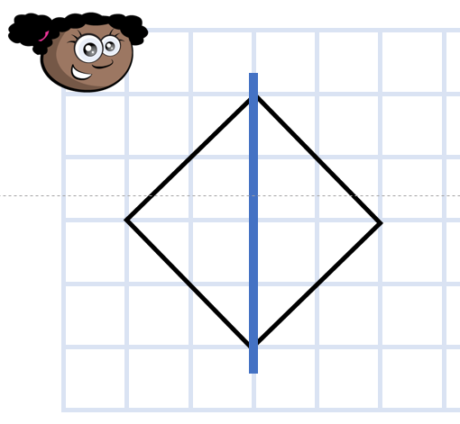
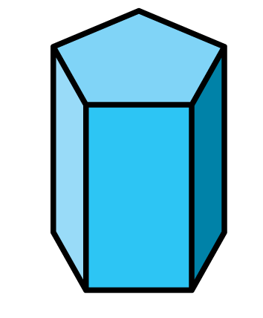
Symmetrical?
Have a think

Slide 11
Symmetrical?
Have a think

Slide 12


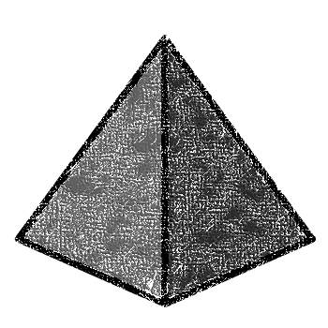
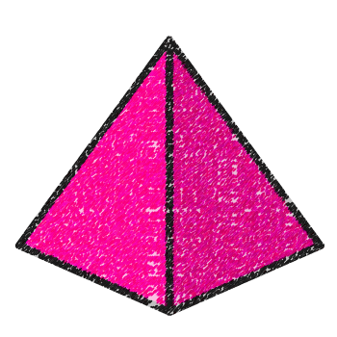

Have a go at the questions on the worksheet

