Slide 1
LO: To describe a setting in detail
Monday 1st MaRch 2021

Slide 2
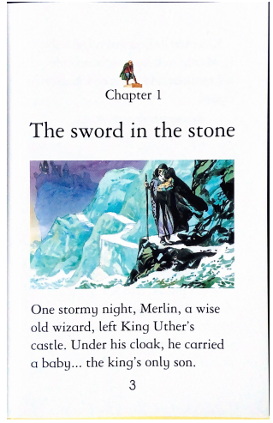

Slide 3
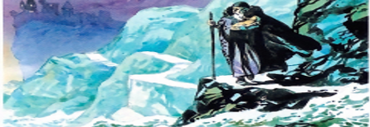
Look at the picture from the first page of the story…
castle
mountain
rocks
sky
path
snow
Your task is to describe it using powerful adjectives. Think about the things (nouns) you can see and write a sentence about each clearly. We are using the past tense, since we are describing what it was like at that time.
What can you see in the picture?
There was a path.
What adjectives could we use to describe the path?

Slide 4
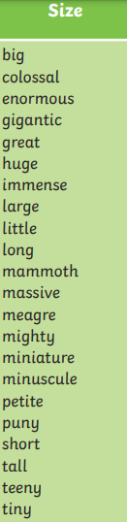
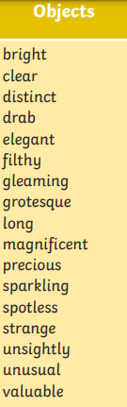
Choose and use interesting adjectives.
castle
mountain
rocks
sky
path
snow
There was a path.
Might become….
There was a long, bright path and immense, sparkling mountains.

Slide 5
Choose and use interesting adjectives.
castle
mountain
rocks
sky
path
snow
The castle was on top of the mountain.
Might become….
The mighty, magnificent castle was on top of the strange mountain.

Slide 6
Your Options:
Opt. 1 – Print out template and write your description.
Opt. 2 – Write up your description on a piece of paper.

Slide 7
Once you have completed your sentences…
Think about this old man carrying the baby.
Who do you think he might be?
Why do you think he is carrying this baby boy through the mountains?
Who do you think this baby boy might be?
Be ready to share your ideas with your class in tomorrow’s lesson!

