Slide 1
Thursday 7th January 2021
LO: To use question words and ?

Slide 2
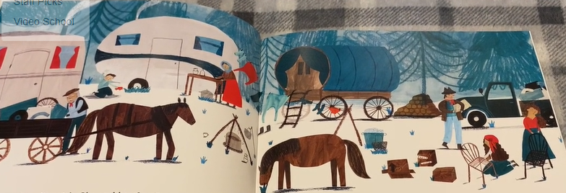
We talked yesterday about what we thought their lives might be like.
Today we will think of questions to ask different members of the family to find out about their lives.

Slide 4



Pose Three Questions:

Slide 5
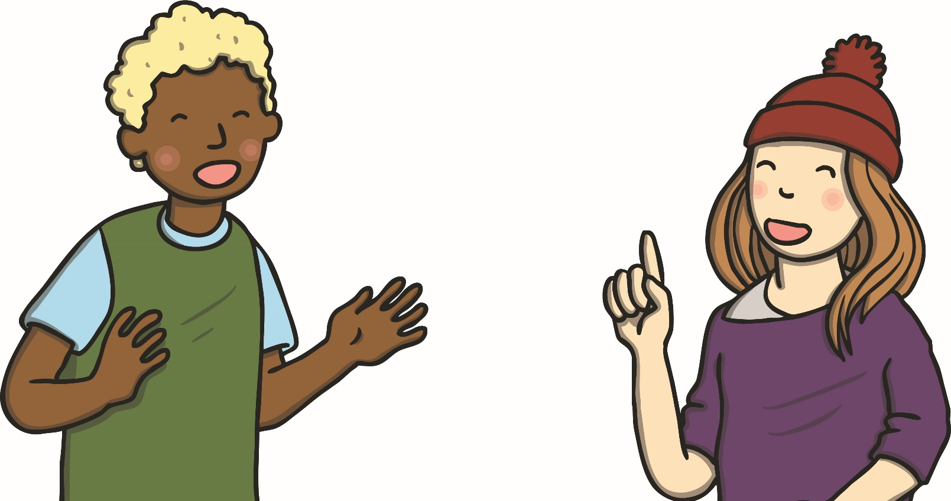
Are your questions reasonable to answer?

Slide 6
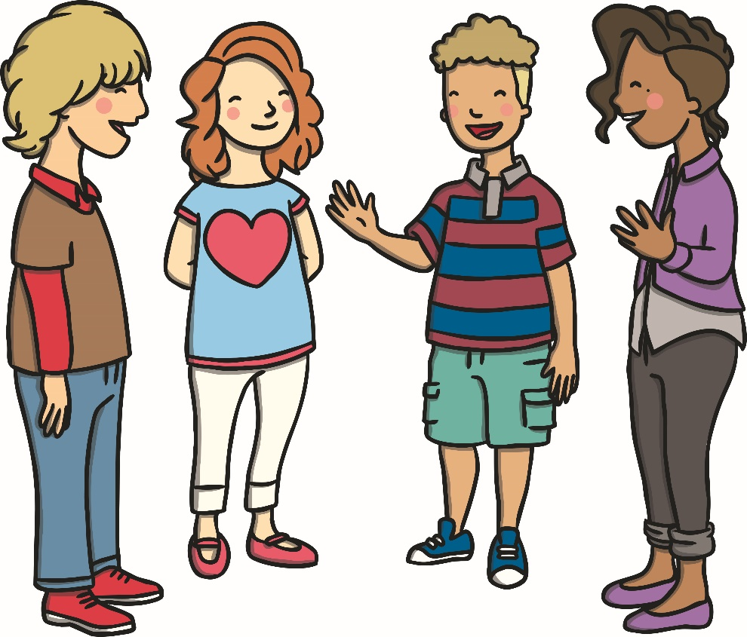
Will your questions be interesting to others?

Slide 7
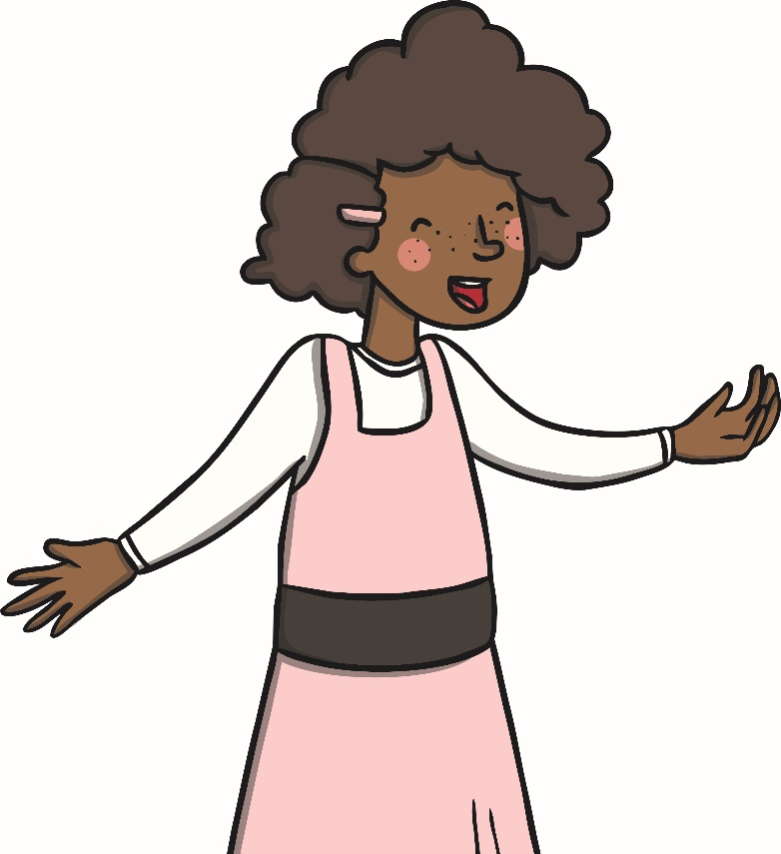

Are you asking questions that will need more than one word to answer?

Slide 8
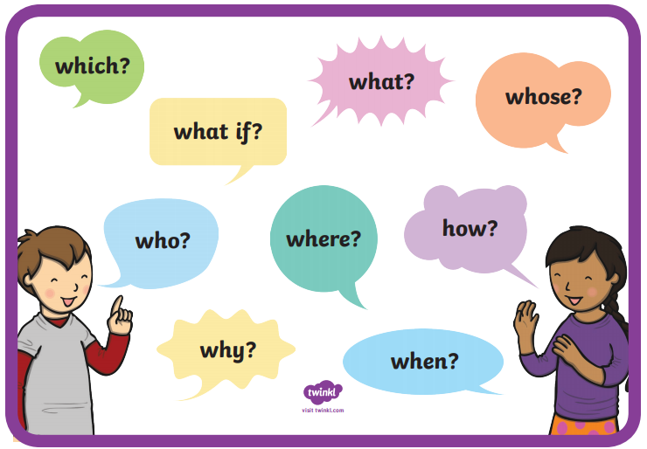

Slide 9
Choose someone you might ask a question.
What would you like to find out about life on the site?
What question words have we learned?

Slide 10
What is jobs do you do in the day?

Slide 11
Where do you do your washing?

Slide 12
Who looks after the horses?

Slide 13
How do you cook your food?

Slide 14
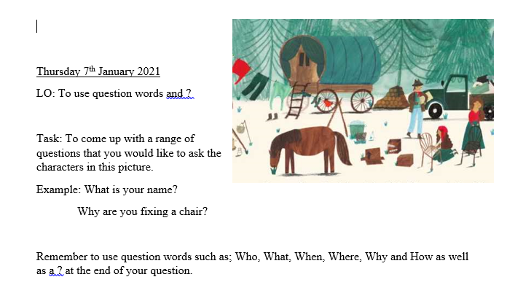
Your task today: Worksheet available.

Slide 15
Think!
What questions did you come up with?
Did you use question words?
Did you use a question mark (?) at the end of each question?

