Slide 1
LO: To write the backstory of how the twins were separated
Tuesday 29th June 2021

Slide 2
What can you remember about this story?
This is a famous play written by William Shakespeare.
It’s about two sets of identical twins who were separated at birth.
Years later fate brings them to the same city and lots of exciting things happen caused by mistaken identities!

Slide 3

Let’s remember who is in our story?
Antipholus of Ephesus (rich merchant married to Adriana)
Antipholus of Syracuse (looking for his brother and mother)
Dromio of Ephesus (funny servant of Antipholus of Ephesus)
Dromio of Syracuse (funny servant of Antipholus of Syracuse)

Slide 4
Your Task:
You will be writing the back story of how the twins were separated.
Antipholus of Ephesus
(rich merchant married to Adriana)
Dromio of Ephesus
(funny servant of Antipholus of Ephesus)
How did they end up at Ephesus?
Antipholus of Syracuse
(looking for his brother and mother)
Dromio of Syracuse
(funny servant of Antipholus of Syracuse)
Ended up with Aegon.
How did they end up at Syracuse?

Slide 5
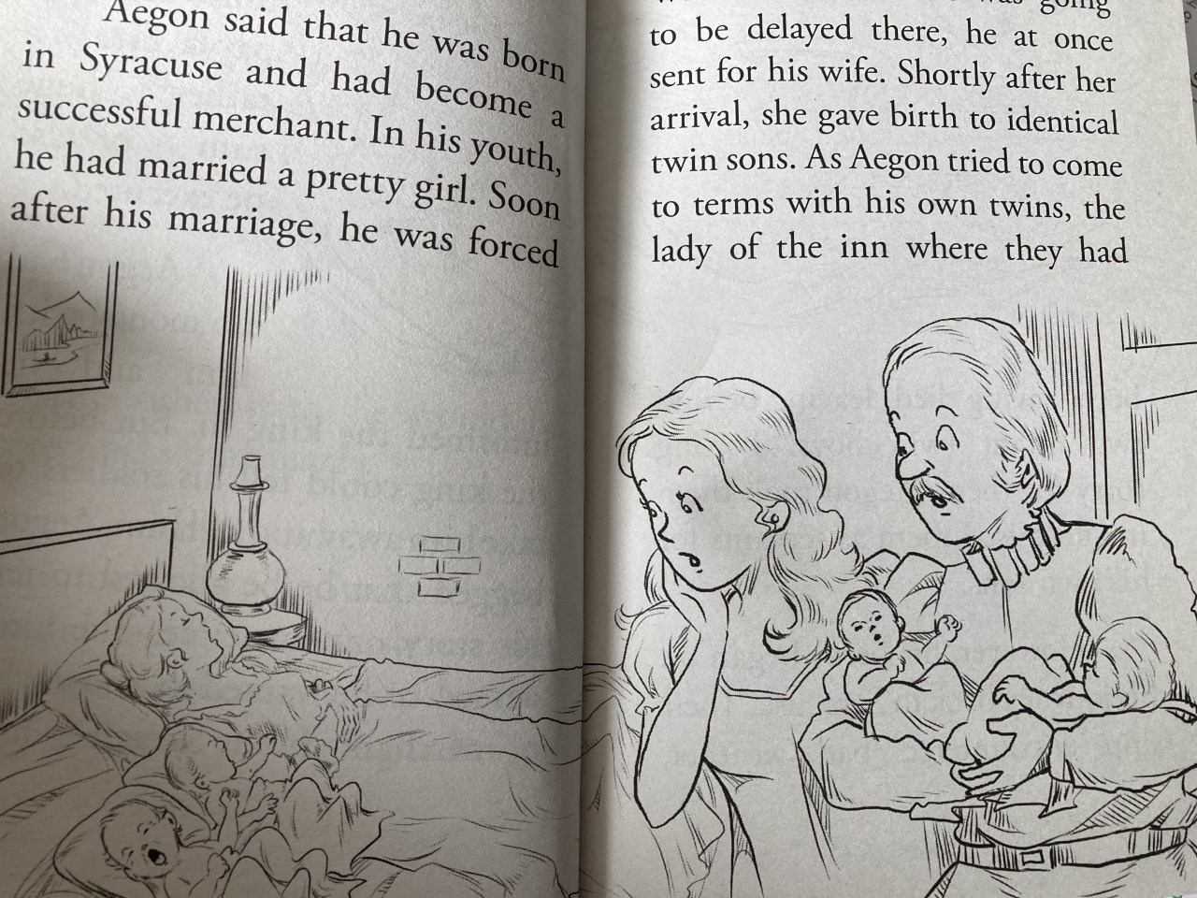
Let’s Read
Let’s read the story to find out how things started
(read to p.12)

Slide 6
Now…
Create a cartoon strip showing how the four boys and Aegon got separated.
What events may have happened after Aegon and his wife took the second set of twins?
Remember to keep the idea of each twin having a very different life and how they ended up in their home town.

Slide 7
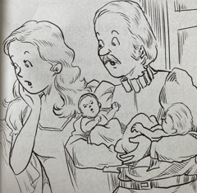

Antipholus of Ephesus
(rich merchant married to Adriana)
Dromio of Ephesus
 |  |  |  | Ephesus
 |  |  |  | Syracuse
Aegon and his wife ended up with two sets of twins.
Antipholus of Syracuse (stayed with Dad and looking for brother and Mum)
Dromio of Syracuse

