Slide 1
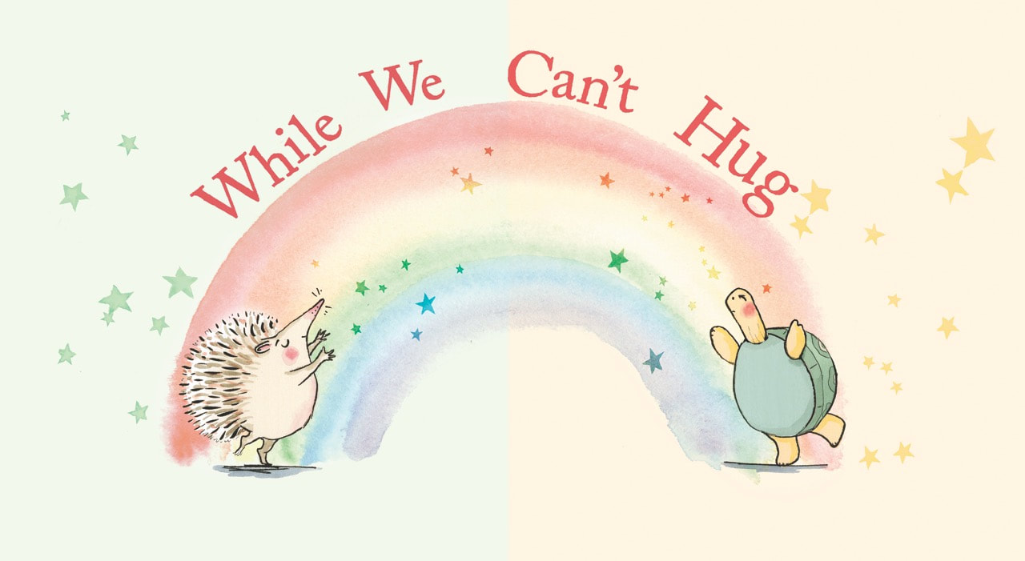
Friday 12th February 2021
PSHE

Slide 2
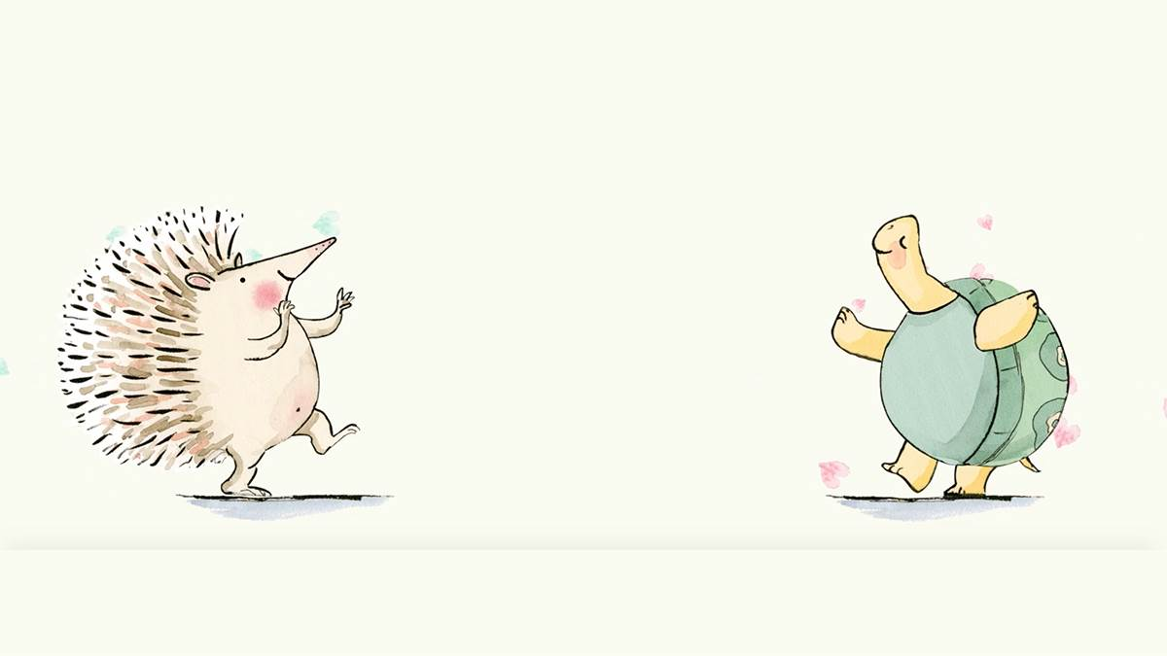
Watch the animation of the story and read along
https://www.youtube.com/watch?v=2PnnFrPaRgY

Slide 3
In this story hedgehog and tortoise want to show each other how much they care about each other but they aren’t able to hug at the moment.
Can you remember any of the ways they showed each other they cared?

Slide 4
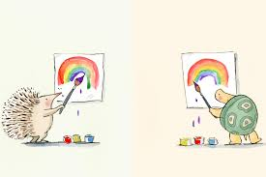
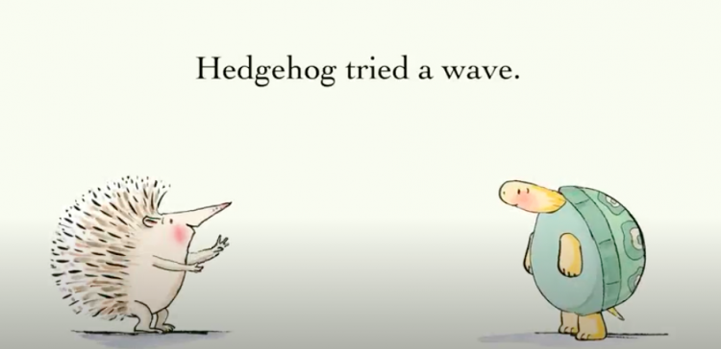
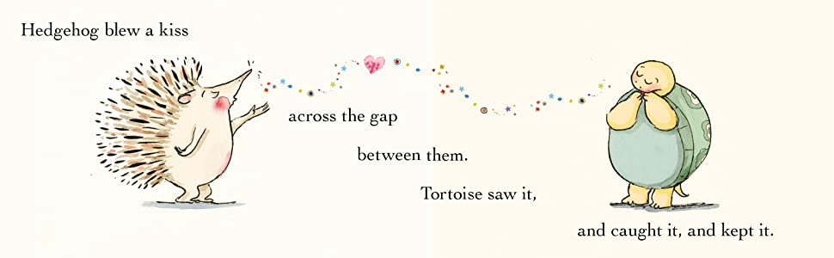
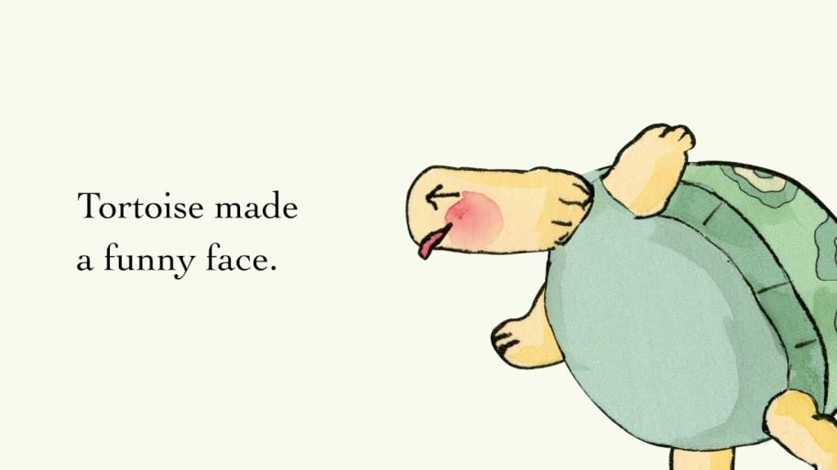
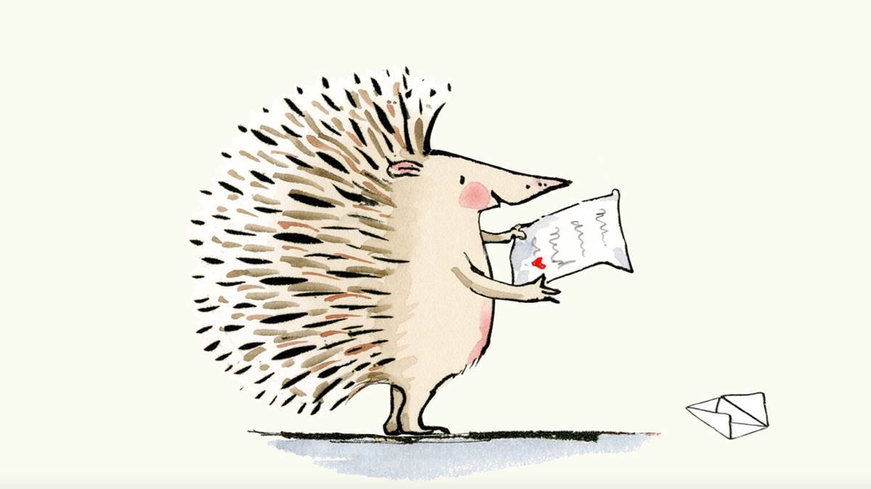
They painted pictures
They waved
They danced
They blew kisses
They pulled funny faces
They wrote letters

Slide 5
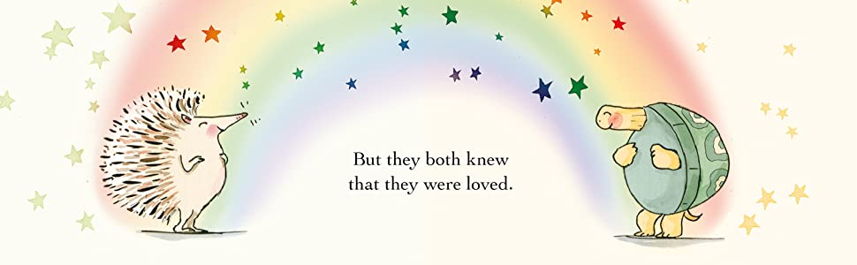
The hedgehog and the tortoise realised that even though the couldn’t hug each other that there were lots of other ways to show how much they care.

Slide 6
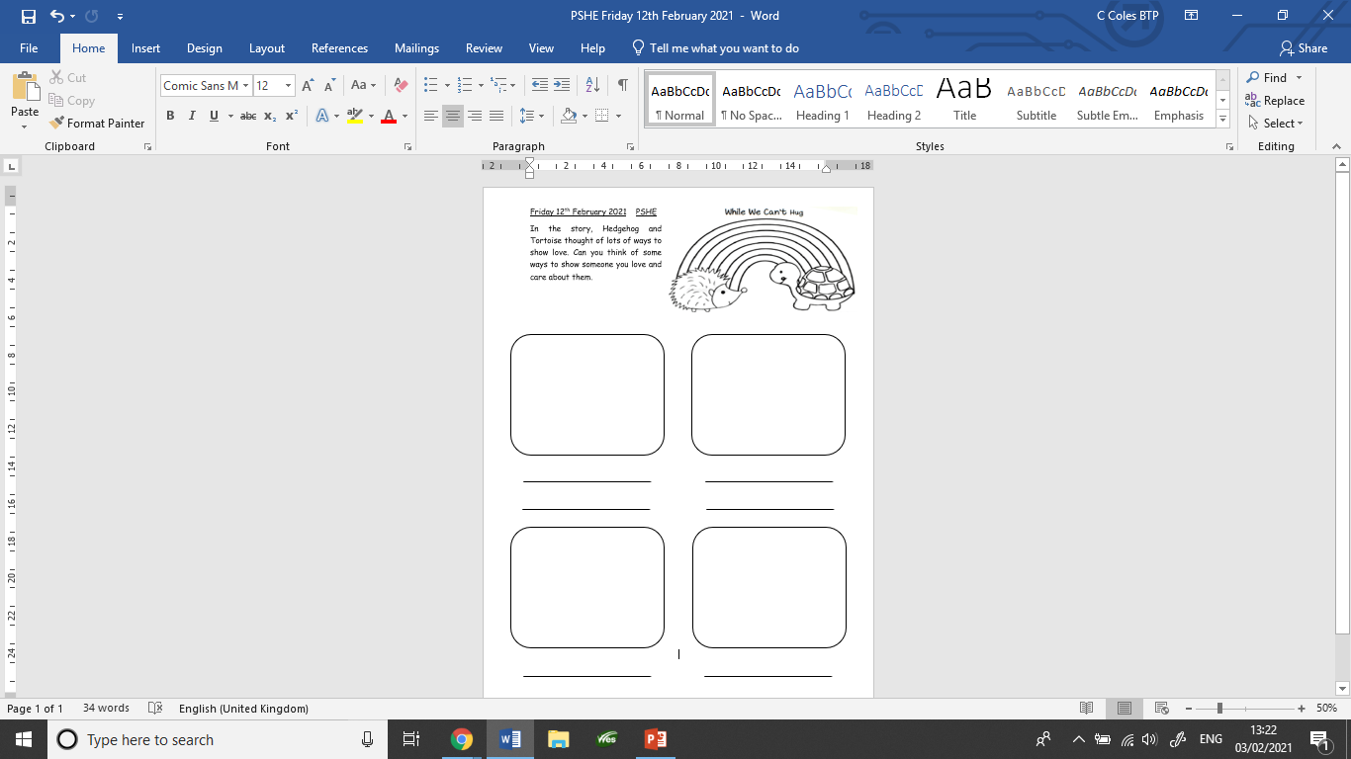
As we are currently in lockdown and not able to see everyone we would like to I would like you to think of different ways you can show someone you care about them. Create a poster or complete the worksheet below.

