Slide 1
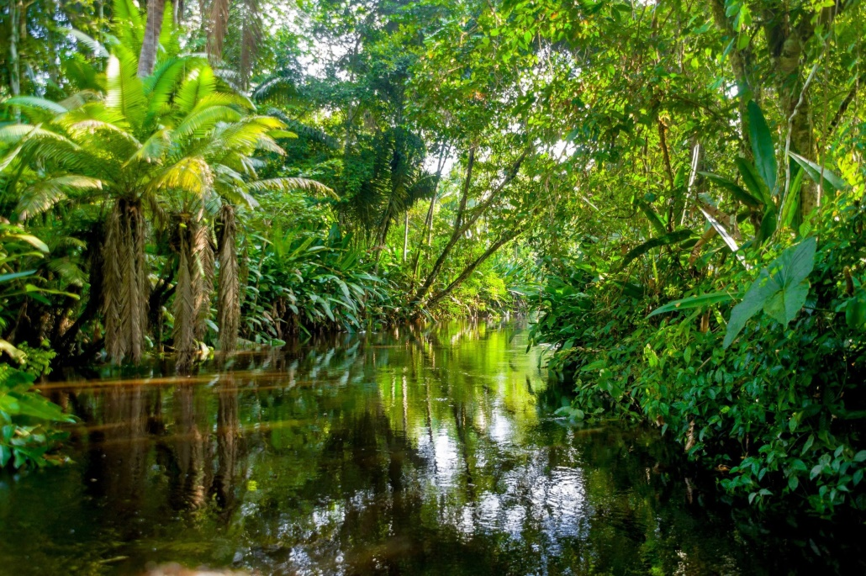
Wednesday 10th February 2021
To write a postcard to someone telling them all about your adventure in the Amazon Rainforest.

Slide 2
The past few days you have planned what you would take to the Amazon Rainforest as well as describing what you could do there.
Your task today is to imagine you have been there on an amazing adventure. Think about what you saw and what you did?
You are then going to write a postcard home to someone telling them all about your amazing adventure.
Here are some ideas of what Max and Rosie did on their adventure.

Slide 3
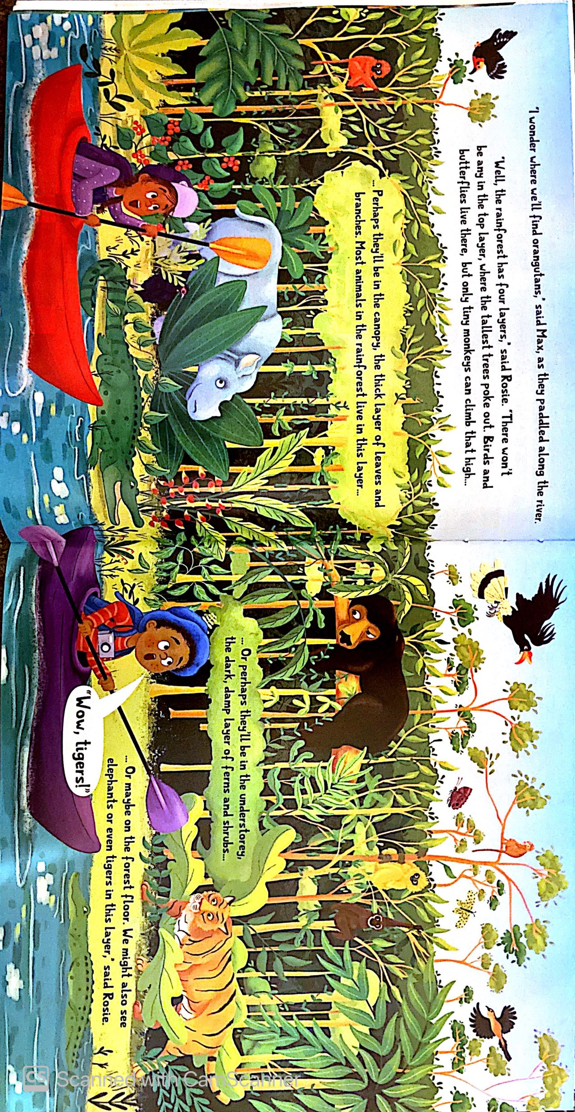

Slide 4
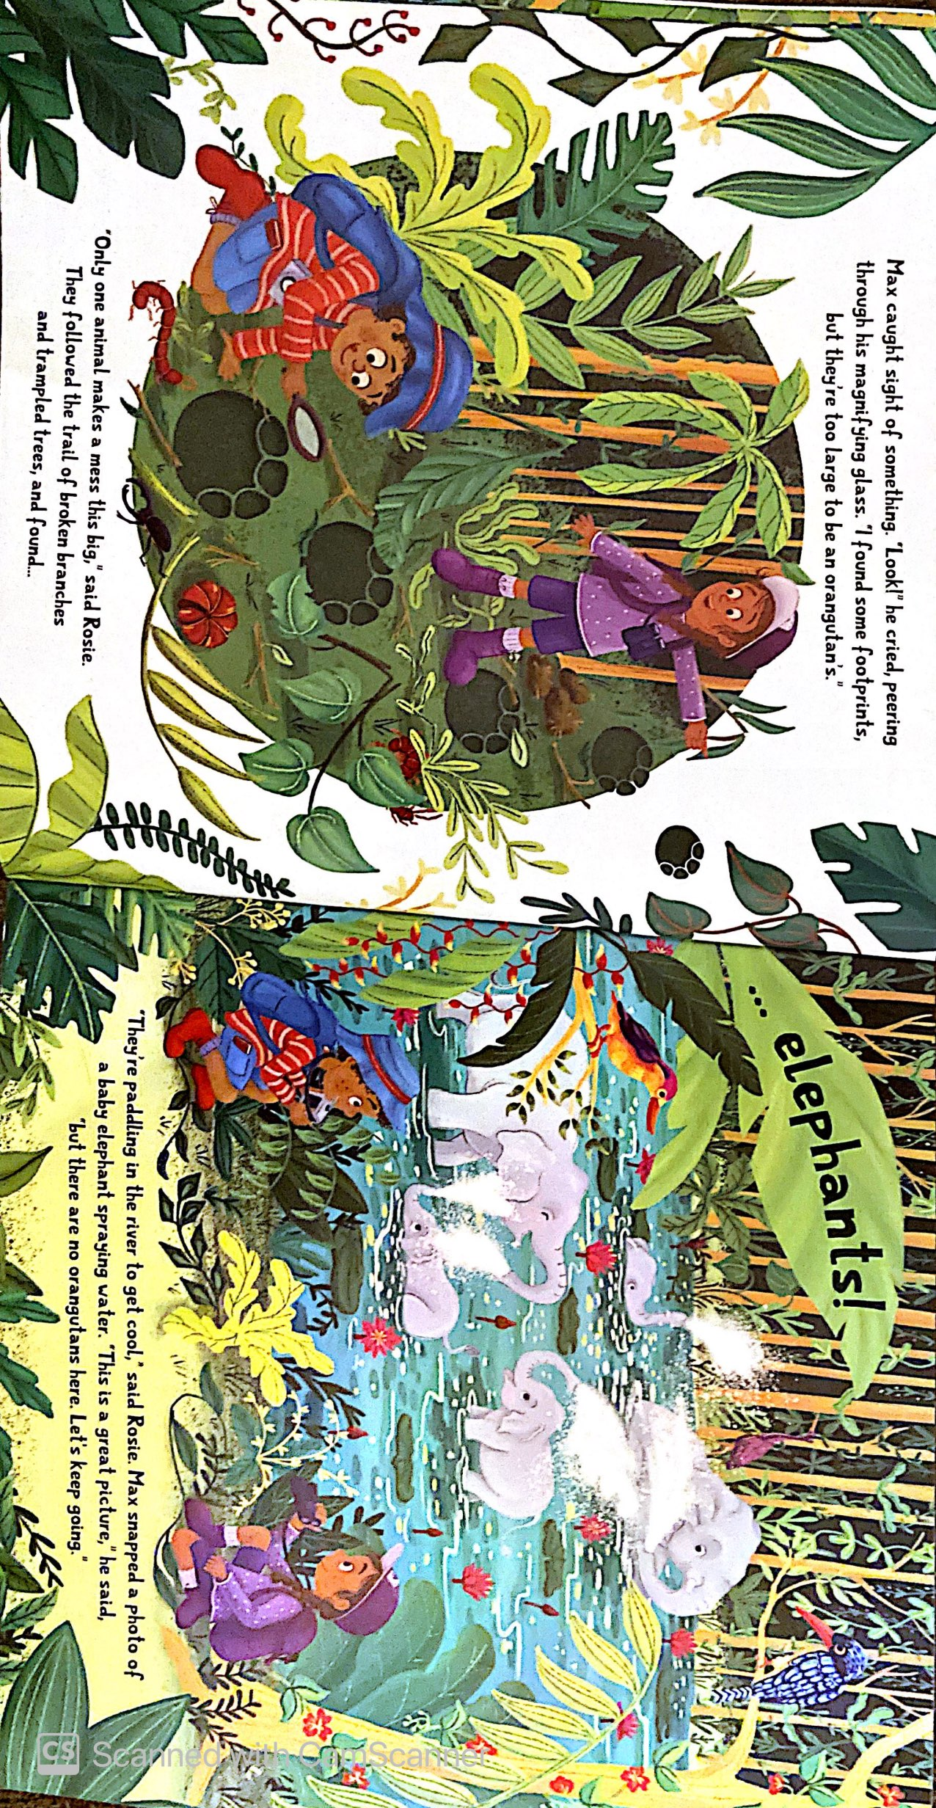

Slide 5
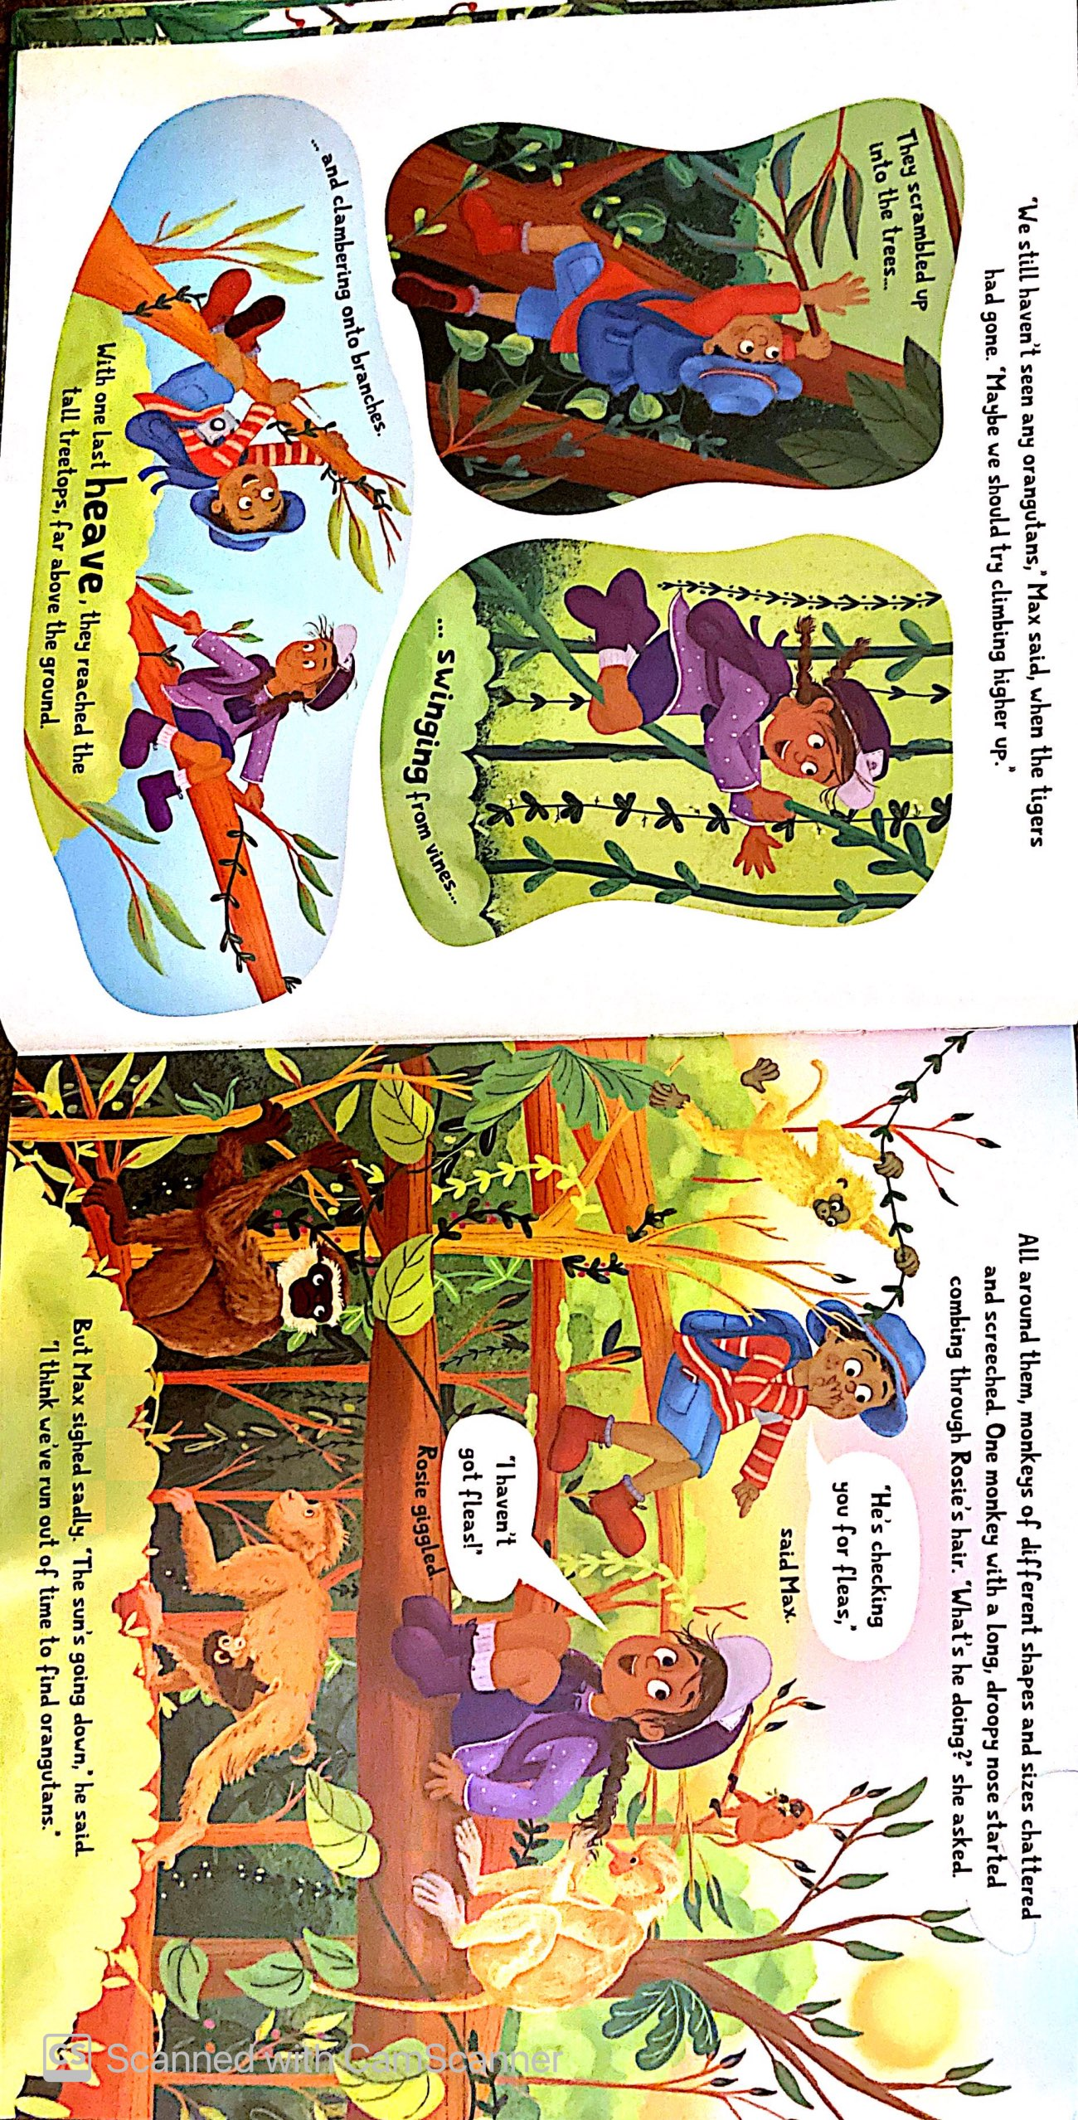

Slide 6
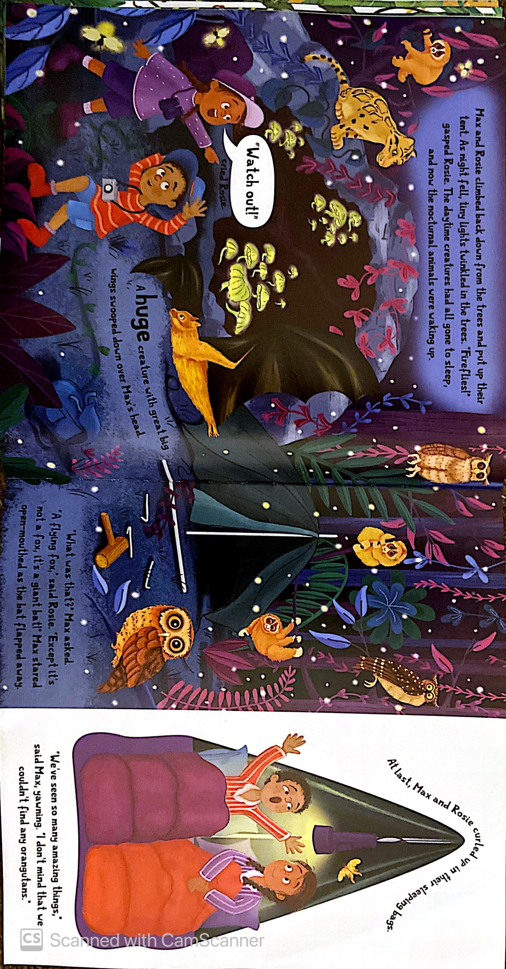

Slide 7
Let's think of ideas of what you saw and did.
What I saw…
The tallest trees
The world’s largest bird the Harpy eagle.
Jaguars relaxing by the river.
Snakes slithering along tree branches.
What I did…
Went kayaking down the Amazon River
Climbed a tall tree
Camped out under the stars.
Meet people from Amazon tribes.

Slide 8
What to be included in a postcard?
Space for a picture (on the front)
Space to write about your holiday.
Blank lines for an address.
postcard
The name and address of who you’re sending it to.
Some writing to say what you’ve been doing on your holiday.
Space in the top right corner for a stamp.

Slide 9
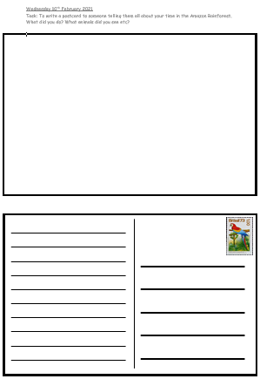
How to write your postcard. This template below is available on the class pages of the school website. You can also just create your own to avoid printing.
Draw a picture of part of your adventure in the amazon rainforest.
Who are you sending your postcard to?
Tell your chosen person all about your adventure.

Slide 10
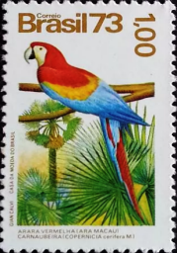
Dear Rosie
___________,__________________________________________________________________________________________________________________________________________________________________________________________________________________________________________________________________________________________________________________________________________________________________________
I am having so much fun here in
the Amazon Rainforest. Today I saw
Rosie Jones
__________________________________________________________________________________________
a jaguar laying by the river, I was
11 Pig Pen Lane
a little bit scared but very excited.
Hogshill, England
I made some new friends, they are
HH92IG
part of the Yanomami tribe, we even
went out looking for sloths together.
Later we are going kayaking down the
river. Did you know it’s the second
longest in the world?
See you soon, Max p.s. I hope you like my drawing.

