Slide 1

Tuesday 9th February
Safer Internet day 2021

Slide 2

Watch this safety smart video by Timon and Pumbaa from The Lion King, about how to stay safe on the internet.
https://www.youtube.com/watch?v=Zp2EvM2tzgg

Slide 3
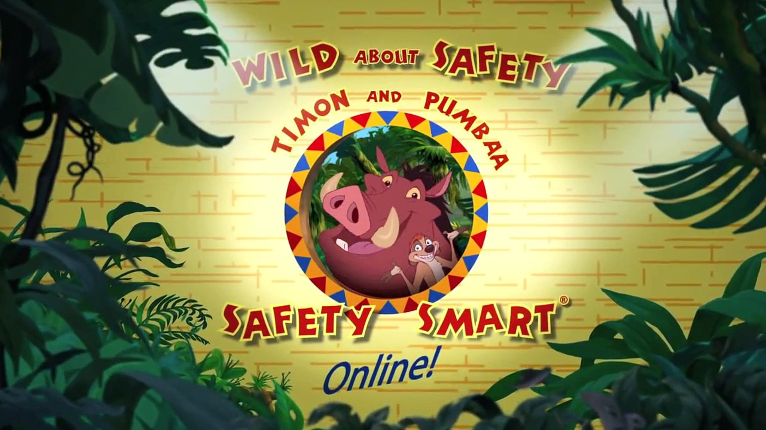
During the video Pumbaa taught Timon about how to stay safe online.
Can you remember any of the ways he said?
Not to give out any personal information e.g. your name and address.
Ask your grown ups before going on anything new.
Don’t talk to strangers.
Don’t send unkind messages.

Slide 4
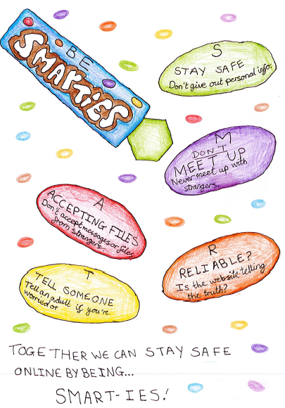
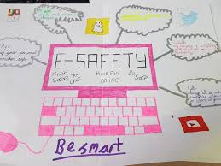
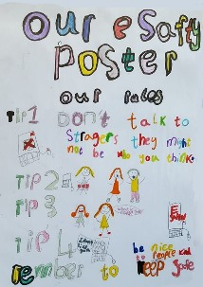
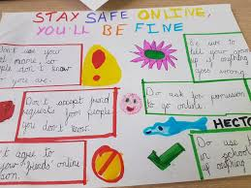
Your Task:
Create a colourful poster showing how to stay safe online.

