Slide 2
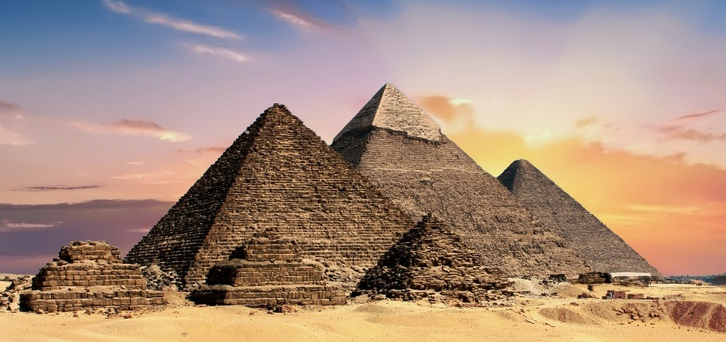
The Seven Wonders of the World
The Seven Wonders of the World are a group of places around the world that are considered to be of great importance.
The ancient Seven Wonders of the World were:
The Great Pyramid of Giza, Egypt
The Hanging Gardens of Babylon;
Did You Know…?
The Great Pyramid of Giza is the only ancient Wonder of the World that still exists today.
The Statue of Zeus at Olympia;
The Temple of Artemis at Ephesus;
The Mausoleum at Halicarnassus;
The Colossus of Rhodes;
The Lighthouse of Alexandria.

Slide 3


The New Seven Wonders of the World
In 2000, a campaign was started to decide on seven new Wonders of the World.
Over 100 million people cast their votes in order to whittle over 200 places down to just seven.
Seven New Wonders of the World.
The winners were announced on 7th July 2007 in Lisbon, Portugal.
Talk About It
What places in the world do you think should be considered a ‘wonder’ and why?

Slide 4
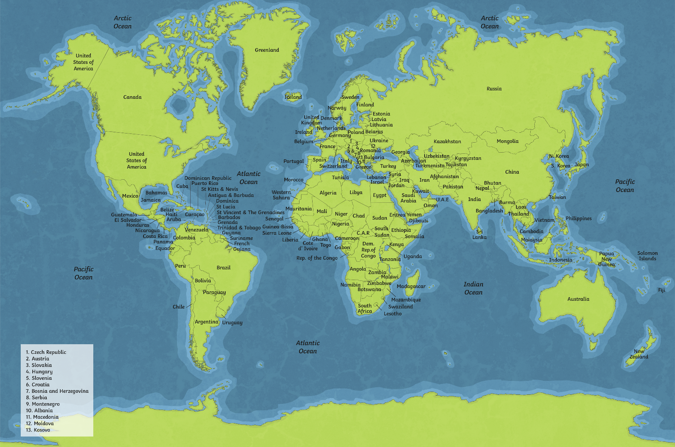
The New Seven Wonders of the World
Click on the map to find out more about the new Wonders of the World.
The Colosseum in Italy
Petra
in Jordan
Chichén Itzá in Mexico
Christ the Redeemer
in Brazil
Talk About It
Machu Picchu
in Peru
Taj Mahal in India
The Great Wall in China

Slide 5
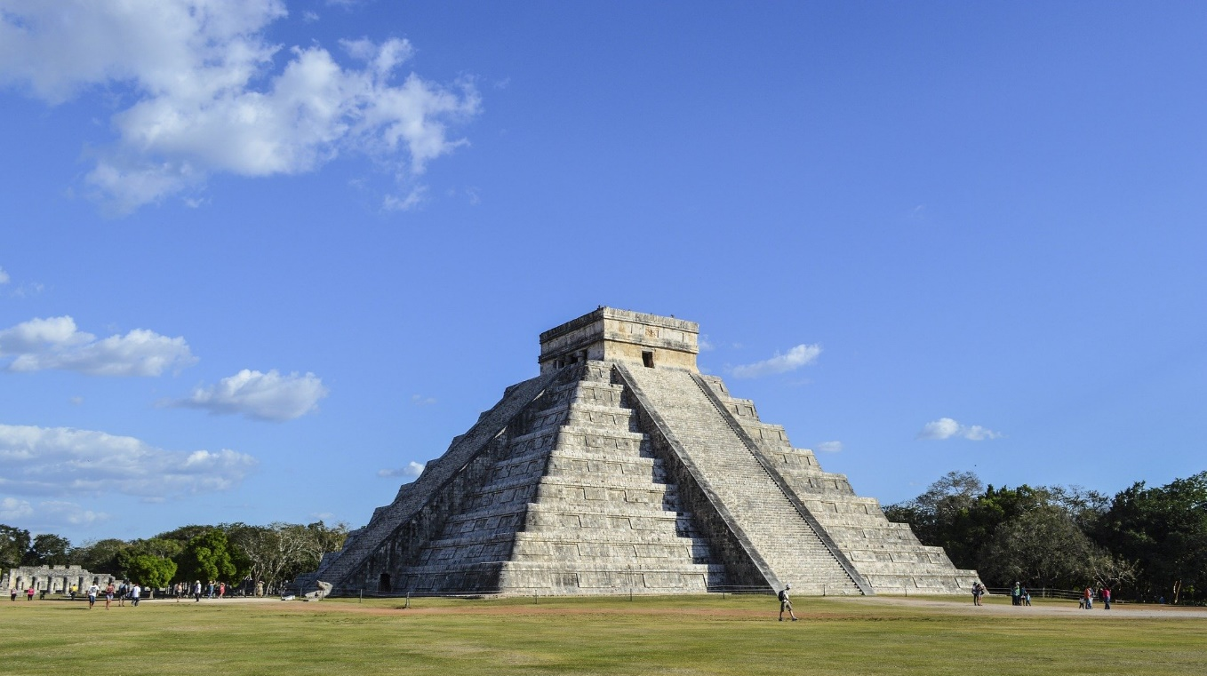
Chichén Itzá, Mexico
Back
Chichén Itzá was a city built by the Mayan tribe over 1500 years ago. The city was an important political and economic centre for the Mayans.
The photograph shows the Temple of Kukulkan, sometimes known as El Castillo. It has 91 steps on each of its four sides. Added to the final step at the top of the temple, this totals 365 steps - one for each day of the year.

Slide 6
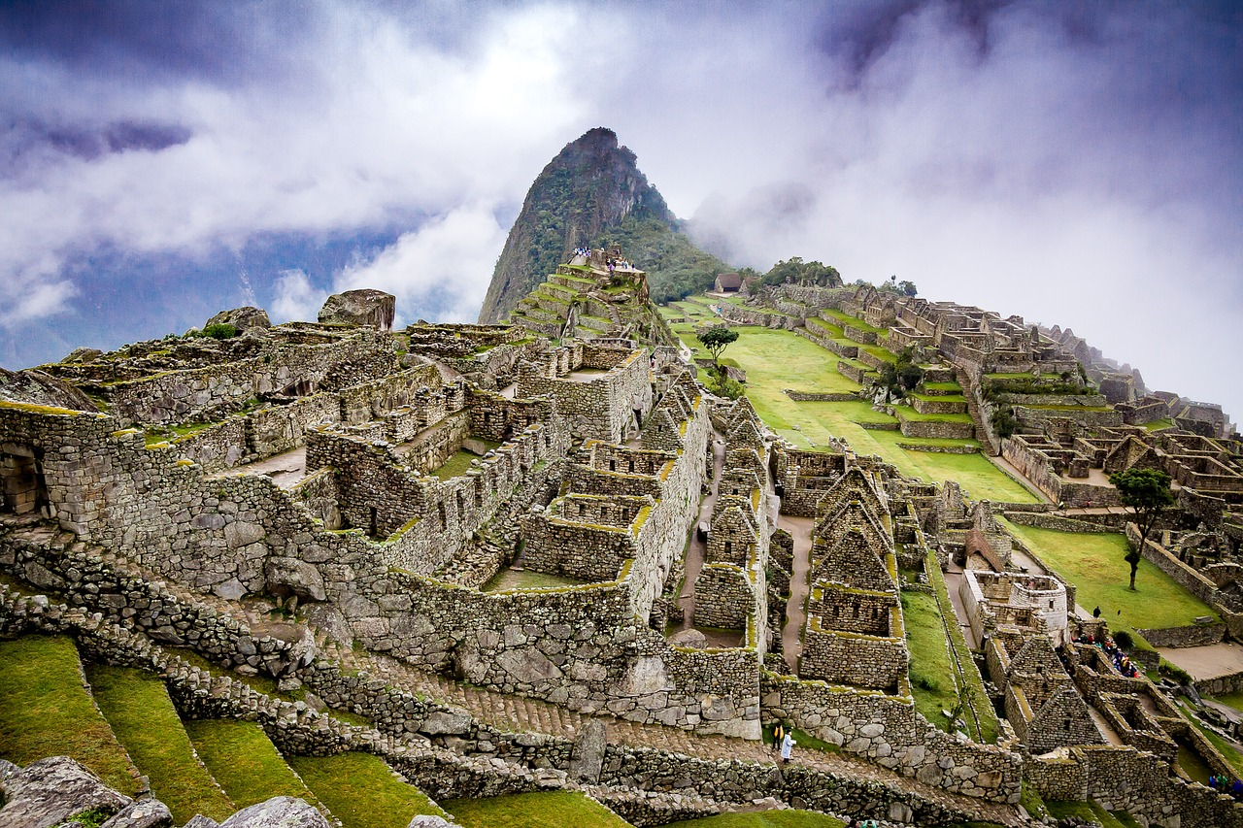
Machu Picchu, Peru
Back
Machu Picchu is the ruins of a city from the Incan empire that was built in the 15th century. The ruins are in the Andes Mountains, over 2000 metres above sea level. It is not certain why the city was first built. Gradually, over time, the city was abandoned.

Slide 7
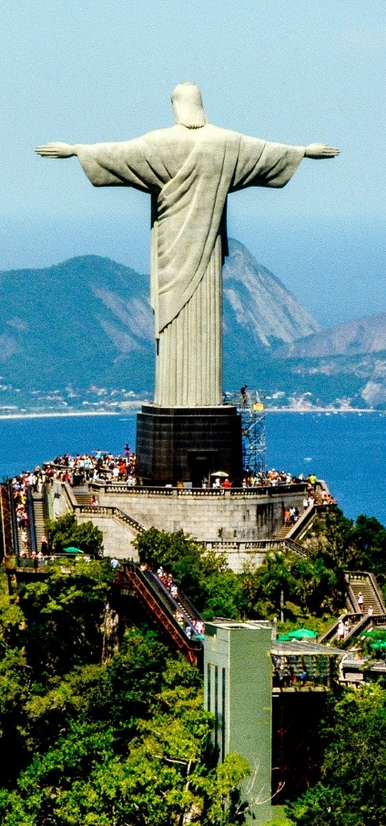
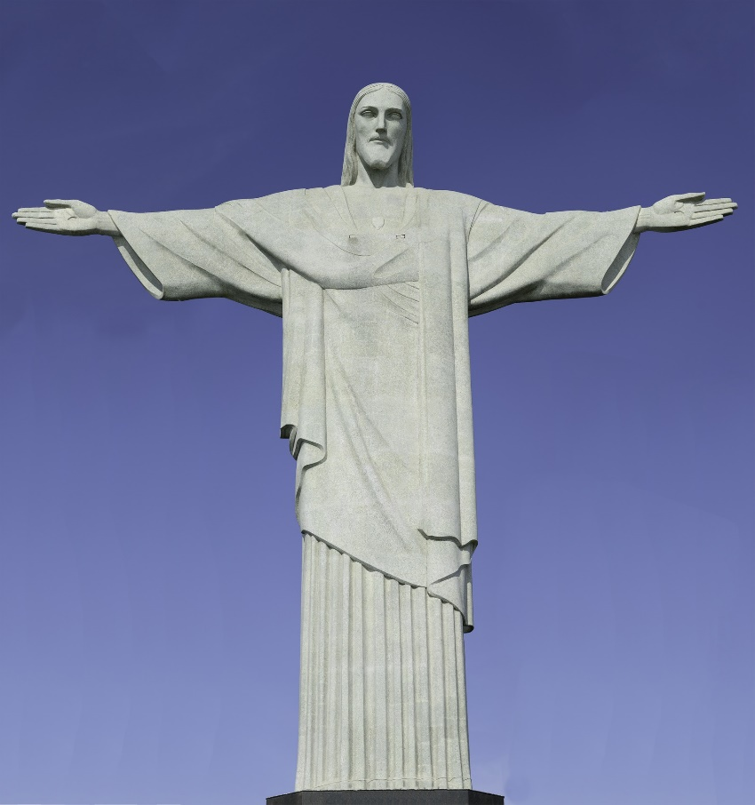
Christ the Redeemer, Brazil
Back
Christ the Redeemer is a 30 metre tall statue that is at the summit of Corcovado Mountain overlooking Rio de Janeiro, Brazil. The statue shows Jesus Christ with his arms spread out over the city. The arm span of the statue is 28 metres. The statue was completed in 1931.

Slide 8
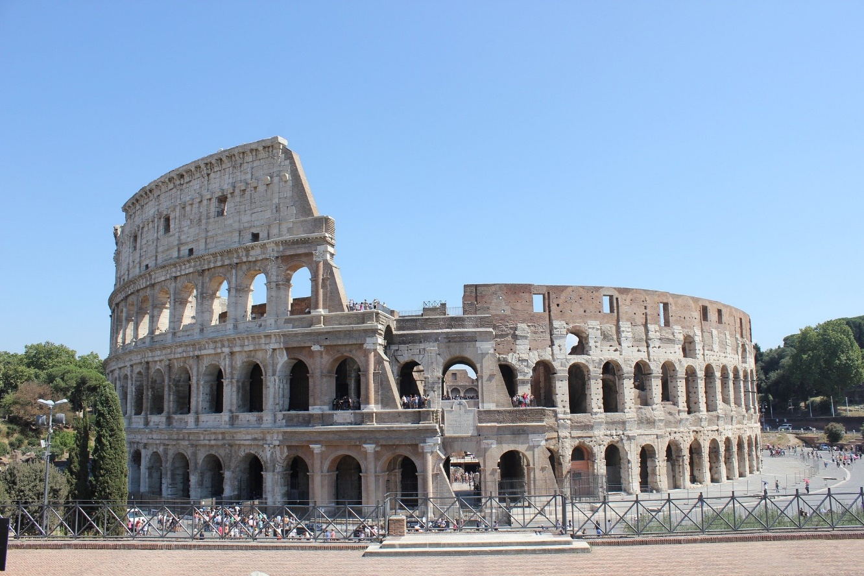
The Colosseum, Italy
Back
The Colosseum, also know as the Flavian Amphitheatre, was built between AD 70 and AD 80. It was used for gladiator fights, animal hunts and public executions. The floor of the Colosseum could be flooded in order to stage sea battles. Although some of the Colosseum was destroyed in the great earthquake in 1349, it remains a popular tourist attraction.

Slide 9
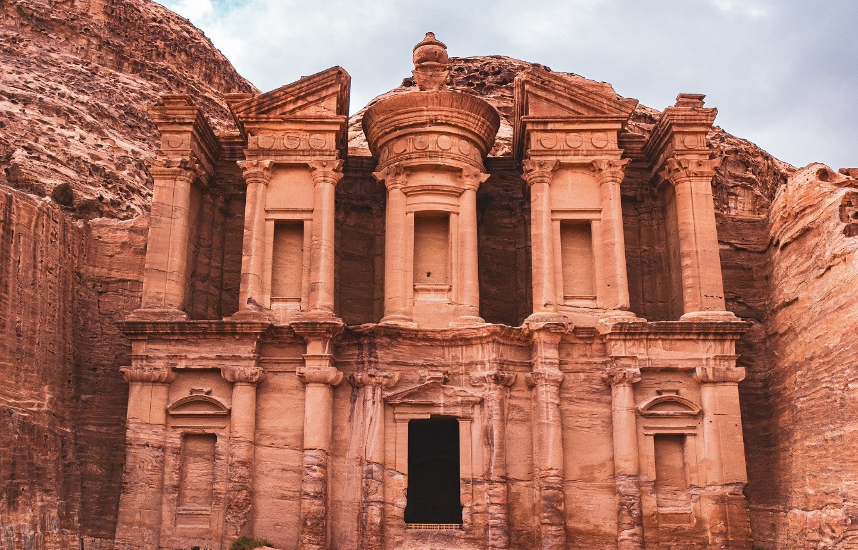
Petra, Jordan
Back
Petra is an ancient city carved into rock. It is thought that it was built over 2000 years ago by a group of people called the Nabateans. However, not much is known about the Nabateans. An earthquake in AD 363 damaged the city and it eventually fell into disuse. The city ruins were rediscovered in 1812 by a Swiss explorer called Johann Burckhardt.

Slide 10
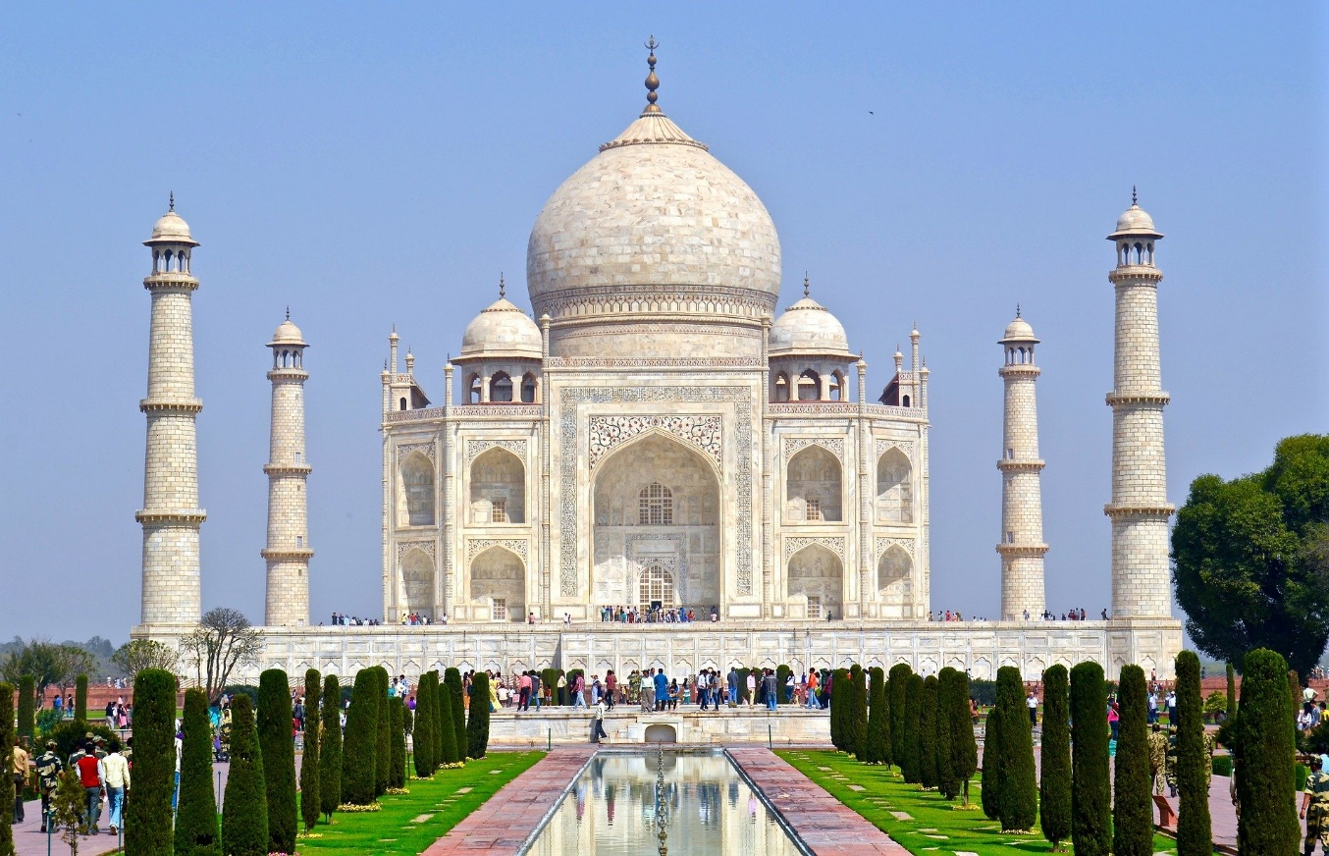
Taj Mahal, India
Back
In 1632, Emperor Shah Jahan commissioned the Taj Mahal to be built to house the tomb of his wife, Mumtaz. In the morning sun, the white marble looks a shade of pink. During the evening, it looks the colour of milk and looks golden at night when lit by the moon. Because the Taj Mahal commemorates Shah Jahan’s love for Mumtaz, couples like to have their photographs taken with the building in the background.

Slide 11
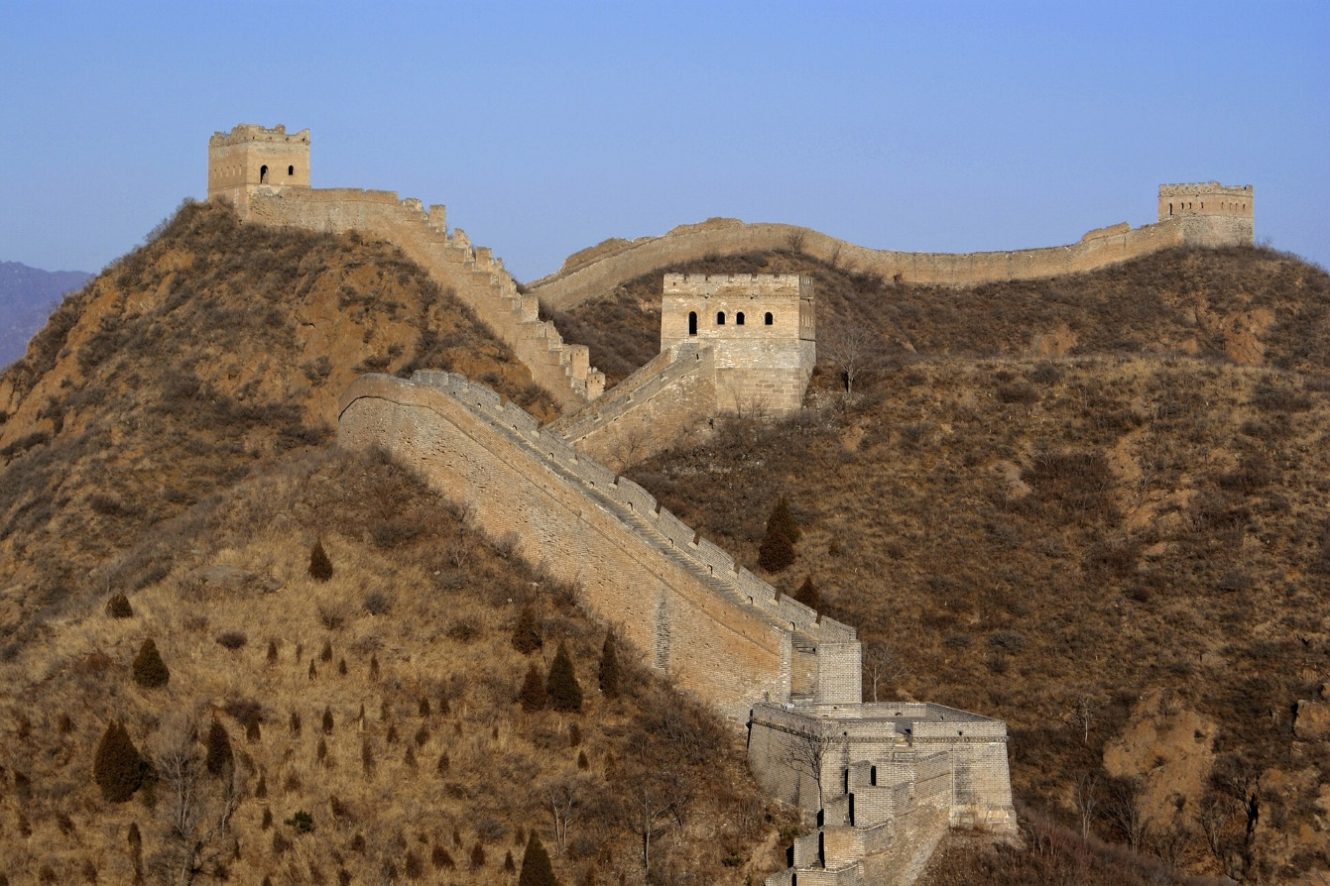
The Great Wall, China
Back
The Great Wall of China is the longest wall in the world. It was built by several different dynasties (ruling families) over several hundred years, starting in about 220 BC. The wall was built to defend areas from invasions and had watch towers built on the highest places.

Slide 12
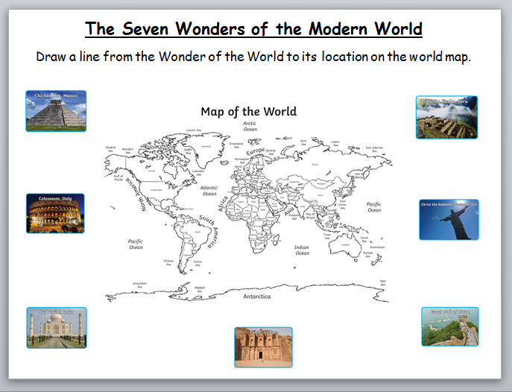
Your Task
Either print out or using PowerPoint, draw a line from the Modern Wonder of the World to its location on the world map.
If you do not have a printer, why not make a fact file about your favourite Modern Wonder of the World or draw a detailed picture of it.

Slide 13
These videos may be useful
https://www.youtube.com/watch?v=K6DSMZ8b3LE - Continents song
https://www.youtube.com/watch?v=b9pst4-_FWM – Seven Wonders of the World song
https://www.bbc.co.uk/iplayer/episodes/m0007z03/go-jetters?seriesId=b06l1w5z&page=2 -Join the Go Jetters as they visit many of the Modern Wonders of the World.

Slide 14
Talk About It
Which of these places would you most like to visit and why?
Were you surprised by any of the places on this list of the new Seven Wonders of the World?
Do you know anyone who has visited any of these places?
Is there a place not listed in the new Seven Wonders of the World that you think should be there? If so, explain why it should be there.
Which place would you remove?

