Slide 1
Tuesday 9th February 2021
LO: To write a travel activity brochure

Slide 2

We are going to reread the story Rainforest Adventures.
Pay attention to what different activities they do throughout the story. This will help you with ideas for todays activity.

Slide 3
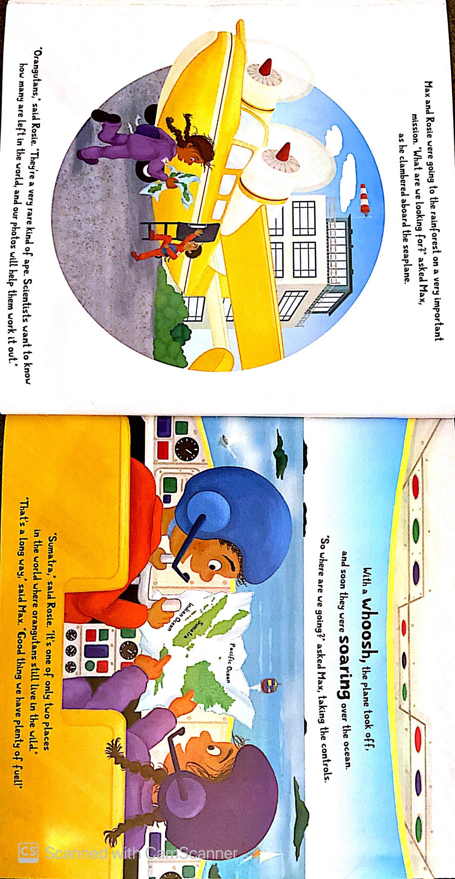

Slide 4
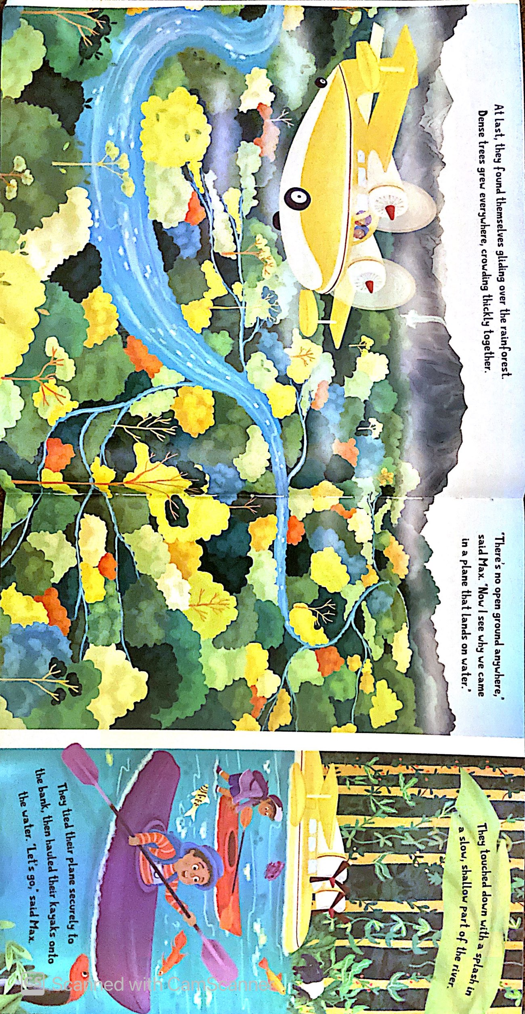

Slide 5
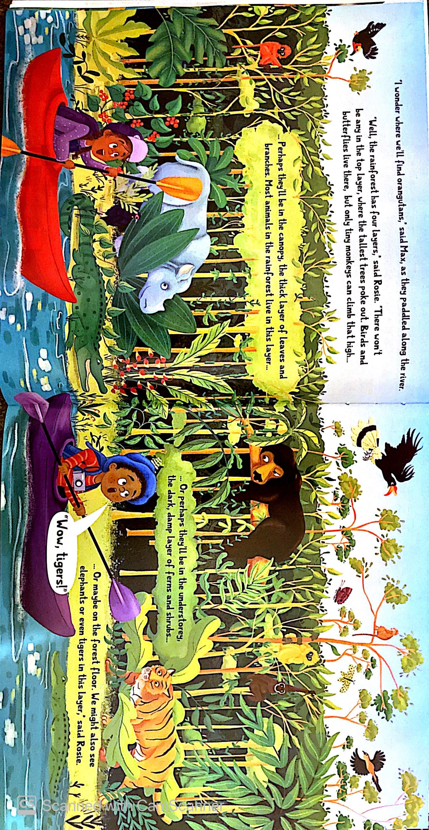

Slide 6
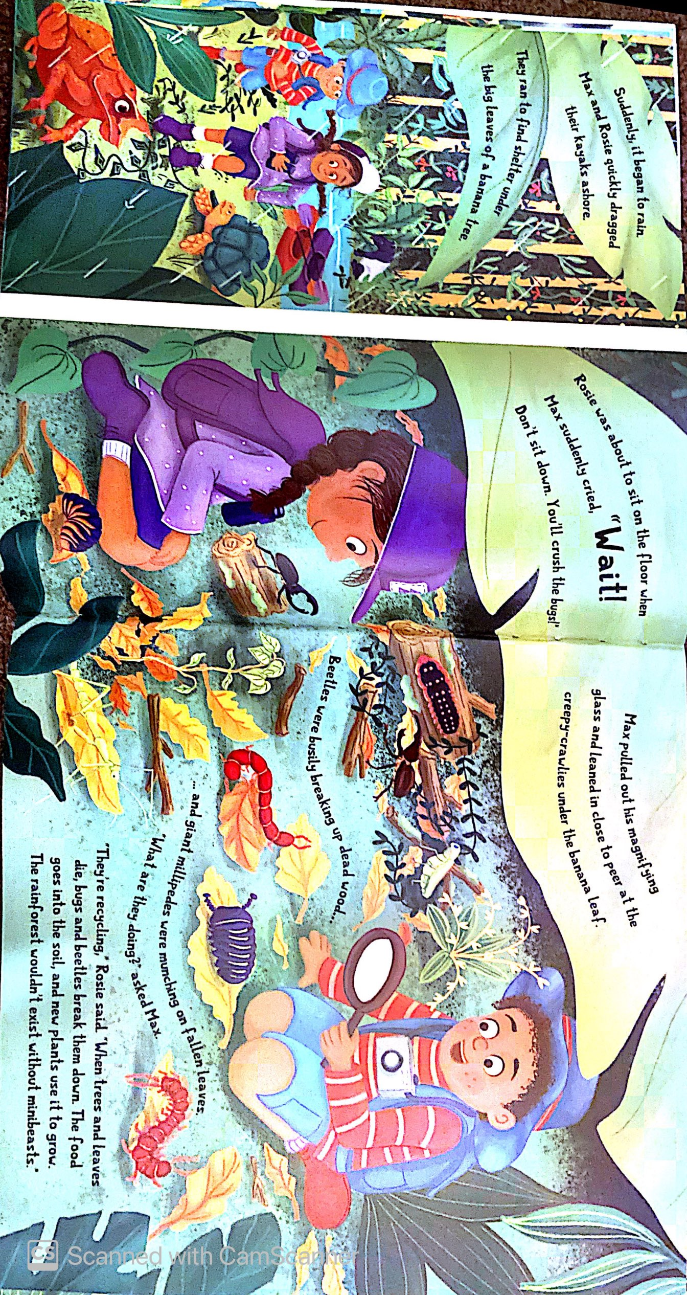

Slide 7


Slide 8


Slide 9
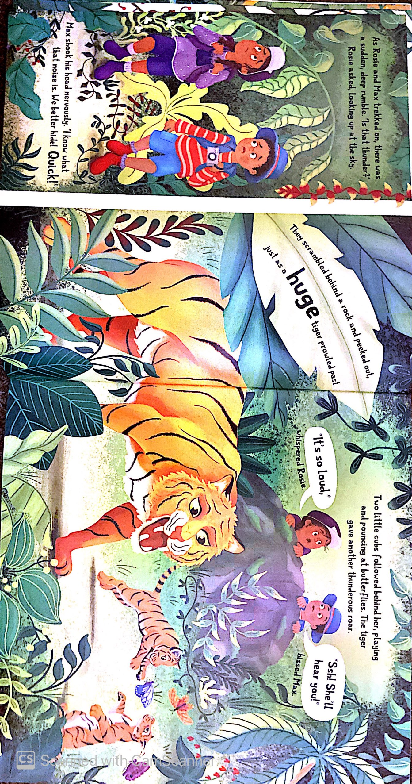

Slide 10
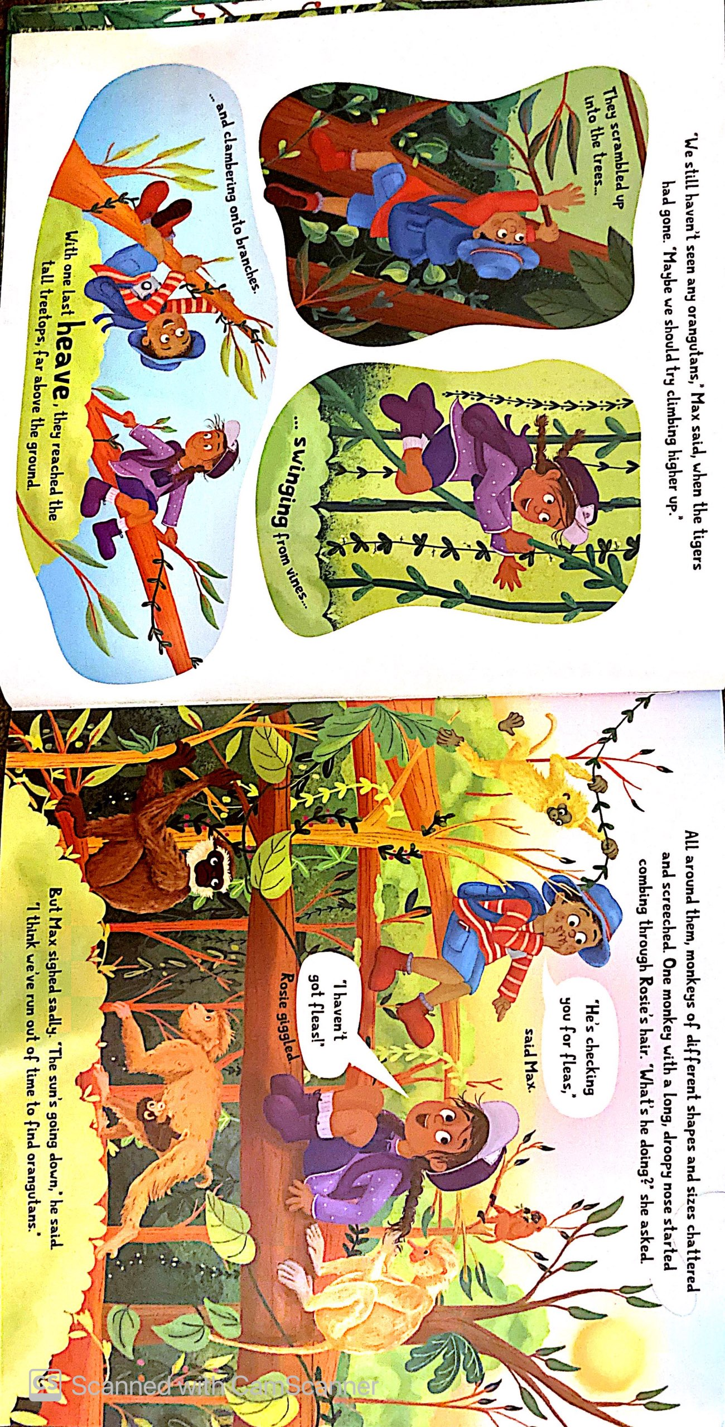

Slide 11
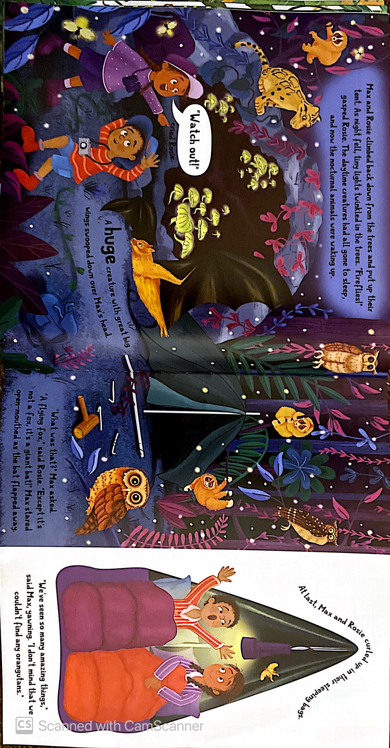

Slide 12
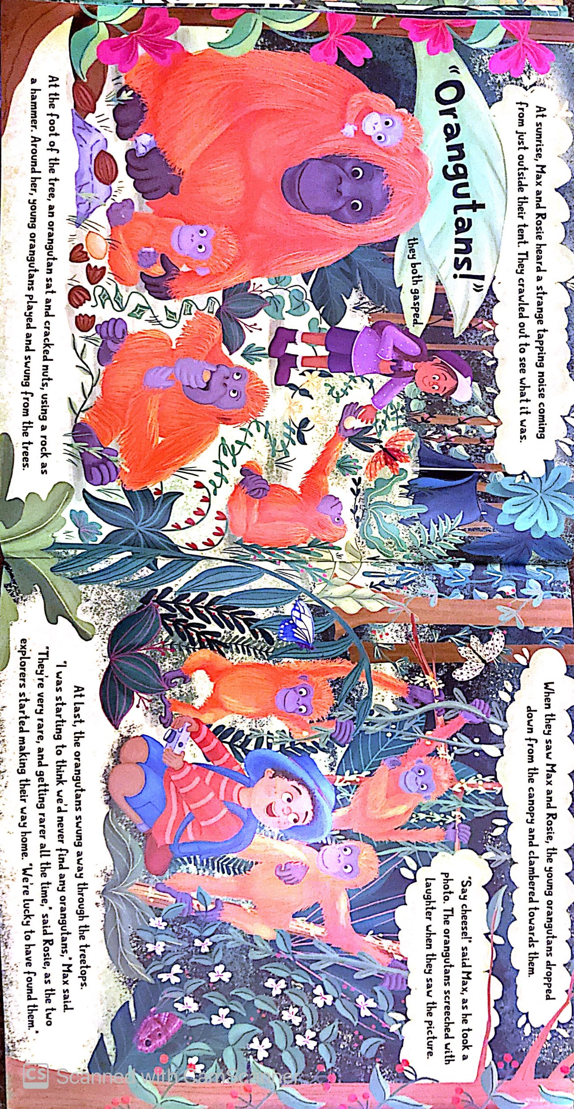

Slide 13


What activities did they do while in the rainforest?

Slide 14
Your task today is to create a persuasive travel leaflet/brochure about the Amazon Rainforest.
You will need to talk about all the amazing activities you can do in the Amazon Rainforest and why people should go there.
Try and include some of the facts you have found out about the rainforest and the animals that live there.
Let’s look through an example.

Slide 15
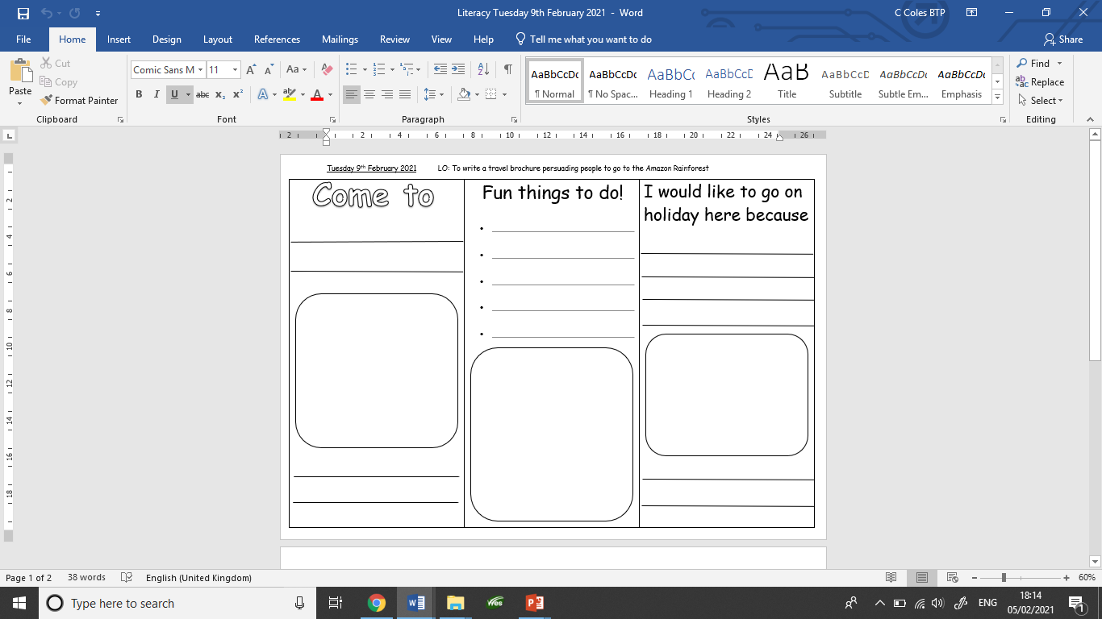
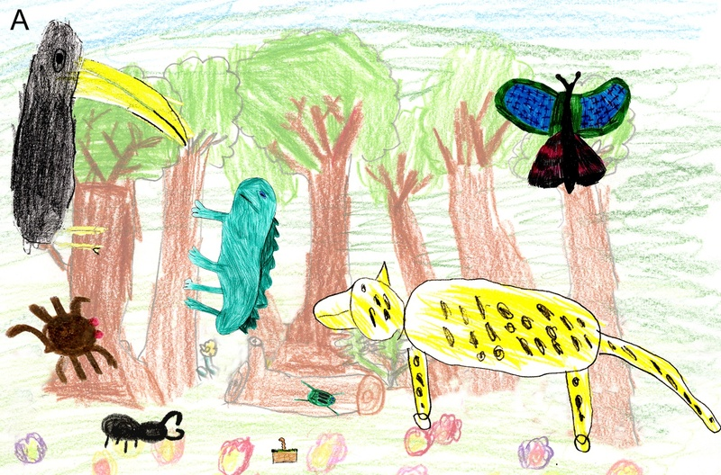
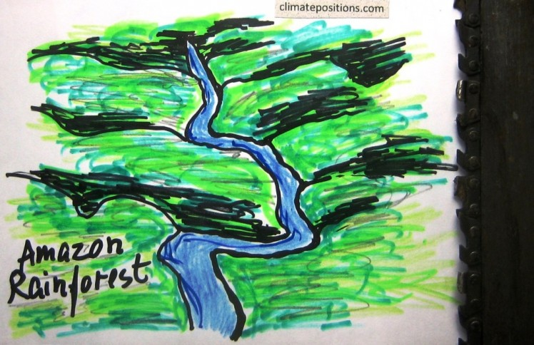
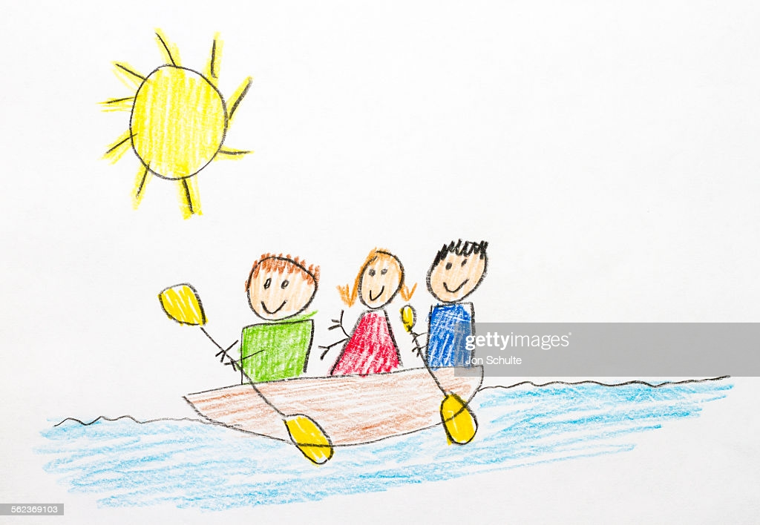
The Amazon
Climbing trees
Kayaking
I would get to see
Rainforest
lots of amazing
Camping
animals I could not
Going for walks
see anywhere else.
Looking for animals
The most beautiful
Did you know the
place in the world.
Amazon River is the
second longest?

Slide 16

Either use the template provided or create your own
travel leaflet/brochure.
Draw/print out pictures to go in the large spaces.
Include fun and interesting things that would make you want to visit the Amazon Rainforest.

