Slide 1
2D Shape Challenge

Slide 2
Your Task
Use the information on the next few slides to complete the following challenges.
Search for regular and irregular shapes around your home.
Find irregular and irregular shapes in the patterns on the next few slide.
Use regular and irregular shapes to make your own patterns. When shapes fit together we say that they tessellate. Can you use tessellation to create your own patterns?

Slide 3

Regular and Irregular Shapes
Regular shapes have sides that are all equal and angles that are all equal.
Here are some examples:

Slide 4
Regular and Irregular Shapes
Irregular shapes have sides and angles of any length and size.
Here are some examples:

Slide 5

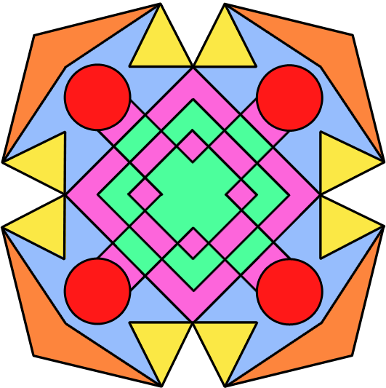
Shipwreck Patterns
Which shapes are regular and which are irregular?
Can you explain to your partner why they are regular or irregular?

Slide 6
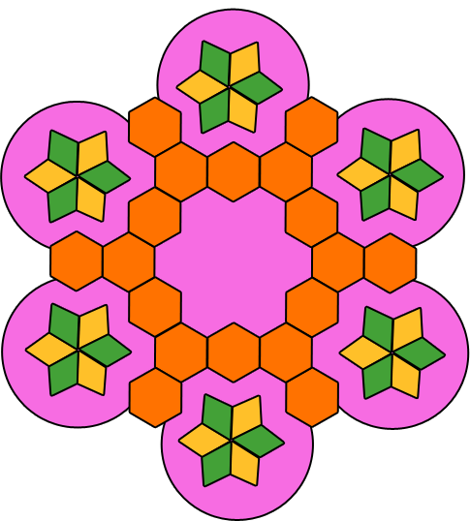
Shipwreck Patterns
Which shapes are regular and which are irregular?
Can you explain to your partner why they are regular or irregular?

Slide 7
Shipwreck Patterns
Which shapes are regular and which are irregular?
Can you explain to your partner why they are regular or irregular?

Slide 8
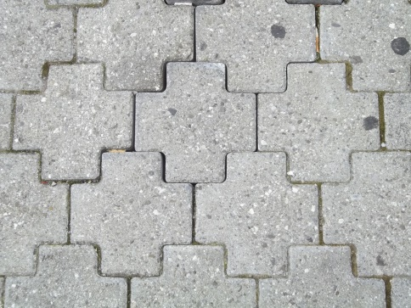
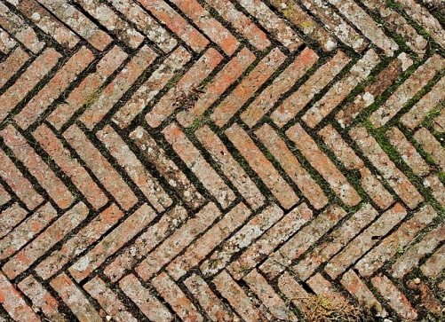
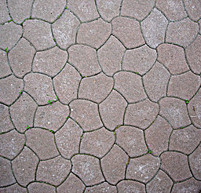
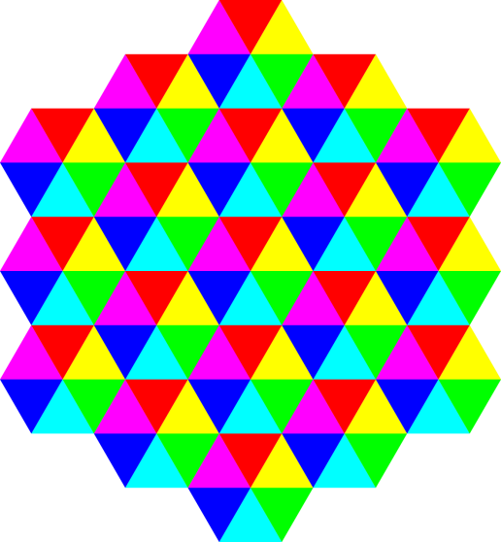
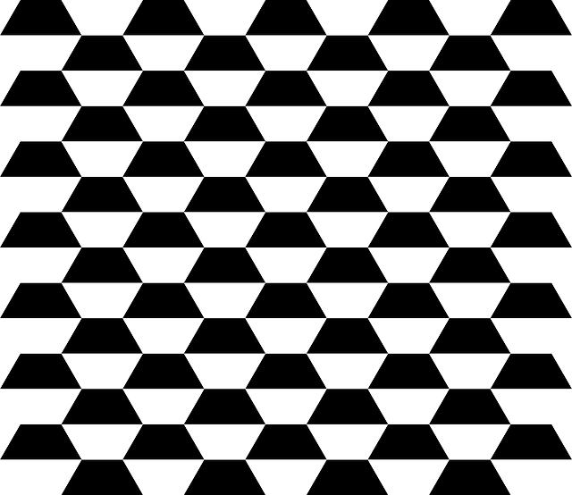
Tessellation
What do you notice?
Photo courtesy of Mathew Reames, aitoff, Dmharvey, OpenClipart-Vectors (@flickr/pixabay.com) - granted under creative commons licence – attribution

