Slide 1


Slide 3
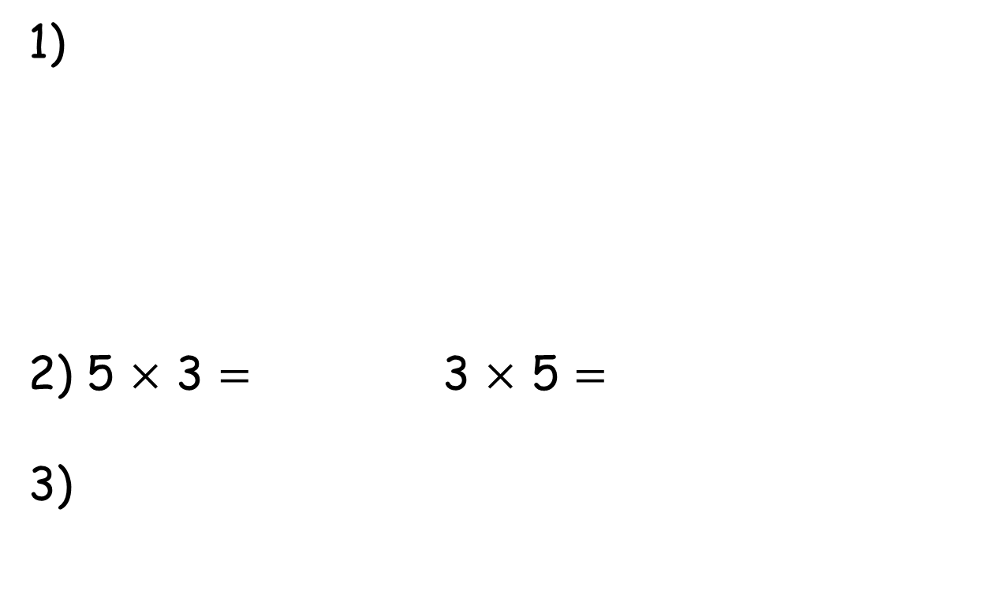
1)
2) 5 $×$ 3 $=$ 3 $×$ 5 $=$
3)
100
10
4
30
85
28
10
10
10

Slide 4
1)
2) 5 $×$ 3 $=$ 3 $×$ 5 $=$
3)
14
100
10
4
30
70
15
15
85
30
28
57
10
10
10

Slide 6
Have a go at questions 1 and 2 on the worksheet.

Slide 7
100
30
70
50
30
20

Slide 8
0
1
2
3
4
5
6
7
8
9
10
11
12
13
14
15
16
17
18
19
20

Slide 9
Have a go at questions 3 and 4 on the worksheet.

Slide 10


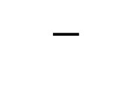

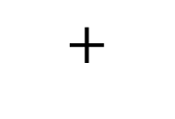
85
28
Have a think
85
28
28
$$+$$
$$=$$
85
85
$$−$$
28
$$=$$

Slide 11
Have a go at questions 5 and 6 on the worksheet.

Slide 12
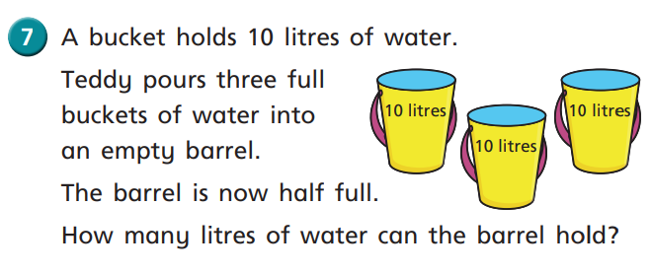
10
10
30
10

Slide 13
Have a go at the rest of the questions on the worksheet.

