Slide 1


Slide 3
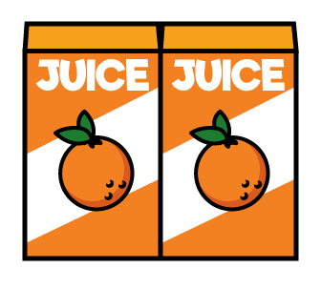


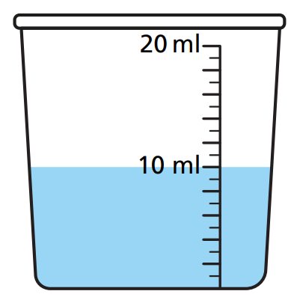
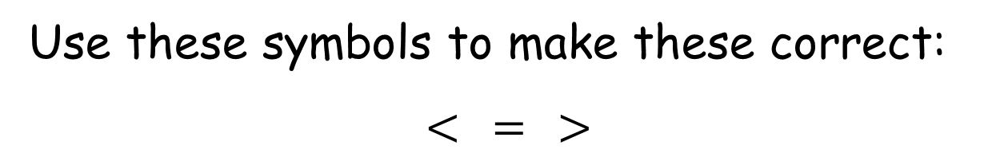
Use these symbols to make these correct:
$$< = >$$
2 litres
2 litres
2 litres
1 litre
1 litre
1 litre
5 litres
1 litre
1 litre
1 litre
5 litres

Slide 4



Use these symbols to make these correct:
$$< = >$$
2 litres
2 litres
2 litres
$$>$$
1 litre
1 litre
1 litre
5 litres
$$>$$
1 litre
1 litre
1 litre
5 litres
$$<$$

Slide 6
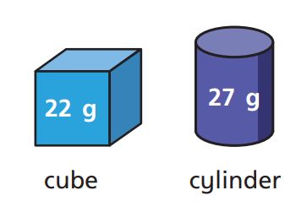

Slide 7
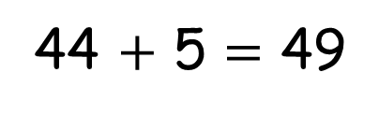
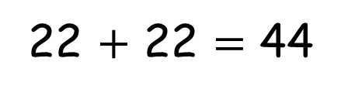
Cube
22 g
22 $+$ 22 $=$ 44
Cylinder
22 g
27 g
5 g
44 $+$ 5 $=$ 49

Slide 8
Have a go at questions 1 and 2 on the worksheet.

Slide 9
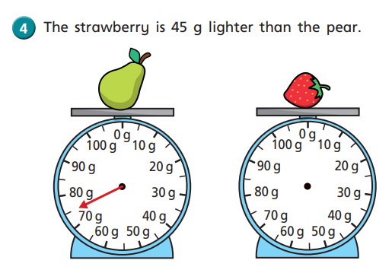
45
75
?
Notes:
Has he filed to 400 ml?

Slide 10
Have a go at questions 3, 4 and 5 on the worksheet.

Slide 11



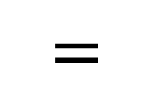
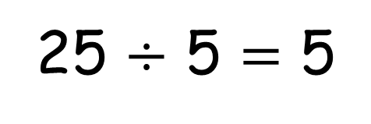
$$=$$
25
5
5
5
5
5
25 $÷$ 5 $=$ 5
Have a think
Notes:
The temp today is 18 d c which of these

Slide 12
Have a go at the questions on the worksheet

