Slide 1
Friday 26th March 2021
Comprehension
LO: To answer questions about the events in the story

Slide 2


Slide 3
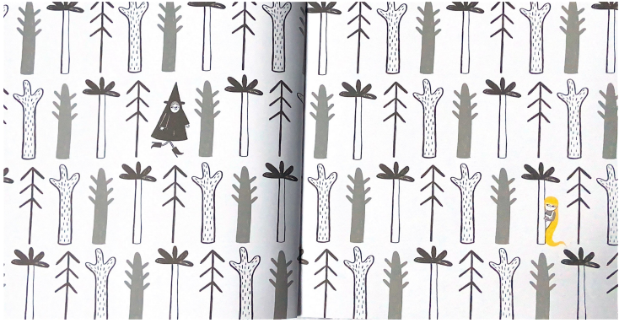

Slide 4
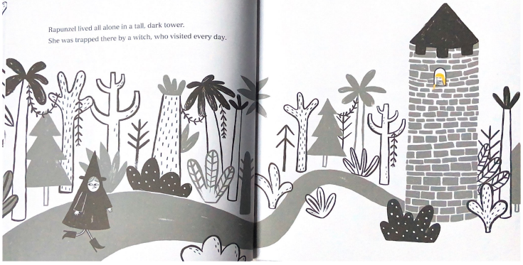

Slide 5
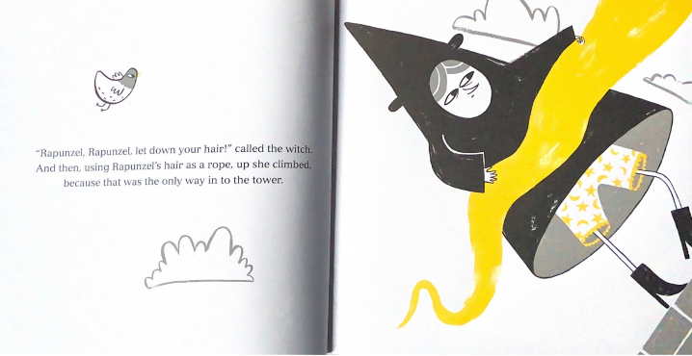

Slide 6
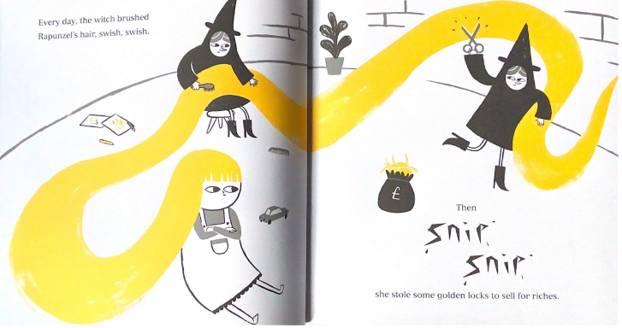

Slide 7
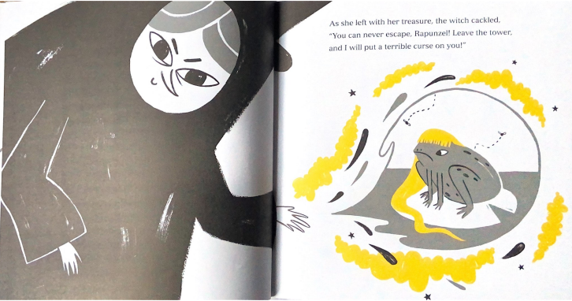

Slide 8
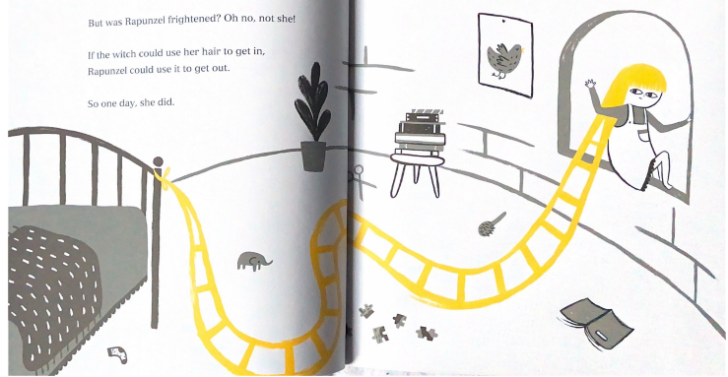

Slide 9
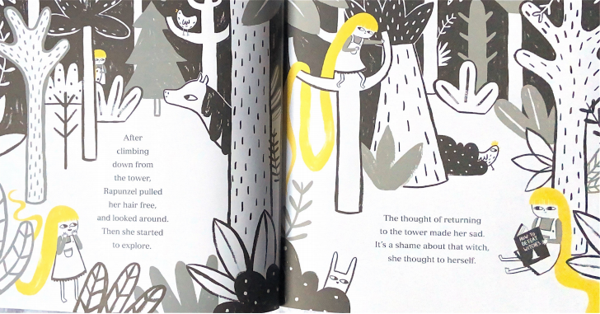

Slide 10
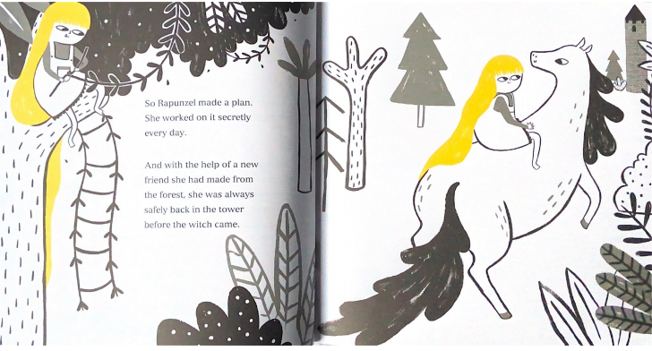

Slide 11
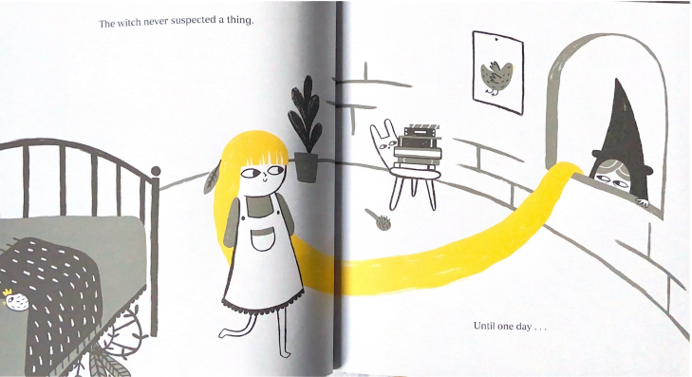

Slide 12
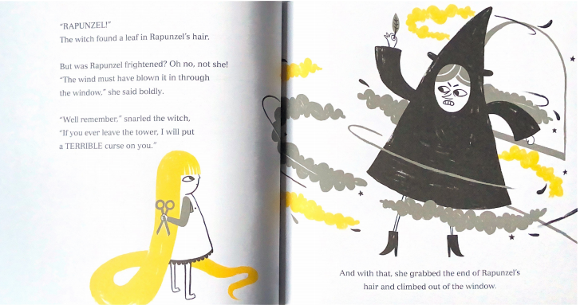

Slide 13
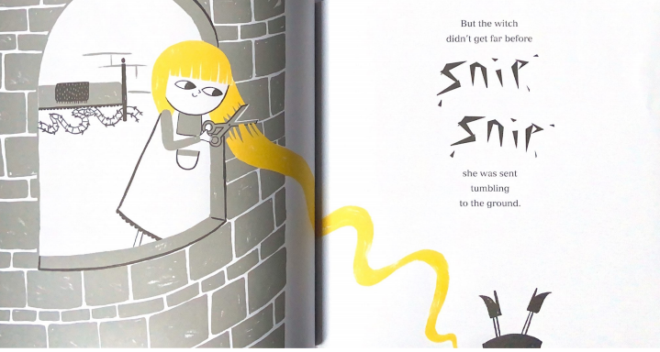

Slide 14
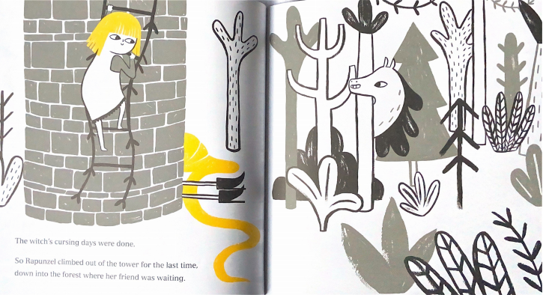

Slide 15
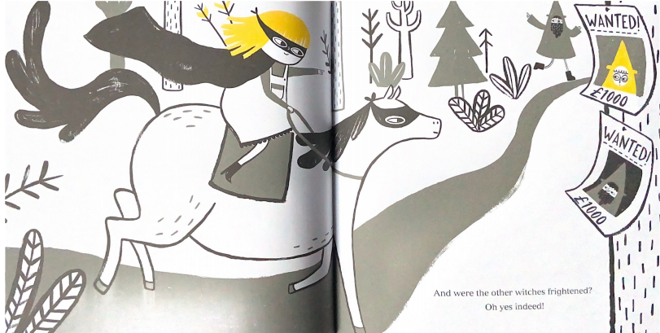

Slide 16
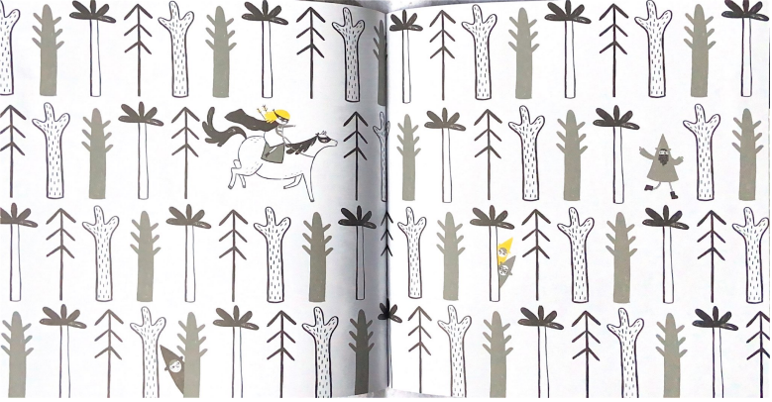

Slide 17
Your task
Yesterday your task was to order pictures of events from the story Rapunzel and write a caption to say what was happening during that part of the story.
Today using the same pictures you are going to answer some questions about the story.
Remember to try and use part of the question in your answer.

Slide 18
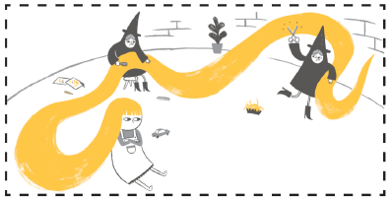
Example question
During this part of the story, what two things did the witch do to Rapunzel’s hair?
In this part of the story the witch brushed and cut Rapunzel’s hair to sell it.
Used part of the question in the answer.

Slide 19
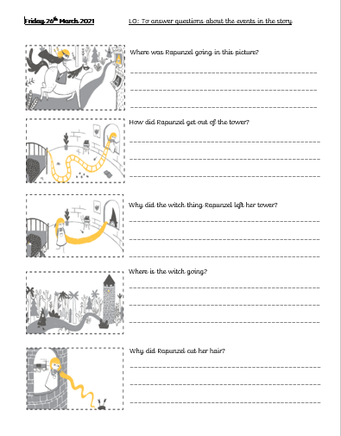
The questions all link to the picture next to it.
Remember to use part of the question in the answer.

