Slide 1
Thursday 25th March 2021
LO: To order events in a story

Slide 2


Slide 3
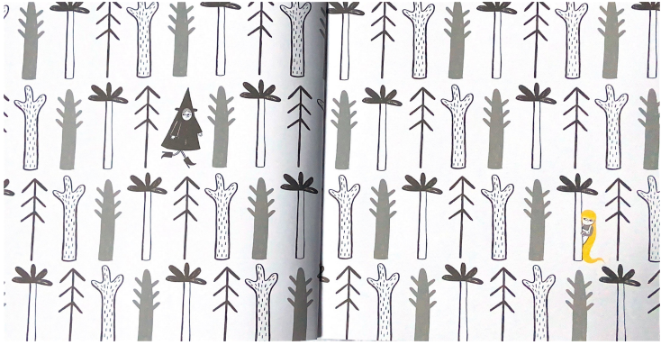

Slide 4
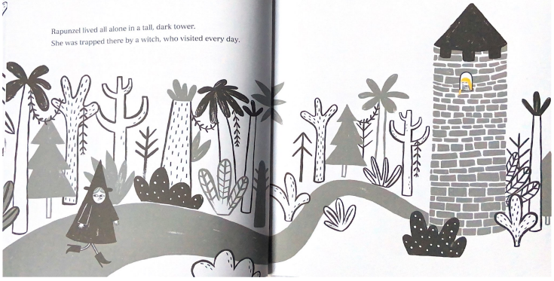

Slide 5
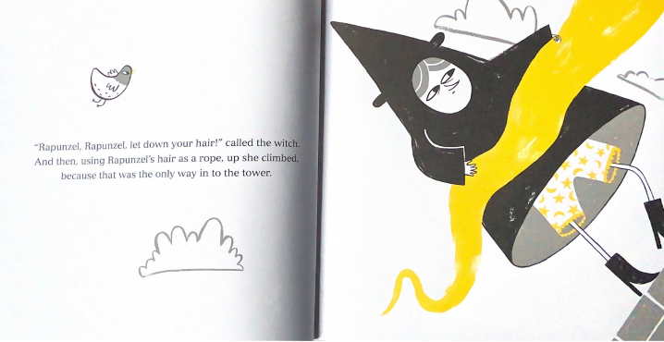

Slide 6
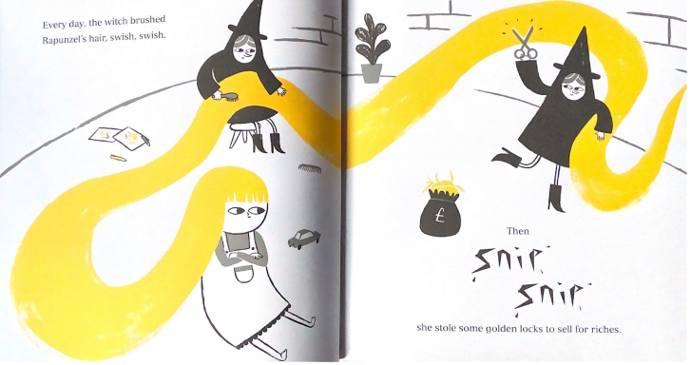

Slide 7
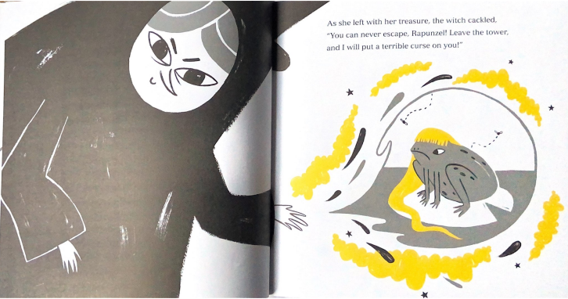

Slide 8
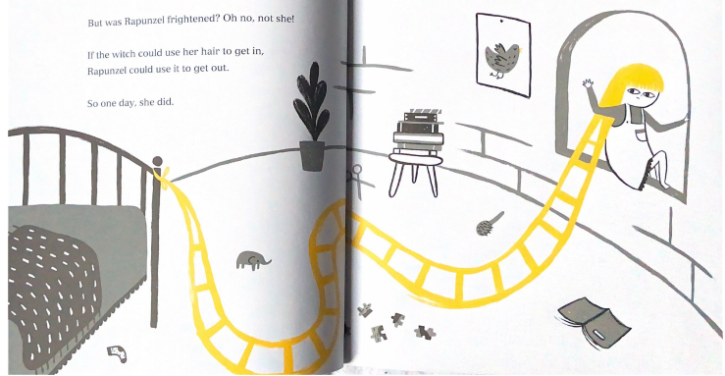

Slide 9
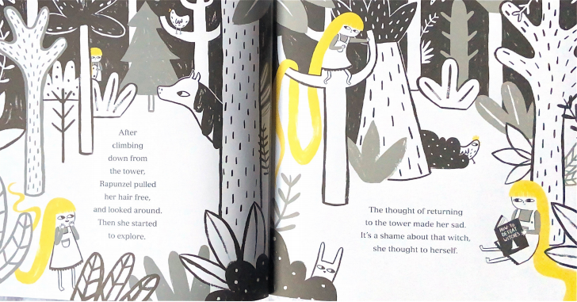

Slide 10
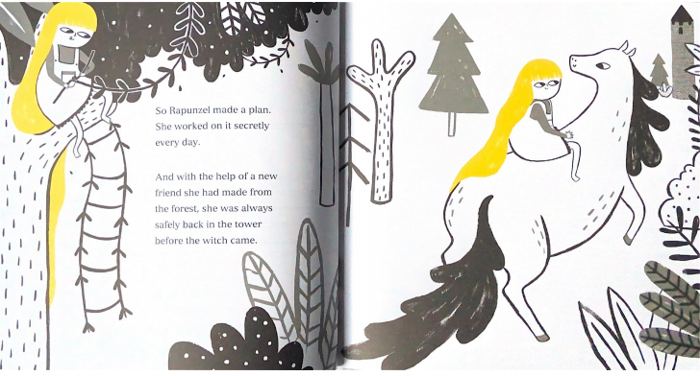

Slide 11
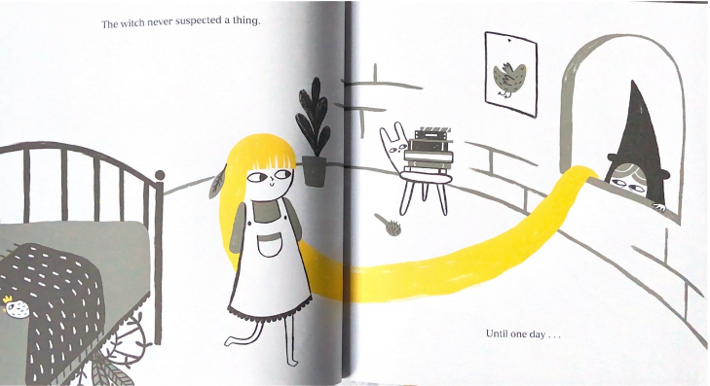

Slide 12
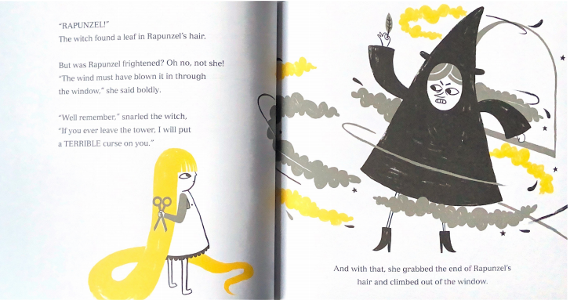

Slide 13
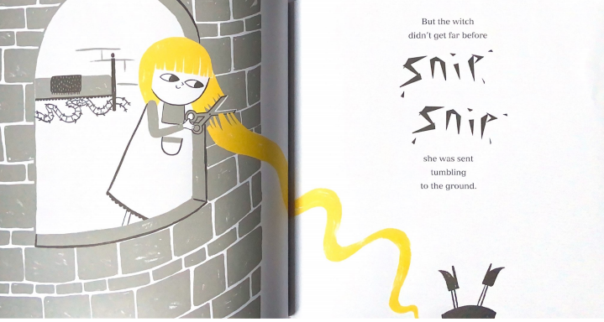

Slide 14
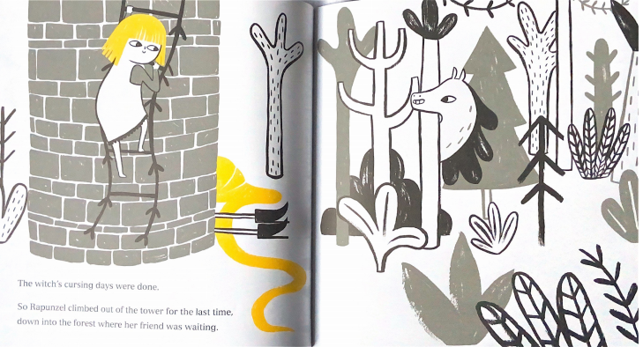

Slide 15
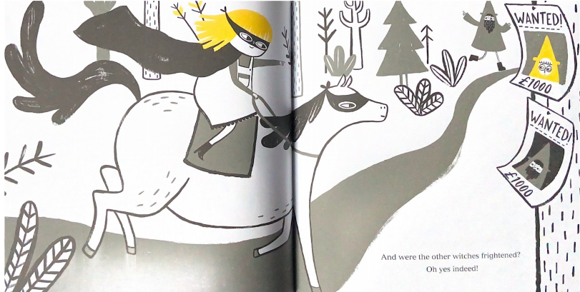

Slide 16
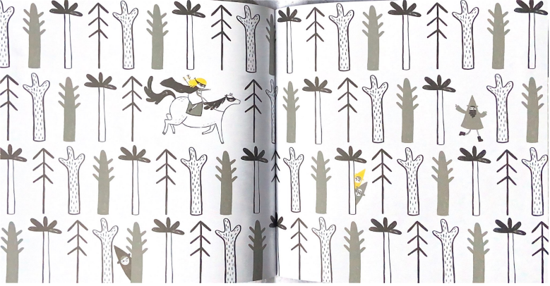

Slide 17
Your task:
You will have pictures from the story. You will then need to put them in order and write what happens during that part of the story ( a caption).
You should try and include details from the story and use adjectives to make the caption interesting.

Slide 18
What might a caption be for this part
of the story?
Then Rapunzel came up with a genius plan. She
turned her hair into a ladder to help her climb down
from the tall tower.

Slide 19
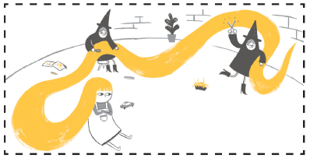
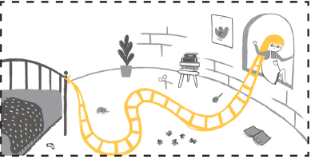
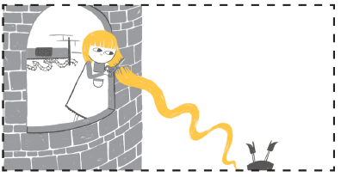
Thursday 25th March 2021
LO: To order the events in a story
3 events

Slide 20
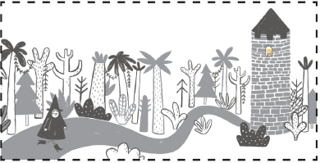
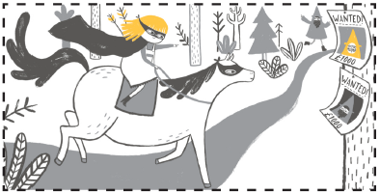
Thursday 25th March 2021
LO: To order the events in a story
5 events

Slide 21
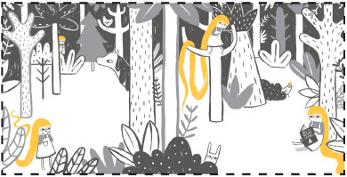

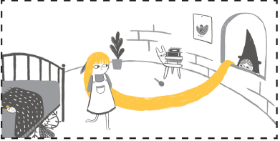
8 events

