Slide 1
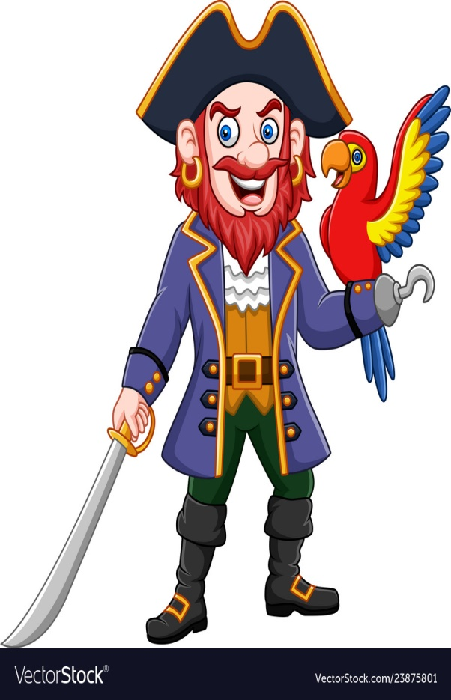
Music
L.O. To listen to and appraise a sea shanty.
Friday 11th June 2021

Slide 2
Listen to the sea shanty Blow the Man Down.
https://www.youtube.com/watch?v=Od6YdqPFCCA
What do you think the shanty is about?
Why do you think pirates sang sea shanties?
What do you notice about words in the shanty? (Are any repeated?)
What do you notice about the rhythm?

Slide 3
Now listen to the theme from Sponge Bob Square Pants.
https://www.youtube.com/watch?v=r9L4AseD-aA
What similarities do you notice between this piece of music and ‘Blow the Man Down’?
What instruments can you hear?
How does these two shanties make you feel?
How do they make you want to move?

Slide 4
Sea Shanty Facts
Sea shanties were sung by sailors when completing hard work like pulling ropes to lift the sail. The sailors would move in time to the shanty being sung. The leader was called the Shanty Man and he would decide what shanty to sing depending on how fast or slow he wanted the sailors to pull.
Sea shanties are normally accompanied by drums or accordions.

