Slide 1


Slide 3
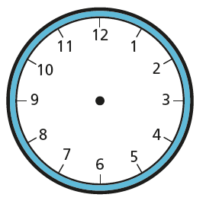
1) Count in 5s to 60
2) How many minutes are there in 1 hour?
3) What time is shown on the clocks?

Slide 4

1) Count in 5s to 60
2) How many minutes are there in 1 hour?
3) What time is shown on the clocks?
0, 5, 10, 15, 20, 25, 30, 35, 40, 45, 50, 55, 60
1 hour $=$ 60 minutes
5 o’clock
half past 5
quarter past 5
quarter to 6

Slide 6




Slide 7


60
55
5
10
50
15
45
20
40
35
25
30

Slide 8
O’clock
55 to
5 past
55 past
10 past
50 to
50 past
15 past
45 to
45 past
20 past
40 to
40 past
35 to
25 past
35 past
30 past

Slide 9
O’clock
55 to
5 past
55 past
10 past
50 to
50 past
Quarter
past
15 past
Quarter
to
45 to
20 past
40 to
40 past
35 to
Half
past
25 past
35 past
30 past

Slide 10
O’clock
5 to
5 past
55 to
55 past
10 past
50 to
50 past
10 to
Quarter
past
15 past
Quarter
to
45 to
20 past
40 to
40 past
20 to
25 to
Half
past
25 past
35 to
35 past
30 past

Slide 11
O’clock
5 to
5 past
10 past
10 to
Quarter
past
Quarter
to
20 past
20 to
25 to
Half
past
25 past

Slide 12

5 to
5 past
10 past
10 to
20 past
20 to
25 to
25 past
5 minutes past 10
Have a go

Slide 13
5 to
10 past
10 to
20 past
20 to
5 minutes to 11
5 minutes to 10
25 past
25 to
Have a go

Slide 14
Have a go
11 o’clock
Quarter past 11
15 minutes past 11

Slide 15
Have a go
7 o’clock
5 minutes past 7
7 o’clock
10 minutes past 7

Slide 16
Have a go
7 o’clock
25 minutes to 7
25 minutes to 8
20 past
20 to
25 to
25 past

Slide 17
Have a go
7 o’clock
20 minutes to 8
20 minutes to 8
Quarter to 8
15 minutes to 8

Slide 18
Have a go at the questions on the worksheet

