Slide 1


Slide 3


What time is shown on each clock below?
2) What fraction of the shapes below is shaded?

Slide 4



What time is shown on each clock below?
2) What fraction of the shapes below is shaded?
6 o’clock
half past 12
half past 6
$\frac{\text{1}}{\text{2}}$
$\frac{\text{1}}{\text{4}}$
$\frac{\text{1}}{\text{4}}$

Slide 6


It’s half past 2
quarter past 2
When the minute hand points to the 3,
it is quarter past the hour.

Slide 7

It’s past 10
Have a think
quarter past 10

Slide 8
11 o’clock
quarter past 11
3 o’clock
quarter past 3

Slide 9
p
a
s
t
quarter past

Slide 10
p
a
s
t
half past

Slide 11
When the minute hand points to the 9,
it is quarter to the hour.
p
t
a
o
s
t
three-quarters past
quarter to 9

Slide 12
10 o’clock
9 o’clock
quarter to 10
quarter past 9
half past 9

Slide 13
11 o’clock
quarter to 12
3 o’clock
quarter to 4

Slide 14
Which clock shows quarter to 3?
p
a
t
t
s
o
o
t
quarter to 3
Have a think

Slide 15
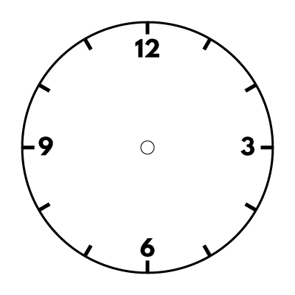
Match each time to the clock.
half past 6
quarter to 6
Have a think
quarter past 6

Slide 16
Have a go at the questions on the worksheet

