Slide 1
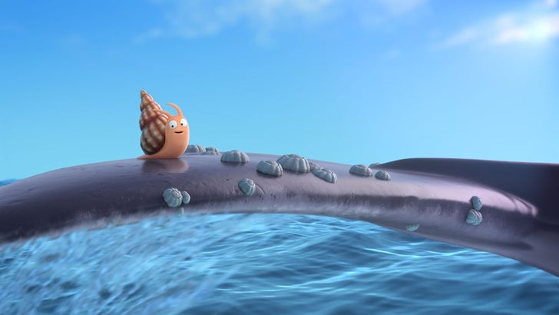
Wednesday 9th June 2021
To recognise and organise different ‘a’ graphemes from a piece of text.

Slide 2
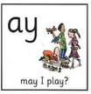
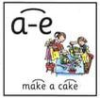
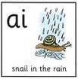
What are the different ‘a’ graphemes we know?

Slide 3
Your task: To read through the first page of the snail and the whale by Julia Donaldson and find any ‘a’ graphemes. Then choose a few of those words and write your own sentences.

Slide 4
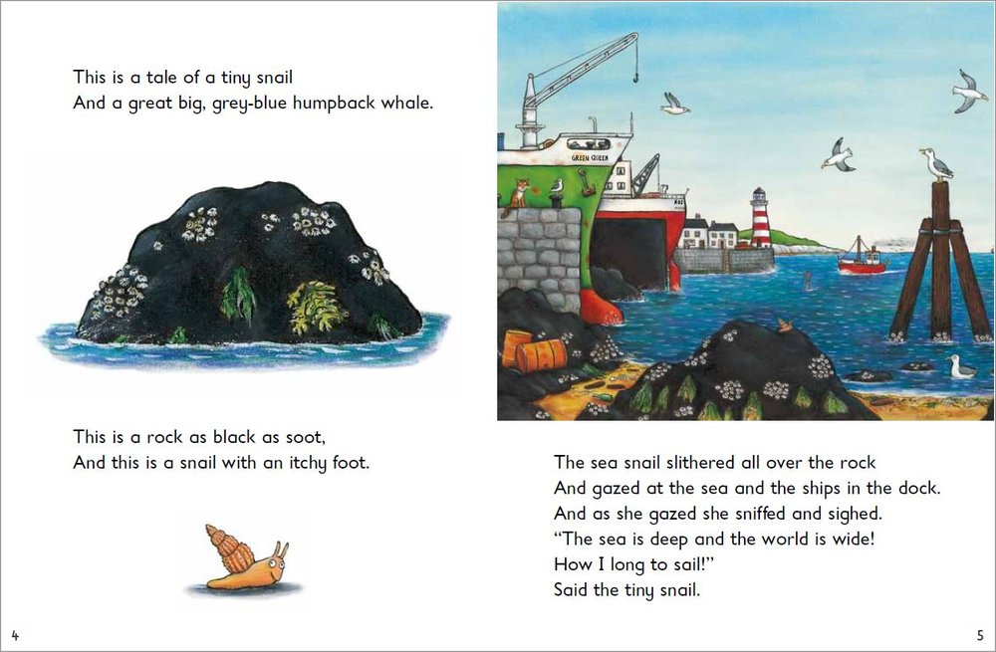

Slide 5
Are there any other ‘a’ graphemes?

Slide 6
After you have found all the ‘graphemes’ your next task is to write a sentence using some of the words you found.
I found the word ‘snail’ so I will now write a sentence using that word.
I went outside in my garden and saw a group of slimy snails.

