Slide 3
1) Which is longer?
2) What number comes next?
7, 8, 9, __
3) What is 1 less than 12?

Slide 4
1) Which is longer?
2) What number comes next?
7, 8, 9, __
3) What is 1 less than 12?
The red arrow is longer.
10
11

Slide 6


Why is time important?
Have a think

Slide 7
Have a look

Slide 8

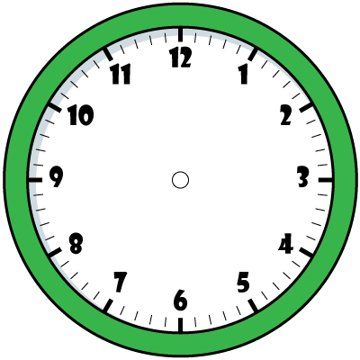
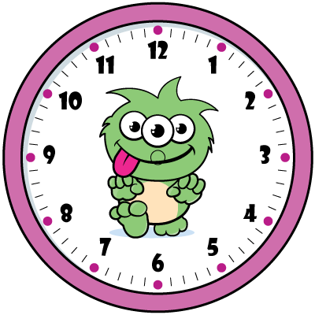
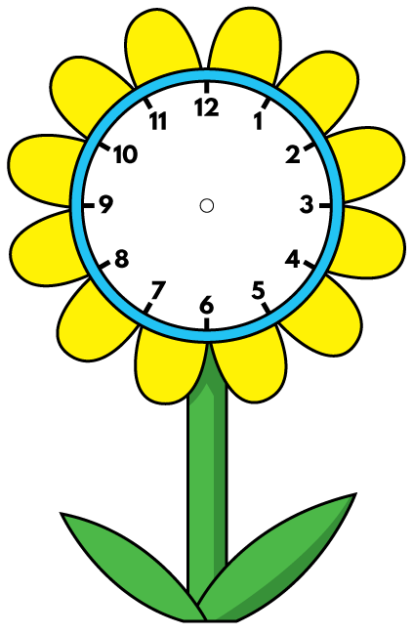

Have a think

Slide 9
The shorter hand is the hour hand
The longer hand is the minute hand

Slide 10
What does 7 o’clock look like?
hour
The ______ hand is pointing to 7
minute
The ______ hand is pointing to 12

Slide 11
What does 5 o’clock look like?
hour
The ______ hand is pointing to 5
minute
The ______ hand is pointing to 12

Slide 12
It’s 3 o’clock!
What time is it?
3
The hour hand is pointing to __
12
The minute hand is pointing to __

Slide 14
Have a go at questions 1 to 3 on the worksheet

Slide 15


1 o’clock
8 o’clock
BUS

Slide 16
Have a go at the rest of the worksheet

