Slide 1
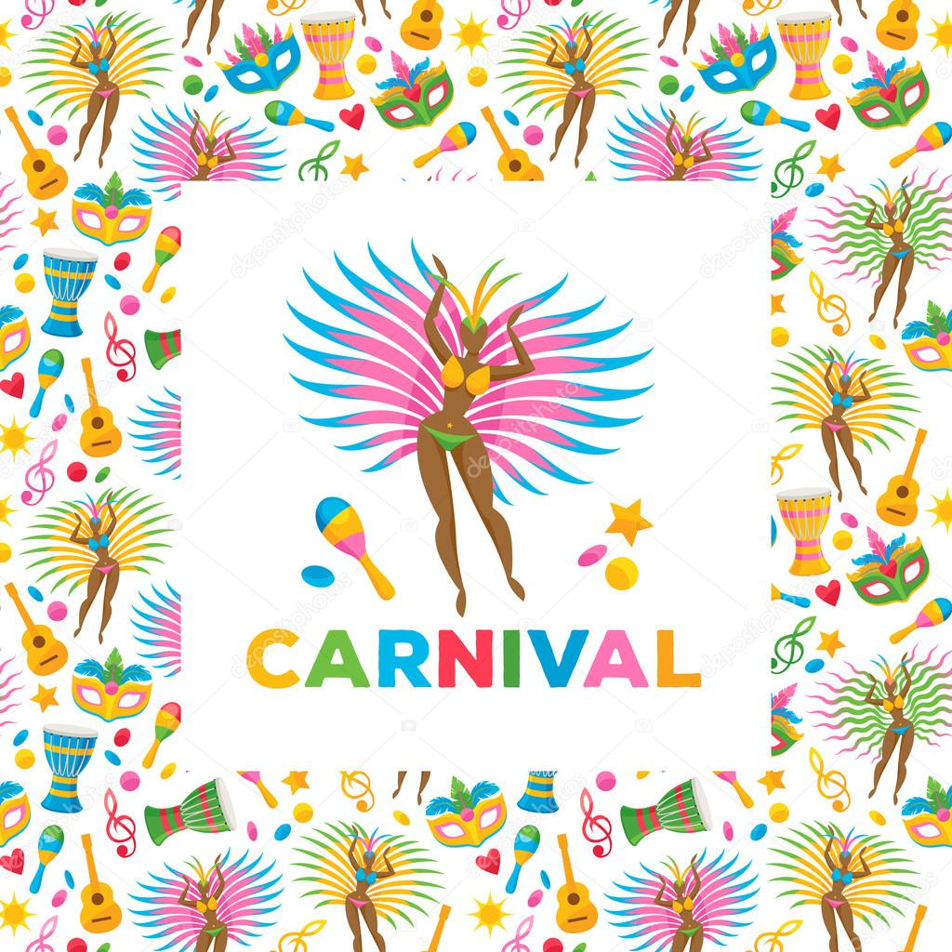
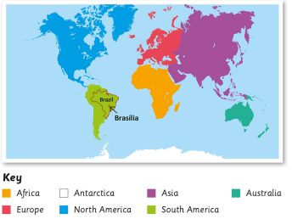
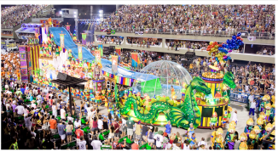
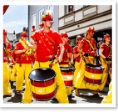
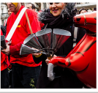
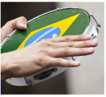
Rio De Vida
Prior Learning |  | Concepts
The names of the seven continents of the world. The use of a map to locate countries. |  | Tradition | A belief or way of behaving by a group of people over many years.
Key Vocabulary |  | Key Facts
Carnival | A celebration with parades, costumes, food, music and dancing. | Brazil is the largest country in the continent of South America. Brazil is famous for its colourful carnivals. Th Rio Carnival is said to be the biggest carnival in the world. The Amazon Rainforest covers parts of Brazil, this is the world’s largest tropical rainforest.
Headdress | A covering or ornament for the head.
Myth | A traditional or legendary story about a being, hero or event that is usually not true.
Percussion | Instruments that make sound when they are hit, scrapped or rattled e.g. drums.
Images, Icons and Maps

