Slide 1

PSHE: A Little Thankful Spot by Diane Alber

Slide 2

Watch the story being read:
https://www.youtube.com/watch?v=GXUoQ5MugCY

Slide 3

What does it mean to be thankful?
The definition of thankful is someone feeling or showing gratitude. When you are pleased and grateful for what you have, this is an example of a time when you are thankful.
https://www.youtube.com/watch?app=desktop&v=PcVQGoalfnk

Slide 4
What are you thankful/ grateful for?
A the minute there is a lot of negativity surrounding the world with many people forgetting that yes it is a shame we can’t do everything we would like to do at the moment but there is also a lot to be thankful for.
A few things I am thankful for are…
My friends and family
My job working with amazing staff and children
My health and happiness

Slide 5
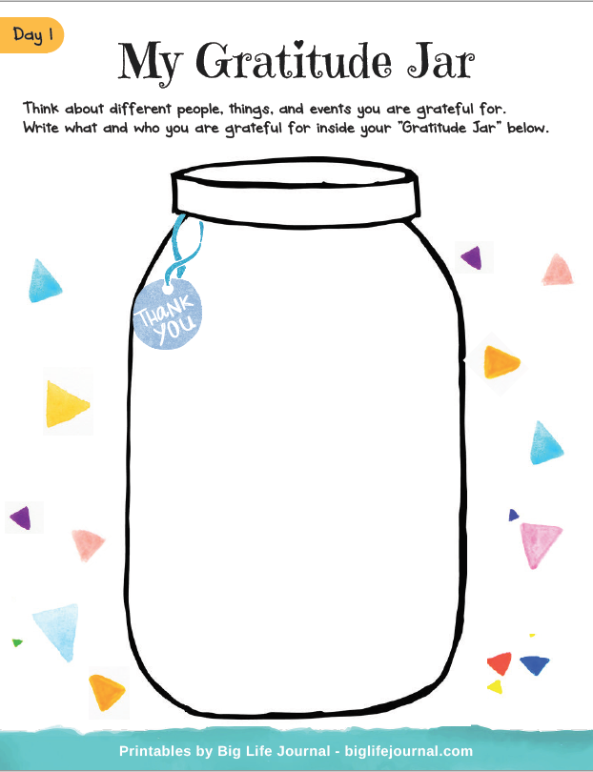
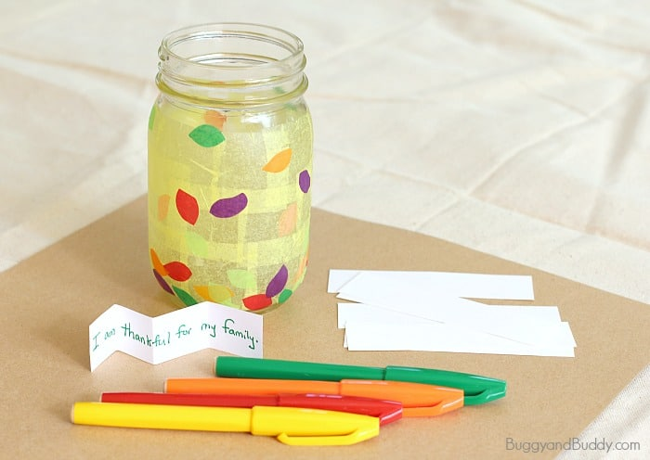
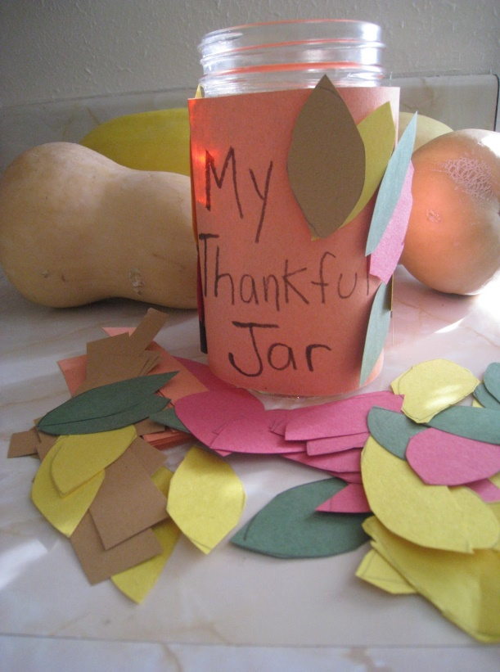
Your Task
Think about what you are grateful/thankful for and create a jar of thanks filled with all the things you are thankful for. This is something you can keep and add to over time.

