Slide 1
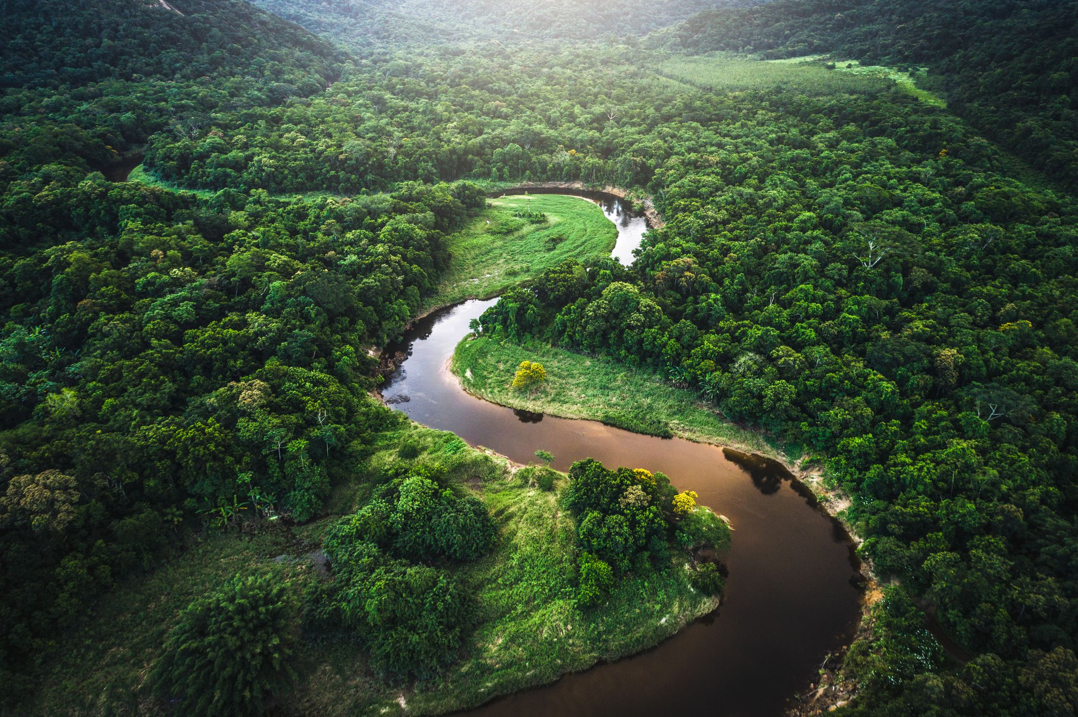
LO: Create a Poem about the Rainforest
Wednesday 20th January 2021

Slide 2
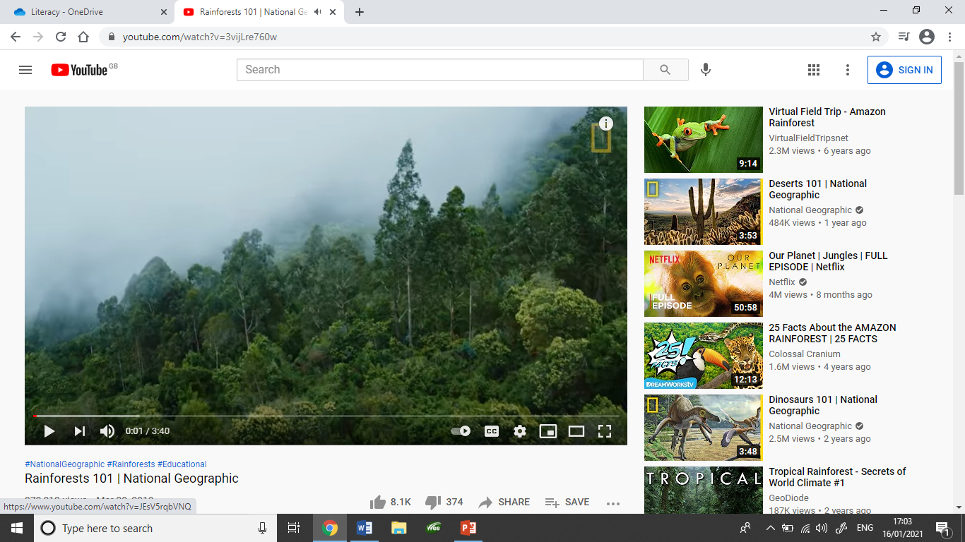
Watch this video of the Amazon Rainforest
https://www.youtube.com/watch?v=3vijLre760w

Slide 3
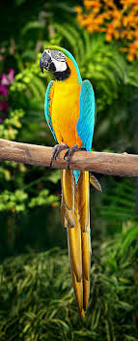

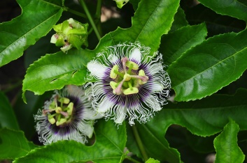
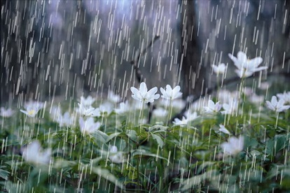
Imagine you are in the Amazon Rainforest
What would you hear?
The loud call of Macaw’s
What would you see?
Tall green bamboo trees.
What might you smell?
The strong smell of fresh flowers.
What might you touch?
The warm rain on my face.

Slide 4

Your Task
Create a poem about being in a rainforest. Think about the things you would
see/hear/smell/taste/touch
You can choose to do one of the following types of poem;
Acrostic, Shape or a free verse poem.

Slide 5

Acrostic Poem
What is an acrostic poem?
An acrostic poem is a poem which the first letter of each line spells out a word, name, or phrase when read vertically.

Slide 6
Example of Acrostic Poem
Frogs hoping around
Orangutan’s eating fruit
Rain falling from the sky
Enormous trees
Snakes slither along tree branches.
Tropical weather

Slide 7
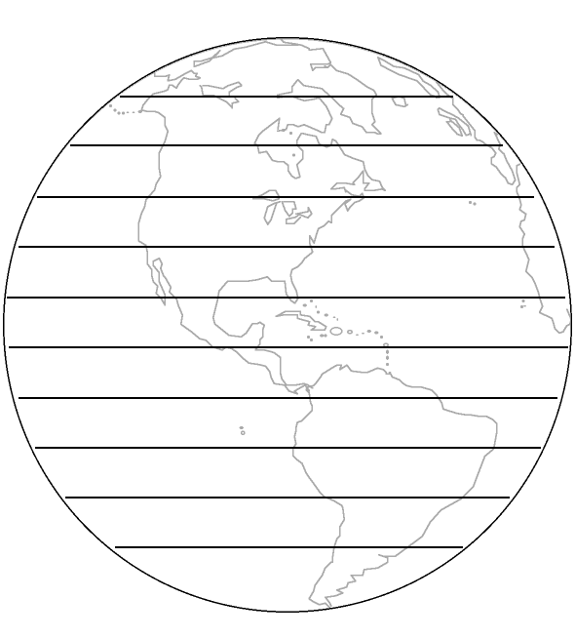
Shape Poem
A shape poem is a poem that is shaped like the thing it describes. The shape adds to the meaning of the poem. To write a shape poem, it helps to start by writing down all the words that come to mind about the chosen topic.

Slide 8
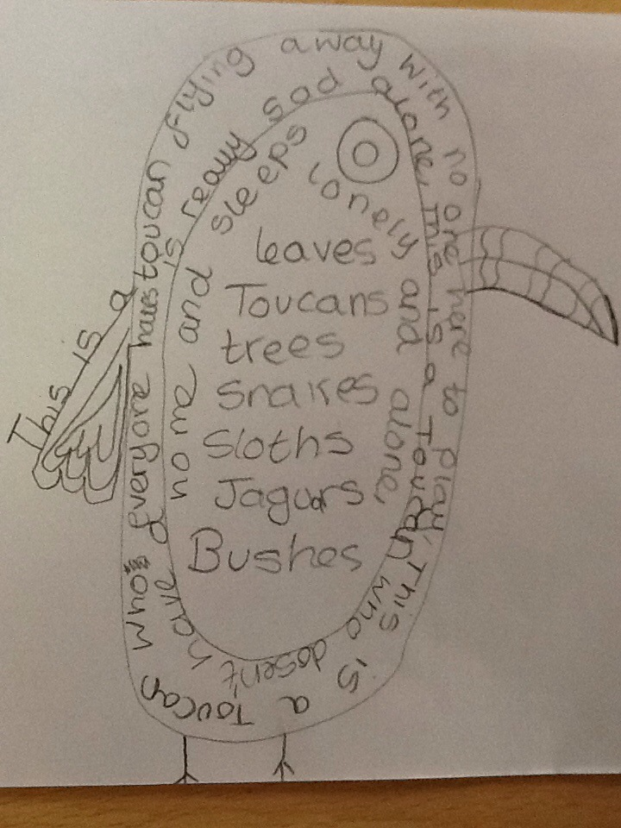
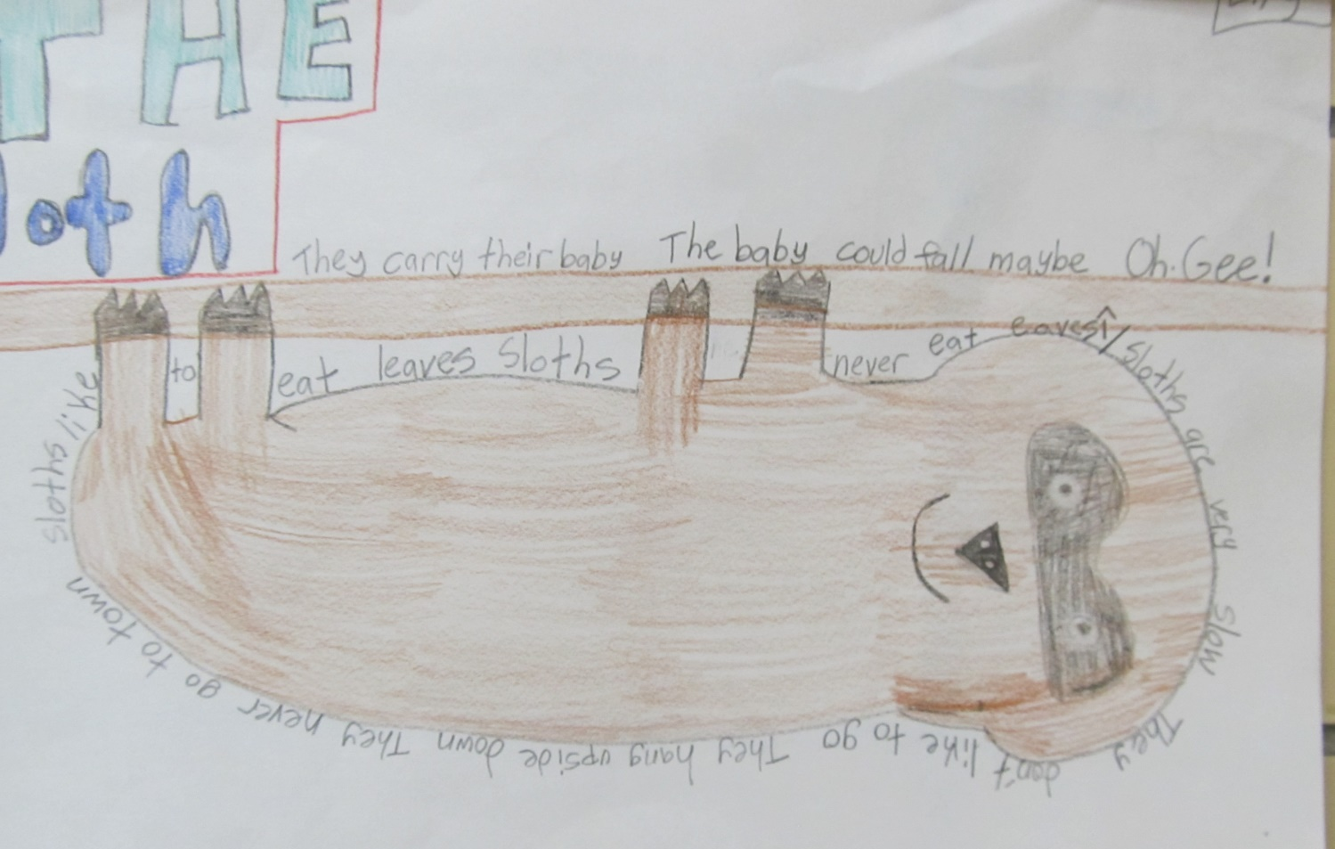
Examples of Shape Poems

Slide 9
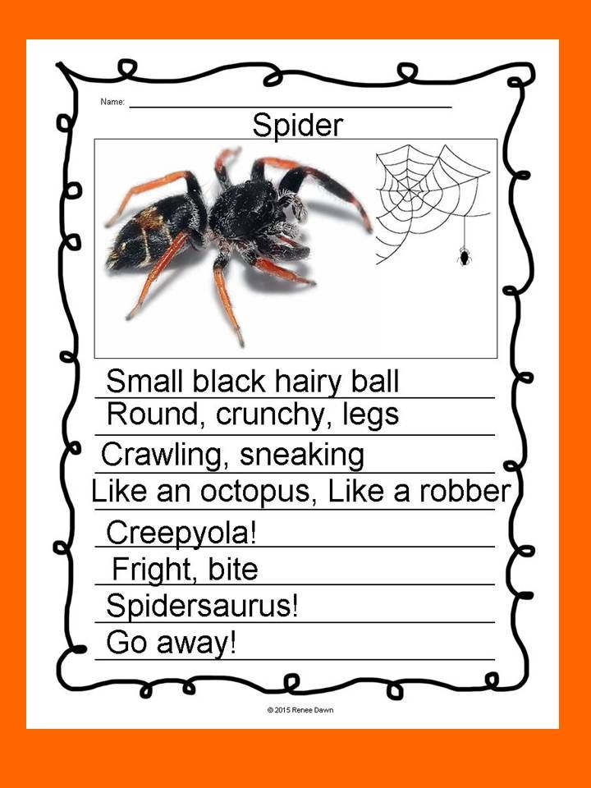
Free Verse Poems
Free verse poems have no specific rules or patterns. They do not follow a rhyme scheme and have no specific rhythm. Free verse poems do not have a set number of syllables or words per line. Free verse poems can be about any topic and can be of any length.

Slide 10
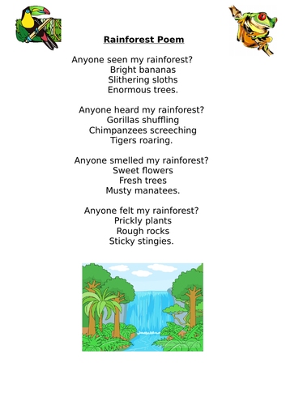
Example of free verse poem

Slide 11
Task
Choose one of the three type of poems shown and write your own poem about a rainforest.
Remember to use your senses to help you.

