Slide 1
Literacy
Thursday 17th June
L.O. To role play an event in our book ‘The Snail and the Whale’.
To create a news report of the event through role-play.

Slide 2
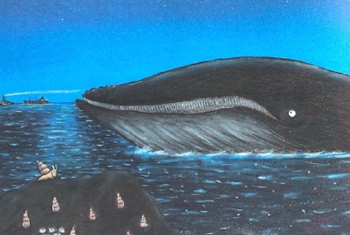
We are going to read the dramatic part of our book.
We will then think about what the different characters in this event might say about what they did and what they saw.
Let’s read this section.

Slide 3
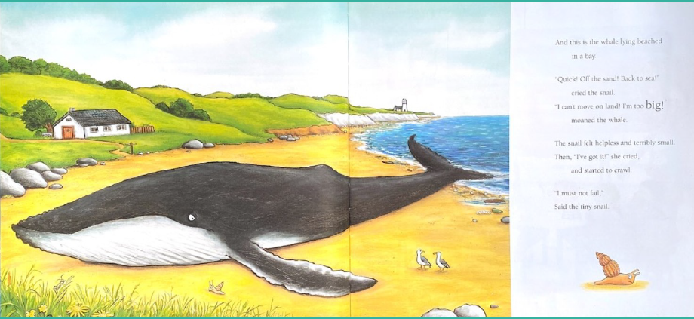

Slide 4
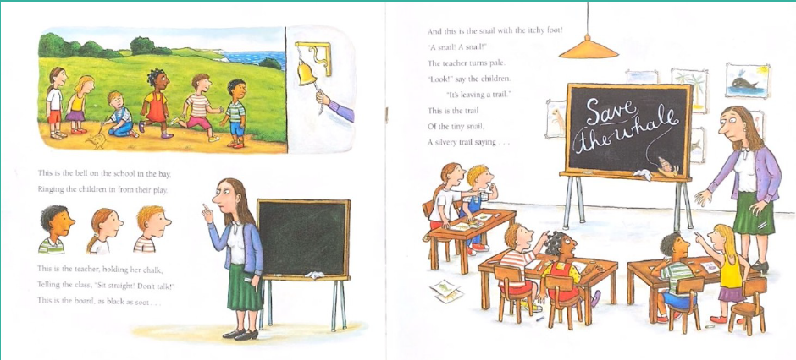

Slide 5
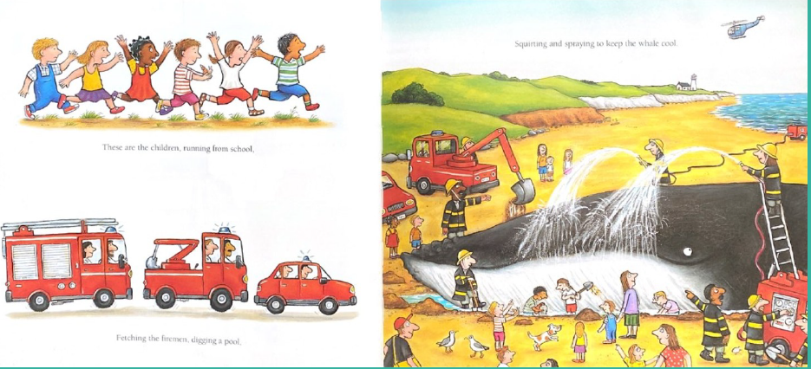

Slide 6
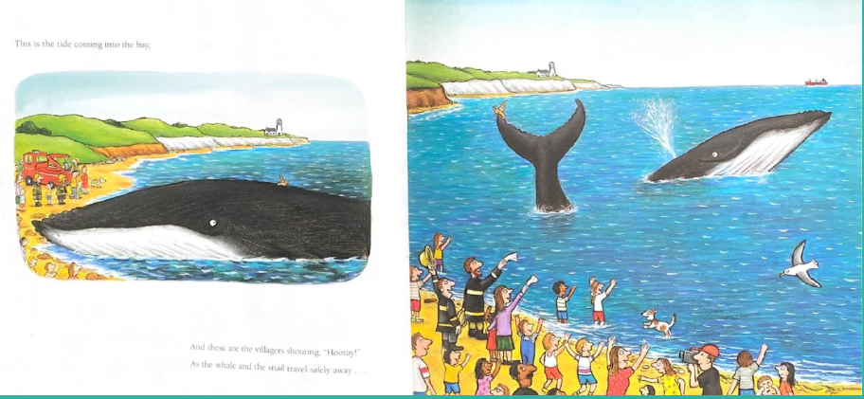

Slide 7
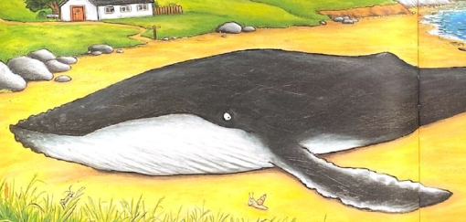
In groups you are going to pretend to be the different characters in that event of the story.
The different characters were:
The snail
The whale
The teacher
The children in the school
The fire men and women
The people who were on the beach
Imagine that a news reporter is interviewing you and asking you to recount the event.
Describe what you did, what you saw and how you felt.
Let’s read some examples and ideas.

Slide 8
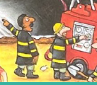
The Fire Rescue workers
We rushed to the beach as soon as we got the call from the headteacher of the school. The most important thing was to keep the whale cool and wet, so we got out all our hoses and sprayed while the construction workers dug a pool. This helped release the whale when the tide came in.”

Slide 9

A family on the beach
We’ve never had anything like this happen before! I couldn’t believe it when I saw the whale stranded there. The children were fantastic, they raised the alarm and helped rescue the whale.

Slide 10
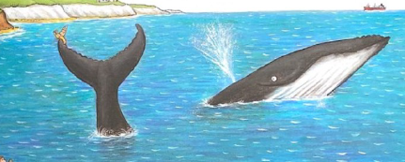
Once you have had a go at role-playing the different characters, take it in turns to be the news reporter.
Your job is to interview the different characters to hear about what happened.
Here is an example of TV news report on a similar event.
https://www.bbc.co.uk/newsround/38949045

