Slide 1


Slide 3
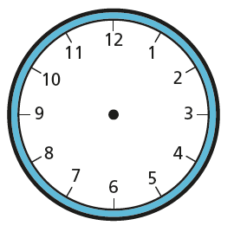

1) How long in minutes is a quarter of an hour?
How long in minutes is half an hour?
How long in minutes is an hour?
4) How long in minutes is an hour and a half?

Slide 4
1) How long in minutes is a quarter of an hour?
How long in minutes is half an hour?
How long in minutes is an hour?
4) How long in minutes is an hour and a half?
15 minutes

Slide 5
1) How long in minutes is a quarter of an hour?
How long in minutes is half an hour?
How long in minutes is an hour?
4) How long in minutes is an hour and a half?
15 minutes
30 minutes

Slide 6
1) How long in minutes is a quarter of an hour?
How long in minutes is half an hour?
How long in minutes is an hour?
4) How long in minutes is an hour and a half?
15 minutes
30 minutes
60 minutes

Slide 7
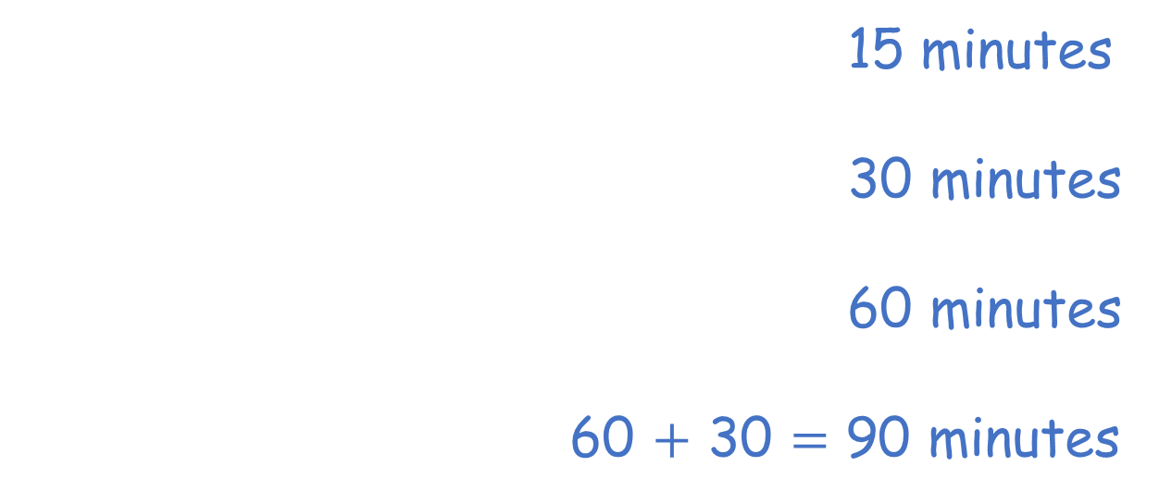
1) How long in minutes is a quarter of an hour?
How long in minutes is half an hour?
How long in minutes is an hour?
4) How long in minutes is an hour and a half?
15 minutes
30 minutes
60 minutes
60 $+$ 30 $=$ 90 minutes

Slide 9
Have a go at question 1 on the worksheet

Slide 10
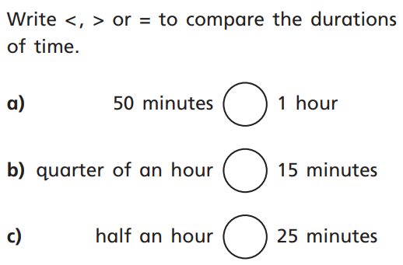



$$<$$
$$=$$
$$>$$

Slide 11
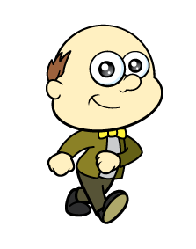

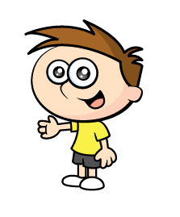
55
5
50
10
You’ve got half an hour left
45
15
40
20
35
25
30
We could go to the beach!
That takes 55 minutes, have we got that long?

Slide 12
5
10
You’ve got half an hour left
15
20
35
25
30
We could play a board game!
That takes 35 minutes, have we got that long?

Slide 13
5
10
You’ve got half an hour left
15
20
25
We could read our book!
That takes 25 minutes, have we got that long?

Slide 14
5
10
You’ve got half an hour left
15
We could go to the park!
That takes a quarter of an hour, have we got that long?

Slide 15
Have a go at questions 2, 3 and 4 on the worksheet

Slide 16

The timetable shows the start and finish times of children’s radio programs.
Which program is the longest?
Which program is the shortest?
 | Start time | Finish Time
Sing along time | 20 past 10 | Half past 10
Dance fun | Half past 11 | Quarter to 12
Story time | 25 past 1 | Quarter to 2
Have a think

Slide 17
The timetable shows the start and finish times of children’s radio programs.
 | Start time | Finish Time | Time taken
Sing along time | 20 past 10 | Half past 10
Dance fun | Half past 11 | Quarter to 12
Story time | 25 past 1 | Quarter to 2
10 minutes
5
10

Slide 18
The timetable shows the start and finish times of children’s radio programs.
 | Start time | Finish Time | Time taken
Sing along time | 20 past 10 | Half past 10
Dance fun | Half past 11 | Quarter to 12
Story time | 25 past 1 | Quarter to 2
10 minutes
15 minutes
15
10
5

Slide 19
The timetable shows the start and finish times of children’s radio programs.
 | Start time | Finish Time | Time taken
Sing along time | 20 past 10 | Half past 10
Dance fun | Half past 11 | Quarter to 12
Story time | 25 past 1 | Quarter to 2
10 minutes
15 minutes
20 minutes
20
15
10
5

Slide 20
The timetable shows the start and finish times of children’s radio programs.
 | Start time | Finish Time | Time taken
Sing along time | 20 past 10 | Half past 10
Dance fun | Half past 11 | Quarter to 12
Story time | 25 past 1 | Quarter to 2
10 minutes
15 minutes
20 minutes

Slide 21
Have a go at the rest of the questions on the worksheet

