Slide 1
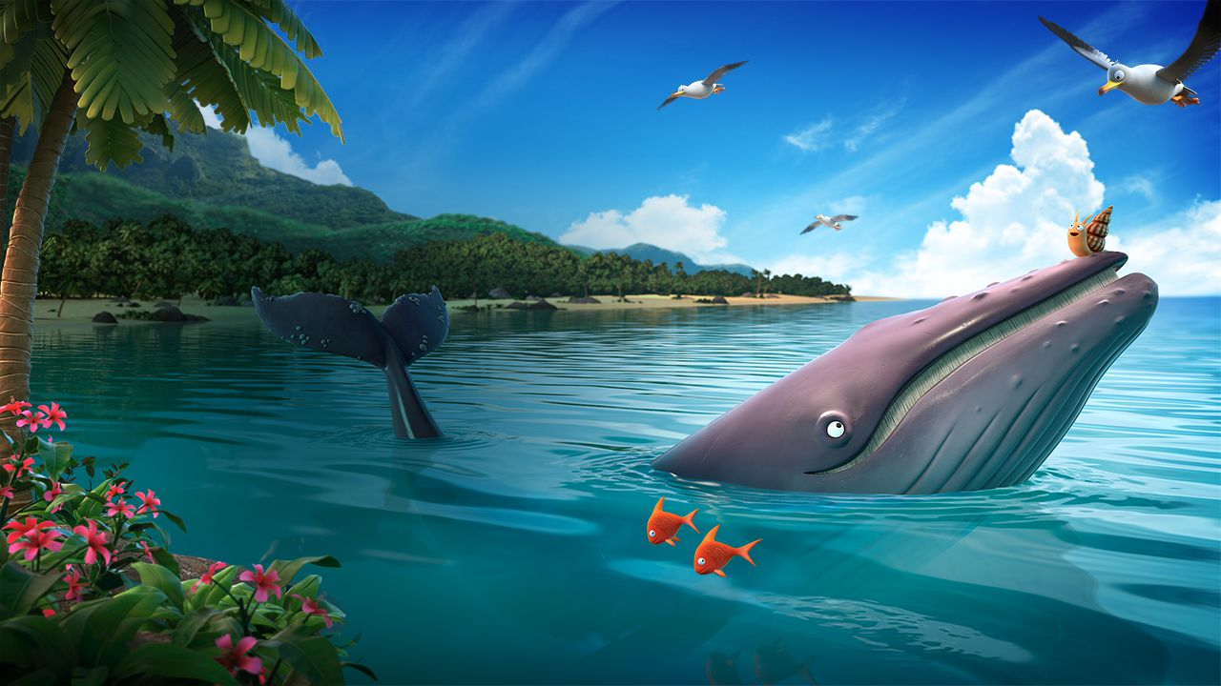
Wednesday 16th June 2021
LO: To use onomatopoeia to write a description of a storm.

Slide 2
In the story the snail and the whale, the characters go through a terrible storm.
Let’s recap that part of the story.

Slide 3
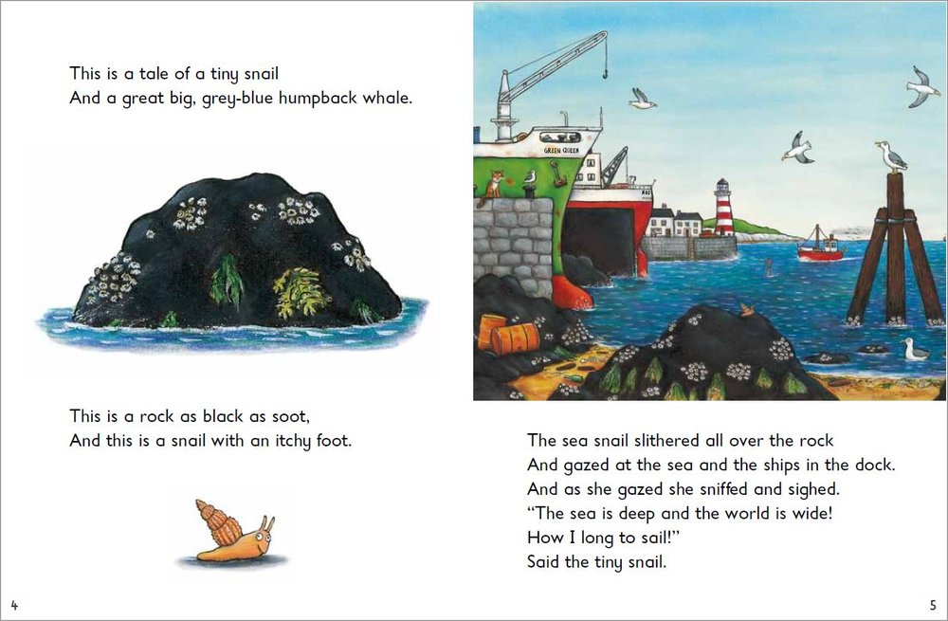

Slide 4
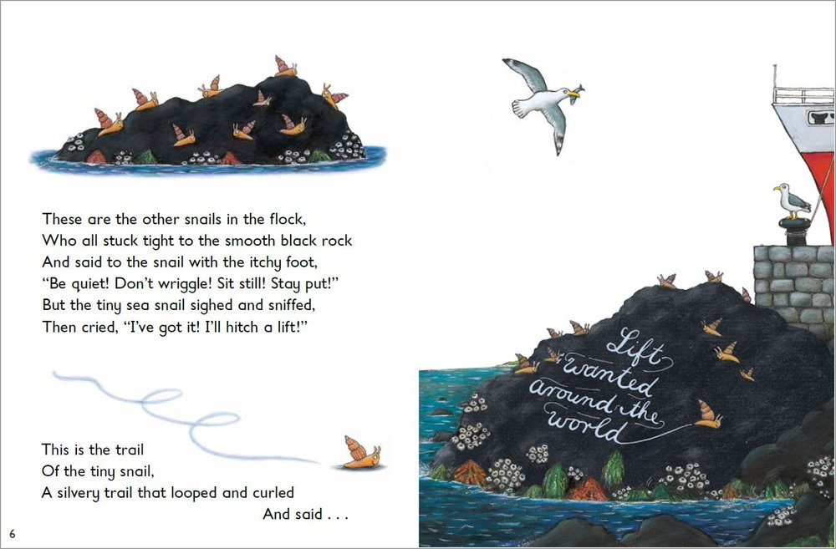

Slide 5
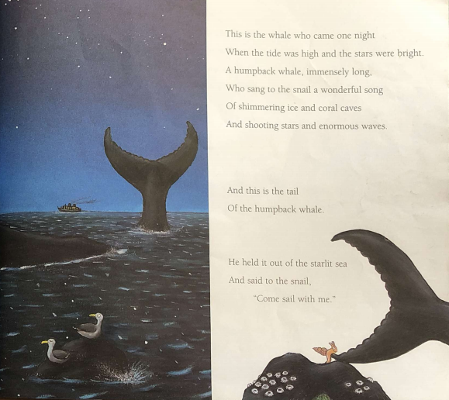

Slide 6
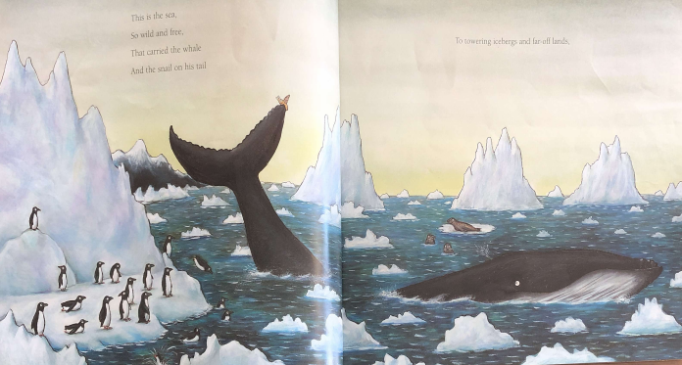

Slide 7
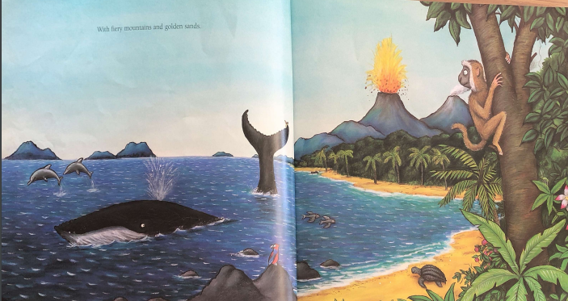

Slide 8
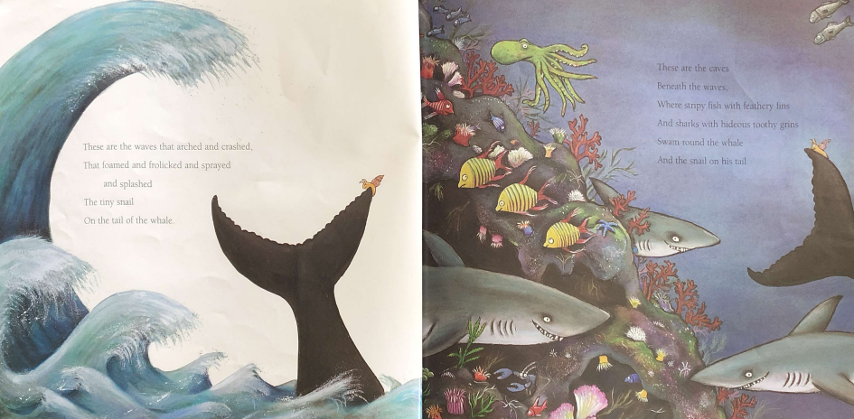

Slide 9
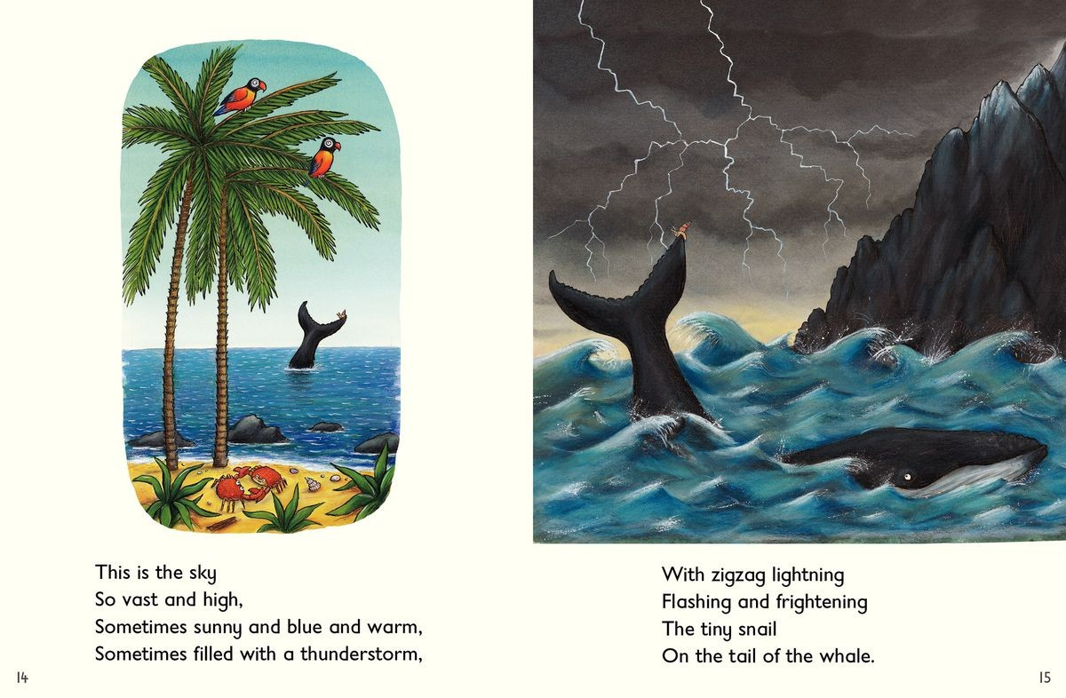

Slide 10
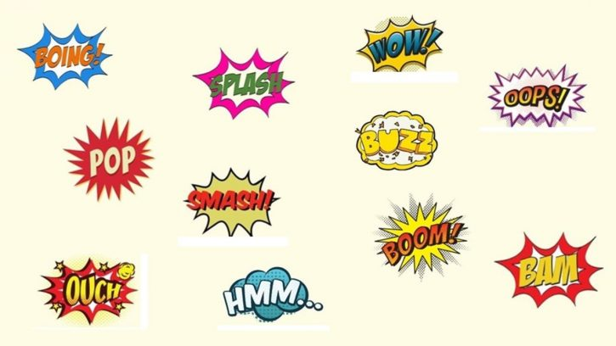
What is onomatopoeia?
https://www.bbc.co.uk/bitesize/topics/z4mmn39/articles/z8t3g82
Onomatopoeia is a word that also makes a sound e.g. bang, crash, boom.

Slide 11
Can you find the onomatopoeia in these sentences
I squeezed the big bottle of tomato sauce.
In the night, the wind was howling.
The leaves crunched under my feet as I walked through the woods.

Slide 12
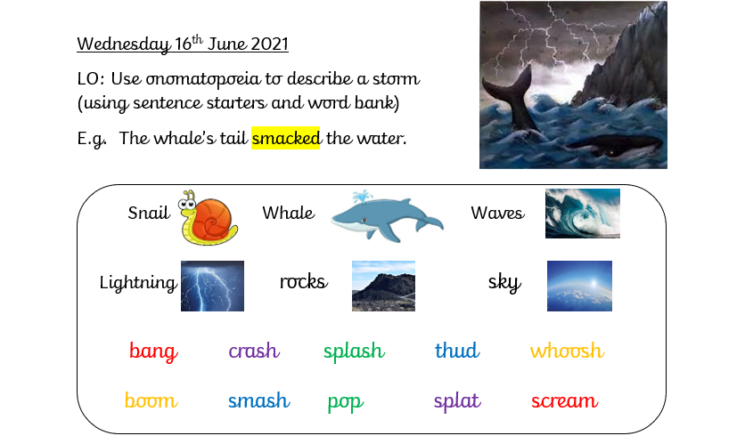
Your task: Write sentences using onomatopoeia to describe the storm from the story.

