Slide 1


Slide 3
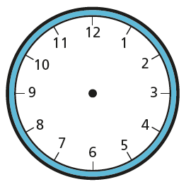

1) What time will in be in 1 hour?
2) What time was it an hour ago?
What time will it be in 5 minutes?
What time will it be in 10 minutes?

Slide 4
1) What time will in be in 1 hour?
2) What time was it an hour ago?
What time will it be in 5 minutes?
What time will it be in 10 minutes?
3 o’clock
1 o’clock
5 past 2
10 past 2

Slide 6
What do we mean by duration?
duration
time taken
start time
end time
The duration is the amount of time something takes.
20 minutes
2 o’clock
20 past 2

Slide 11
15
10
5

Slide 12
Have a go at questions 1 - 3 on the worksheet

Slide 13



Amir went out to play time at 2 o’clock.
When the whistle blew, the time was
How long did play time last?
Play time lasted for 10 minutes.
Have a think
10 minutes
2 o’clock
10 past 2

Slide 14
Amir went out to play at half past 4
When he came back, the time was
How long did he play for?
He played for half an hour.
Have a think
30 minutes
Half past 4
5 o’clock

Slide 15
Amir began his run at 20 past 7
He ran for 20 minutes.
What time did he finish his run?
Have a think
He finished at
20 to 8
20 minutes
20 past 7
20 to 8
?

Slide 16
Amir turned a program off at half past 4
He had been watching for half an hour
What time did the program start?
Have a think
The program started at 4 o’clock
30 minutes
?
half past 4
4 o’clock

Slide 17
Have a go at the rest of the questions on the worksheet

