Slide 1


Slide 3
Seconds, Minutes or Hours?
It takes me 4 __________ to clap 10 times.
There are 60 ___________ in an hour.
There are 24 ___________ in a day.
seconds
minutes
hours

Slide 4
Seconds, Minutes or Hours?
It takes me 4 __________ to clap 10 times.
There are 60 ___________ in an hour.
There are 24 ___________ in a day.
seconds
minutes
hours

Slide 6

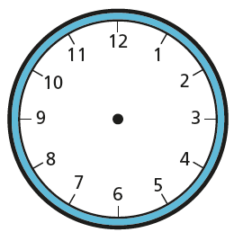
Have a think
o’clock
5 to
5 past
5 minutes past
10 to
10 past
quarter to
quarter past
15 to
15 past
20 to
20 past
25 to
35 past
25 past
half past

Slide 7

Have a think
o’clock
5 to
5 past
10 to
10 past
quarter to
quarter past
20 to
20 past
25 to
25 past
half past

Slide 8




We know there are 30 minutes in half an hour
If there are 30 minutes in half an hour, there must be 60 minutes in 1 hour
I think there are 12 minutes in an hour
I think there are 60 minutes in an hour
Have a think
My clock is broken! It only goes up to 12 minutes

Slide 9
o’clock
5 to
5 past
10 to
10 past
quarter to
quarter past
20 to
20 past
25 to
25 past
half past

Slide 10
Have a go at question
1 on the worksheet

Slide 11


An hour ago it was 2 o’clock
In half an hour it will be half past 3

Slide 12
An hour ago it was half past 3
In half an hour it will be 5 o’clock
In half an hour it will be …

Slide 13
An hour ago it was quarter past 1
In half an hour it will be quarter to 3
In half an hour it will be …

Slide 14
An hour ago it was twenty past 1
In half an hour it will be ten to 3
In half an hour it will be …

Slide 15
Have a go at question
2 on the worksheet

Slide 16
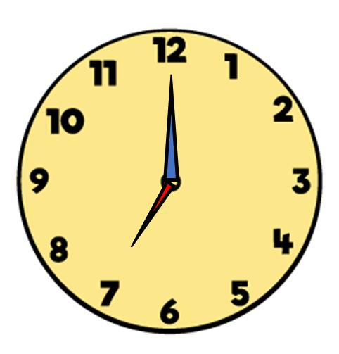


Amir arrived at cubs at 5 o’clock.
When he left cubs, the time was
How long did cubs last?
Cubs lasted for 2 hours.
Have a think
1 hour
1 hour
5 o’clock
6 o’clock
7 o’clock

Slide 17



Whitney started her homework at half past 5
She finished at 7 o’clock.
How long did her homework take?
Have a think
Half past 5 until half past 6 is 1 hour
Half past 6 until 7 o’clock is half an hour
I will count around the clock.
60
$$+$$
30
$$=$$
90
1 hour
half an hour
half past 5
half past 6
7
o’clock

Slide 18



Annie is going to visit her grandma.
She sets off at half past 11
It takes her an hour and 10 minutes.
$+$ 1 hour
$+$ 10 mins
Half past 11
Half past 12
20 to 1
Have a think

Slide 19
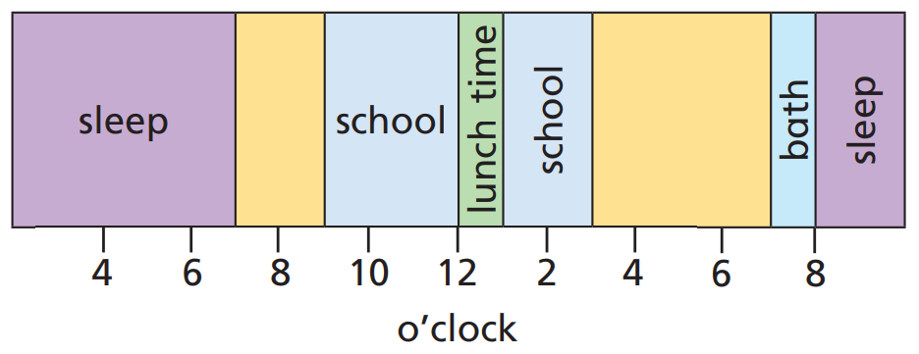

Slide 20
Have a go at the rest of the questions on the worksheet

