Slide 1


Slide 3
1) Order from shortest to longest.
shortest longest
2) Order from shortest to longest.
shortest longest
Minutes
Hours
Seconds
Washing hands
Watching a film
Eating an apple

Slide 4
1) Order from shortest to longest.
shortest longest
2) Order from shortest to longest.
shortest longest
Minutes
Hours
Seconds
Washing hands
Watching a film
Eating an apple

Slide 6

How much time does it take?
Minutes
Hours
Seconds

Slide 7



How long?
Seconds
Minutes
Hours
To wash your hands?
Seconds
To watch a film?
Hours
To drink a glass of water?
Minutes

Slide 8



How long?
Seconds
Minutes
Hours
To brush your teeth?
Minutes
To fill a bowl of cereal?
Seconds
Taking a plane ride?
Hours

Slide 9



What could you do in 4 seconds?
Build a castle Write 1-5 Clap 10 times
Have a go

Slide 10


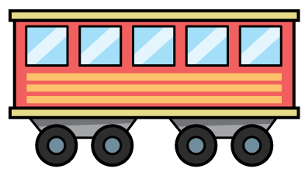
What could you do in 5 minutes?
Eat Ride Change
Have a think

Slide 11

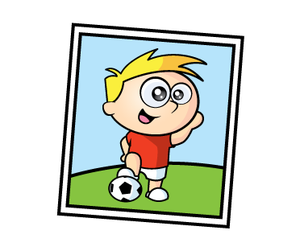
What could you do in 2 hours?
School day Play Fly
Have a think

Slide 12
What could you do in 4 seconds?
What could you do in 5 minutes?
What could you do in 2 hours?

Slide 13
Would you rather?
Seconds
Minutes
Hours
Play your favourite game for…
Wait for a train for …
Clean your room for…

Slide 14



Amir is having a birthday party!
How long will…
it take to make the cake?
it take to blow out the candles?
it take to eat the cake?
Hours
Seconds
Minutes
Have a think

Slide 15

Amir is having a birthday party!
How long will…
it take to decorate the house?
it take to wrap a present?
it take to unwrap a present?
the party last?
Hours
Minutes
Seconds
Hours
Have a think

Slide 16
Have a go at the questions on the worksheet

