Slide 1
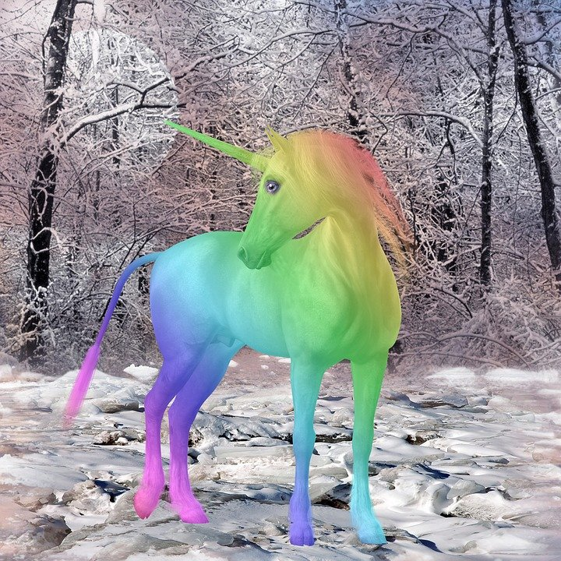
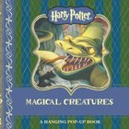
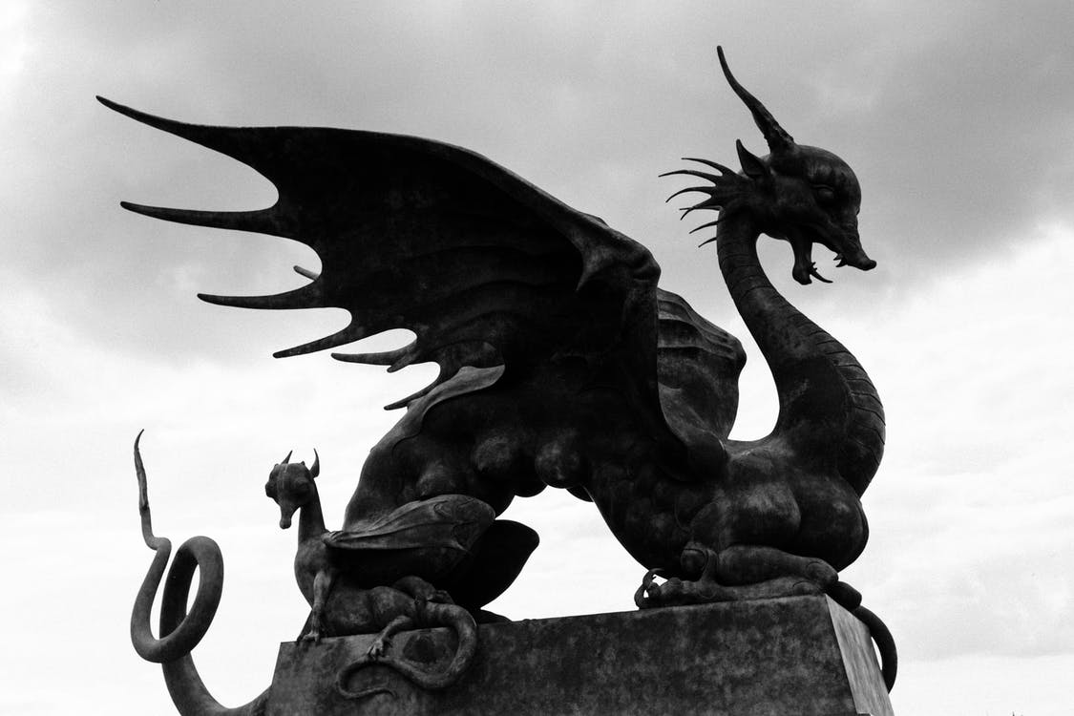
Thursday 11th March
L.O. To create a story plan for your own magical creature.

Slide 2
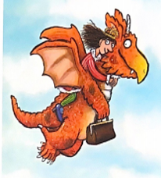
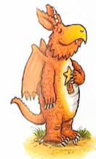
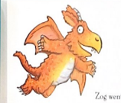
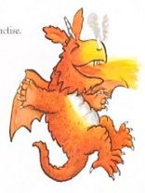
The story ‘Zog’ is about a dragon who learns his dragon skills at Dragon School.
Dragons are magical creatures.
We will use the story ‘Zog’ to create your own story about a different magical creature.

Slide 3
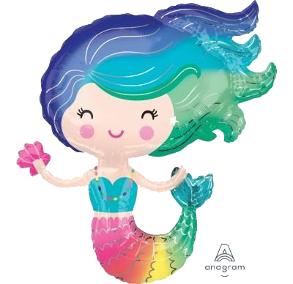
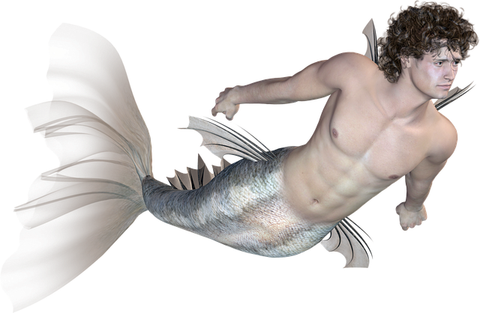
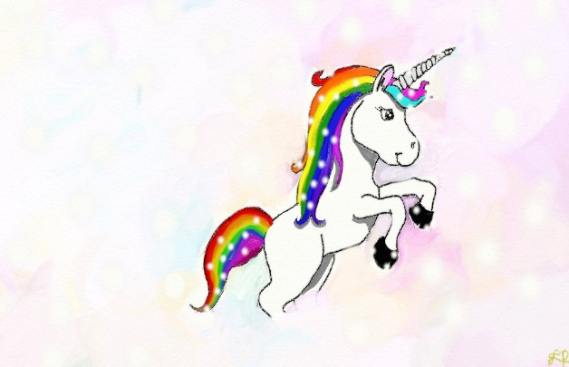
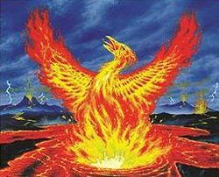
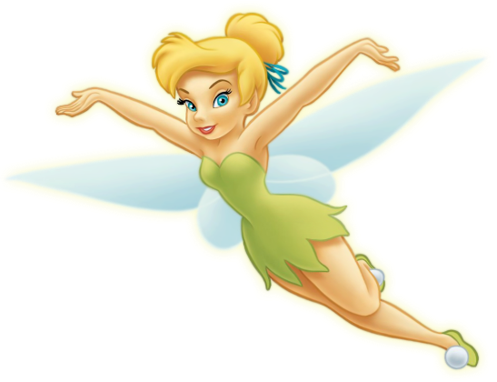
What magical creatures could you choose?
Let’s think of different magical creatures that you could have as your main character.
mermaid
merman
unicorn
phoenix
You can make up your own magical creature.
fairy

Slide 4
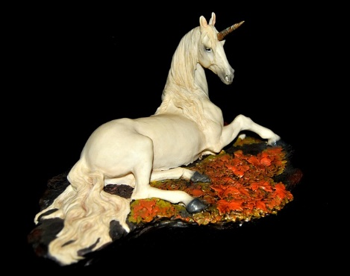
After you have chosen your magical creature, think of a name for him or her.
What skills would they have to learn at their school?
Can you think of 5 skills, like Zog had to learn? He was at school from Year 1 to Year 5.
Put your ideas into a story plan.
We will use these plans to write our stories tomorrow.

Slide 5
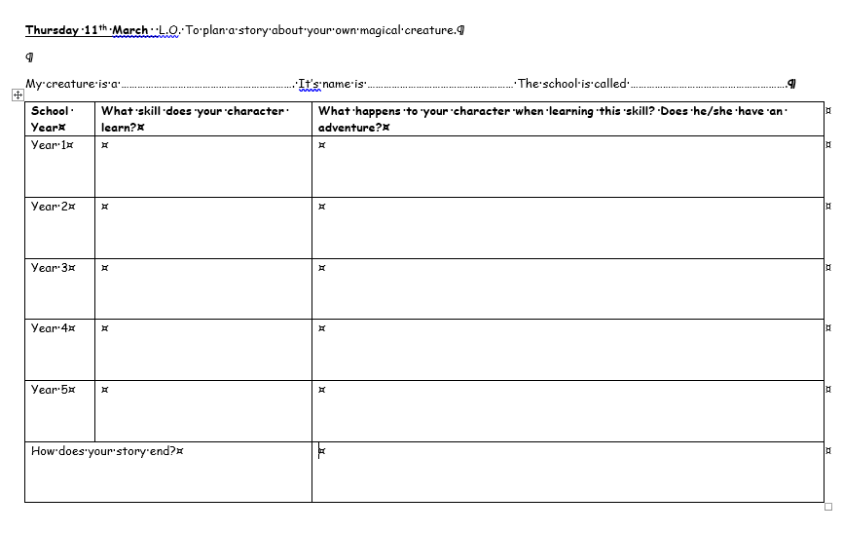
Your Task: Record your story ideas into the planner.
Options
Print off the Word doc and write on.
Type into the Word doc.
Let’s look at an example.

Slide 6
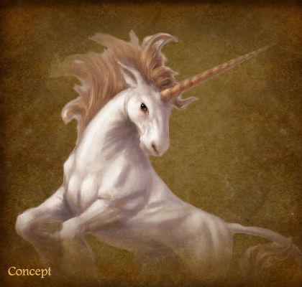
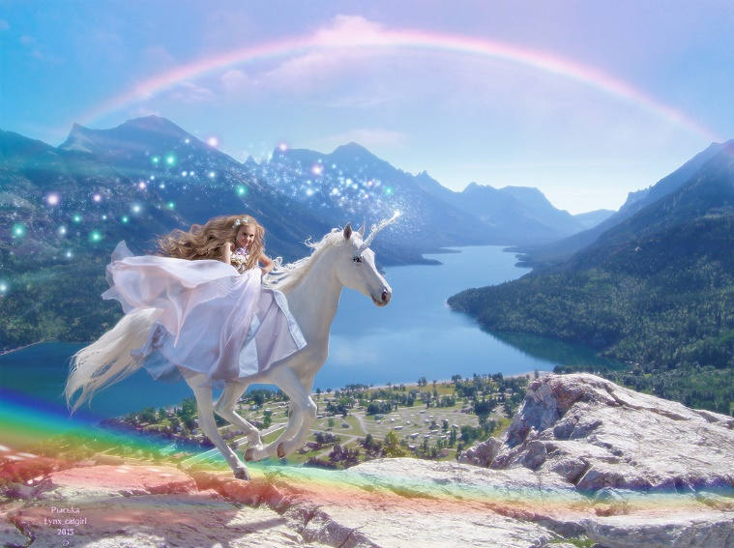
Example
My character is a unicorn. Her name is Moonbeam.
Her school is called Young Unicorn School
School Year | What skill does your character learn? | What happens to your character when learning this skill? Does she/she have an adventure?
Year 1 | She learns to trot and gallop. | She gallops across the fields and through the woods. She has races with her unicorn class mates!

