Slide 1
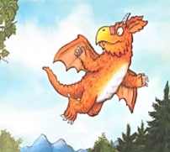
Wednesday 10th March
L.O. To order events that happen in ‘Zog’.
To write a sentence for each event.

Slide 2

We will read again part of our book ‘Zog’.
We want to find out what skill Zog learnt in each year of Dragon School.
Dragon school starts at Year 1 and ends at Year 5.

Slide 3
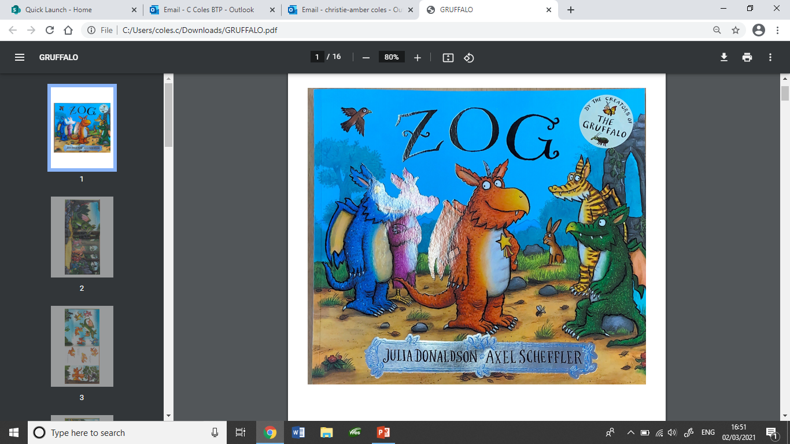

Slide 4
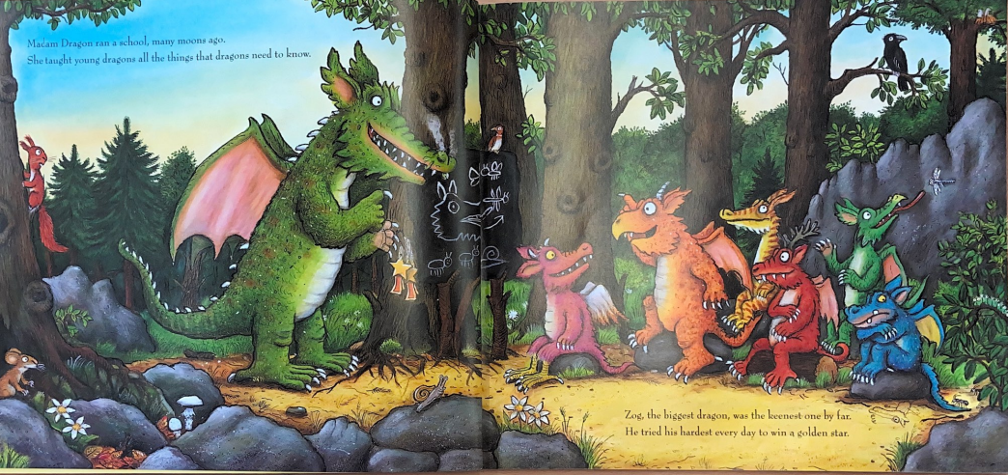

Slide 5
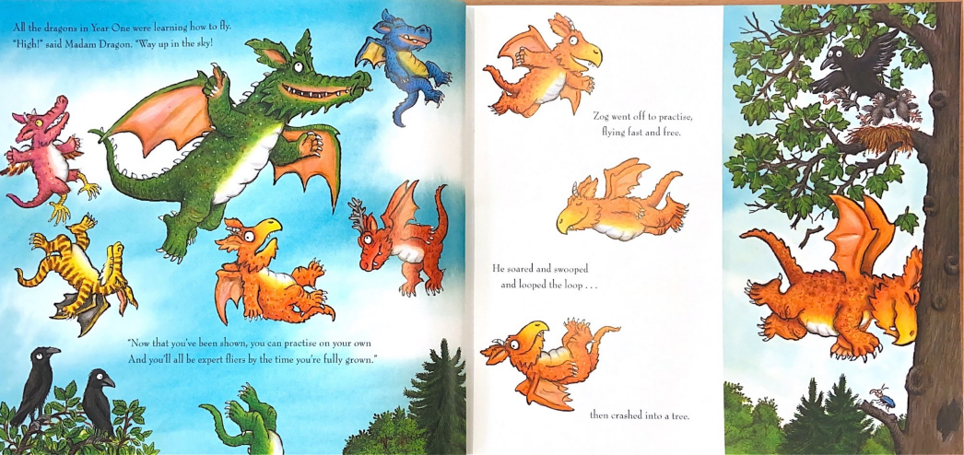

Slide 6
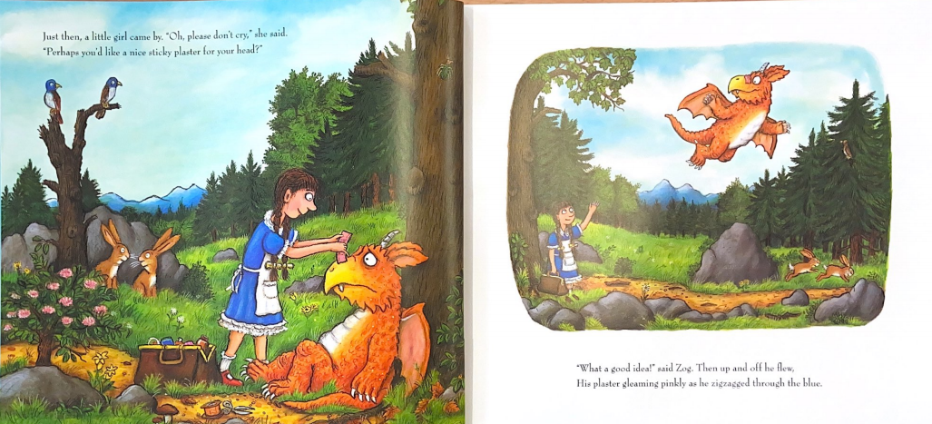

Slide 7
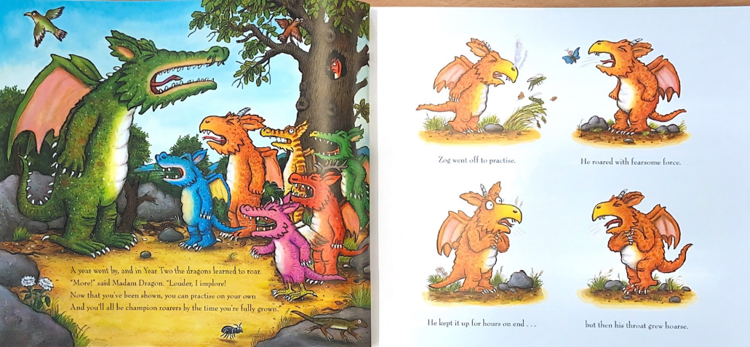

Slide 8
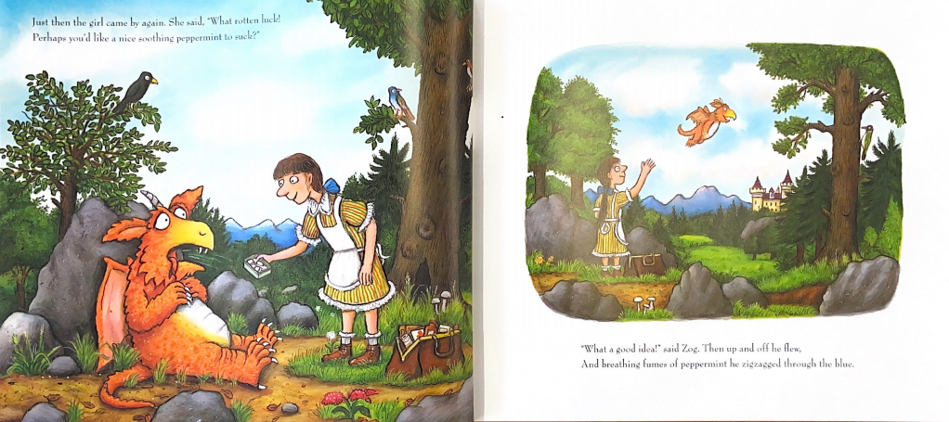

Slide 9
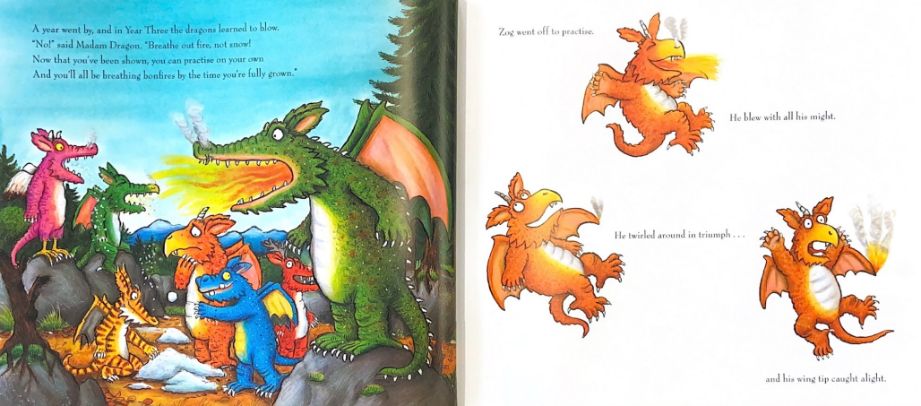

Slide 10
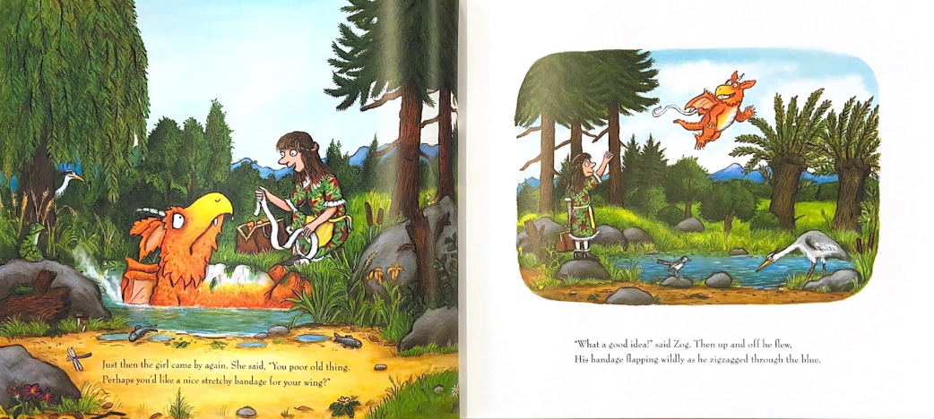

Slide 11
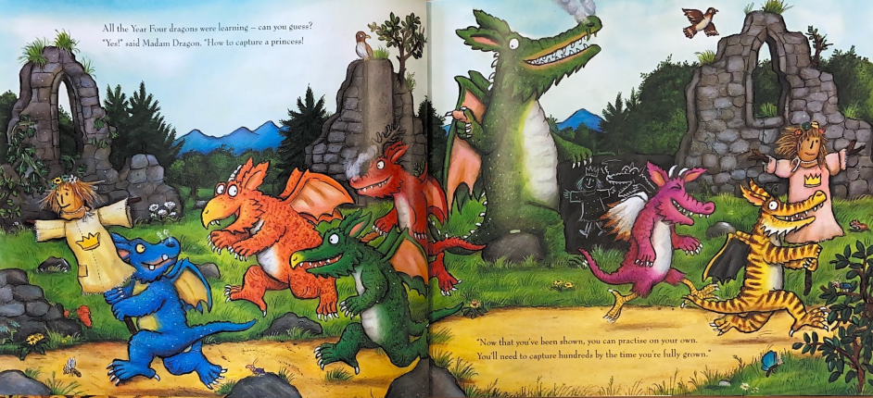

Slide 12
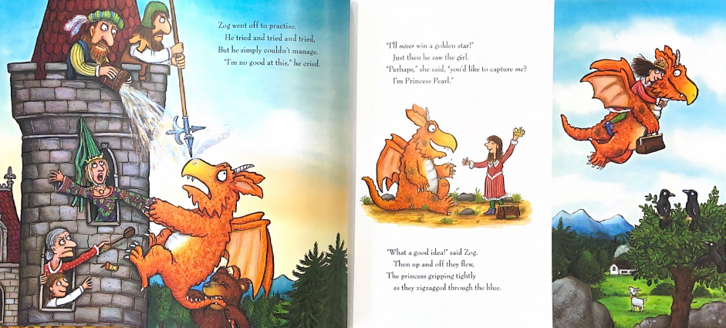

Slide 13
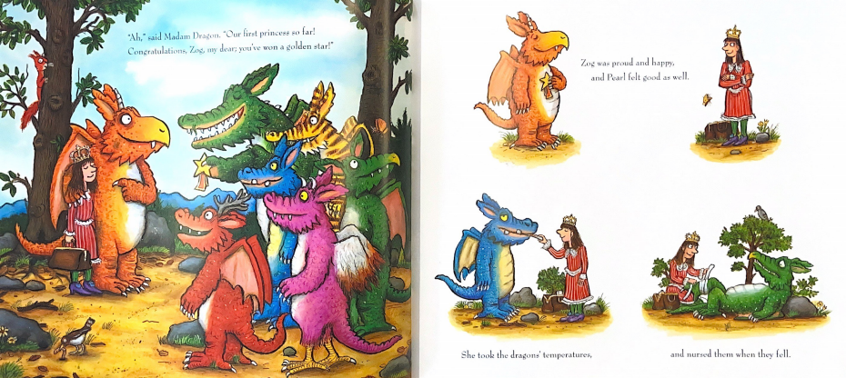

Slide 14
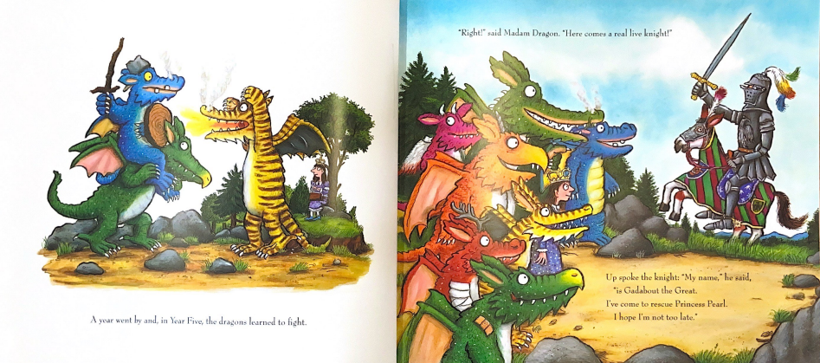

Slide 15
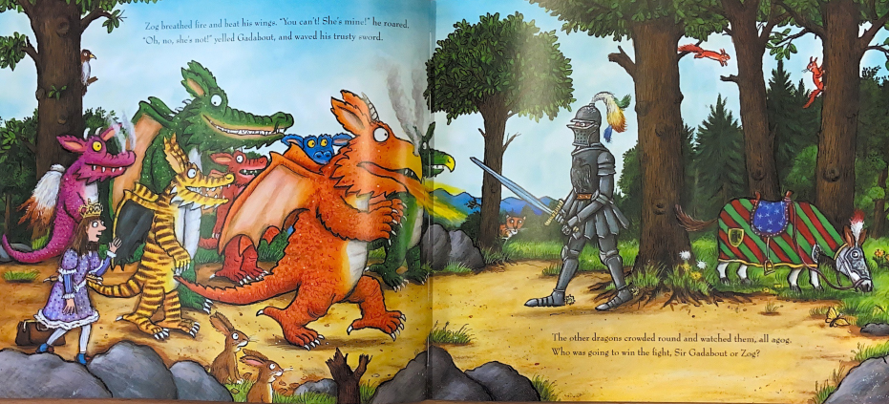

Slide 16
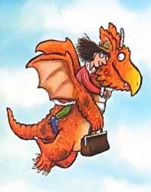
Your task
To match the pictures to the correct school Year.
To write a sentence for what skill Zog has learnt in each Year.
Options for recording
Use the following powerpoint slide. Reorder the pictures under the school Years. Add a text box under each picture and type the skills Zog learnt.
Print off the powerpoint slide. Cut and stick the pictures and write a sentence to say what skills Zog learnt each Year.
Use the Word doc format. Either print off or edit the Word doc.

Slide 17
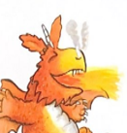
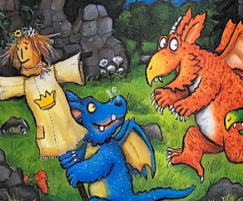
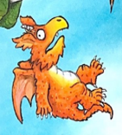
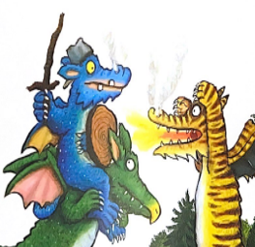
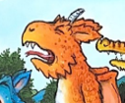
In Year 1 Zog learnt…
In Year 2 Zog learnt…
In Year 3 Zog learnt…
In Year 4 Zog learnt…
In Year 1 Zog learnt…

Slide 18
Pictures for using in class.

