Slide 1
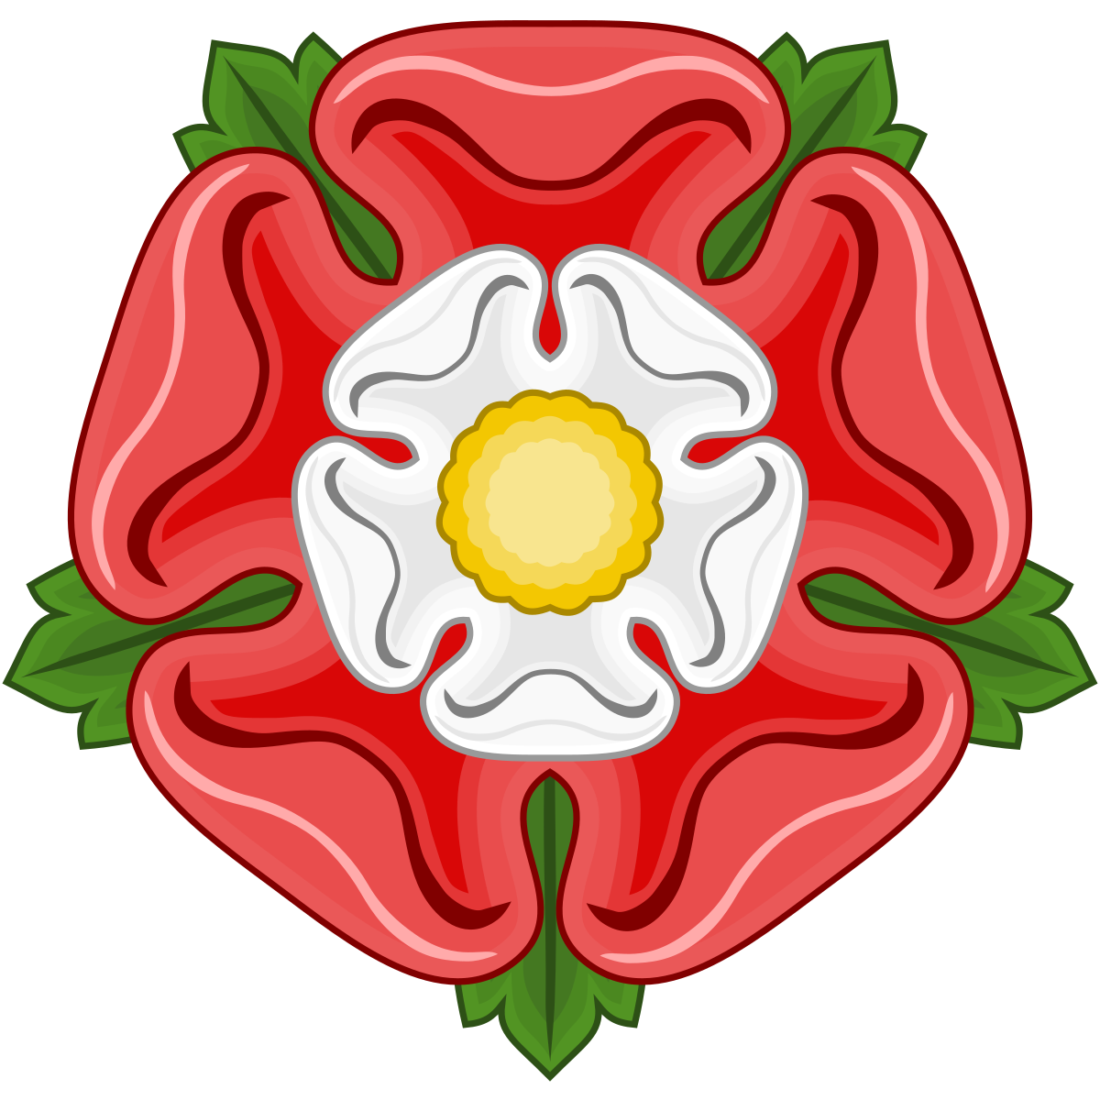
Tuesday 9th March 2021
History
LO: To identify Tudor family tree

Slide 2
Last week we learnt all about Henry VIII
What can you remember about him?
We are going to have a quick recap and watch https://www.bbc.co.uk/bitesize/topics/zkrkscw/articles/zv2bmfr

Slide 3
Key information about Henry VIII
He had six wives.
He was not always kind to his wives and even chopped off two of their heads.
He really wanted to have a boy.
He had three children, two girls and a boy.

Slide 4
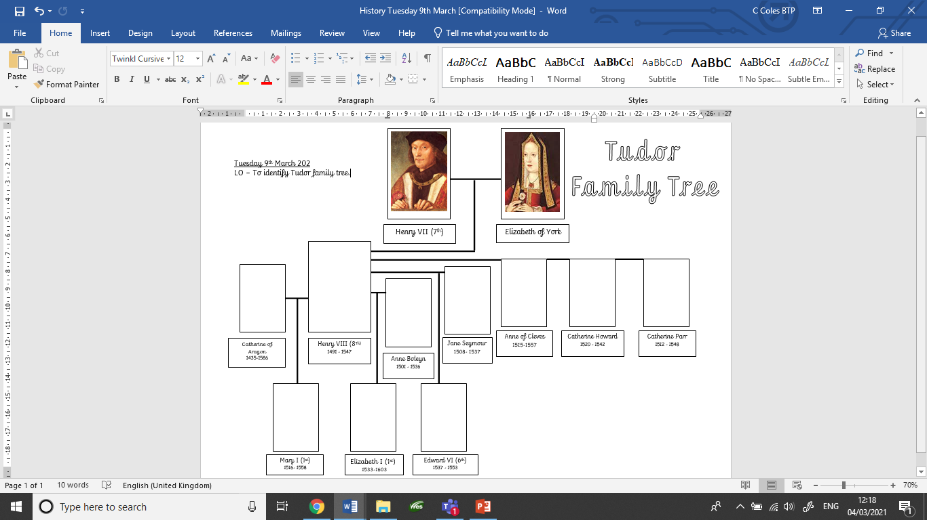

Slide 5
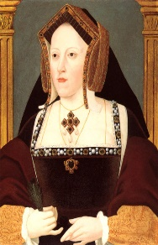
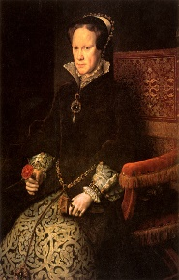
This is Catherine of Aragon.
She was Henry VIII’s first wife.
Together they had a daughter called Mary.

Slide 6
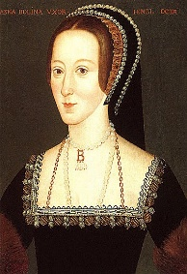
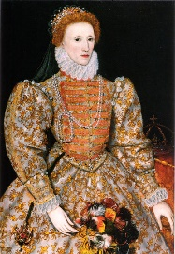
This is Anne Boleyn.
She was King Henry VIII’s second wife.
They had a daughter called Elizabeth.

Slide 7
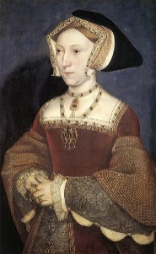
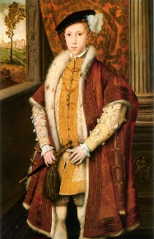
This is Jane Seymour.
She was Henry VIII’s third wife.
Together they had a son called Edward.

Slide 8
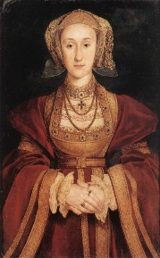
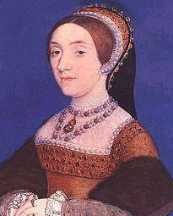
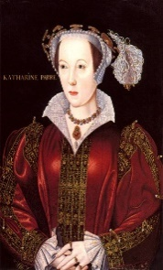
This is Anne of Cleves.
She was Henry VIII’s fourth wife.
This is Catherine Howard.
She was Henry VIII’s fifth wife.
This is Catherine Parr.
She was Henry VIII’s sixth wife.

Slide 9
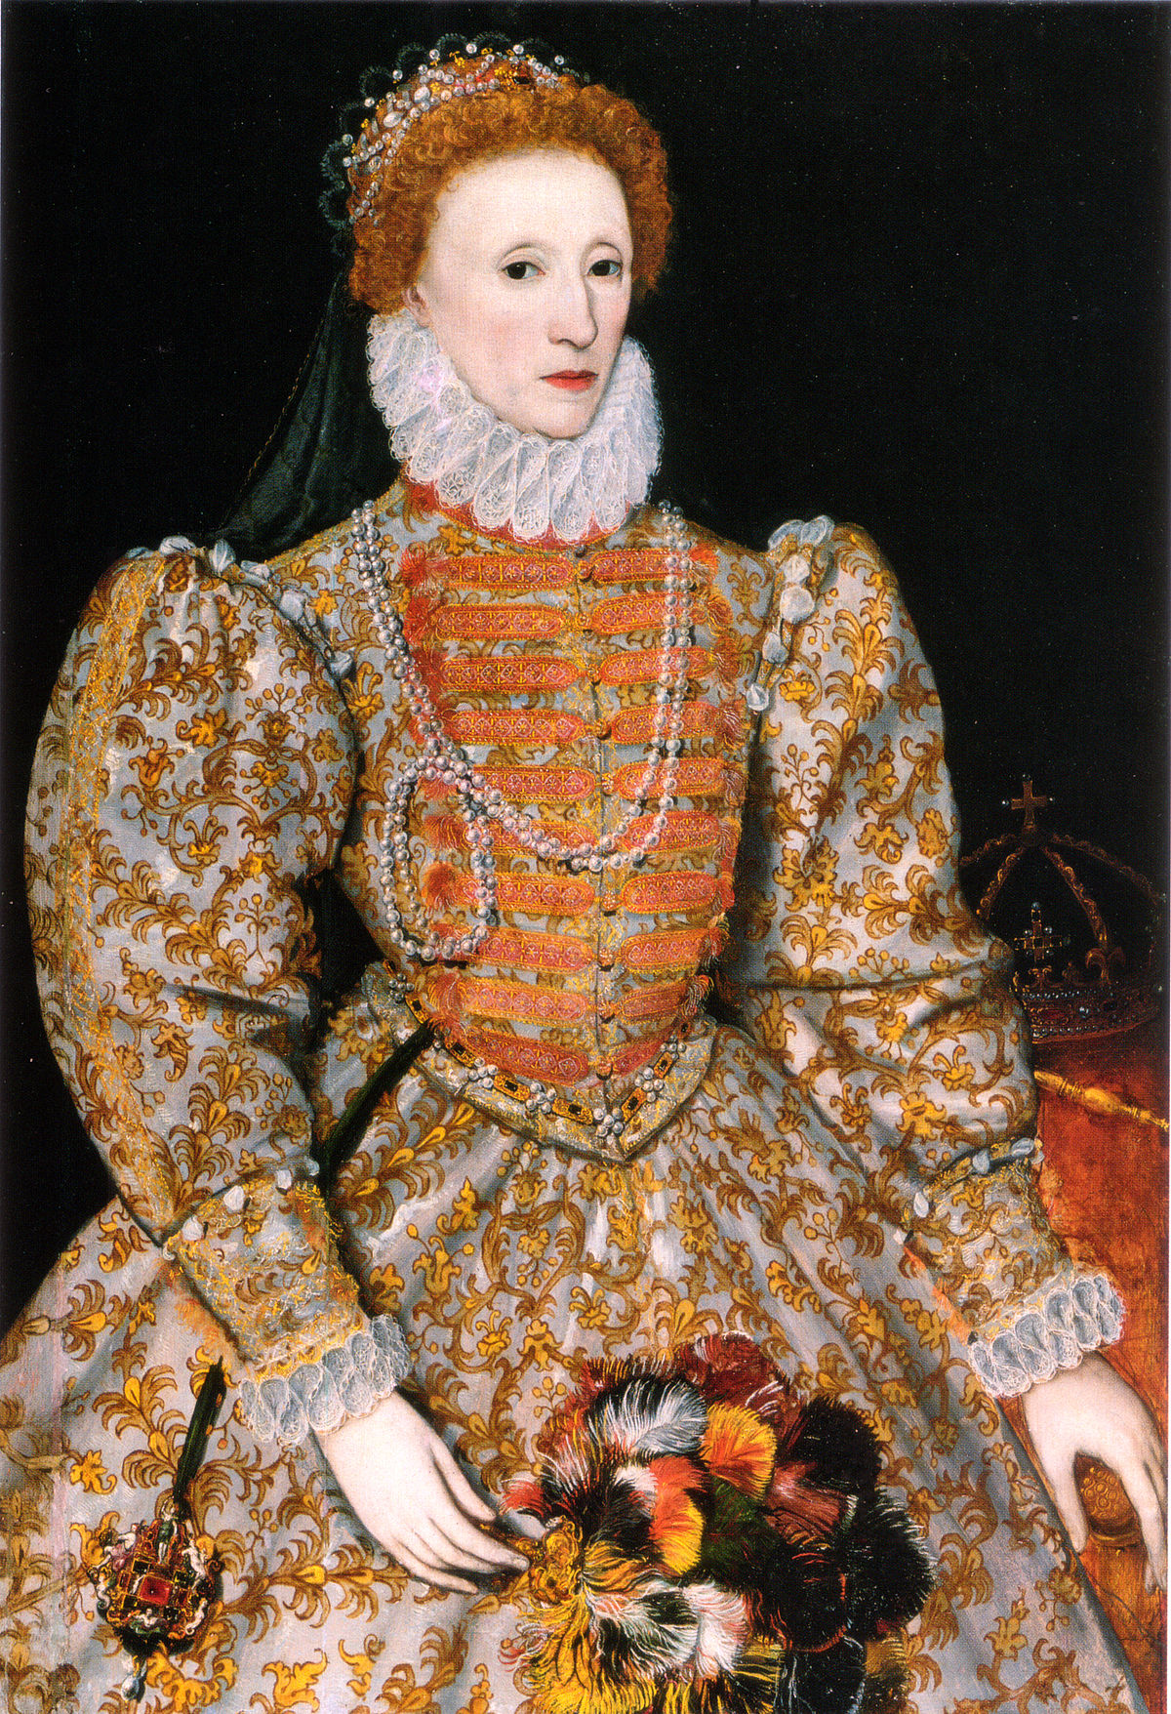
Line of succession
This is the order that the royal family become King or Queen.
When Henry VIII died the next in line to the throne was his son, Edward VI.
He became King when he was 9.
He became ill and died at the age of 16.
When Mary I died Elizabeth I became Queen because Mary had no children.
She was Queen of England for 44 years.
When Edward VI died the next in line to the throne was his sister Mary I.
She became Queen because Edward had no children.
She was the first female monarch.
She reigned for just 5 years.

Slide 10
This week we are learning about Queen Elizabeth I.
Watch this video all about Queen Elizabeth I.
https://www.bbc.co.uk/bitesize/topics/zkrkscw/articles/zkh7bdm

