Slide 1


Slide 3

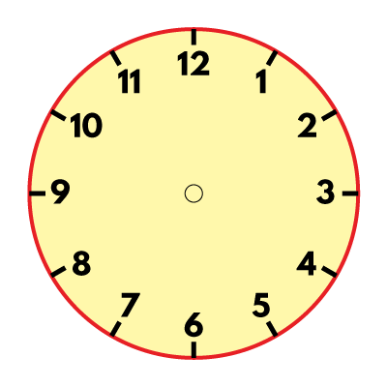
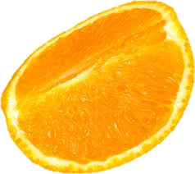

What do you notice?
Have a think
How else could we show one quarter?

Slide 5
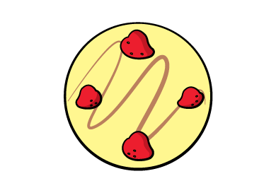
We can recognise a quarter when a shape, measure or quantity has been split into 4 equal parts.
Which cheesecake has been split into 4 equal parts?

Slide 6





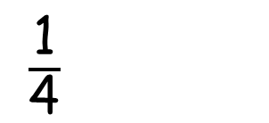
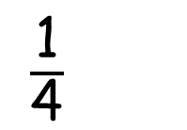
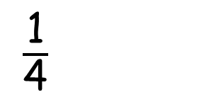
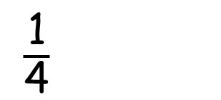
They cut it into 4 equal parts.
They each have one quarter of the whole
cheesecake.
The children are sharing the cheesecake
$\frac{\text{1}}{\text{4}}$
$\frac{\text{1}}{\text{4}}$
$\frac{\text{1}}{\text{4}}$
$\frac{\text{1}}{\text{4}}$

Slide 7
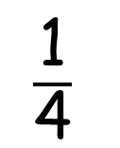
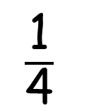
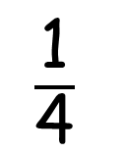
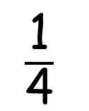
This shape has been divided into 4 equal parts.
Each part is one quarter of the whole shape.
$\frac{\text{1}}{\text{4}}$
$\frac{\text{1}}{\text{4}}$
$\frac{\text{1}}{\text{4}}$
$\frac{\text{1}}{\text{4}}$

Slide 8


Which shapes have one quarter shaded?
v
Have a think

Slide 9
Have a go at questions
1 – 5 on the worksheet

Slide 10
Here is one quarter of a shape.
Can you draw the whole shape?
Is there more than one way to do this?
Have a think

Slide 11

One quarter is half of a half!

Slide 12
Have a go at the rest of the questions on the worksheet

