Slide 1
Friday 19th March 2021
LO: To compare the animated story and the book.

Slide 2
This week we have read the story ‘Zog And The Flying Doctors’ By Julia Donaldson. Now we are going to watch the animation.
https://www.bbc.co.uk/iplayer/episode/m000qq5j/zog-and-the-flying-doctors

Slide 3
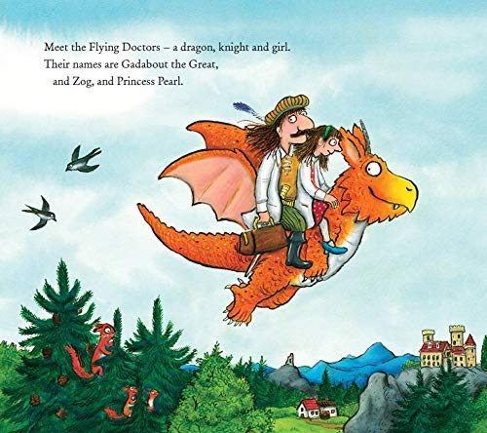
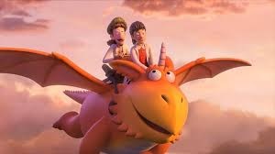
Your Task
To think about both the book and the animation.
Were there any differences? What were they?
Were there any similarities? What were they?
Which one did you prefer? Why?

