Slide 1
Tuesday 16th March 2021
LO: Write and illustrate an additional page of the book.

Slide 2
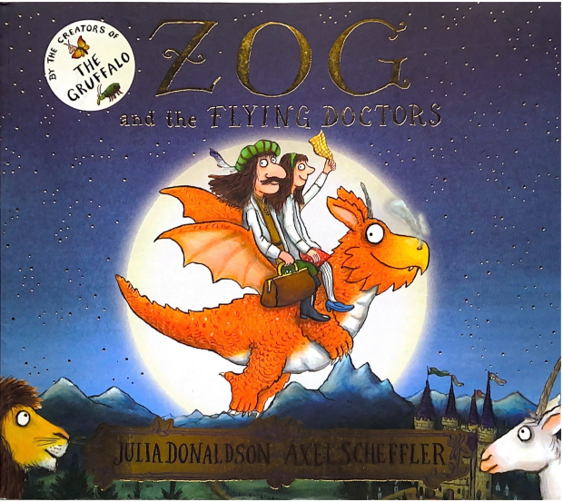

Slide 3
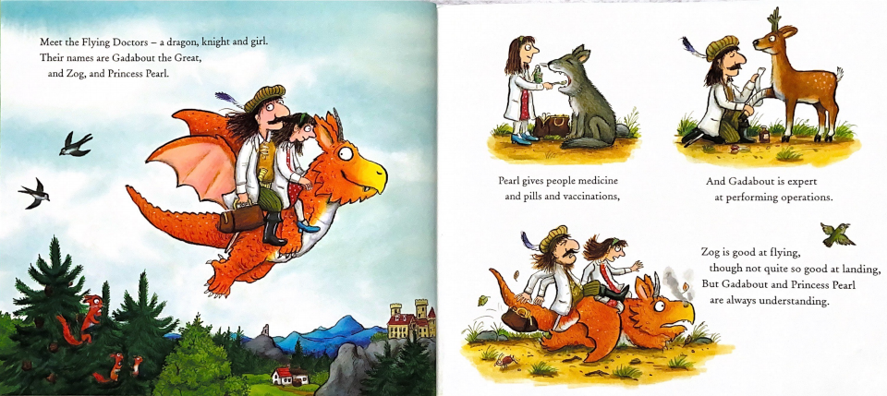

Slide 4
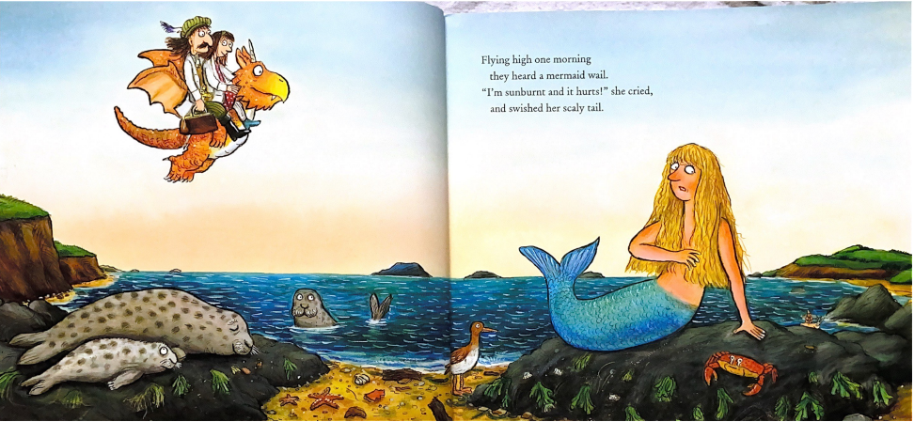

Slide 5
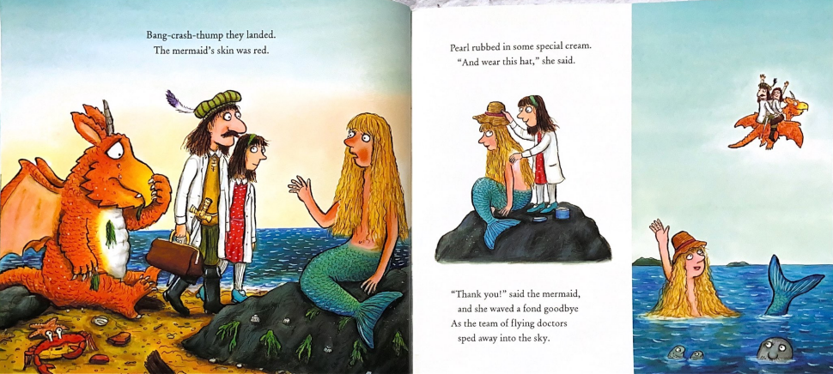

Slide 6
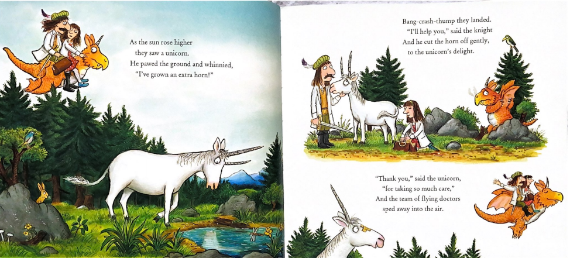

Slide 7
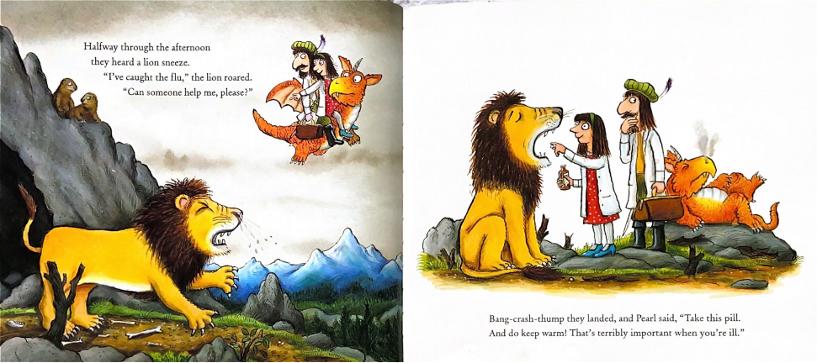

Slide 8
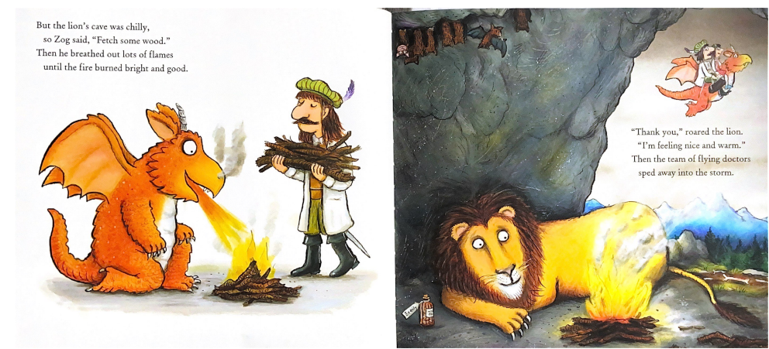

Slide 9
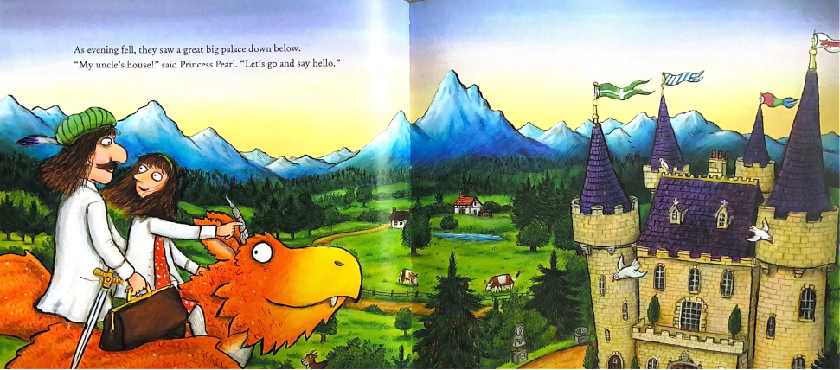

Slide 10
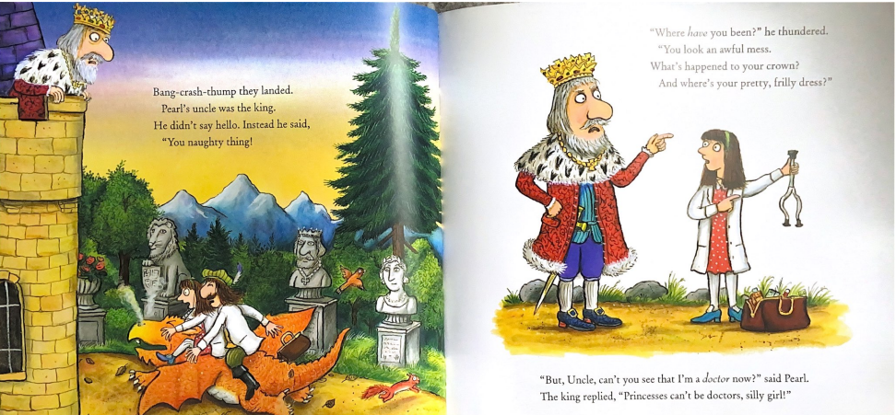

Slide 11
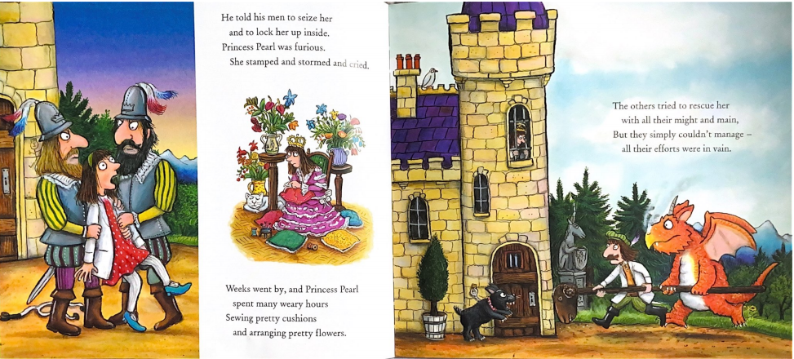

Slide 12
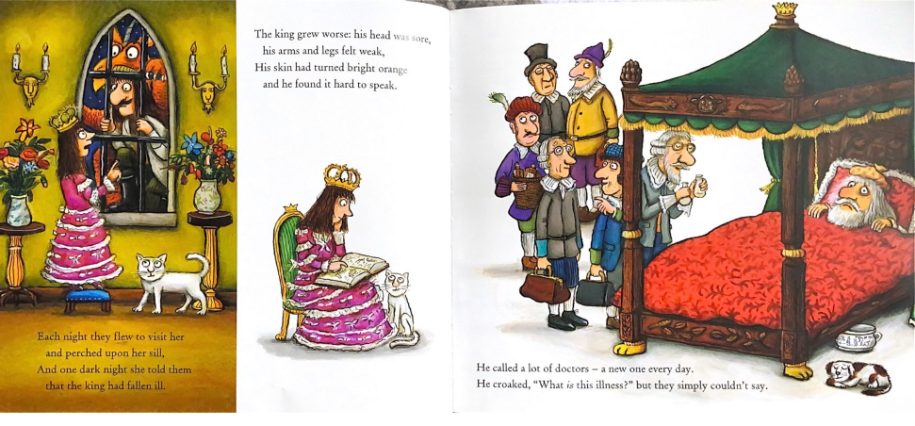

Slide 13
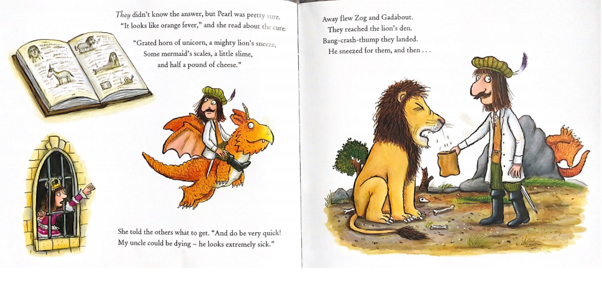

Slide 14
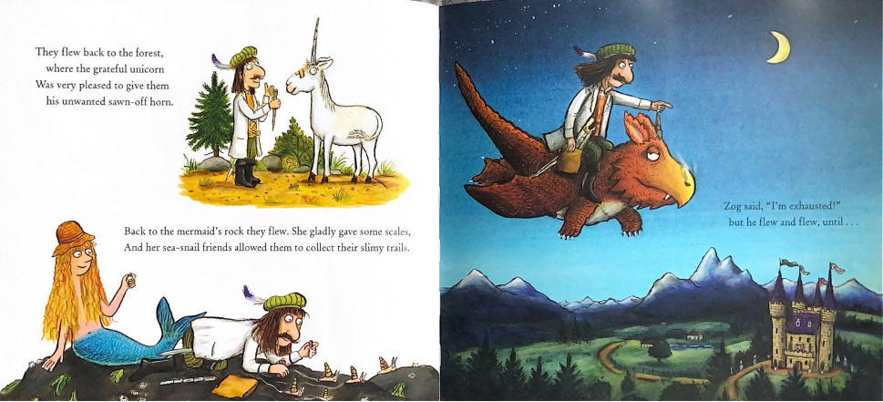

Slide 15
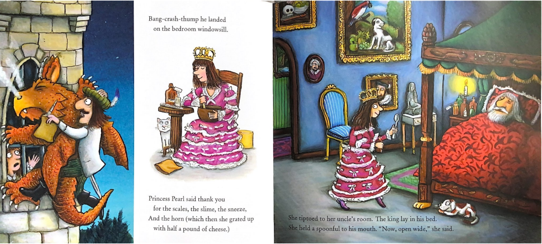

Slide 16
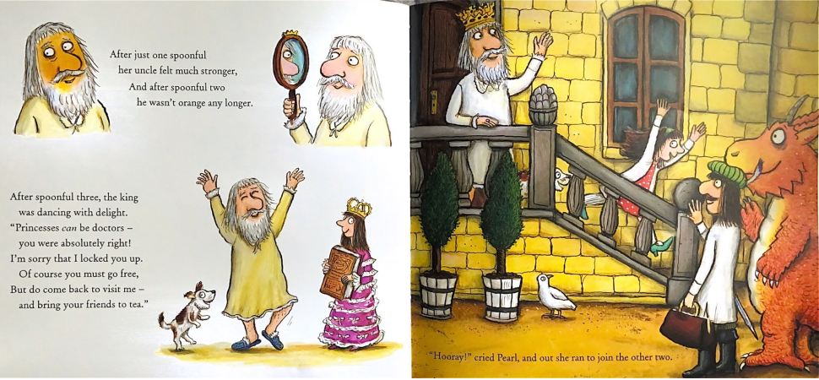

Slide 17
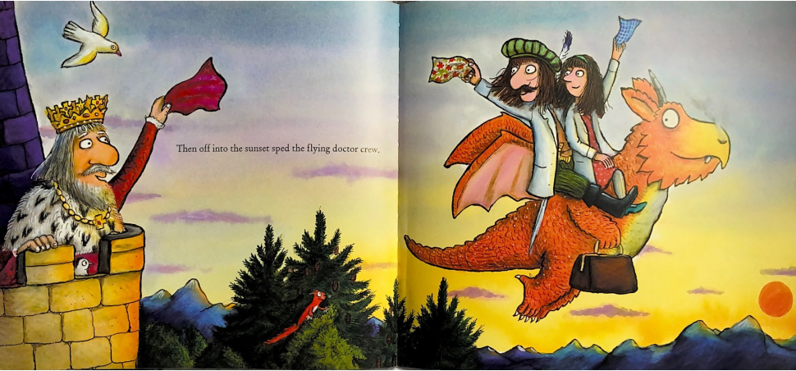

Slide 18
In the story the flying doctors visit different creatures. Can you remember who the doctors visited?
A mermaid
A unicorn
A lion
A king

Slide 19
Your Task
To think about what creature the flying doctors might visit next and create a new page of the book including an illustration and the writing about what happens with that character. You might choose to use the creature you wrote your story about last week.
On your page you must include;
Who needs the doctors help
What is wrong with them
How the flying doctors help them
A picture to match, which includes the setting and the characters.

Slide 20
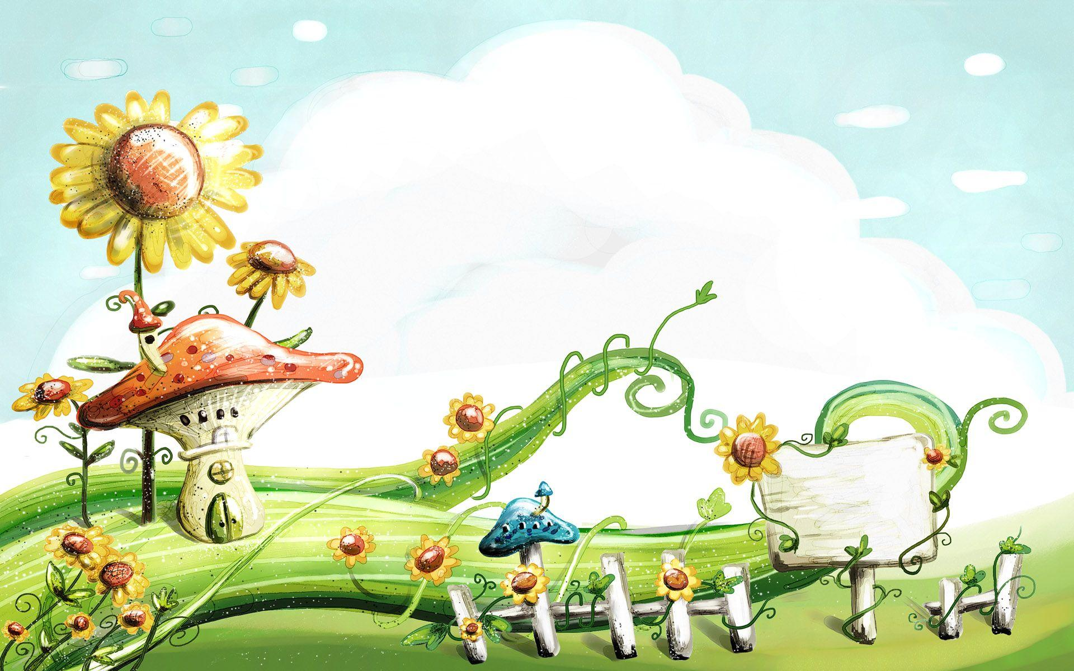
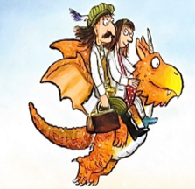
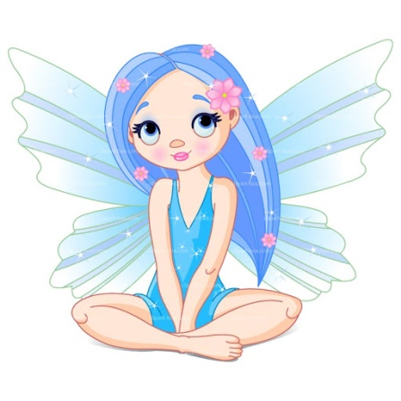
The flying doctors were on their way to visit Madam Dragon when they heard a soft whimper coming from the mushroom field below. It was a small blue fairy called Belle.
“My wing, it’s broken!” she cried
Pearl knew just what to do, she took the magic cream out of her bag and put it on Belle’s wing. “Now you must rest and your wing should heal very soon” explained Pearl.

