Slide 1
LO: To write a character description.
Monday 15th March 2021

Slide 2


Slide 3
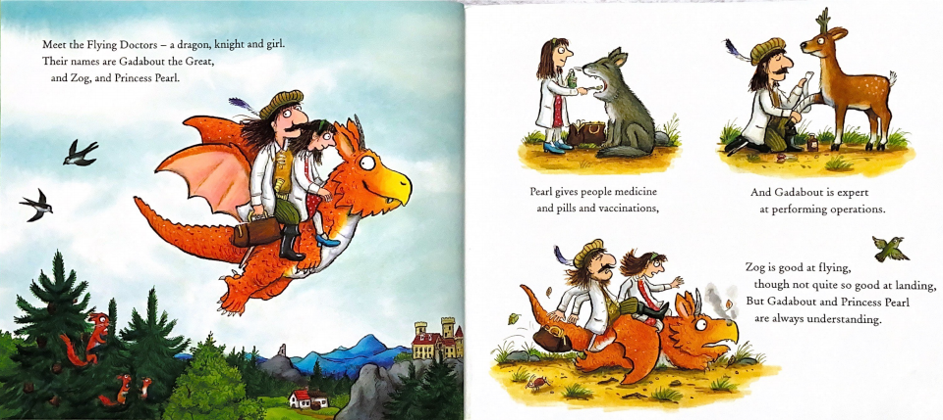

Slide 4
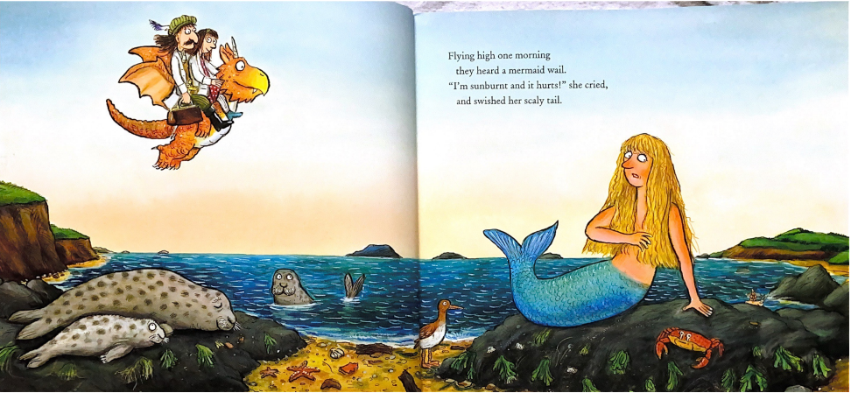

Slide 5
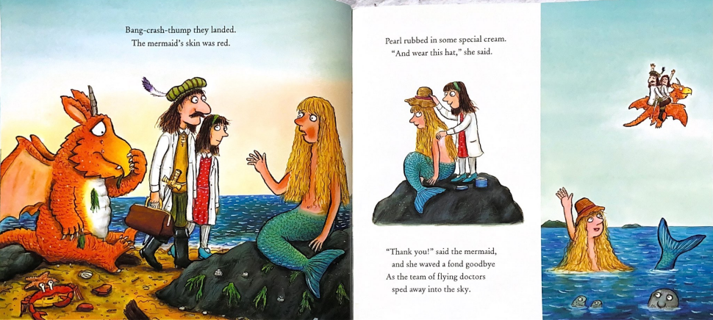

Slide 6
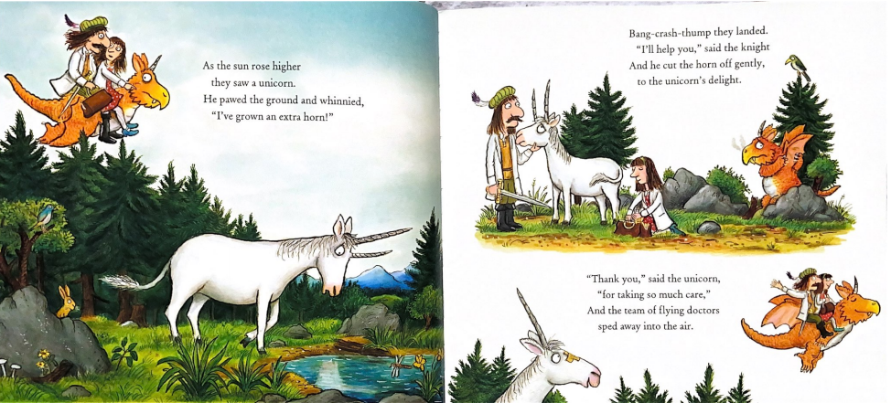

Slide 7
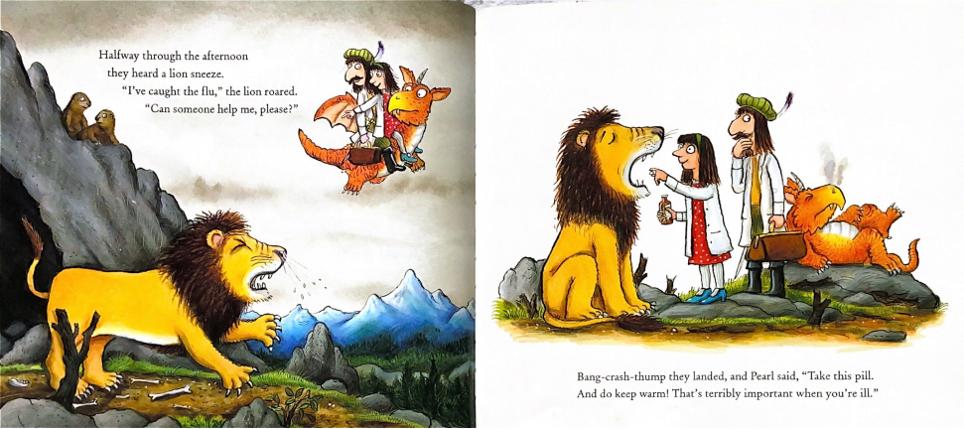

Slide 8
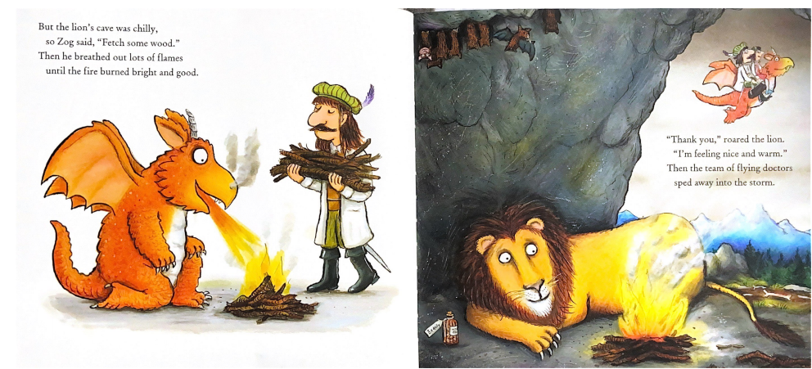

Slide 9
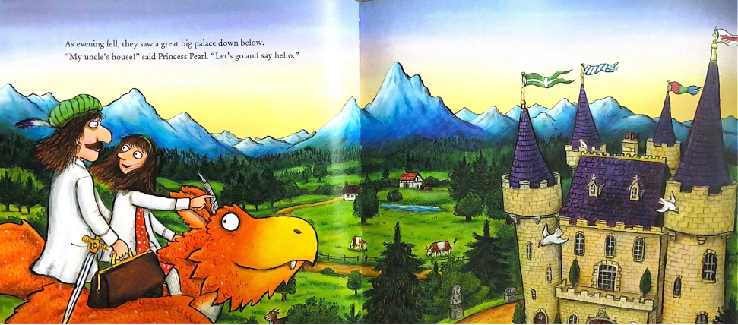

Slide 10
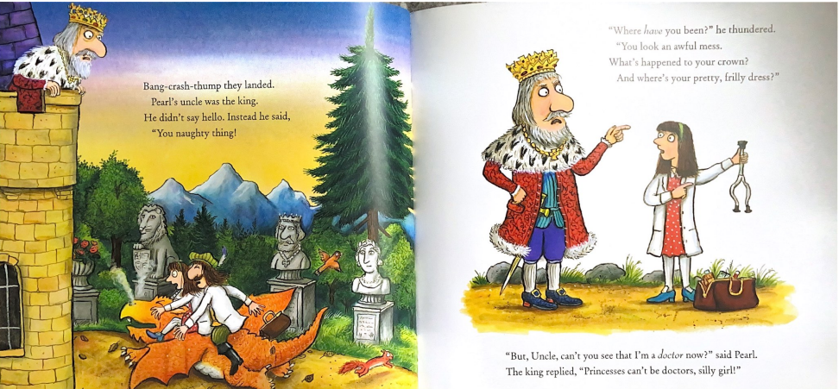

Slide 11
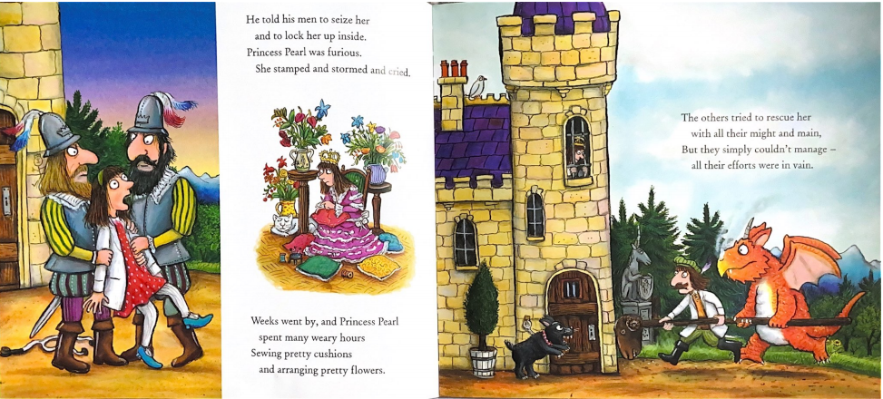

Slide 12
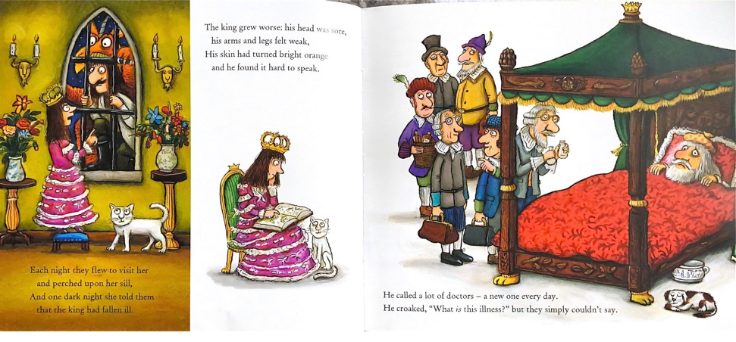

Slide 13
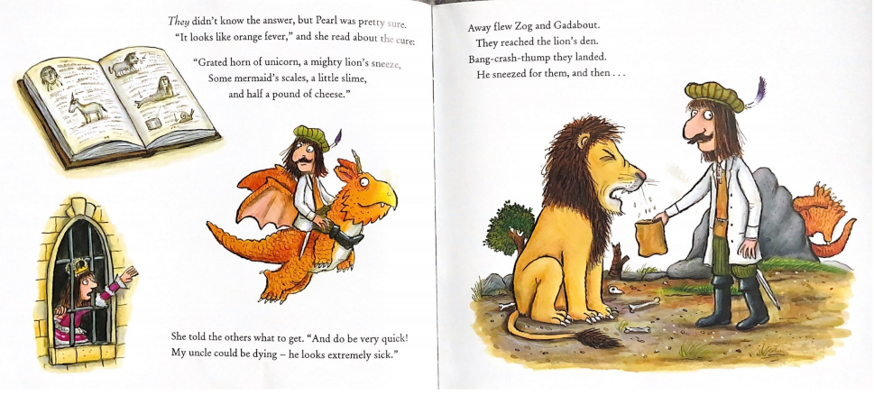

Slide 14
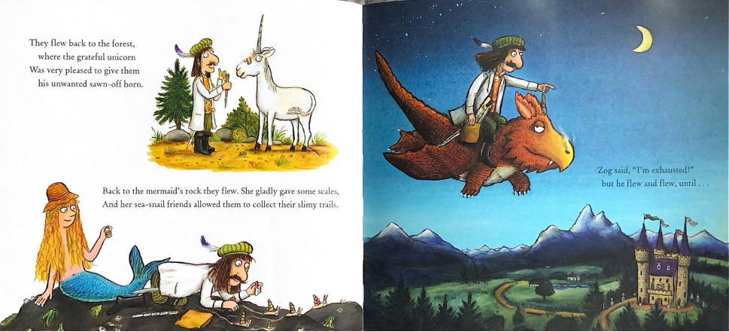

Slide 15
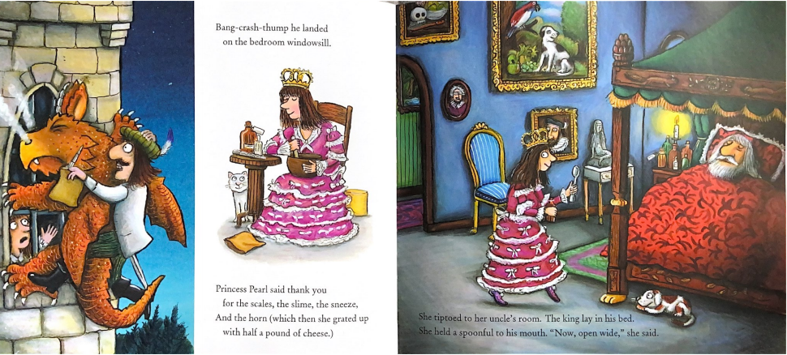

Slide 16
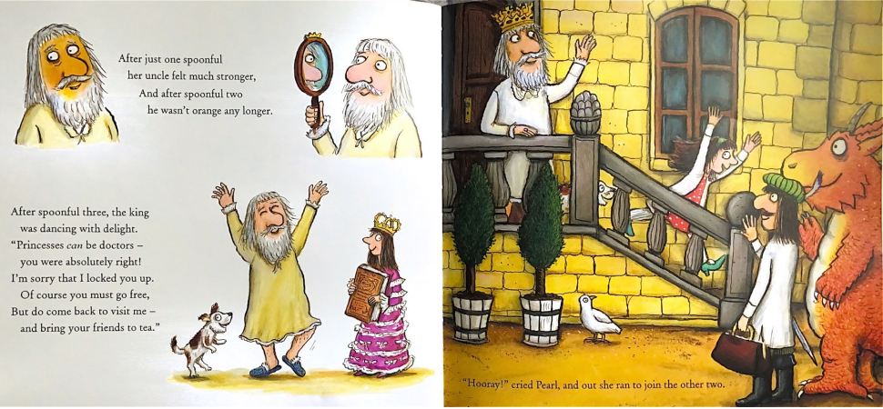

Slide 17
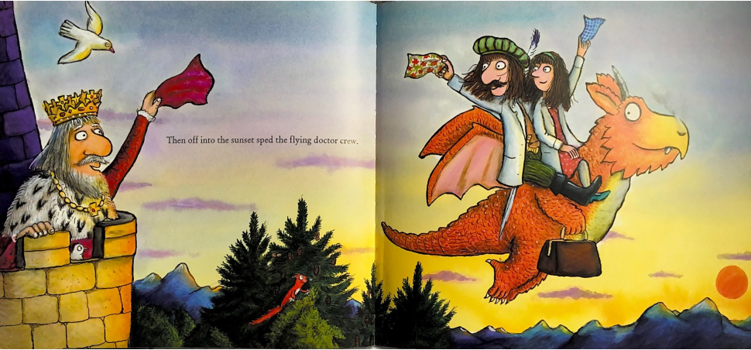

Slide 18
Today we will be thinking of adjectives to describe a character. For example…
  When we describe a character, we need to think about two main things.
What they look like, hair, body, eyes, clothes, tails, horns, pretty much anything you can see when you look at a picture of them!
1) Their appearance:
2) Their personality:
What sort of character they have. Are they happy, sad, grumpy, angry, kind, selfish, sweet, funny or mean!

Slide 19
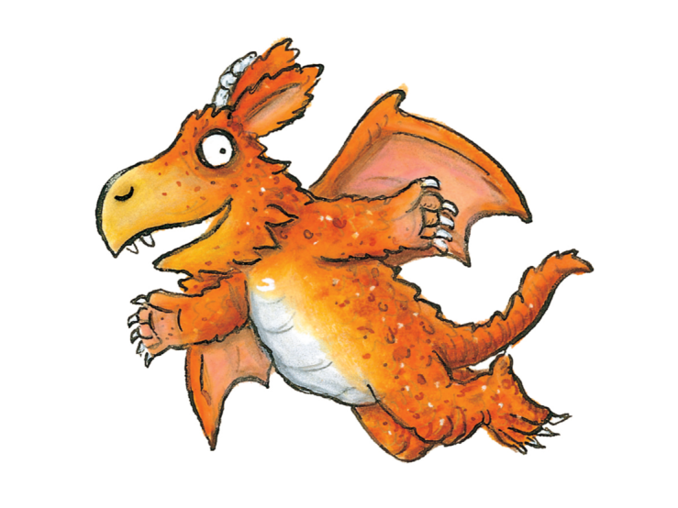
Similes
We can use similes to make our writing more interesting, by comparing a part of his appearance or personality to something similar.
We would use as or like to compare…
Zog’s scales are as orange as a burning fire.

Slide 20
Similes
We can use similes to make our writing more interesting, by comparing a part of his appearance or personality to something similar.
We would use as or like to compare…
Zog’s eyes are round like dinner plates.

Slide 21
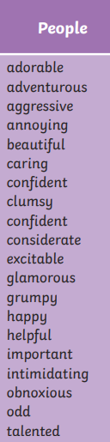
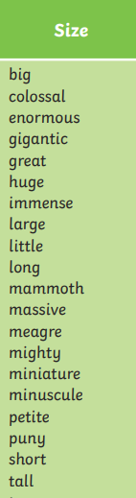
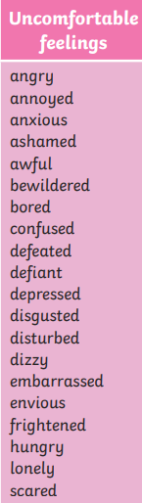
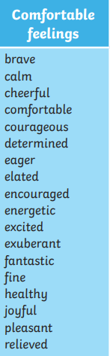

An adjective is a describing word.
How could we describe Zog’s appearance?
Zog is a short and mighty dragon. He has orange scales and sharp claws like knives.

Slide 22
An adjective is a describing word.
How could we describe Zog’s personality?
Zog is a helpful and happy dragon. He is caring because he helps the doctors fly around the country.

Slide 23
Your task!
1) You need to think about Zog and write two sentences to describe his appearance.
2) You need to write two more sentences to describe his personality.
You must include:
Capital letters to start the sentences.
Conjunctions and or because to link your ideas.
Adjectives to describe things.

