Slide 1
31.3.21
LO: To answer questions about a story.

Slide 2
Task: Read the extract from the film/story Tangled.

Slide 3
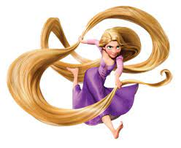
TANGLED
Rapunzel is about a lost princess whose mother was very ill and she got a healing flower that only works when Rapunzel would sing a song.
She falls for a rogue thief named Flynn Eugene Fitzherbert Rider, the kingdom's most wanted-and most charming-bandit.
Flynn Rider, hides out in a mysterious tower, he's taken hostage by Rapunzel, a beautiful and feisty teenager with 70 feet of magical, golden hair.

Slide 4

Rapunzel, wants to escape the tower where she's been locked away for years.
She makes a deal with the handsome thief, after hitting him on the head with a frying pan!
The unlikely pair set off on an adventure, complete with a super-cop horse, a colourful chameleon and a gruff gang of pub thugs.

Slide 5

Together they go on a whirlwind adventure. Near the end of the film it is revealed that Rapunzel has brown hair!
Eugene chopped her hair off using a broken mirror after he got stabbed by Mother Gothel.
She wanted to keep Rapunzel all to herself because she looks around 100 years old and as Rapunzel sings the following lyrics:
Flower, gleam and glow
Let your power shine,
Make the clock reverse, bring back what once was mine,
Heal what has been hurt,
Change the fates design,
Save what has been lost,
Bring back what once was mine,
What once was mine.

Slide 6
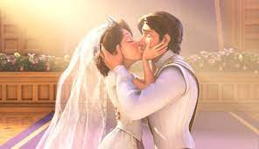
It either makes the person young again or it heals them. At the end of the film Rapunzel married Eugene.

Slide 7
Watch the video clip to remember to main events in the story.
https://www.youtube.com/watch?v=rpepyyhclsQ

Slide 8
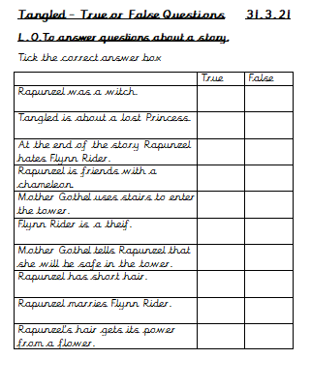
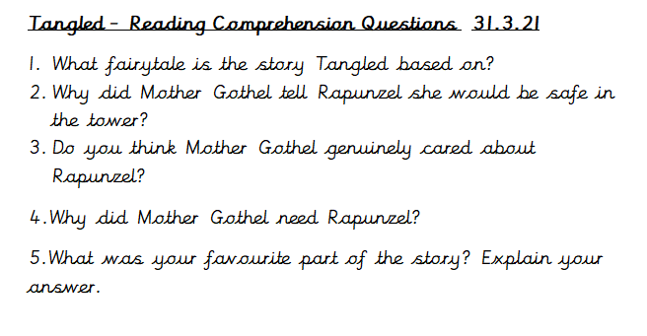
Your Task – Complete the comprehension questions you are given.

