Slide 2
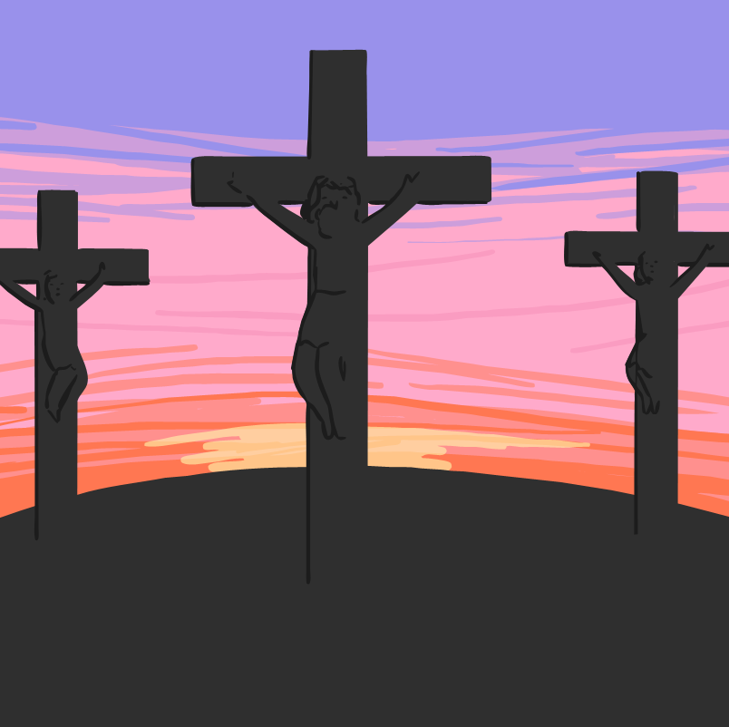
Why Do People Celebrate Easter?
It is a Christian festival.
It is the oldest and most important Christian festival.
To celebrate the death and coming to life again of Jesus Christ.
For Christians, the dawn of Easter Sunday with its message of new life is the high point of the Christian year.

Slide 3
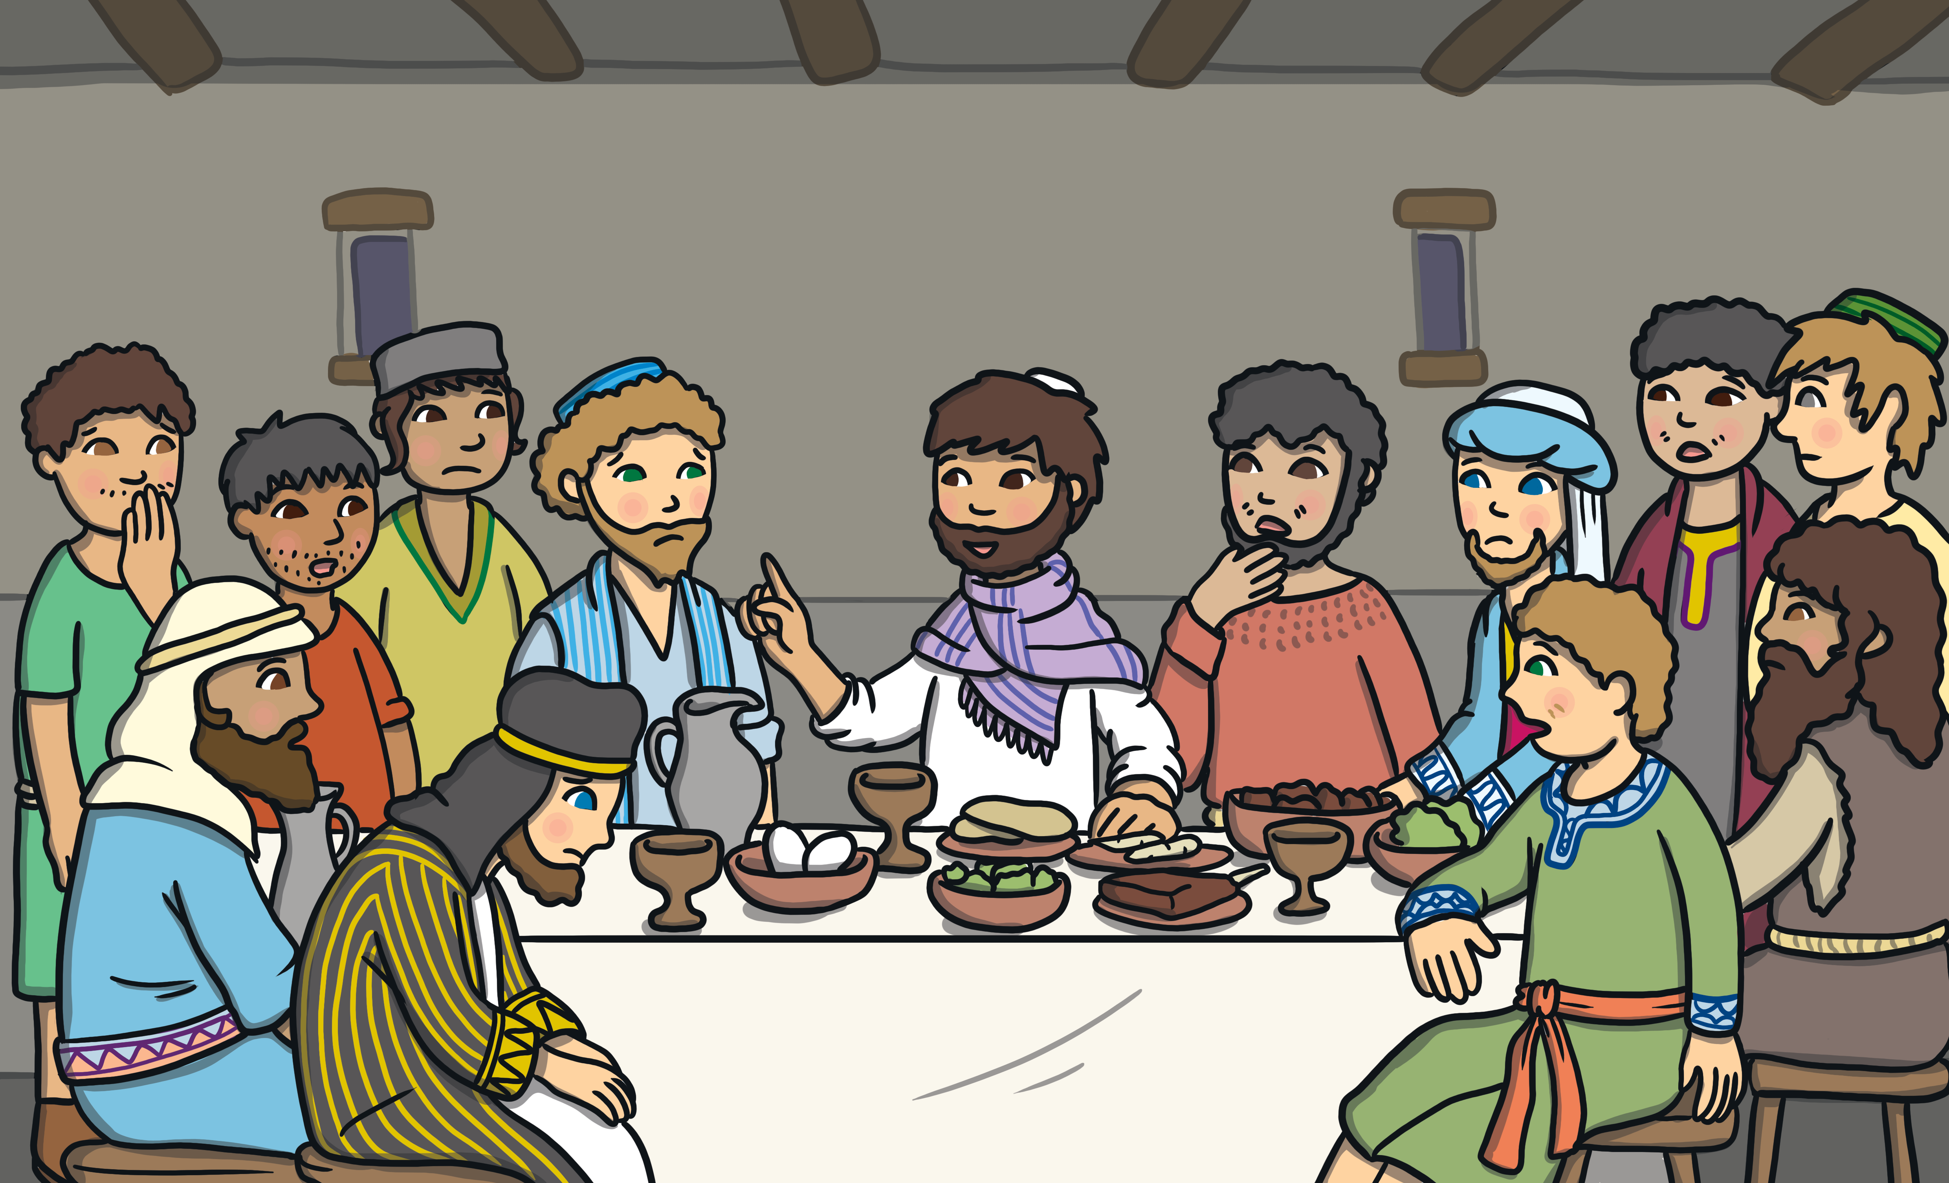

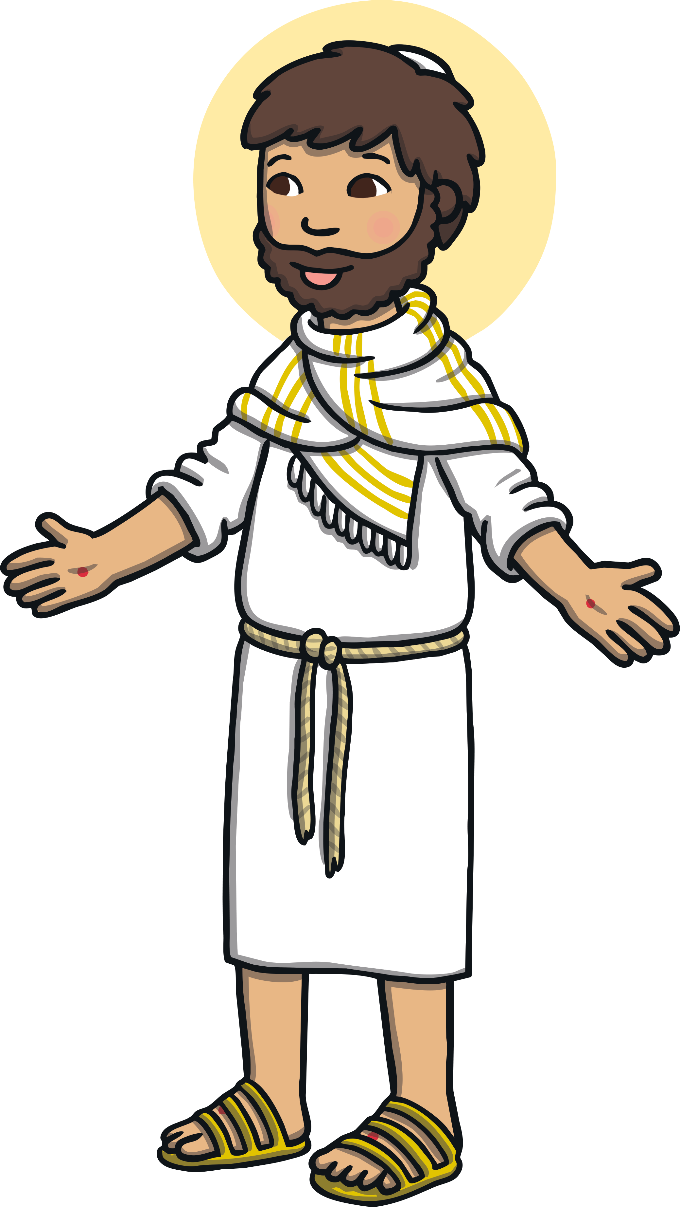
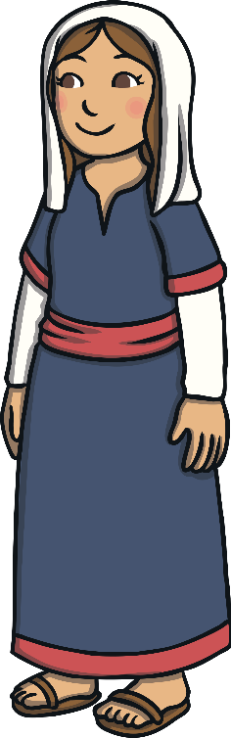
The Easter Story
Maundy Thursday - Jesus had the ‘Last Supper’ with his disciples.
Good Friday - Jesus was nailed to the cross and died. His friends put him in a tomb and covered it with a large rock.
Saturday - Jesus remained in the tomb.
Easter Sunday - Jesus rose from the dead!
He had come back to visit his friends. He told them to teach others about God’s love.
“Tell the people to believe in me, even if they can’t see me.”
And then Jesus went up to Heaven to live with his Father.

Slide 4
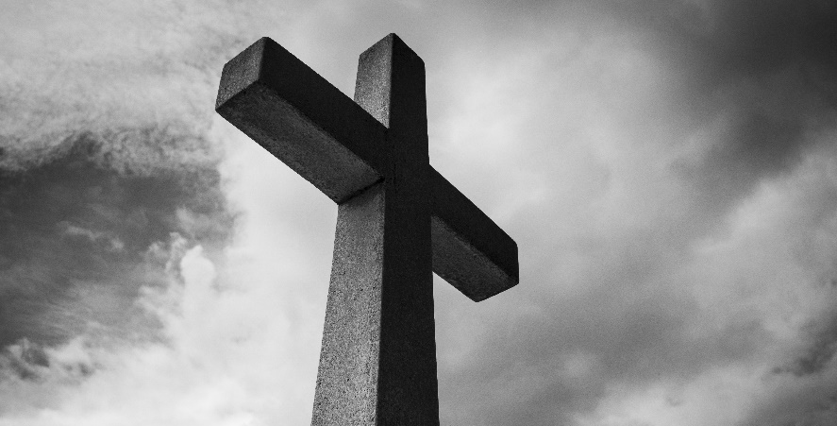
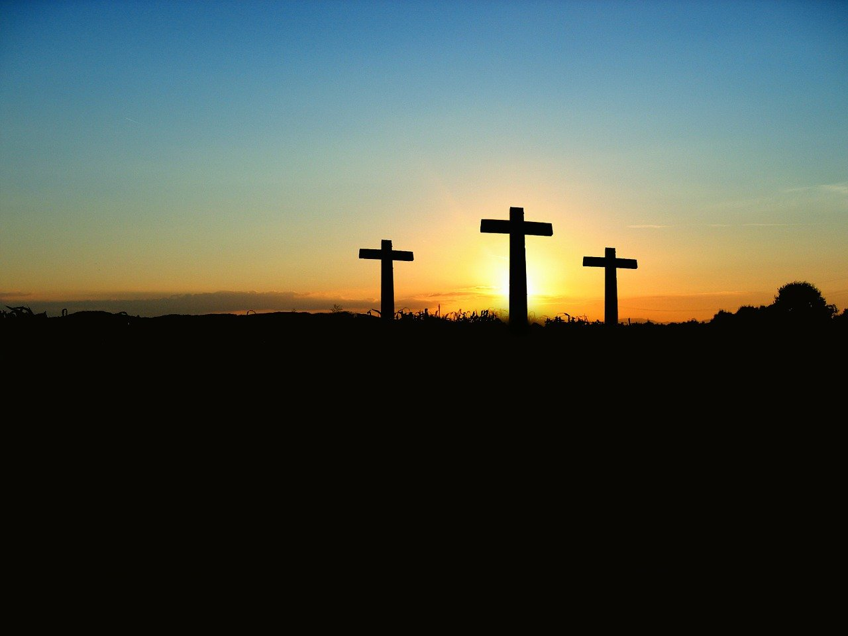

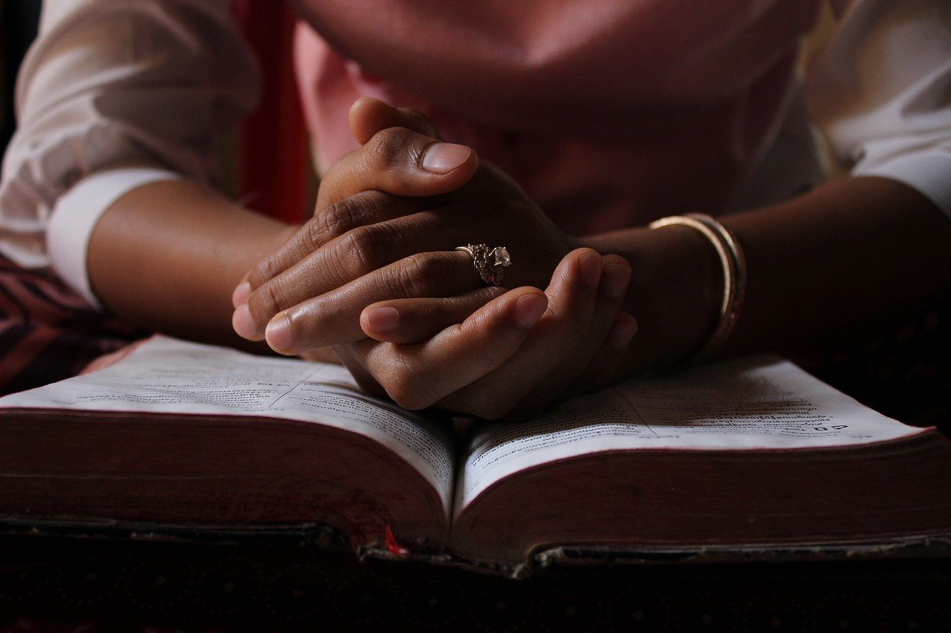
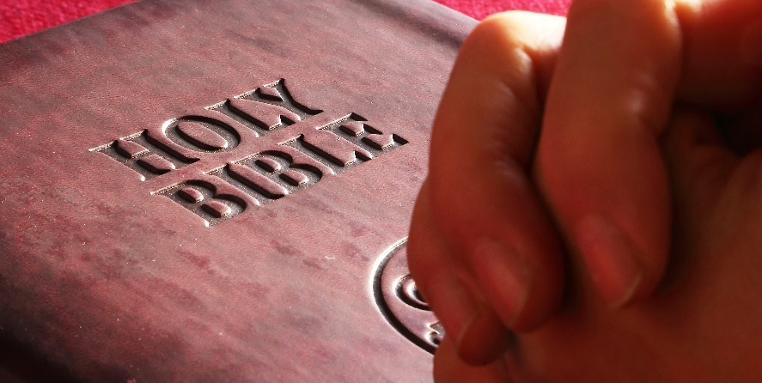
Who Celebrates Easter?
Easter is celebrated by Christians all over the world.

Slide 5
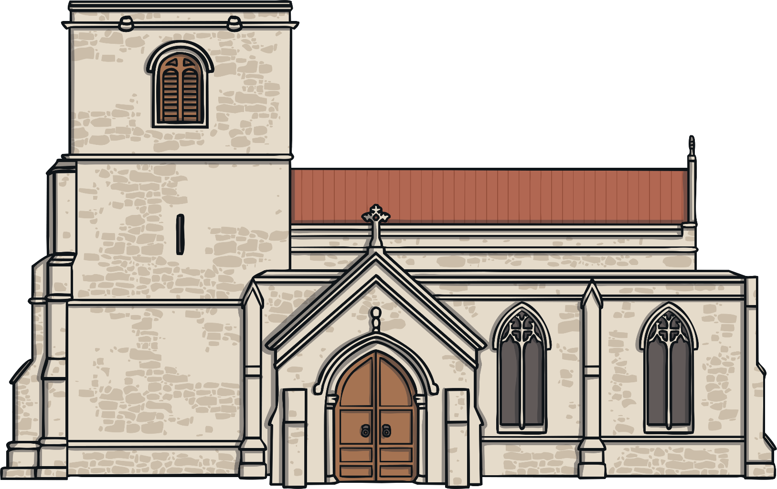
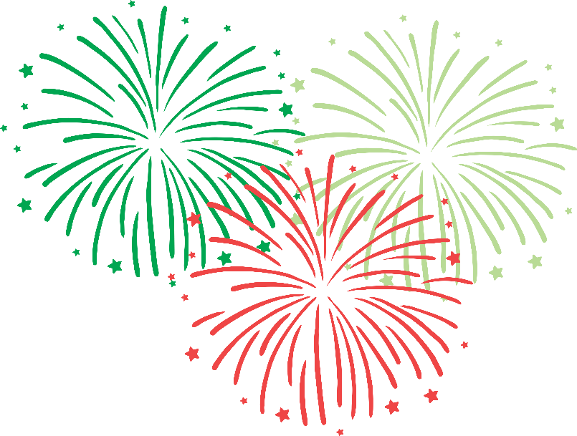

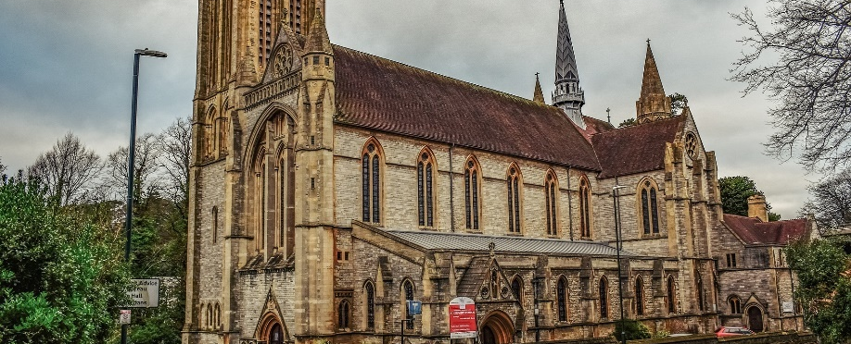
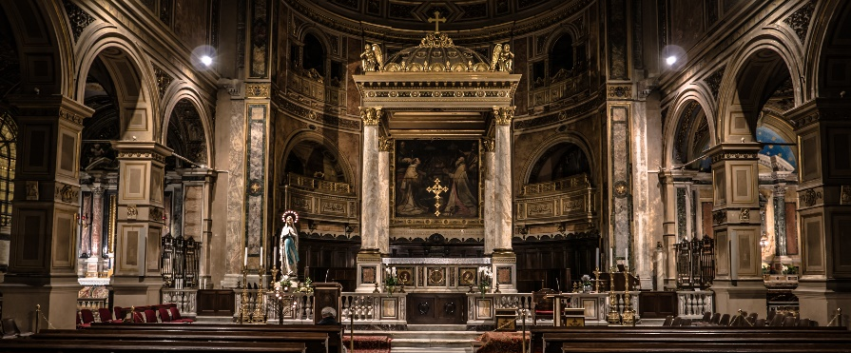



Where Do People Celebrate Easter?
Services sometimes start at midnight of Easter Eve. Candles are used in churches all over the world to start the midnight celebrations.
In churches all over the world.
Churches are often filled with flowers on Easter Day - these represent new life.
In Greece, fireworks are sometimes used to start the service.
Christians also celebrate Easter in
their own homes.

Slide 6

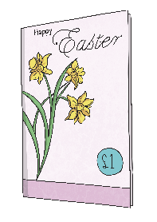


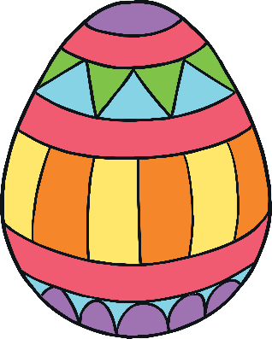

How Do People Celebrate Easter?
By going to church for a special Easter service.
By giving Easter cards.
By eating a special meal with friends and family.
By giving chocolate eggs, going on Easter egg hunts, decorating an egg. Eggs are used as a symbol of new life.
By eating hot cross buns.

Slide 7
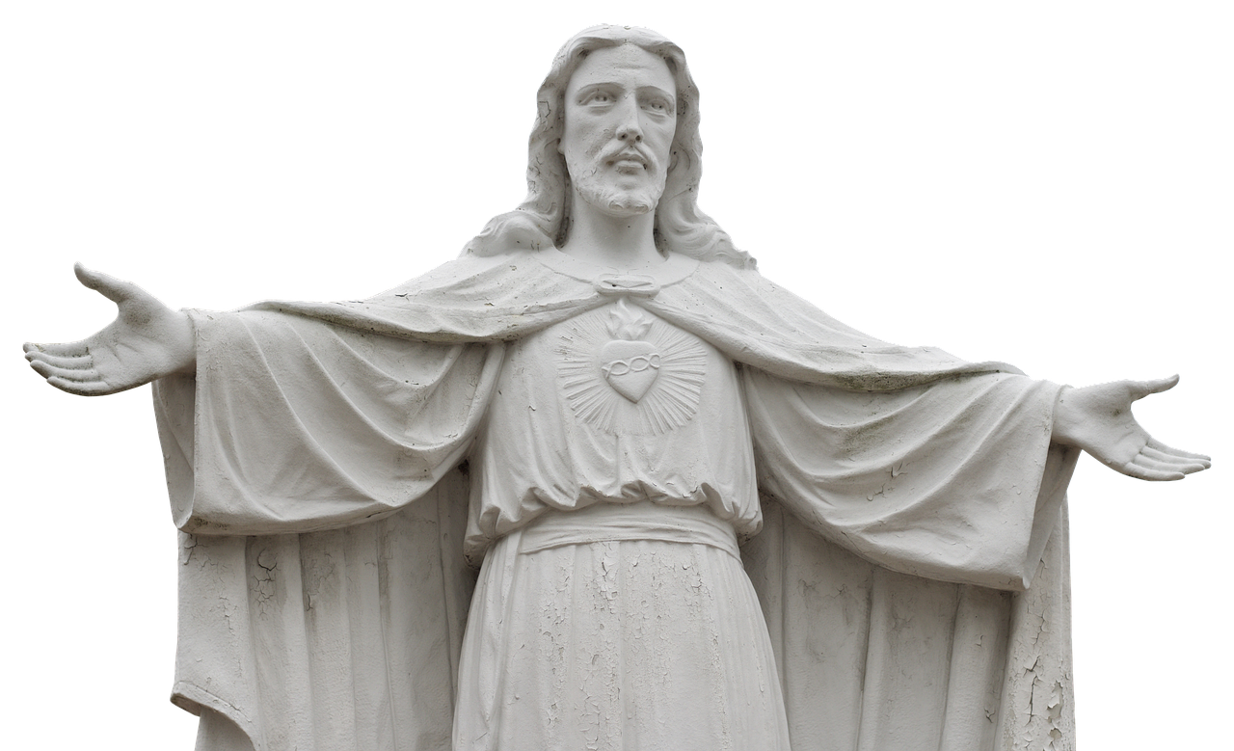
The True Meaning of Easter
For Christians, the true meaning of Easter is to Celebrate when Jesus rose from the dead.

