Slide 2


Australia
In Australia, the Easter bilby is an alternative to the Easter bunny.
Chocolate bilbies are eaten as well as chocolate rabbits.
Rabbits are considered pests in Australia.

Slide 3
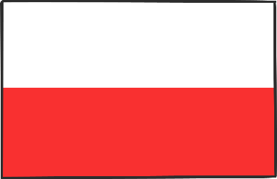
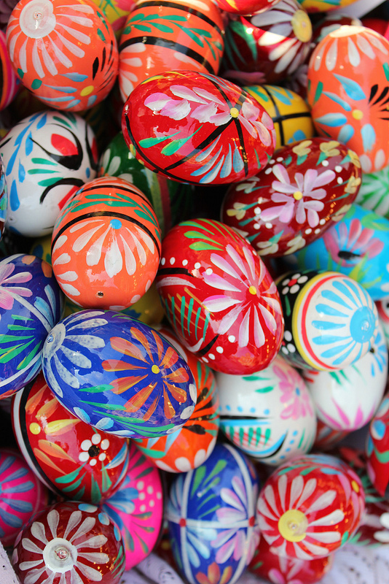
Poland
On Easter Monday, boys roam around the streets and sprinkle girls with water or perfume.
Baskets of food are taken to church to be blessed.
On Easter Sunday, eggs are eaten and also a cake in the shape of a lamb to symbolise Christ.
They also have painted Easter eggs called pisanki that are handcrafted and painted with traditional symbols of fertility and spring.
Photo courtesy of praktyczny.przewodnik (@flickr.com) - granted under creative commons licence – attribution

Slide 4

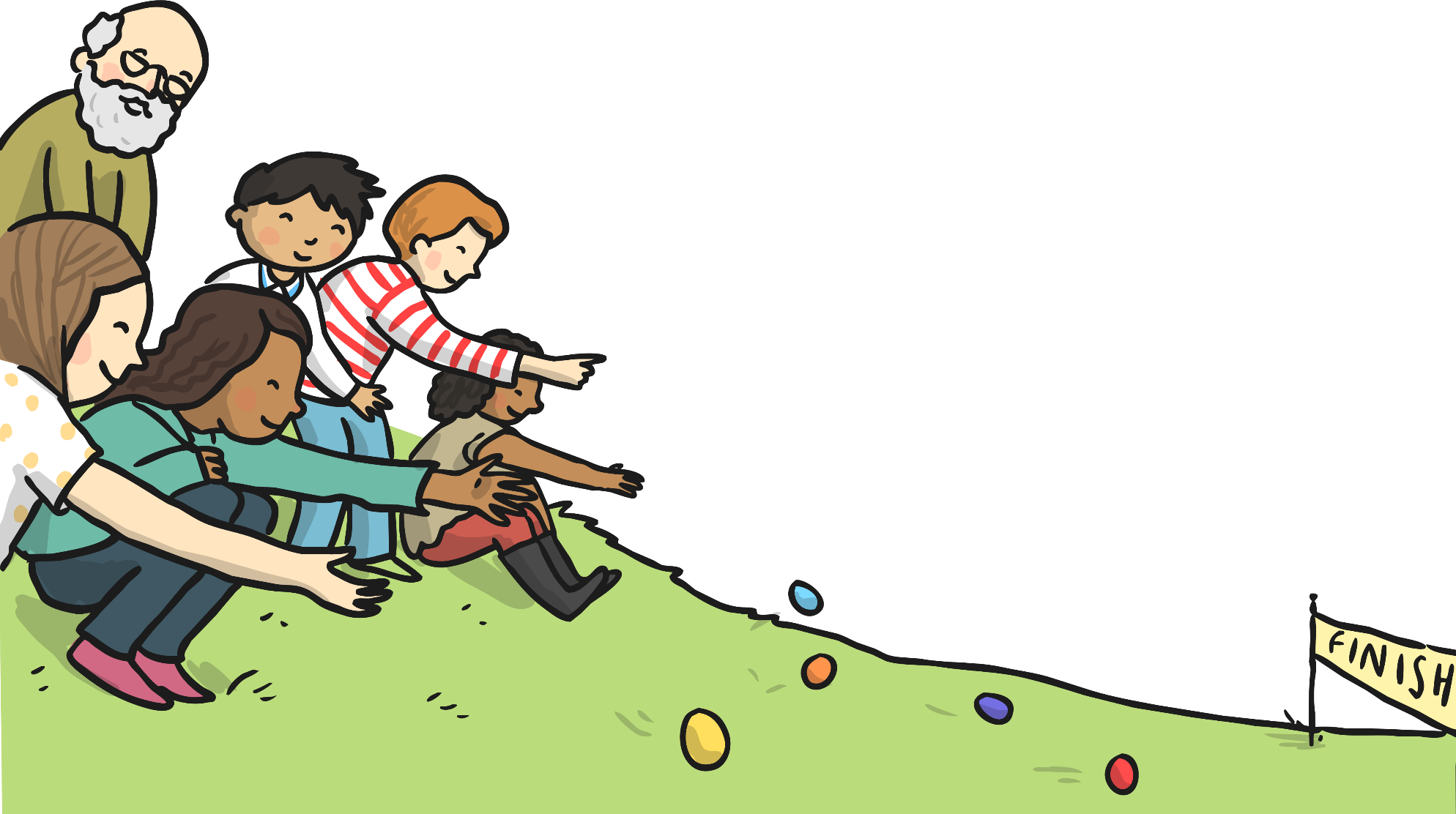
Scotland
In Scotland, they have egg rolling competitions.
Eggs are boiled and then painted.
Children then roll eggs down grassy hills. Whoever’s egg rolls the farthest wins.
The rolling of the egg symbolises the rolling away of the stone from Jesus’ tomb.

Slide 5

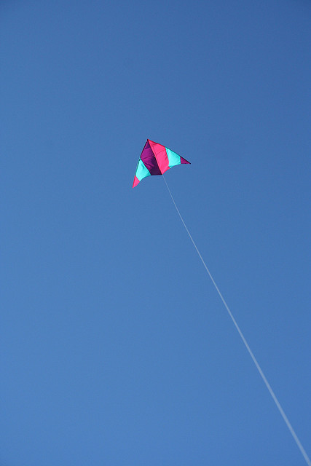
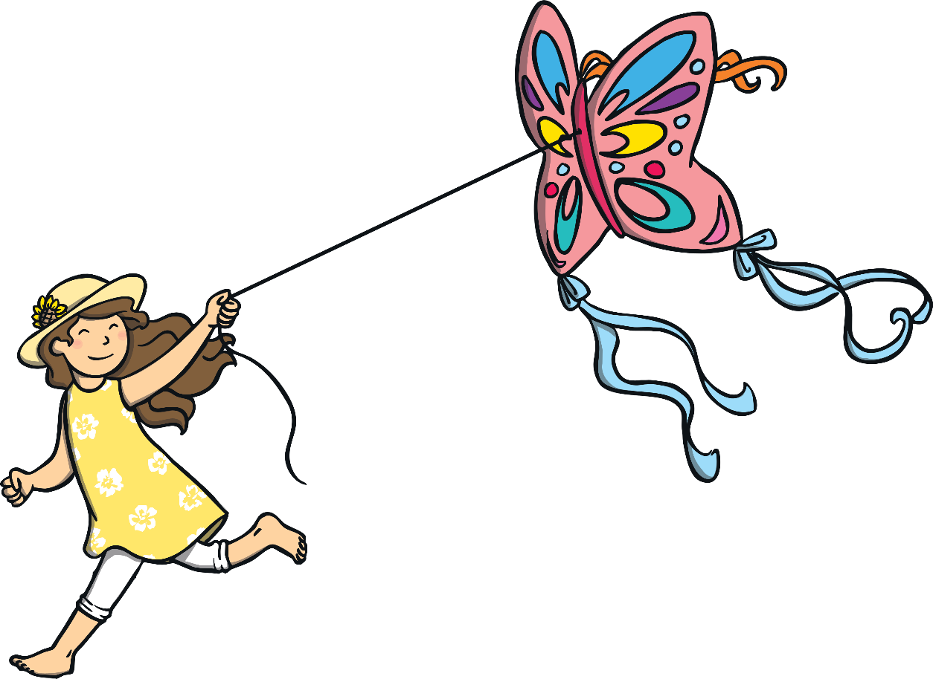
Bermuda
In Bermuda, people fly kites to symbolise the rising of Christ.
Photo courtesy of mr.bologna (@flickr.com) - granted under creative commons licence – attribution

Slide 6

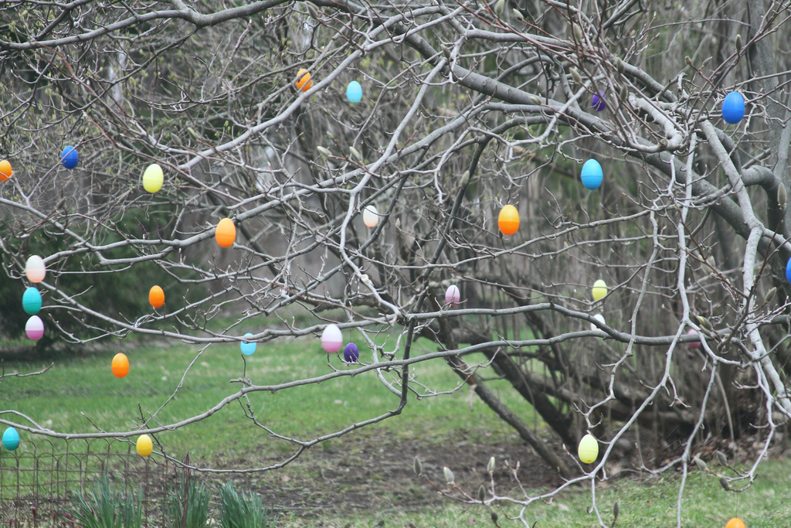
Germany
In Germany, they have Easter egg trees called ostereierbaum.
Decorated eggs are hung from the branches of the tree.
Photo courtesy of waitscm (@flickr.com) - granted under creative commons licence – attribution

Slide 7
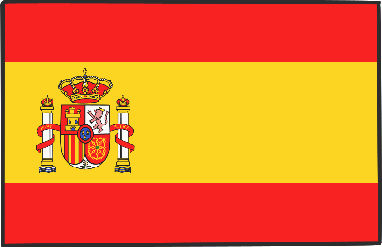
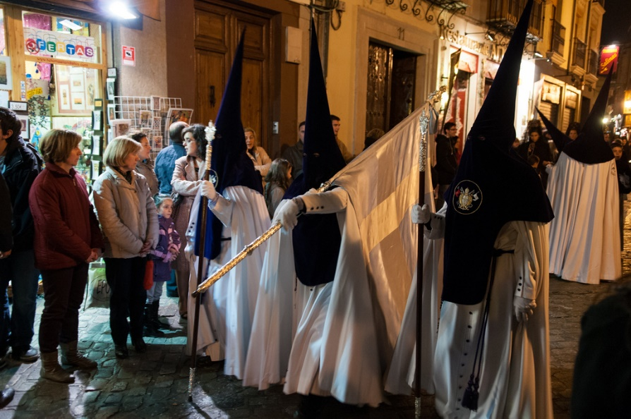
Spain
In Spain, boys and girls bang drums during church processions.
Spain also has parades with pasos or thrones illustrating the Easter story and marching bands. The parades are followed by cloaked people seeking forgiveness
from God.
Children bring palm leaves to church on Palm Sunday. People decorate their branches
with flowers.
On Ash Wednesday, a cross of ash is put onto people’s foreheads to say sorry to God for the bad things they have done.
In some places, on Maundy Thursday, men dress as skeletons to perform a dance of death to symbolise Jesus’ death.
Photo courtesy of waitscm (@flickr.com) - granted under creative commons licence – attribution

Slide 8

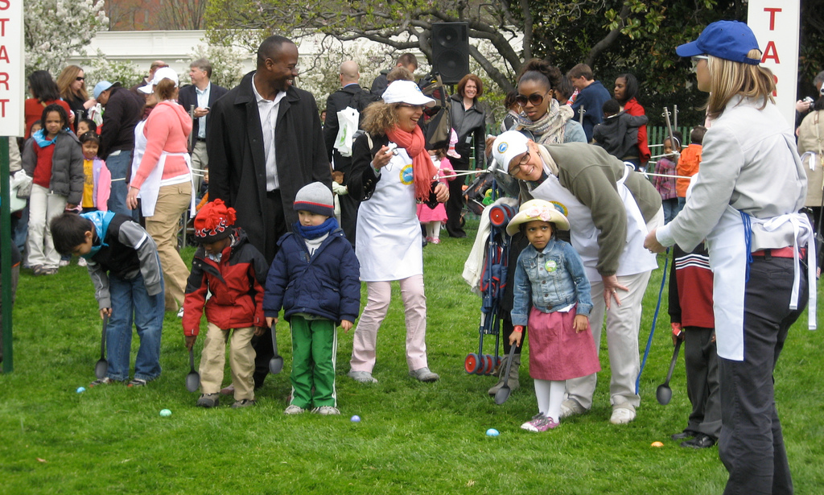
USA
At the White House in Washington DC, USA, there is an Easter egg rolling event held every year.
Children push decorated eggs through the grass with long handled spoons.
In recent years celebrities have turned up to entertain the rollers!
Photo courtesy of creativedc (@flickr.com) - granted under creative commons licence – attribution

Slide 9

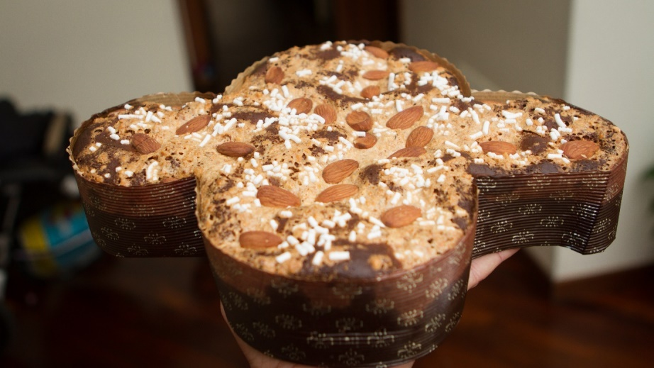
Italy
In Italy, eggs are boiled and painted with colourful decorations on Easter Saturday. These are then eaten as part of a traditional Easter Sunday breakfast along with other foods. As part of the breakfast, a special Easter cake called ‘Colomba Pasquale’ is eaten that is in the shape of a dove.
A large lunch is also usually eaten on Easter Sunday, with traditional dishes such as lamb eaten, as well as vegetarian dishes using new vegetable sproutings to celebrate new life.
Easter Monday is traditionally a day out, with picnics and barbecues a popular pastime.
“Colomba pasquale, edizione 2013” by N I c o l a is licensed under CC BY 2.0

Slide 10

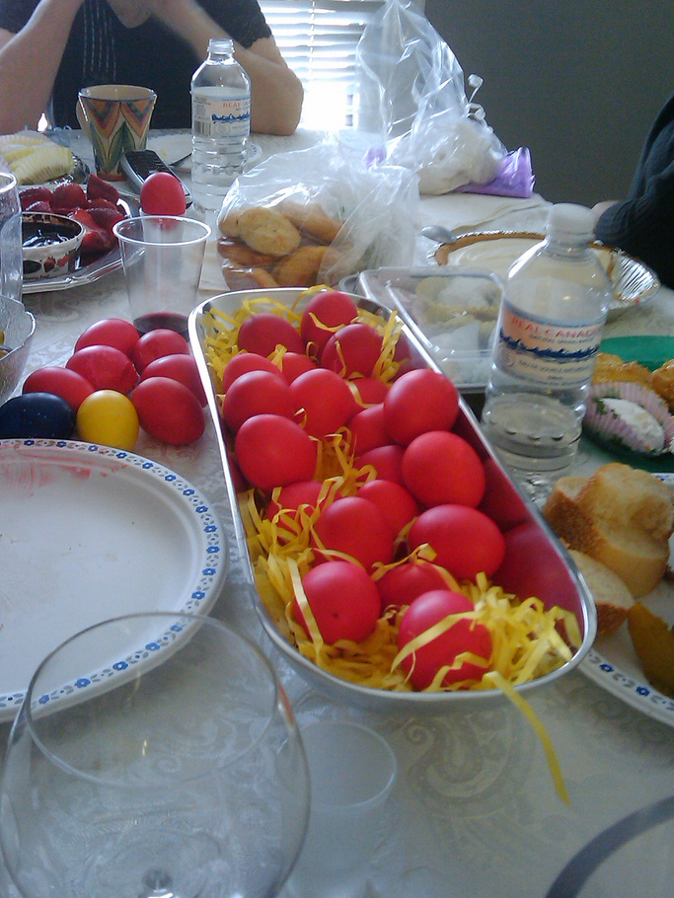
Greece
Easter festival begins before Easter.
On Maundy Thursday, Easter bread is baked and eggs are dyed red symbolising the blood of Christ.
On Holy Saturday, people attend midnight mass where they all bring a candle to light from the churches' Holy Flame.
Easter Sunday is spent with friends and family for a meal of roast lamb.
Photo courtesy of Julio.garciah (@flickr.com) - granted under creative commons licence – attribution

Slide 11
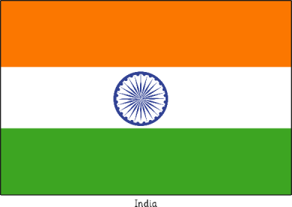
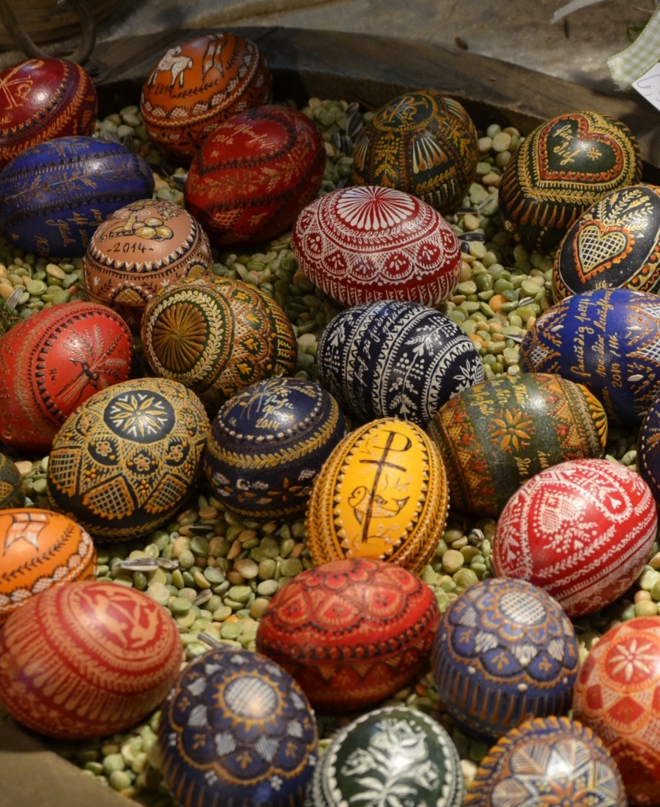
India
Easter celebrations start at Lent and end on Easter Sunday.
Easter gifts are exchanged, such as painted eggs, cakes, flowers and colourful lanterns.
In some areas, there are carnivals that involve street plays, songs and dances.
The major activities take place on Good Friday when large numbers of Christians gather at churches, passion plays are held and people exchange Easter wishes with one another.

Slide 12
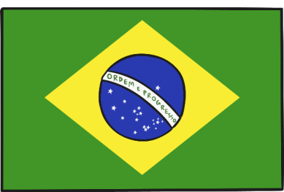
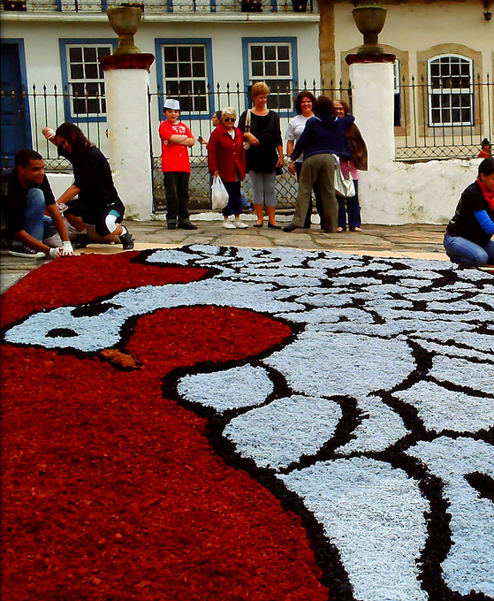
Brazil
In Brazil, Easter is known as ‘Páscoa’.
People celebrating Páscoa may give each other chocolates as gifts.
On Good Friday, many people may choose to not eat meat and eat fish instead.
On Easter Sunday, many people spend the day with their families and go to church later in the afternoon.
Throughout Brazil, many colourful celebrations may take place, including in Ouro Preto, where the streets are decorated with flowers, sand and sawdust to create beautiful patterns.
“Páscoa” by Ana_Cotta is licensed under CC BY 2.0

Slide 13
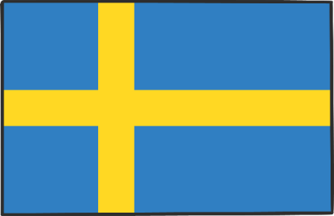

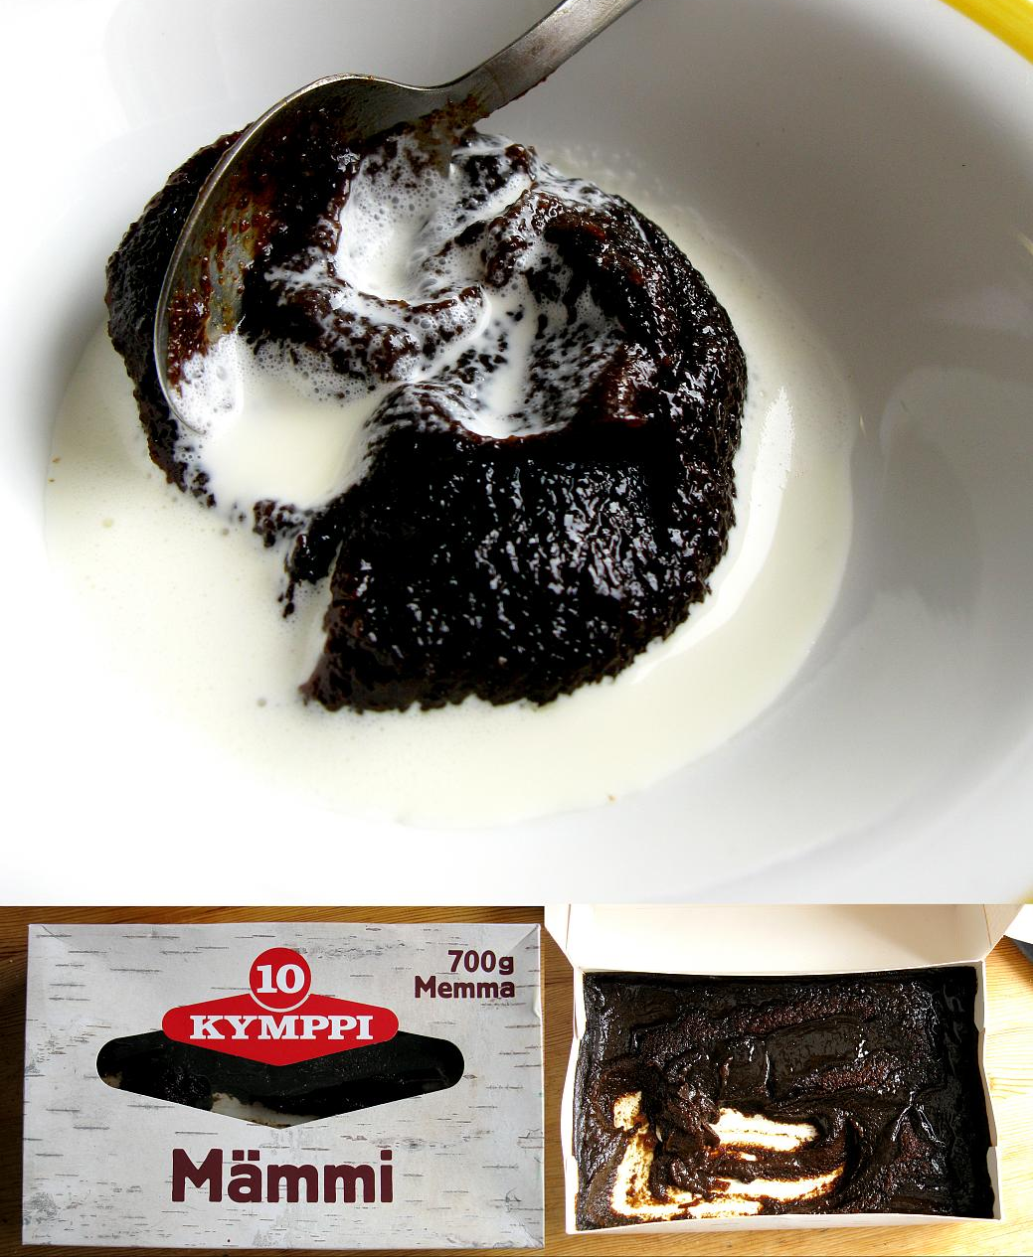
Sweden and Finland
In Sweden and Finland, children dress up as Easter witches and go around the neighbourhood granting wishes of happiness and good health. They carry decorated willow twigs as part of their costume. As a reward, they usually receive sweets and chocolate eggs.
Easter Monday is the largest day of celebration in Finland and Mämmi is usually served; a sweet rye porridge served with whipped cream, milk or vanilla ice cream. Other foods eaten include Pasha (a curd dessert), lamb, fish and baked cheeses.
“Mämmi Kymppi” by Martin Terber is licensed under CC BY 2.0

Slide 14
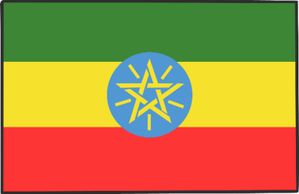
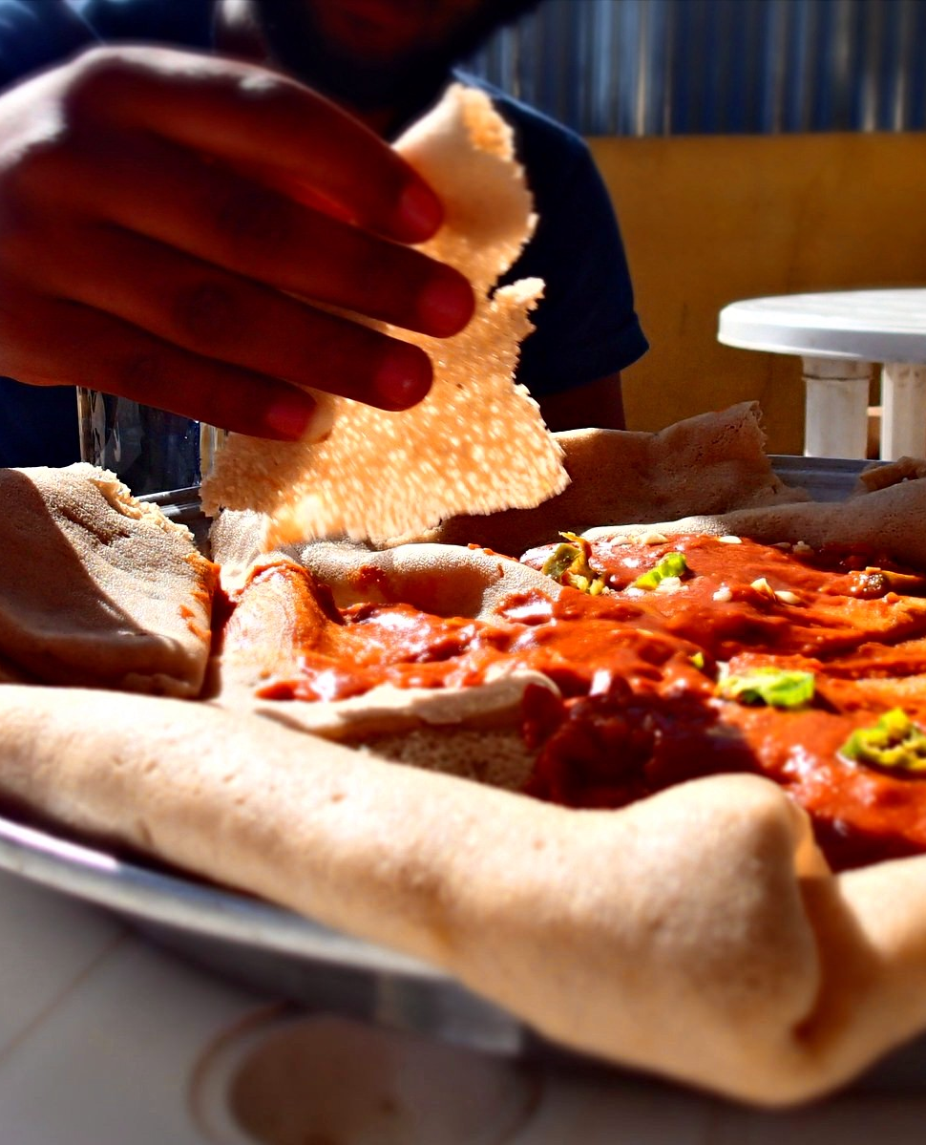
Ethiopia
In Ethiopia, Easter is known as ‘Fasika’.
During Fasika, many people choose to fast for the 55 days of Lent in which no animal products (including milk, eggs and butter) are eaten.
On Good Friday, church services are held, prayers are said and these continue until the early hours of the morning. Many people return home to break their fast around 3 a.m.
After a rest, celebrations continue and there is a large feast.
“Fasting food” by Jasmine Halki is licensed under CC BY 2.0

Slide 15

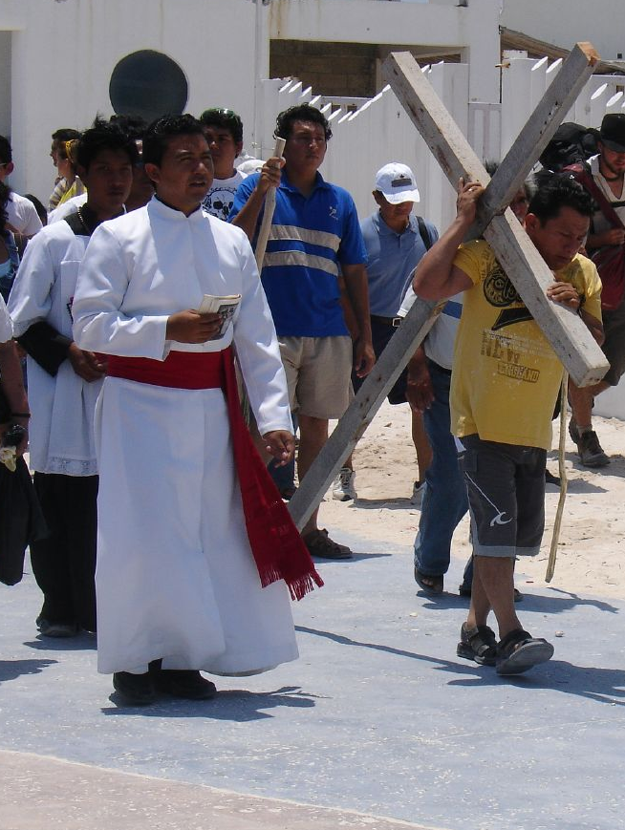
Mexico
Easter in Mexico is a two-week period starting with Semana Santa (Holy Week), which lasts from Palm Sunday to Easter Saturday, and Pascua, which starts on Easter Sunday and ends the following Saturday.
Many Mexicans choose to celebrate this period with processions, passion plays and ceremonies throughout towns and cities. Some also choose to travel to the beach to enjoy time with their friends and family.
Traditional foods eaten during the Easter period include fish, empanadas and ‘nopal’, a flat leaf cactus eaten in salads.
“Mahahual, México - Semana Santa 2009” by Antonio Meneses L is licensed under CC BY 2.0

Slide 16
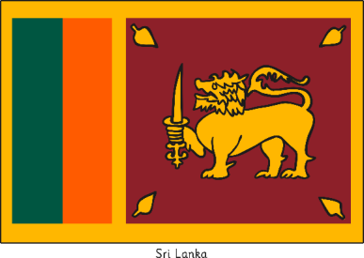

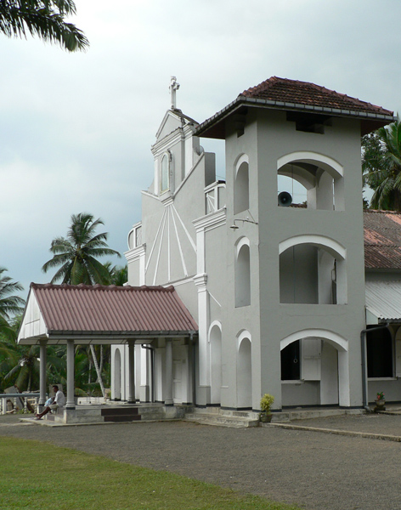
Sri Lanka
In Sri Lanka, Christians traditionally go to church to attend Easter celebrations.
Good Friday is the main day for celebration and is a national holiday. Many events happen on Good Friday including church services (some which can be 3 hours long), processions and passion plays.
Some people make pilgrimages to shrines that show the Way of the Cross.
Easter is seen as a time for helping those in need in the community and many churches hold large feasts in order to support them.
Many families plan gatherings during Easter time.
“Hiniduma, Christian Church - panoramio - Frans-Banja Mulder” by Frans-Banja Mulder is licensed under CC BY 2.0

