Slide 1
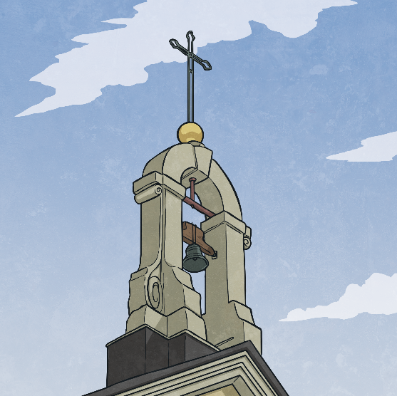
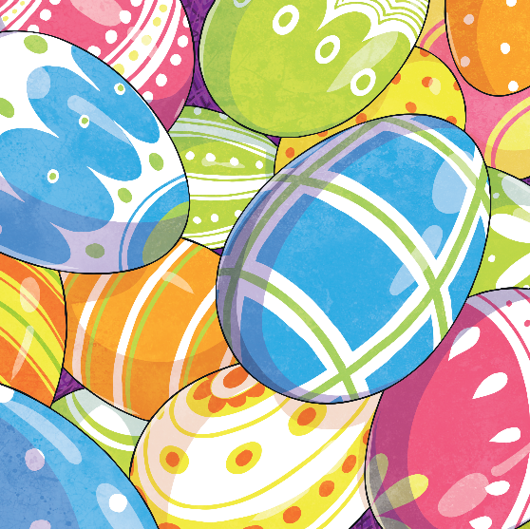
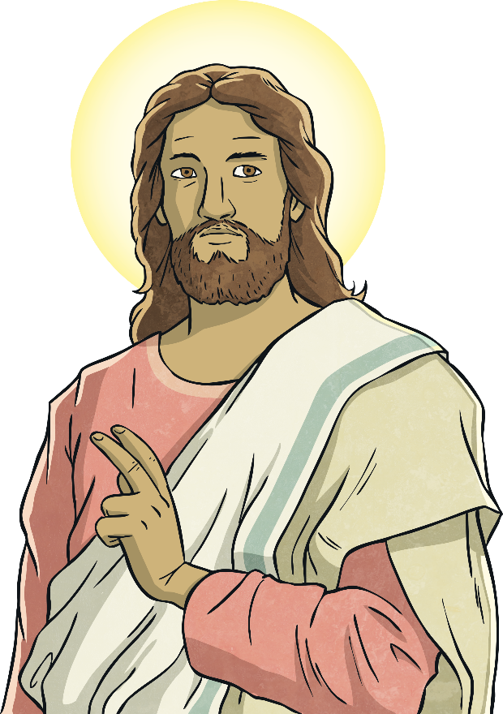
Easter Crafts
Easter is a time of celebration for Christians, who remember when Jesus was crucified on Good Friday and rose from the dead on Easter Sunday.
There are many Easter traditions, such as eating
chocolate eggs, going on Easter egg hunts and making
Easter bonnets. However, around the world there are other
traditional crafts done.

Slide 2
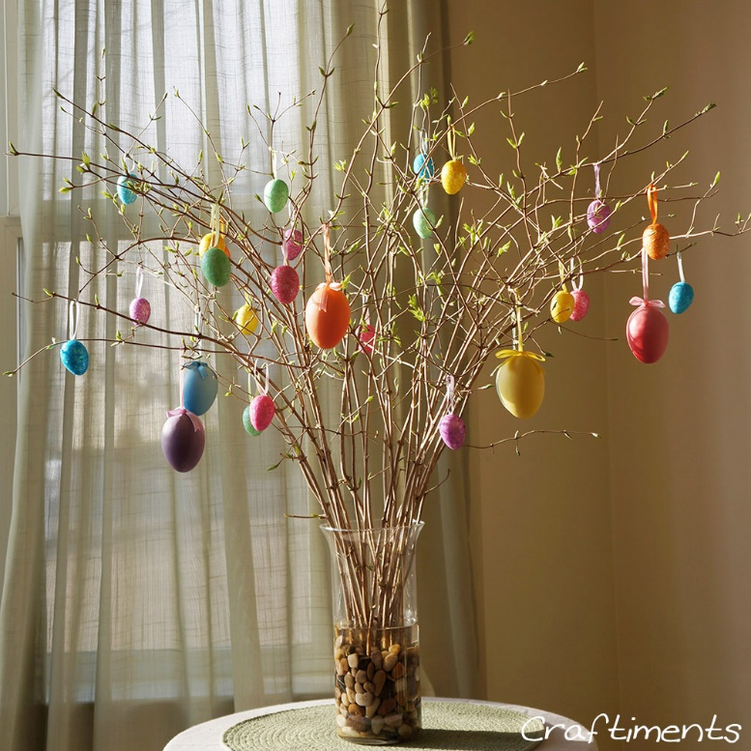
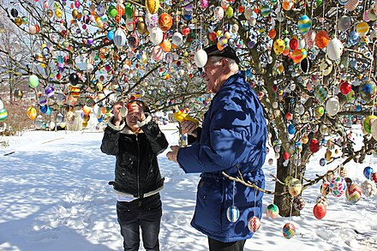
Easter Egg Tree
Easter Egg Tree Link
The custom is found mostly in Germany, Austria and America. They hold Easter egg hunts, where children take a basket and hunt for eggs around the home or open spaces outside. You could try making an Easter tree at home like the one in the picture!

Slide 3
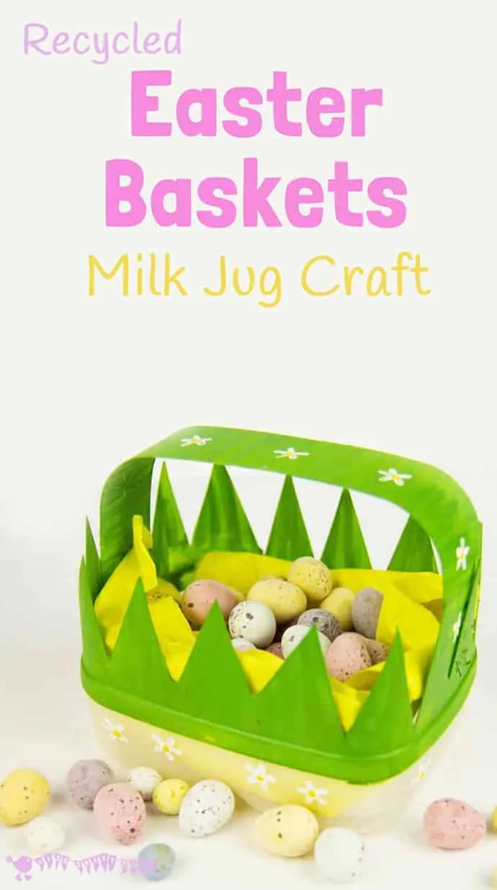
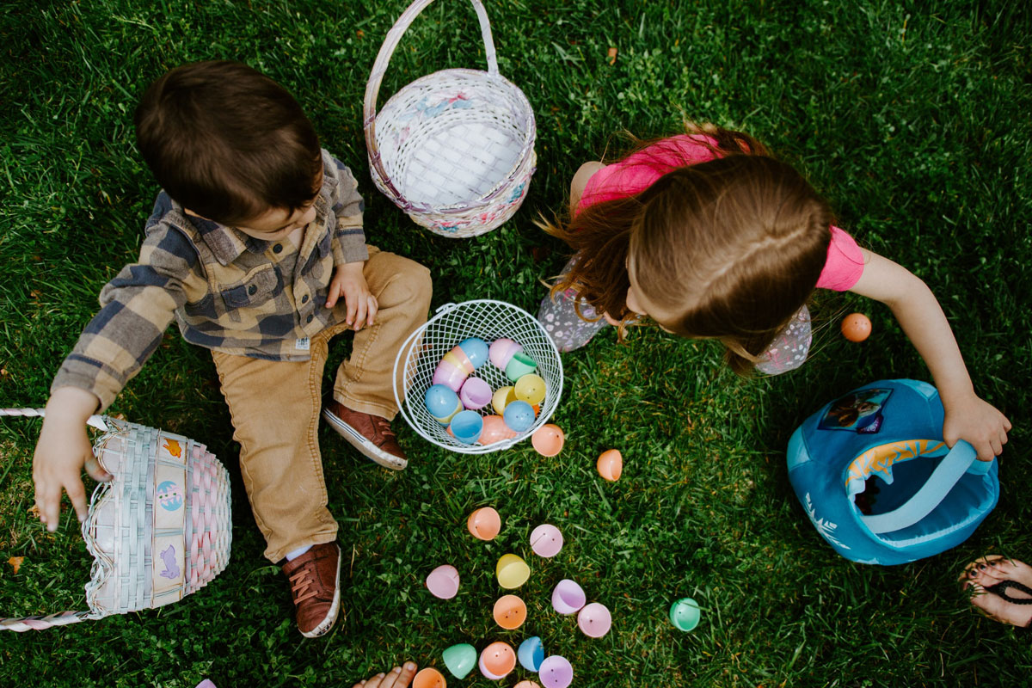
Easter Egg Hunts
Many parts of the world hold Easter egg hunts, children take a basket and hunt for eggs around the home or open spaces outside. You could try making an Easter basket at home like the one in the picture!
Easter Basket Link

Slide 4
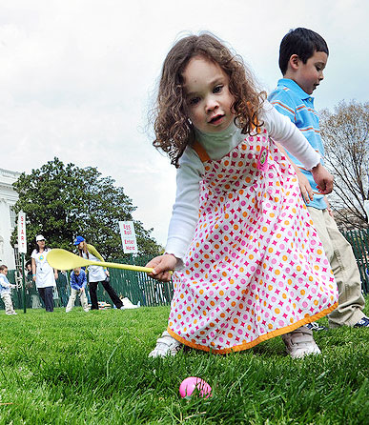
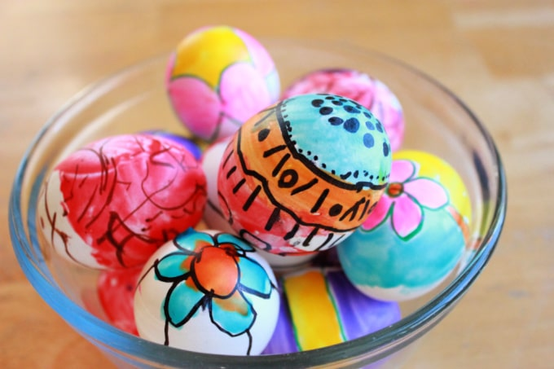
Rolling Eggs
In some parts of the world, people join in the contest of egg rolling. This involves rolling eggs down a slope. First the children decorate their egg!
The winning egg, which remains intact, represents the stone which was rolled away from the tomb where Jesus had been laid after his death.

Slide 5
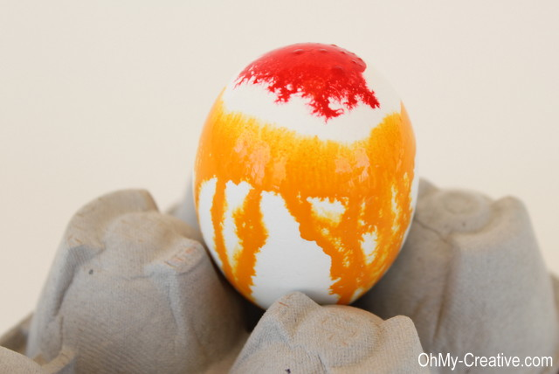
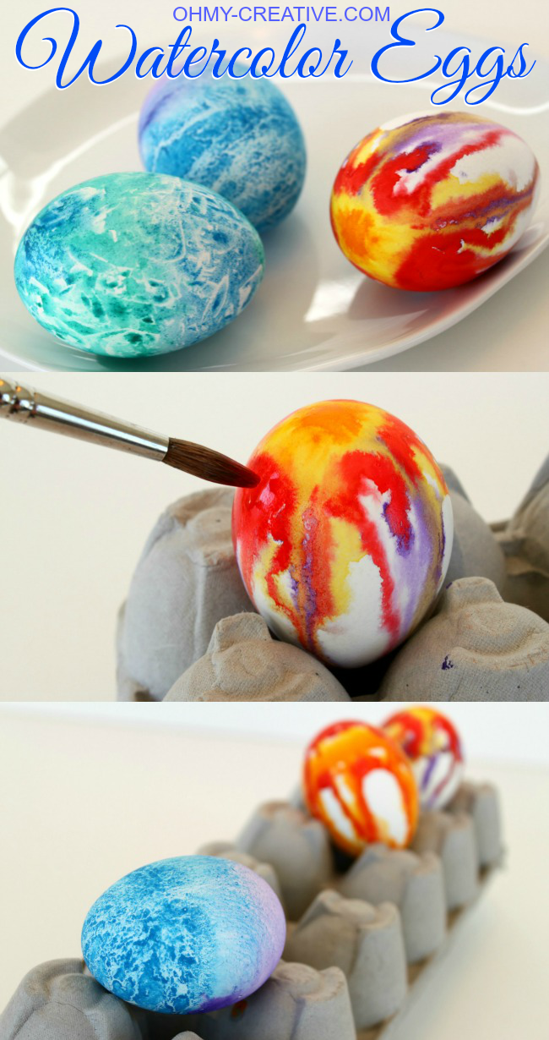
Decorated Easter Eggs
Watercolor paint can be hard to control, but one of the cool things about it is the interesting effects it creates when the colors bleed together. For the Bleeding Egg (looks a little tie-dyed) first dip the entire egg in water, then dab the egg with heavy paint. It takes a few minutes, but the colours begin to bleed together. Add additional paint and colours as needed.
Decorated Easter Egg Link

Slide 6
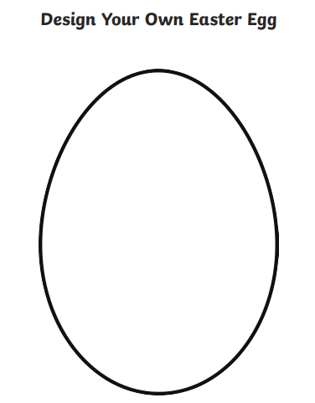
Decorate your personalised Easter egg ready for the Easter egg hunt!
Your Name

Slide 7
Enjoy decorating your egg!
Are you ready to roll your egg in our Easter egg rolling competition?

