Slide 1
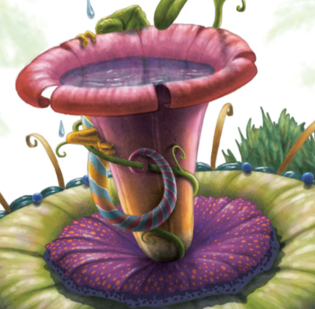
Friday 29th January
L.O. To use words that describe the position of things in a sentence.

Slide 2
Words that describe the position of things
We use different words and phrases that tell us where something is e.g. on, under, next to
These words are called prepositions.
What prepositions do you know?
Go through the following slides and use prepositions to say where Max the dog is.

Slide 4

Where is Max?
Max has gone on an adventure all around the house.
His owner, Tim, needs you to help him find Max.
When you see Max, tell Tim where he is.
Make sure you use the right word to describe where Max is.

Slide 5
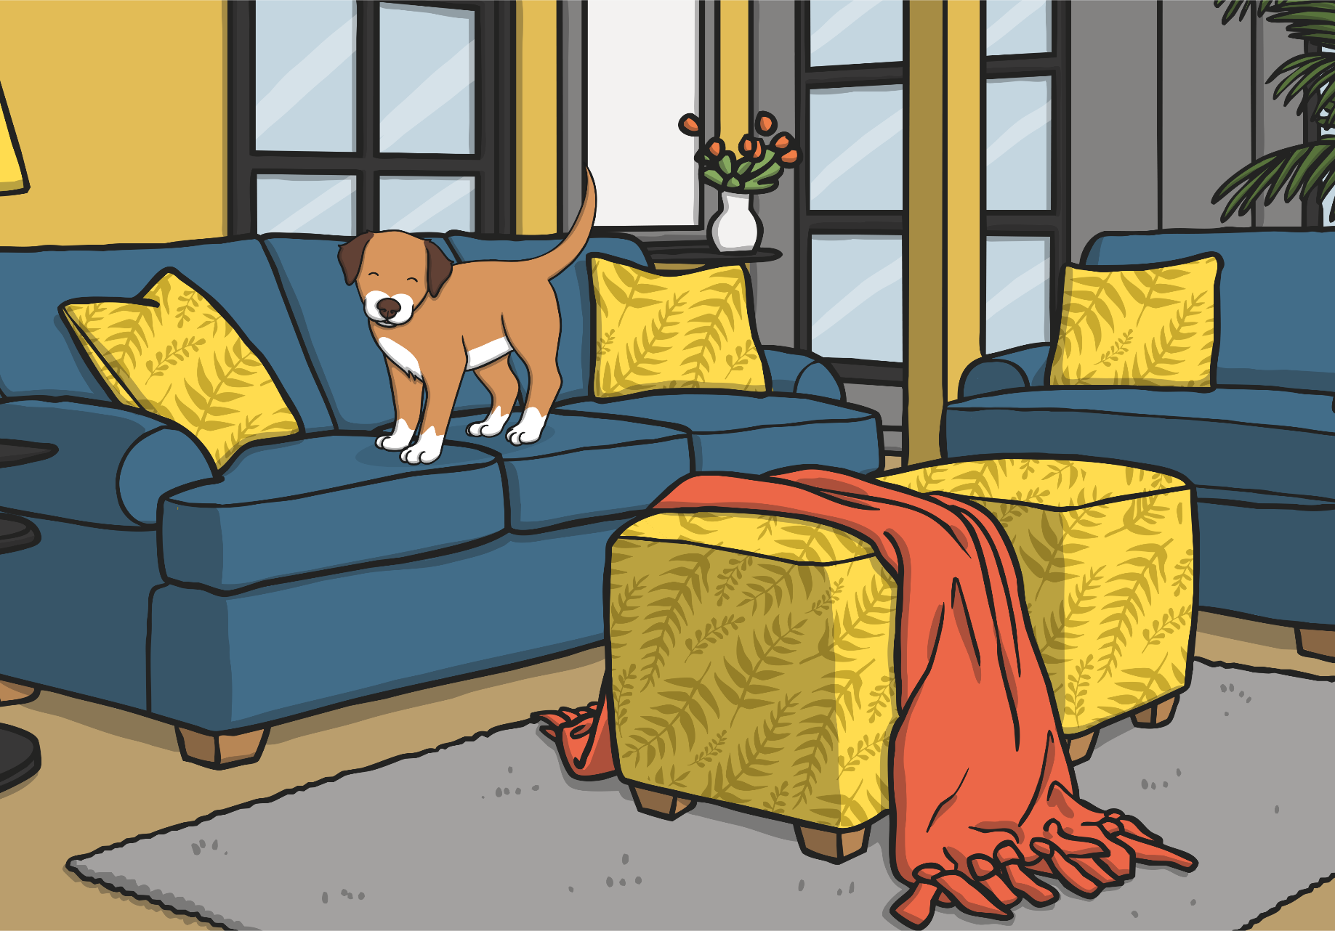
Max is standing on the sofa.
Can you
see Max?

Slide 6
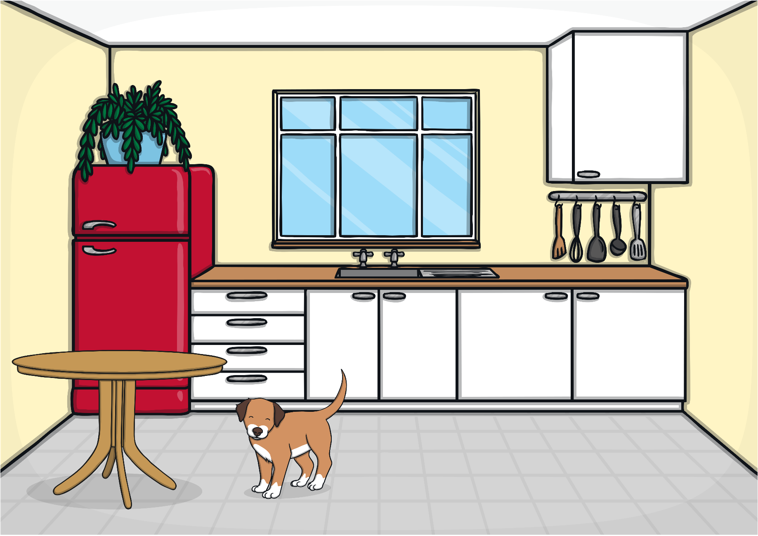
Can you see Max?
Max is standing beside the table.

Slide 7
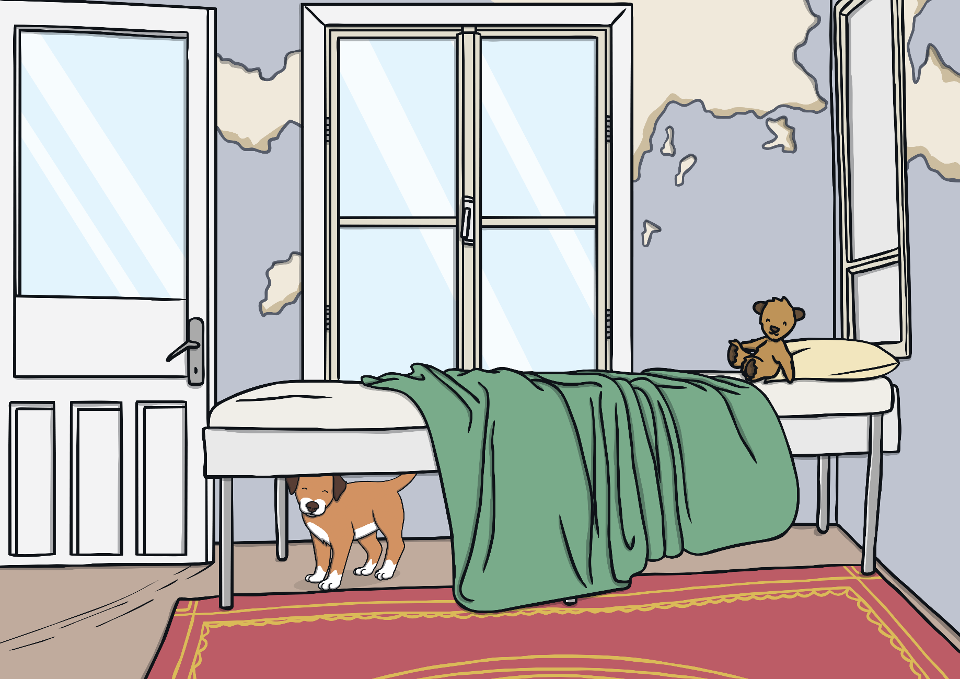
Can you see Max?
Max is under the bed.

Slide 8
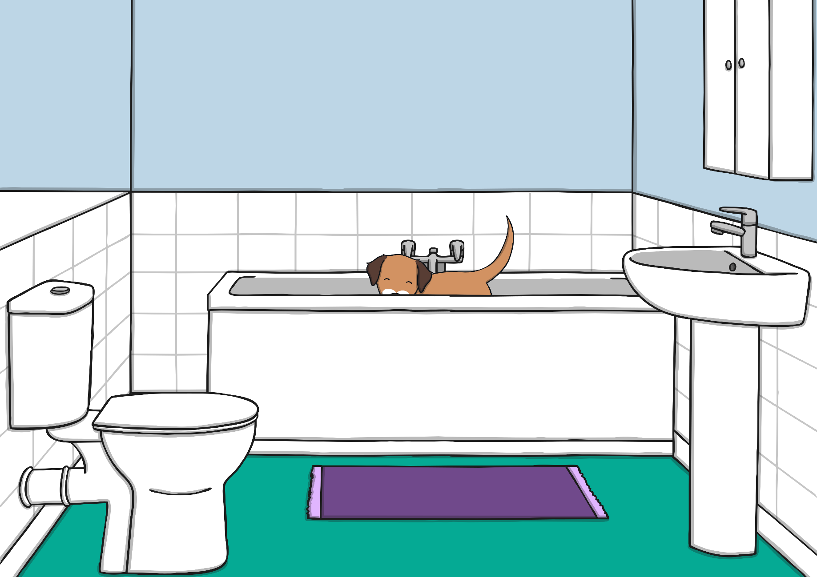
Can you see Max?
Max is in
the bath.

Slide 9
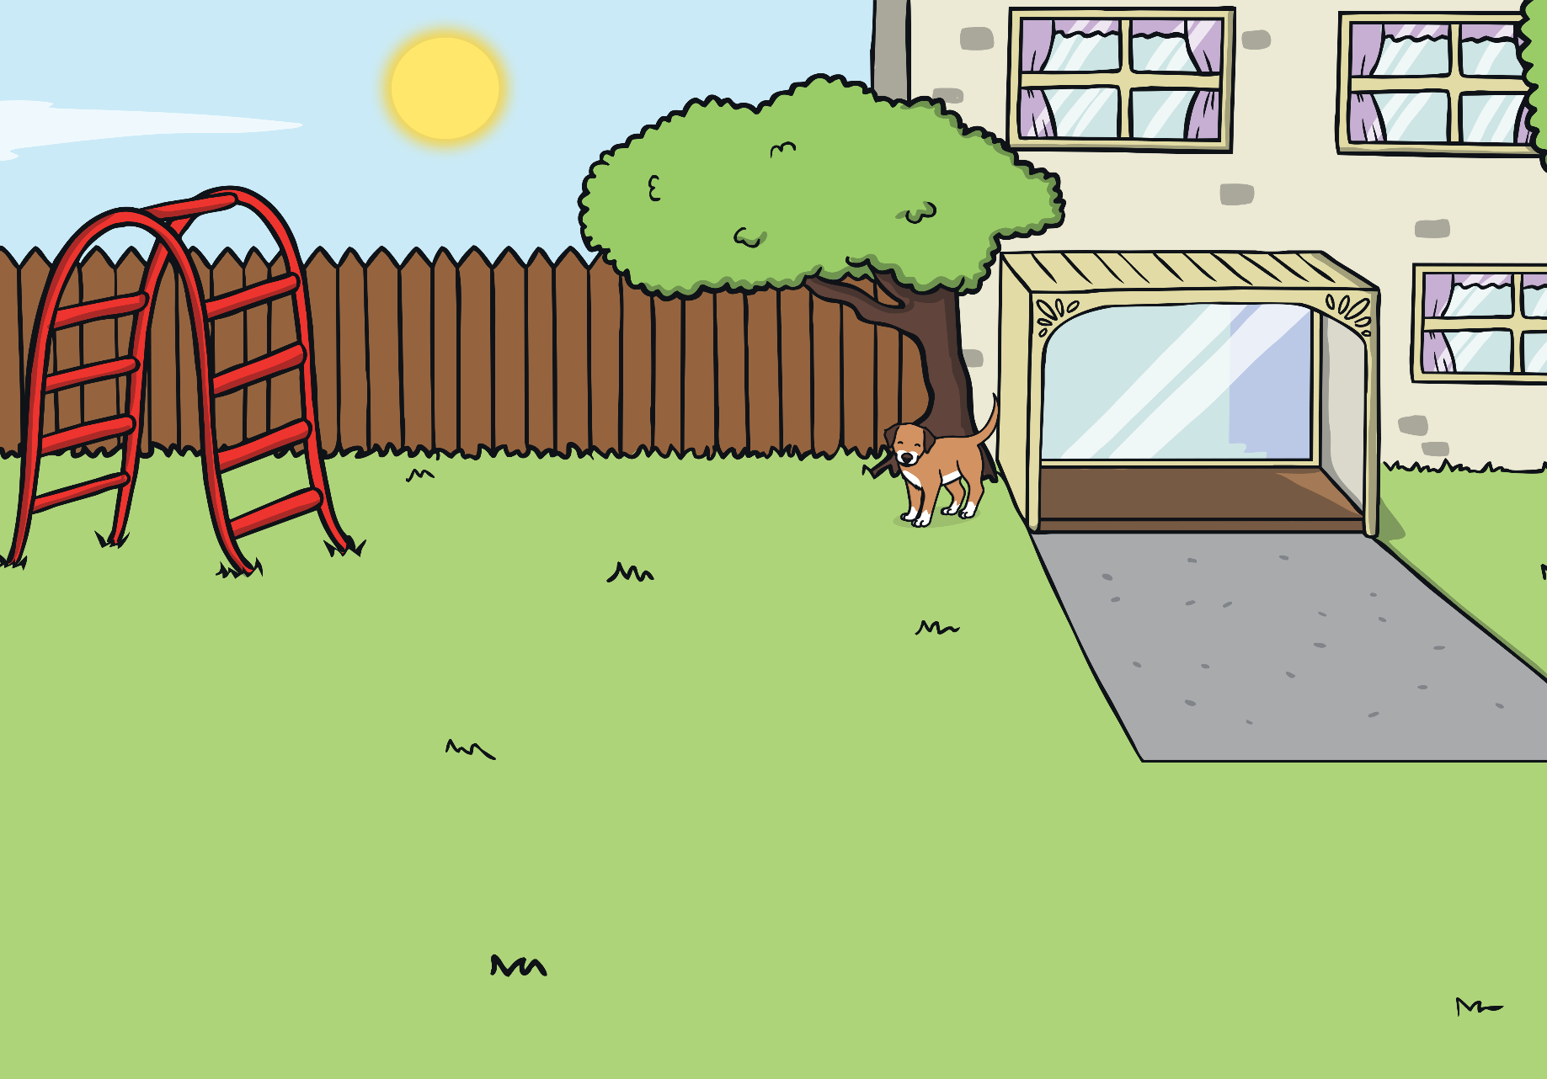
Can you see Max?
Max is in front of the tree.

Slide 10
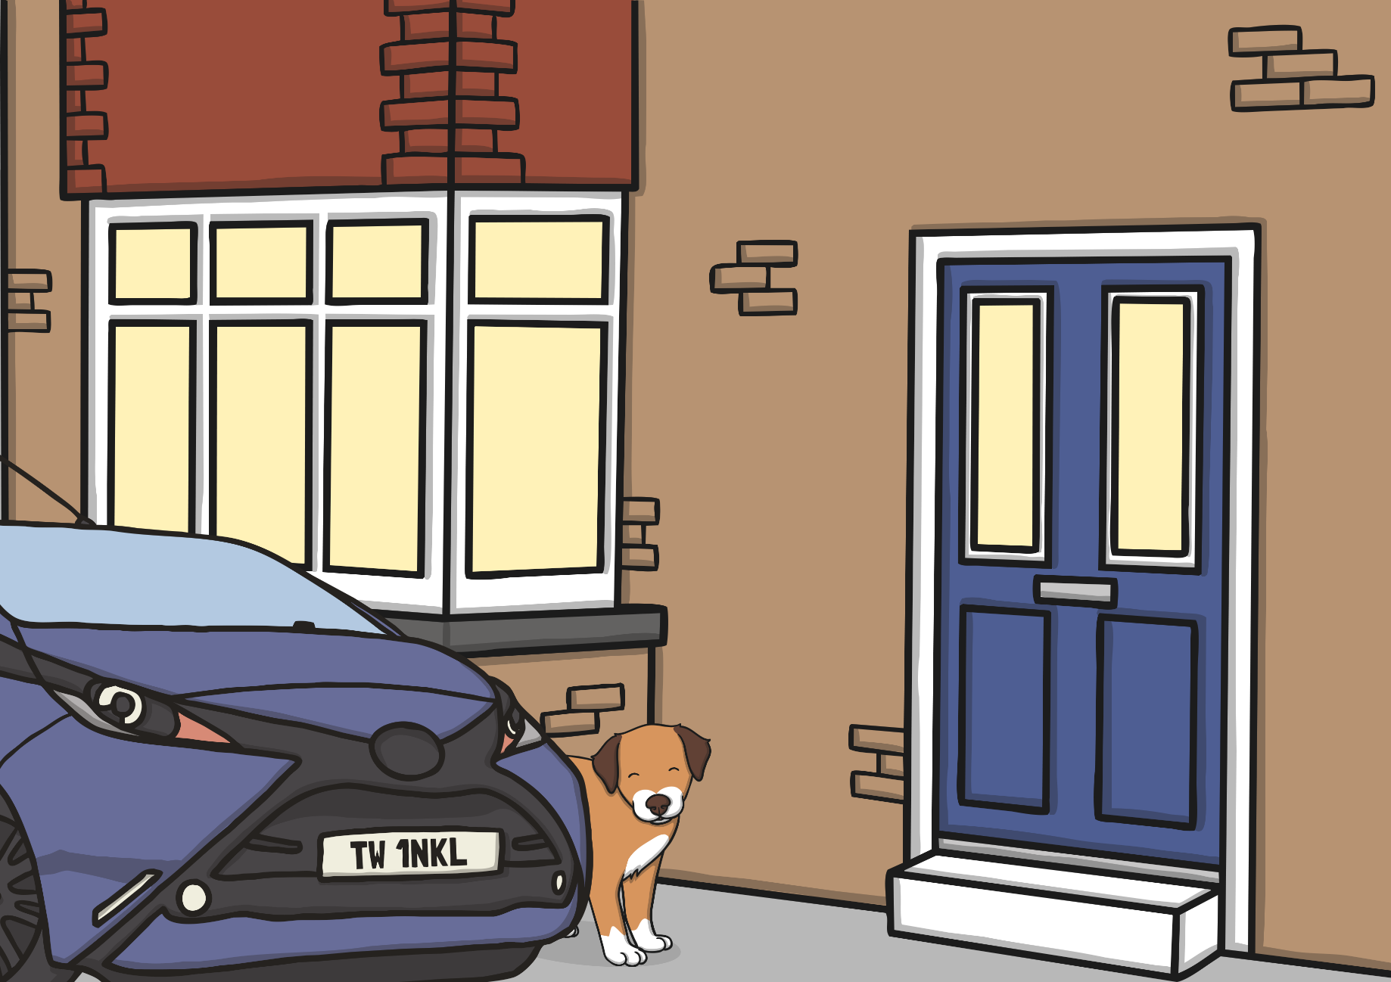
Can you see Max?
Max is behind the car.

Slide 11
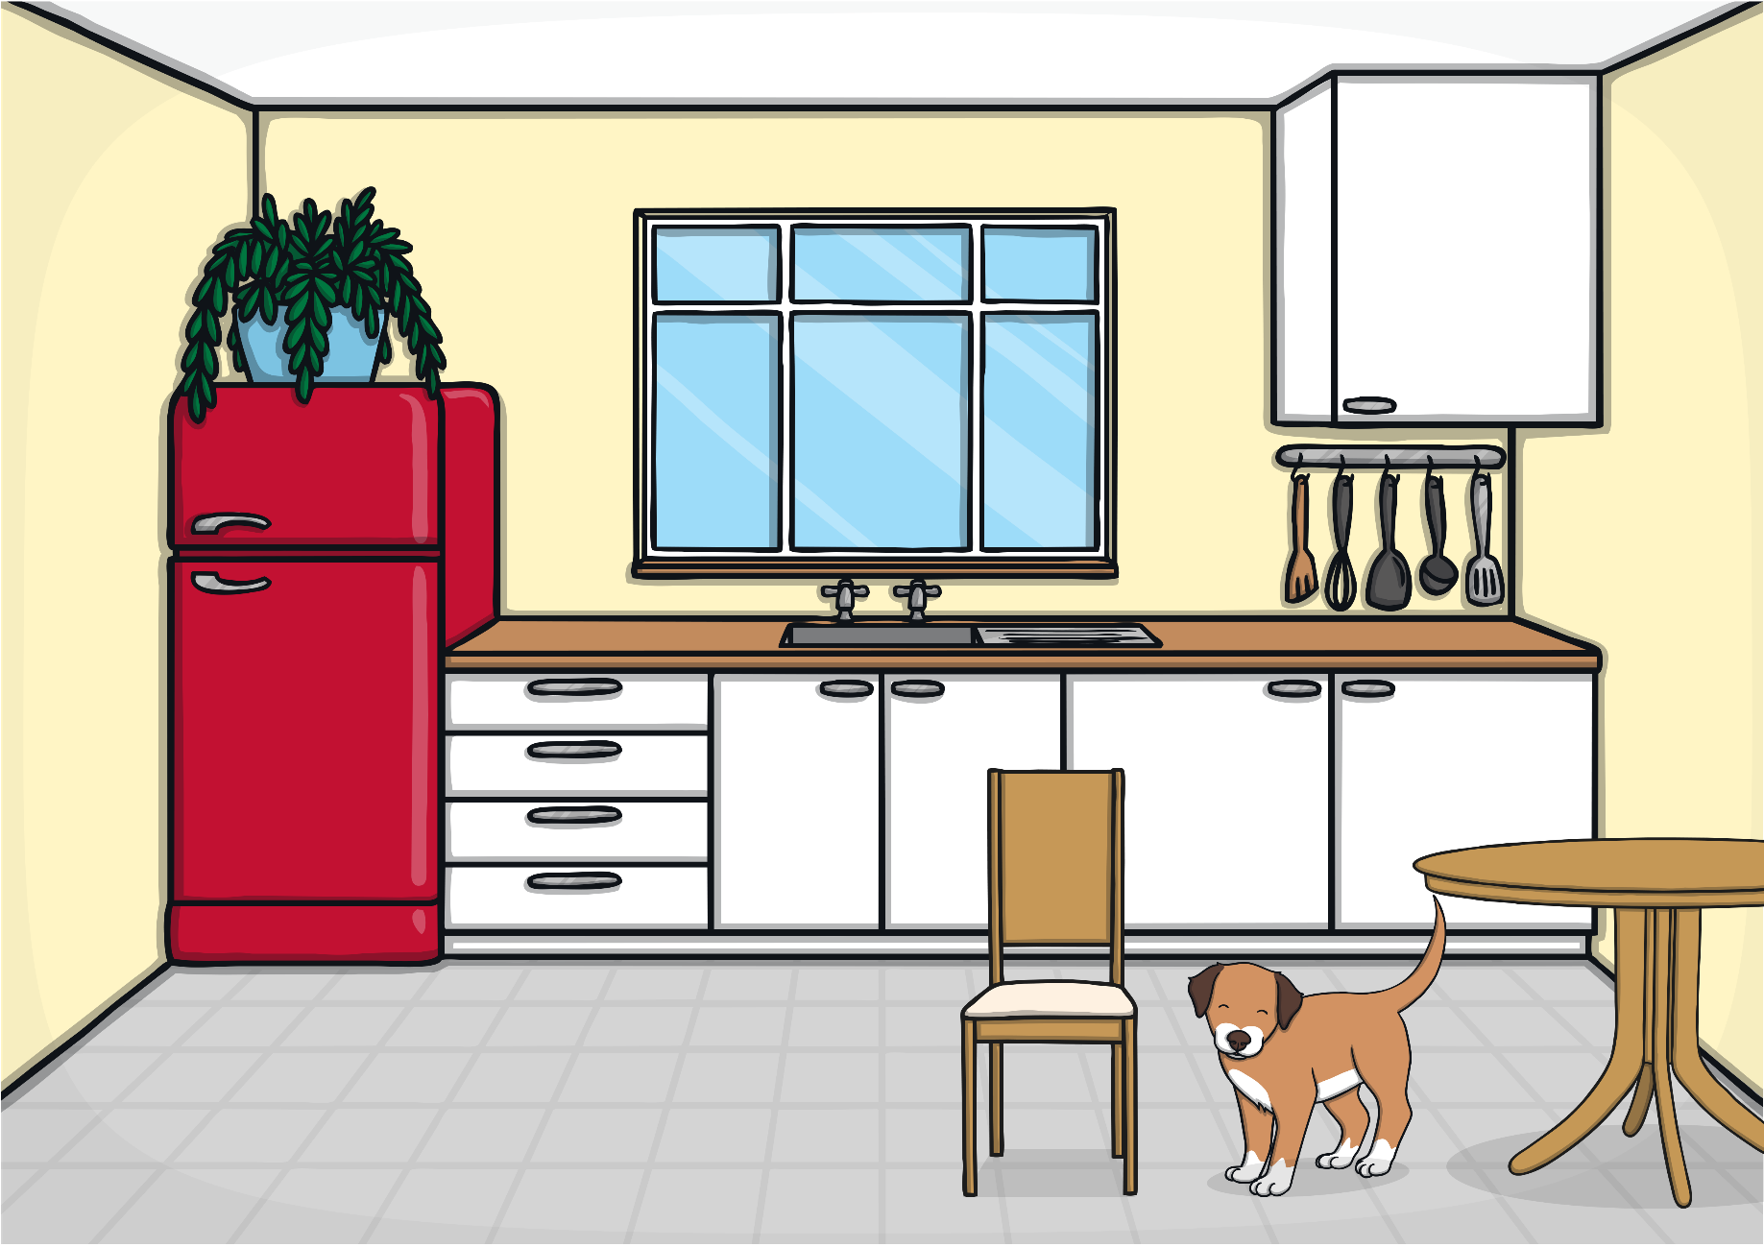
Can you see Max?
Max is between the table and chair.

Slide 12
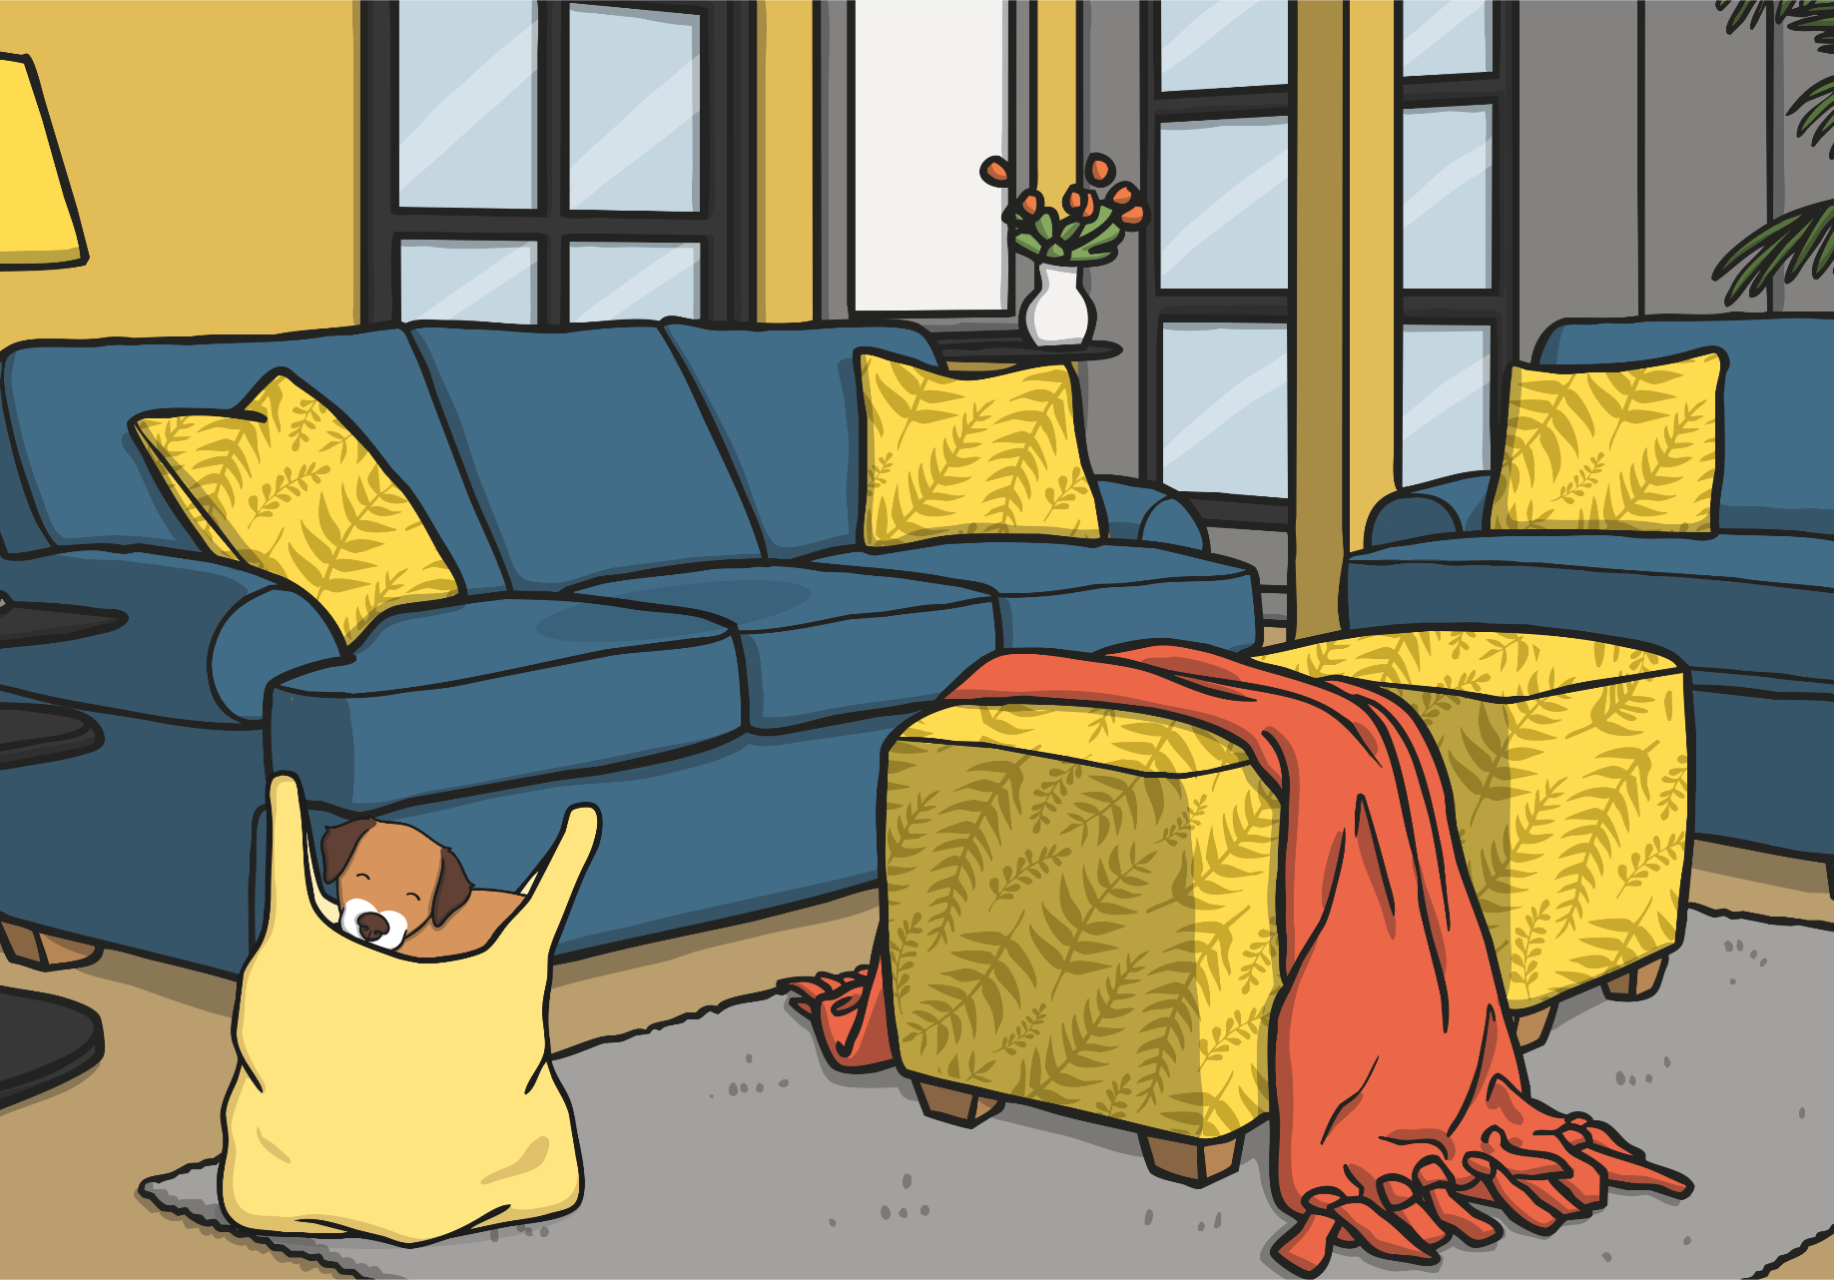
Can you see Max?
Max is inside the shopping bag.

Slide 13
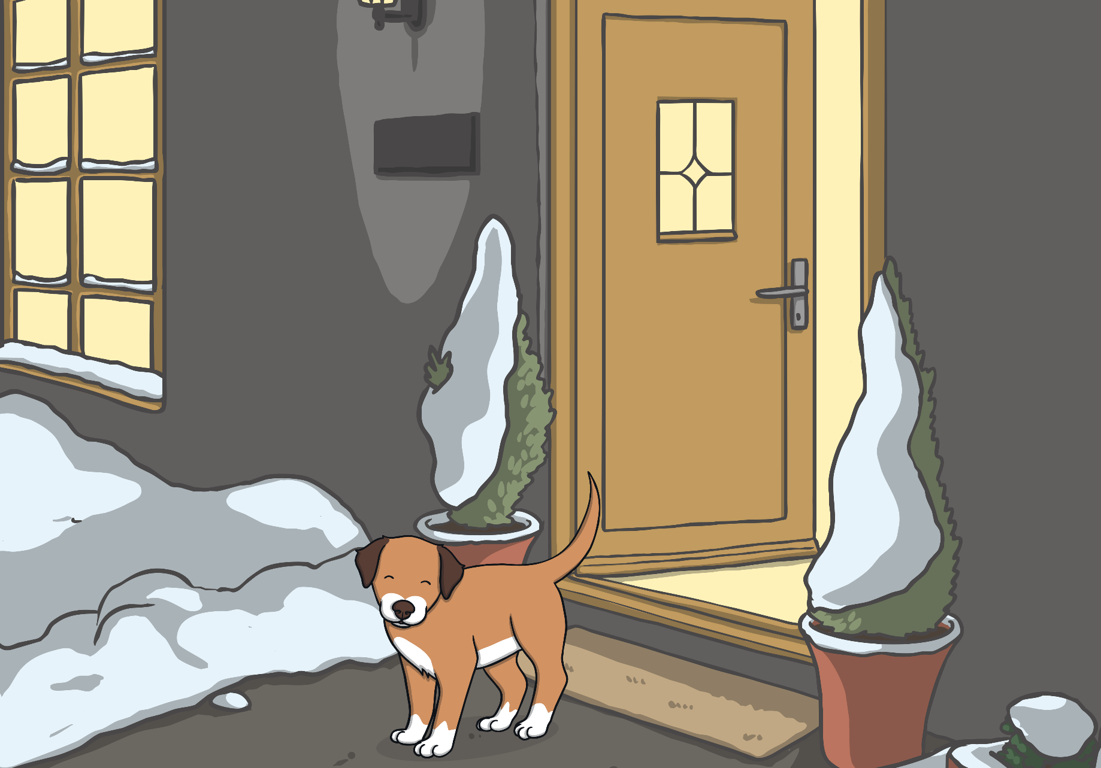
Can you see Max?
Max is outside the house.

Slide 14
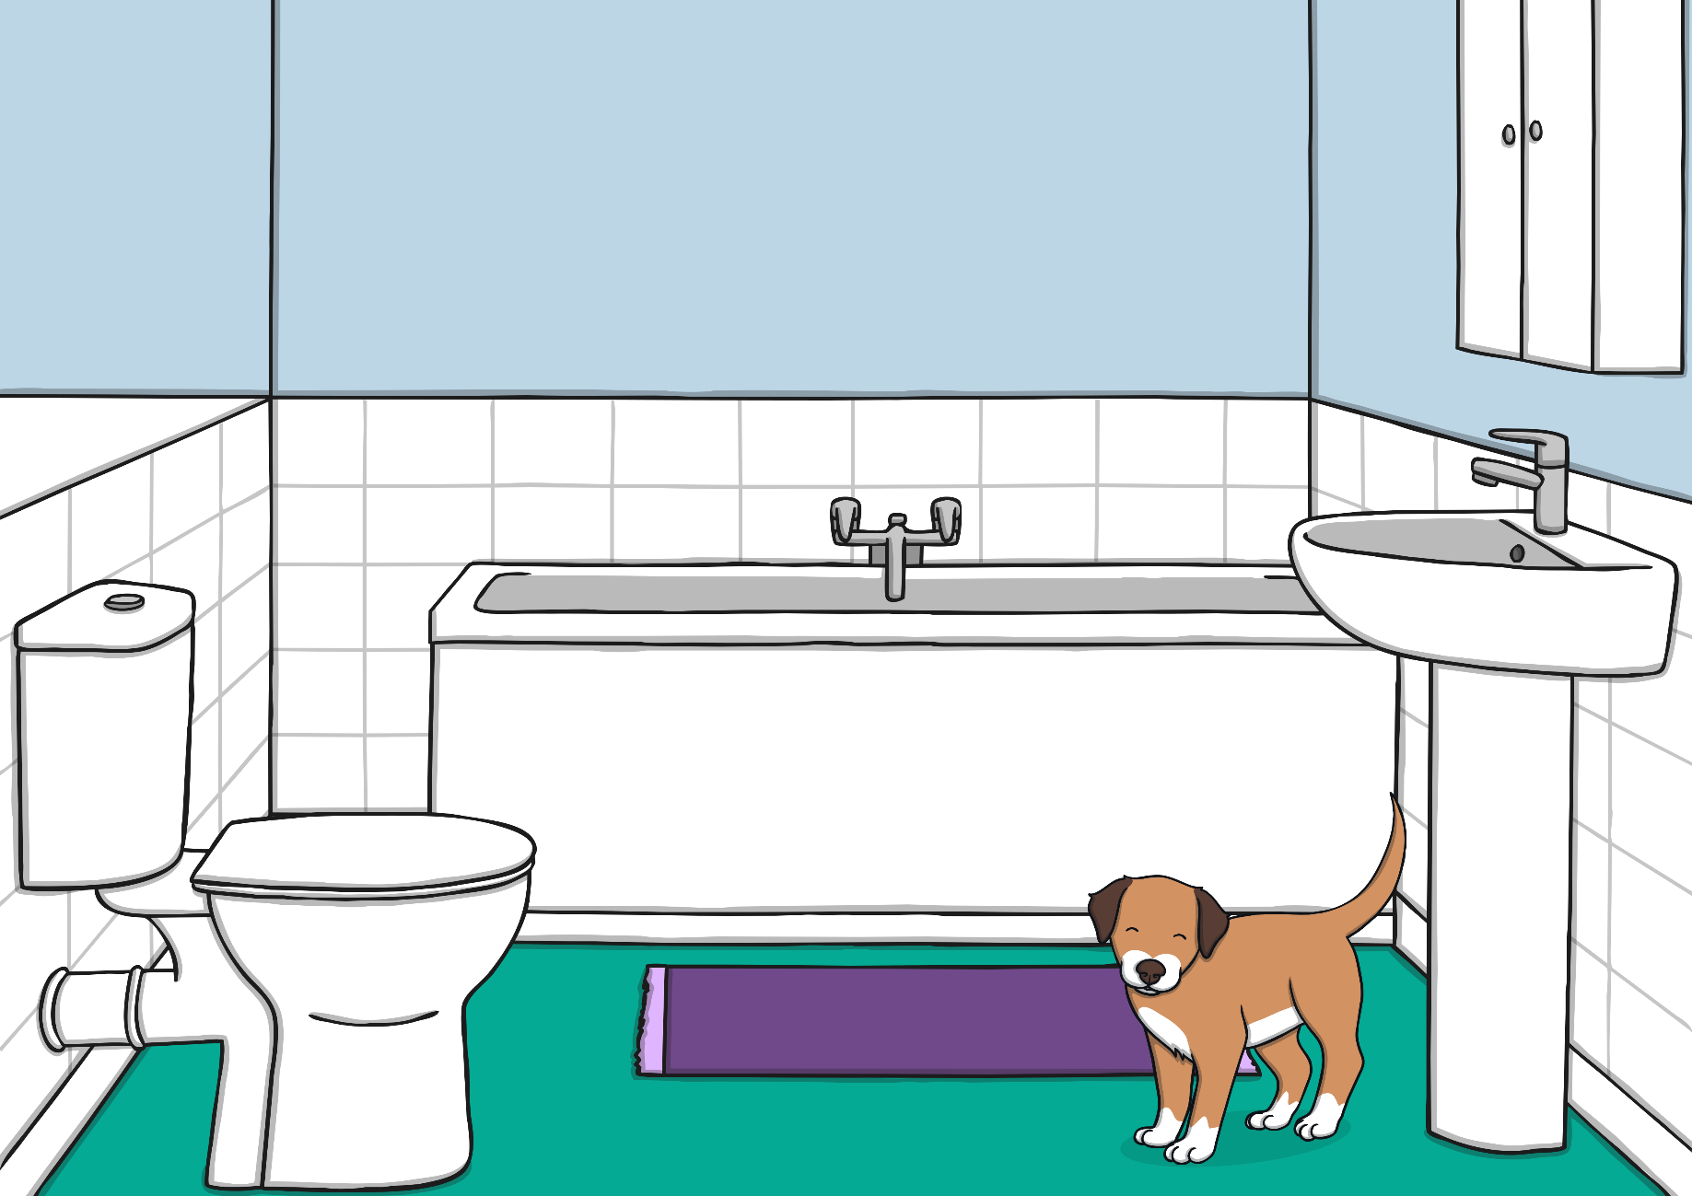
Can you see Max?
Max is next to the sink.

Slide 15
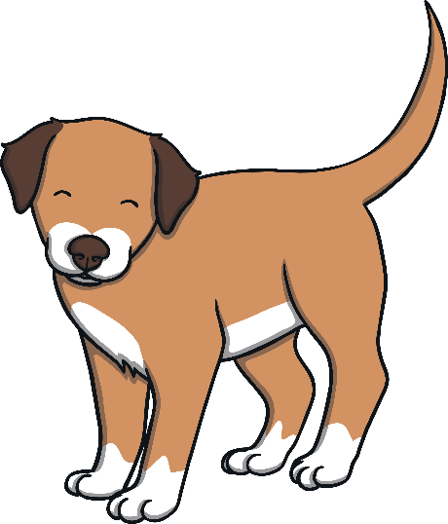
Well done.
You were able to help Tim find Max during
his adventure all around the house.
Thanks for your help.

Slide 16
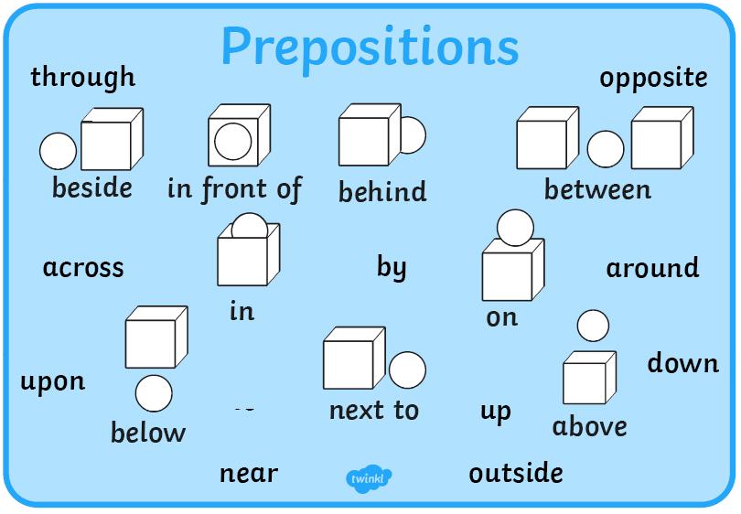

Slide 17
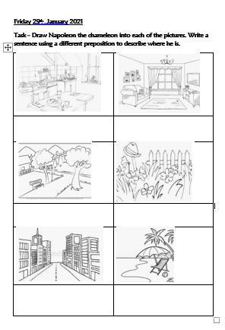
Your Task: to write sentences using prepositions to describe where Napoleon is.
Use the pictures on the Word document.
Talk about where Napoleon could be in the picture e.g. He is on the table.
Options for completing the task
Print off the Word document, draw Napoleon in each picture then write a sentence to describe where he is (i.e. where you put him).
Type directly onto the Word document. You can just say where you would put Napoleon, you do not need to try to add a picture, although you can if you like the technology!
Write your sentences onto your own paper, choosing where you would put Napoleon.

